Slide 1
Design Process
Digital Security
Radboud University Nijmegen

Slide 2
The three levels of abstraction
assumption
Attacker/
Threat Model
1. Functional &
security requirements
security requirement engineering
& threat modelling
assumption
design decision
2. Abstract Design
- Key & certificate distribution
- Security protocols in Alice->Bob style
assumption
design decision
3. CODE

Slide 3
Ingredients for your design document
Description of the first 2 levels,
ie requirements & abstract design,
with clear relations between them
This involves thinking about
Use cases
Security requirements, incl.
Attackers & threat model (maybe abuse cases ?)
Trust assumptions (incl. definition of the TCB and trusted insiders, etc. )
Abstract protocols to provide the required functionality & security
Ideally making all design decisions explicit.
Later on, at the code level, there will be with further design decisions.

Slide 4
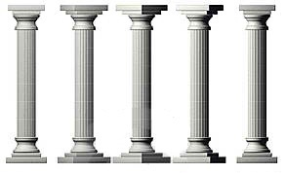
Security
requirements
Threats
Trust assumptions

Slide 5
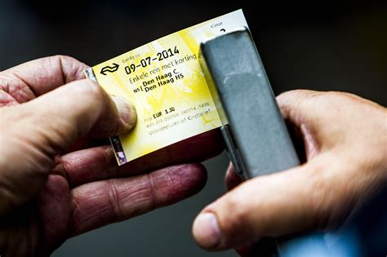
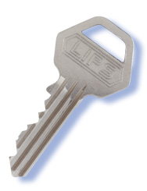
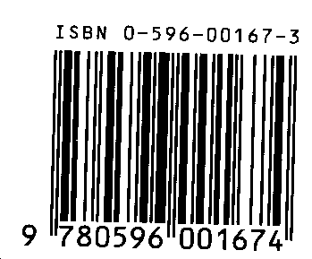
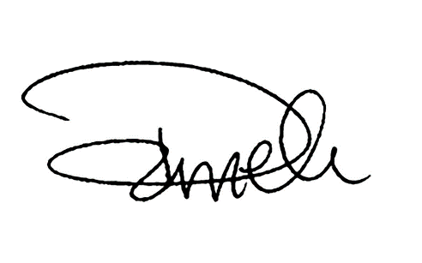
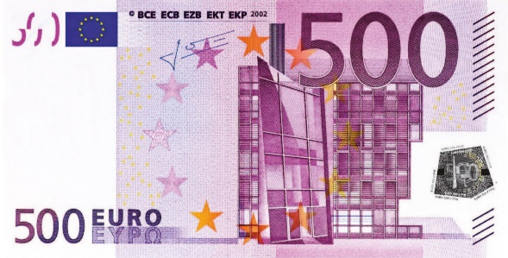
Tip to articulate security requirements: Remember the old-fashioned alternatives
and the security guarantees they make

Slide 6
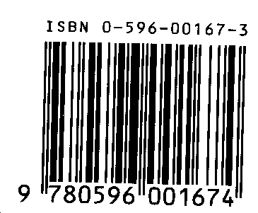
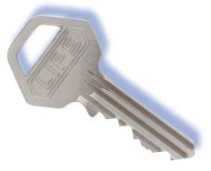
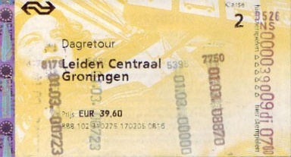
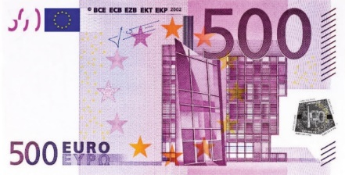
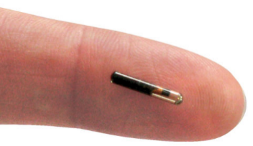
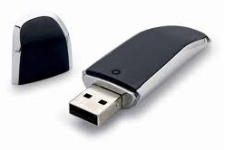
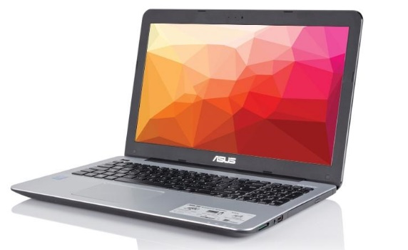
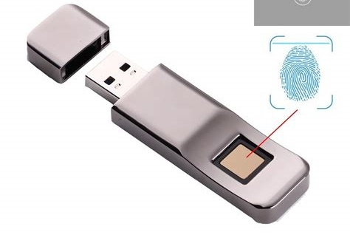
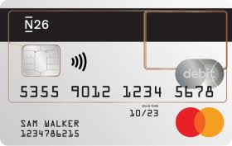
Differences & commonalities?
1) W.r.t. functionality? 2) W.r.t. security?

Slide 7
Threats vs attacks vs risks
Often used interchangeably, but there are different meanings
Threat
Something bad that may happen, an attacker’s goal
Attack (or attack vector)
A particular way to realise that a threat
Risk
∑_{attacks} probability * impact
To distinguish these, note that
There may be different attacks to achieve the same threat
Threats never really go away, no matter how good the defences,
but risk of threats can be reduced.
Some attack vectors do go away with a certain design.
Even if we cannot prevent some attack,
we can detect & react to them, which reduces their risk

Slide 8
Attacker/threat modeling
Threat / attacker model describes of
the attacker’s capabilities
knowledge, skills, expertise
(physical or logical) access to places, systems, info
insiders? malicious clients? ...
time & money to buy equipment, expertise, or bribe people
the attacker’s motivation/goals
ie. the bad things you do not want to happen
Complementary notion: trust assumptions describe which systems or agents we trust for some property
because we want to (eg because the risk is small, or because it simplifies the design), or because we have to

Slide 9
Use cases: incl. personalization, issuance, and end-of-life?
Cards need to be personalised
installing software, initialising keys, PIN codes, IDs, names, ...
before issuance to the user (aka card holder)
This will typically require a separate terminal
In addition to say point-of-sale terminal,...
This may happen in several stages
Cards may also need to be disabled, eg. at the end-of-life?
Or still be able to report data for fraud investigations?
Be explicit about the life-cycle of the card, eg with a state diagram

Slide 10
Persistent life cycle state
Card always has to record some life cycle state
This state has to be recorded & maintained in persistent memory (ie EEPROM)
Your report MUST include a state machine like this!
initial
personalised
issued
blocked
end-of-life

Slide 11
Transient protocol state?
Cards and terminals may need to maintain transient protocol state for each ‘session’
Eg
with some actions only allowed in state 1 or 2
Such constraints may be enforced by cryptographic relations between messages. If not, they may need to be enforced by recording the protocol state in transient memory (ie RAM)
0. new session
1. terminal authenticated
2. terminal & user authenticated

Slide 12
Example security requirements
Eg
authentication of the card holder
authentication of smart card
authentication of all communication by party A
confidentiality of PIN code
non-repudiation
What is wrong with these?

Slide 13
Example security requirements
Eg
authentication of the card holder
authentication of smart card
authentication of all communication by party A
confidentiality of PIN code
non-repudiation
What is wrong with these?

Slide 14
Example security requirements
OF WHAT?
BY WHOM?
TO WHOM?

Slide 15
Example security requirements
Authentication of the card holder by the card
Or by the terminal?
Or by the back-end?
Authentication of all communication by party the smartcard
up to the terminal?
up to the backend?
Confidentiality of data Z so that only parties A and B can read it

Slide 16
Authentication (of entities or of data)
Beware of the subtle differences, eg between
authentication of smart card by the terminal
authentication of an individual message sent by the smartcard
authentication of the entire communication session from smartcard
2 does not prevent replay of an individual message, but 3 does.
Authenticity and freshness needed to prevent replays.

Slide 17
Extra tricky: (non-)repudiation
In Dutch: (on)weerlegbaarheid
Tricky to express & potentially confusing!
Non-repudiation of some action X by some party B to another party A
is more clearly be expressed as
B can prove to A that action X took place
or B can prove to A that C agreed to action X
or B and C cannot deny to A action X took place

Slide 18
Non-repudiation to reduce trust
Non-repudiation can be crucial to reduce the TCB
for some specific security property
Eg
Bank may not want to trust POS terminals in shops
for which properties?
for which properties is this unavoidable?
Government may not want to trust equipment at petrol stations
for which properties?
for which properties is this unavoidable?

Slide 19
Don’t forget detection & response
It’s natural to focus on preventing security problems, and forget about detecting or reacting to problems
Logging can be useful - or crucial - here !
Note that logs can serve different aims, eg
detecting that things go wrong
doing forensics or rolling back transactions in case things went wrong
The ability to detect problems or to determine where things went wrong can be important security requirements!
Eg. even if you cannot prevent some forms of insider attack, you want to be able find out who or what was responsible if & when these come to light

Slide 20
Example design decisions
It should be crystal clear that your implementation is ‘secure’
ie. that all security requirements are ensured in the design and in the code, by some design decisions
Eg
authentication of the card holder by party B using a PIN code
authentication of party A by party B using private/public keys & certificate that have been distributed as follows and the following challenge-response protocol: ...
non-repudiation of action X by having MAC or digital signature over data Z using key K

Slide 21
Pitfall: HOW vs WHAT
It is easy to mix up
WHAT security requirement you want to meet
eg
authentication of party A by B
authentication of message M
...
HOW you meet that security requirement
eg
some challenge-response protocol between A & B
some digital signature or MAC on message M
…
Keep these separate, so that difference between security requirements (WHAT) and design decisions (HOW) is clear

Slide 22
Include overview of key & certificate distribution!
Who has which keys & certificates for what purpose?
For example
The smart card has keys SK_{C}, PK_{C}, PK_{master} and certificate C_{cardID}
The terminal has keys K1, K2 and certificate C_{termID}
Key AK_{C} is used to authenticate messages sent by the card
Certificate C_{ID} signed by X proves that ...
Key EK is used to encrypt …
NB it is bad practice to use the same key for different security goals (eg integrity and confidentiality)

Slide 23
Logical chain of motivation
Ideally assets & attacker model
lead to
security requirements
lead to
design decisions - use of keys, protocols, PINs, ...
In practice, and chronologically, things often happen in the opposite order!
eg you decide ‘let’s encrypt this’, then consider why, and only then discover some security requirement about confidentiality that was implicit so far
That’s fine, as long as in the end the motivations and rationale are clear and explicit!

Slide 24
Design process
Typically a combination of
structured & methodological approach
using standard lists of security objectives, attacks, etc.
creative chaos
brainstorming about attacks, solutions, etc
Brainstorming may work best if everyone first tries it on their own, to avoid tunnel vision
As usual, thinking like an attacker is the only way to see if a design is secure
Either is fine, as long as the end result is clearly documented, and rationale are clear

Slide 25
Pitfalls
Implicit assumptions
Could be invalid, or become invalid over time due to changing circumstances or new functionality (function creep)
Better an unrealistic assumption than an implicit one!
Implicit or unmotivated design decisions
These may hide implicit security requirements or implicit threats, or be totally pointless
It is fine to ignore some threats because you think the risk is negligible, or because they are to hard to defend against, but say so explicitly

Slide 26
Design choice: symmetric vs asymmetric crypto?
Pros symmetric
Cost & Speed?
Old cheap smartcards could only do symmetric crypto
But modern cheap cards can do asymm. crypto, and fast enough, so not really an issue?
Quantum resistance
Pros asymmetric
Symmetric crypto cannot achieve proper non-repudiation, as verifying MAC requires access to the same key that created it.
Key management is much more flexible with asymm. crypto, as you can use PKI & certificates.
Security benefit: some parties only need to know a public key instead of a shared symmetric key
eg some master public key to verify certificates

Slide 27
Key diversification for symmetric crypto
If each card has its own symmetric key, the back-end (and terminals?) has to record all of them
If we use asymm. crypto, the use of certificates avoids this.
A standard trick to reduce this key management hassle:
Give terminals and/or central back-end some master key M
Give card with card number ID a diversified key derived from the master key M and ID, eg.
M_{ID} = AES_{M}(ID)
This avoids the need of a database recording the key for every card. Still, the master key ending up in lots of places remains a security weakness.

Slide 28
Pitfalls
Encrypting data does not ensure integrity!!
Attacker can flip bits in encrypt_{K}(M) with unpredictable – and undetectable – result
The only robust way to ensure the authenticity of a message M is to append a Message Authentication Code (MAC) or a digital signature, ie. an encrypted hash of the message M

Slide 29
Practical considerations
Model & implement as little of the back-office system as possible
Don't forget about personalisation & issuing of smartcards
This will require another terminal application
Steal as many standard solutions as possible
eg. crypto protocols, key management, key diversification
It is OK to have security flaws, or cut corners because you accept certain risks, as long as these are documented!
esp. in the rush to meet the final deadline, you may have to cut corners

Slide 30
DEADLINE
Feb 18: high-level design document
You can read back what I told you in the document linked in Brightspace

Slide 31
Checklist before handing it in
Your report MUST include
List of security requirements Description of the life-cycle stages
A clear overview of the keys & certificates used, incl. description of who has which keys & what the purpose of a key is
Security protocols as messages sequence charts or in Alice->Bob style
Explain notations for signing and encrypting data used here!
Think about non-repudiation requirements, if you haven’t mentioned any
Check that you use consistent notation for the keys and parties throughout the document, that is explained
Number sections & pages. Numbering or labelling other things can be useful too: eg. use cases, the steps in a protocol, security requirements, ...

