Slide 1
Smartcards
Erik Poll
Digital Security
Radboud University Nijmegen

Slide 2
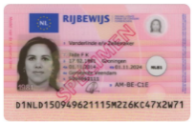
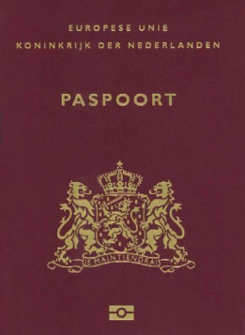
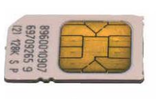
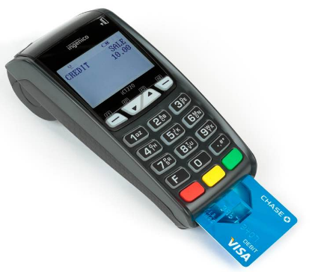
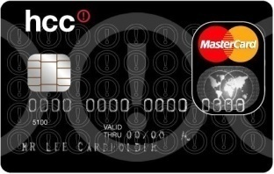


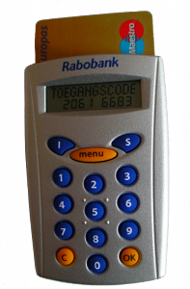
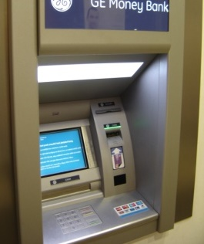

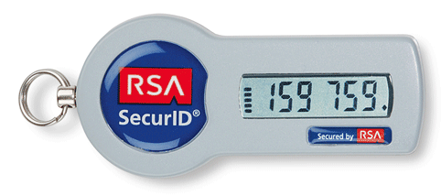
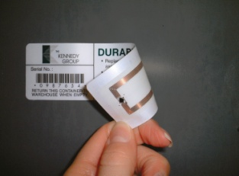
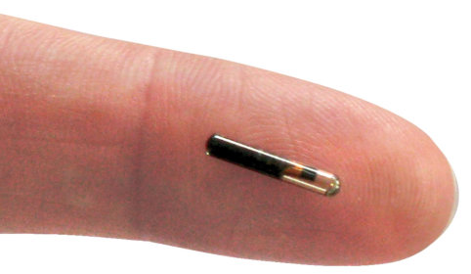
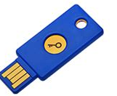
Applications of smartcards & RFID tags
“Payment”
“ID”

Slide 3
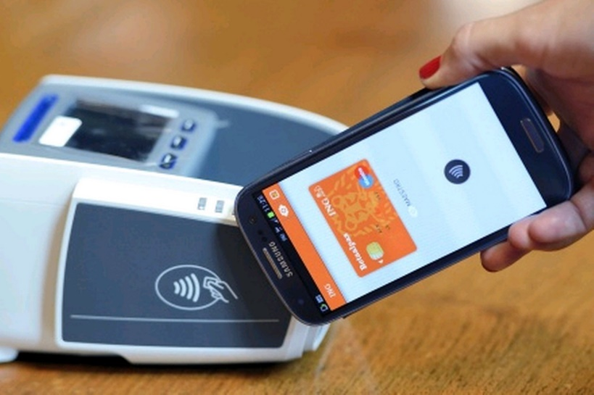
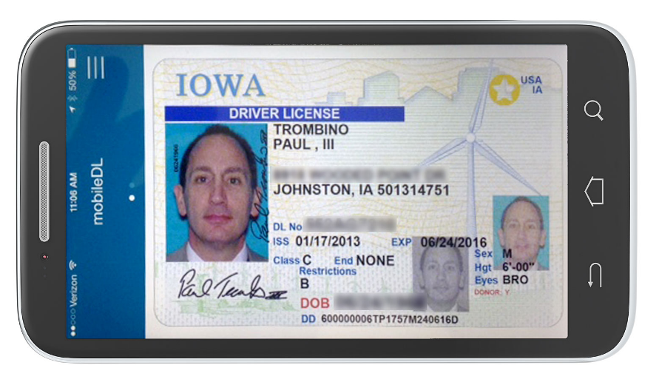
Exit smart cards?
mDL
(mobile Driving License)
mobile payments
This may use secure hardware inside the mobile phone:
Apple Secure Enclave or Android hardware-backed keystore

Slide 4
Why use smartcards?

Slide 5
Why use smartcards?
What are the security objectives?
What are the capabilities of the smartcard that let it realise these objectives?
How are these security objectives guaranteed?
What are the security assumptions all this relies on?

Slide 6
Security objectives
Identification of the card and/or the card holder
Authentication of the card and/or the card holder
Non-repudiation of some action
  In Dutch: onweerlegbaarheid
Integrity – of the software & data on the card
Confidentiality – esp. of the data on the card

Slide 7

How to achieve authentication or non-repudiation
private
key K
challenge c
CPU
response enc_{K}(c)
If card can perform encryption,
then the private key K never has to leave the card
The card issuer does not have to trust the network, the terminal, or the card holder
The card can also sign a message using asymmetric crypto, or compute a MAC using symmetric crypto.

Slide 8
Security (critical) functionality in smartcard
Crypto: storing cryptographic keys &
executing cryptographic operations
Access control for functionality
  Eg with a PIN code
  Incl. functionality to install keys!
  Easy to overlook, but crucial of course…

Slide 9
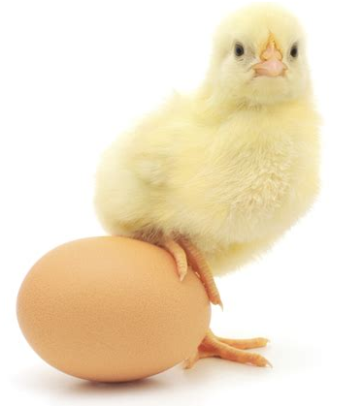
Crypto solves some problems
ensuring integrity, authenticity, non-repudiation, confidentiality,…
but also introduces new problems:
Where to store keys?
How to distribute them?
What hw/sw can we trust to do crypto operations?
How to ensure integrity & confidentiality of the cryptographic key? Here we will need access control again

Slide 10
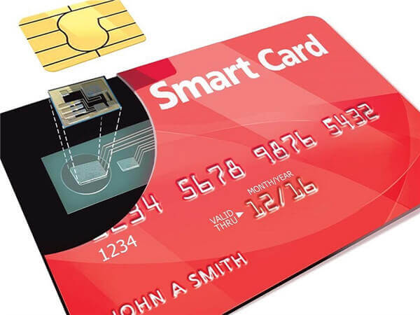
Overview of today
What is a smartcard?
Hardware, protocols

Slide 11
What is a smartcard?
Tamper-resistant computer, embedded in piece of plastic, with limited resources
aka chip card or integrated circuit card (ICC)
capable of securely
  storing data
  processing data
    This is what makes a smartcard smart; stupid cards can store but not process
    Processing capabilities vary greatly!

Slide 12
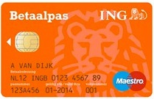
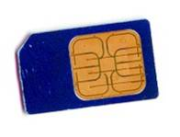

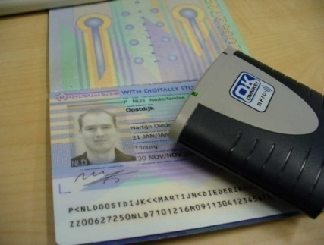

Smartcard form factors
traditional credit-card sized plastic card
  ISO 7816
mobile phone SIM
  cut-down in size
contactless cards
  aka proximity card or RFID tag
  also possible: dual interface

Slide 13
Stupid vs smart smartcards
Memory cards (“stupid” smartcards)
  essentially just provide a file system
  possibly with some access control or, simpler still,
destructive (irreversible) writes as in old payphone-cards
  configurable functionality hardwired in ROM
Microprocessor cards (“smart” smartcard)
  contain CPU
    possibly also crypto co-processor
  programmable
    program burnt into ROM, or stored in EEPROM
RFID tags are often like old memory cards
Focus in this course will be on microprocessor cards

Slide 14
Smart card hardware
ROM
RAM
EEPROM
CPU
memory management unit (MMU)
Test &
Security
Crypto
coproc.
Clock/
Charge
Pump
RNG
I/O

Slide 15
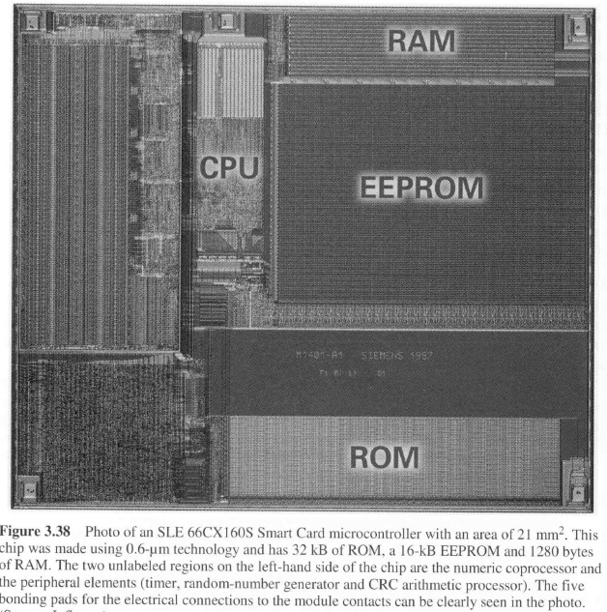

Slide 16
Smartcard hardware
CPU
memory
  volatile (RAM) and non-volatile (ROM+EEPROM)
limited I/O: just a serial port
Possibly:
crypto co-processor
random number generator (RNG)
No clock, no power!

Slide 17
CPU
8, 16 and now also 32 bit
Steady need for more processing powers
  for virtual machines & cryptography

Slide 18
Crypographic co-processor
DES, AES
  DES in hardware takes same size as DES program code in ROM
For public-key crypto, ALU providing exponentation and modulo arithmetic with large numbers

Slide 19
Smartcard memory
ROM
BIOS + operating system
EEPROM
the smartcard's hard disk
RAM
workspace
Typical modern card may have 512 bytes RAM, 16K ROM, 64K EEPROM, 13.5 MHz

Slide 20
RAM
Volatile aka transient memory
SRAM (static RAM) used rather than DRAM (Dynamic RAM) for lower power consumption
Used for temporary data
  stack
  I/O buffer
Typically 128 bytes to 16 Kbyte
Volatile, but small permanent storage characteristics

Slide 21
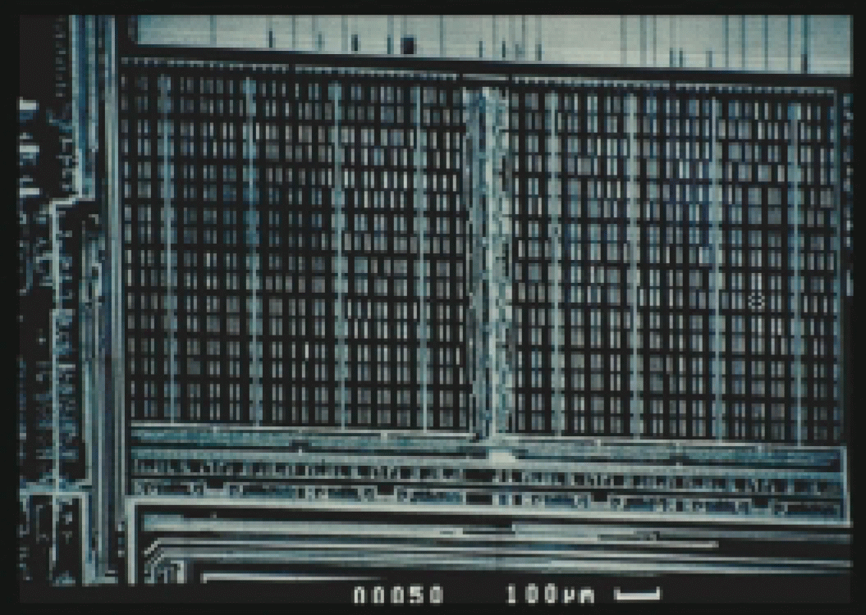
Reading RAM with scanning electron microscope?
Very tricky, and only if card operates at a low frequency
21

Slide 22
ROM
Permanent storage
Filled during production, using ROM mask
Contains OS + possibly application code
Typically 8 to 512 Kbyte
Flash is coming up as replacement of ROM
Optically readable after removing top layers

Slide 23
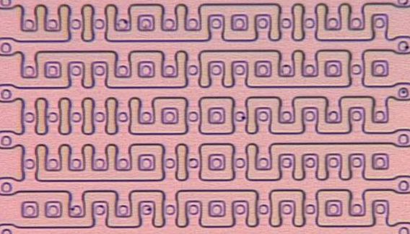
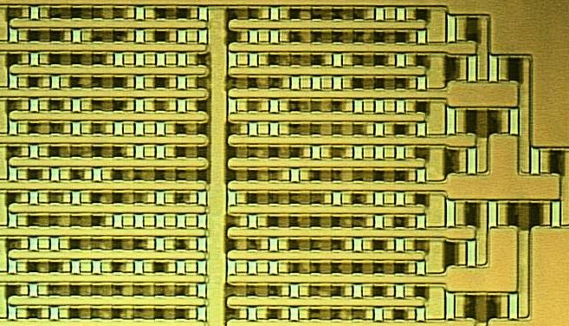
Extraction of ROM content
10x16 bits of NOR ROM
visible outlines reveal content
14x20 bits of NAND ROM
after staining, shadows reveal content
[Source: Oliver Kömmerling, Marcus Kuhn]
23

Slide 24
Staining for ion implant ROM array
Stai
[Source: Brightsight]
24

Slide 25
EEPROM
Non-volatile aka persistent, rewritable memory
Used for applications and data:
  "the smartcard's hard disk“
Typically 1 to 512 Kbyte
Characteristics:
  slow: 1000x slower than RAM
  has limited lifetime in # writes (but > 10⁶)
  writing is two stage operation: erase & write
  data retention 10-100 years
  writing takes high power consumption
    17V, realised using charge pump

Slide 26
ROM vs EEPROM for program code?
Choice between code in ROM or EEPROM has big impact on development
Program code in ROM must be suitable for mass-use
  And can never be patched or updated
Trend away from having a lot of code in ROM towards
  eg just some library code or OS in ROM, and all custom functionality (the ‘application’) in EEPROM

Slide 27
Other non-volatile memory types
Modern alternatives for EEPROM and ROM
Flash
  writing 10 μs instead of 3 -10 ms for EEPROM
  programming voltage 12V, against 17V for EEPROM
  >100,000 writes, >10 years data retention
  Flash replacing ROM eliminates need for ROM mask & reduces development time
FRAM (Ferro-electric RAM)
  writing 100 ns
  programming voltage 5V

Slide 28
Size matters!
Memory types also vary in amount of chip surface per byte:
  RAM requires more space than EEPROM,
  EEPROM requires more space than ROM
Size of chip is a major cost factor, hence little RAM
Size = Money

Slide 29
Comparison of memory types
 | # of write/ erase cycles | writing time | typical size
RAM | unlimited | 70 ns | 1700 μm²
EEPROM | >10⁴-10⁶ | 3-10 ms | 400 μm²
Flash | >10⁵ | 10 μs | 200 μm²
FRAM | >10¹⁰ | 100 ns | 200 μm²
ROM | - | - | 100 μm²
source: W. Rankl & W. Effling, Smartcard Handbook, 2nd edition, 2000
These numbers give a rough impression, but are outdated !!!

Slide 30
Memory Management
Responsible for allocating memory
Possibly also for some memory access control, eg
  between the different types of memory (eg stack, program data, and code)
  between application code and the operating system (OS)
  between applications, for cards that allow multiple applications to be installed

Slide 31
Clock circuit & charge pump
Charge pump
  to generate EEPROM programming voltage
Clock circuit
  eg. division of the external clock signal to get a lower clock frequency for I/O
Typical clock speed 8-13.5 MHz
Esp. for SIM cards: the processor can go into sleep-mode, where clock pulse is stopped, to reduce power consumption

Slide 32
Test & Security
Self-test hardware & software
  checking if all RAM & EEPROM cells work
  checksums for ROM and static EEPROM
Possible additional monitoring and response against attacks
Test functionality is a security risk and may partly have to be disabled before personalisation!
  by writing EEPROM, blowing fuses, or even physically removing hardware

Slide 33
Random Number Generation (RNG)
Needed for key generation & fresh nonces
Typically pseudo RNG (PRNG) in software
  True RNG that is immune to external influence is hard to realise in hardware
NB different cards of same production batch should produce different sequences of random numbers
  PRNG using seed (stored in EEPROM) supplied as part of OS initialisation
Potential hardware security problem with storing PNRG state in EEPROM?
What if this EEPROM wears out after generating lots of random numbers? Card may have to check for this !!

Slide 34
NB nonces vs randoms
Many security protocols require the use of nonces (numbers only used once)
  to prevent replay attacks (aka ensure freshness)
Random numbers are only one of the ways to generate nonces
Another way is to simply have an increasing counter
  Eg, your bank cards all use have a counter that is included in integrity & non-repudiation checks
  Wrapping around after an integer overflow is a security risk for such counters

Slide 35
Random Number Generation (RNG)
Tested eg according to FIPS 140-1 which states
single stream of 20,000 consecutive bits must pass
  monobit test: 9,546 < # ones < 10,346
  poker test: frequency of 4 bits patterns:
    divide in 5000 4 bits segments,
    calculate f(p) = # of occurrence of 4 bits pattern p
    1.03 < X < 57.4, where X is 16/5000*Σ_{p}f(p)²-5000
  run test: requirements of runs (sequence of all 0's or all 1's) of lengths 1-6
  long run test: no runs ≥ 34

