Slide 1
Security Protocol Project Generic Feedback
Cristian Daniele & Erik Poll
Digital Security
Radboud University Nijmegen

Slide 2
Use case: lost or stolen cards
What happens if cards get stolen or lost?
Reporting a card as stolen or lost would be a separate use case
Decision not to have procedure for this deserves to be explicitly stated & motivated.

Slide 3
Attacker/threat model
Don’t forget to explicitly state the security requirement that
‘breaking’ a single card (e.g. retrieving key material by side
channel analysis) should not break the entire system
Most groups have thought about this, but almost no group stated it as requirement

Slide 4
Blocking cards
‘Blocking a card’ is an overloaded term, as it can mean
blocking a card itself
blocking a card in the back-end
ie. setting a EEPROM state flag on the card to BLOCKED
vs
setting some flag in the back-end database
You may have both operations and they may then be related.

Slide 5
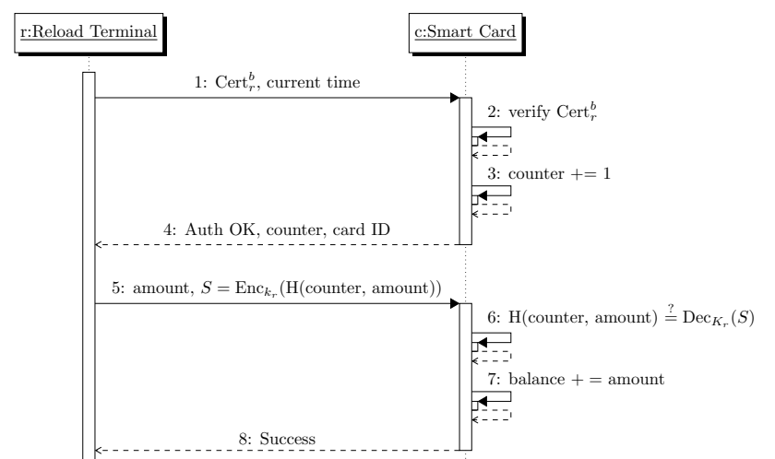
Spot the security flaw (1)

Slide 6
Spot the security flaw (2 & 3)

Slide 7
Spotting protocol flaws/improvements
Authentication MUST use some form of challenge-response
Just exchanging & certificates is not enough!
The challenge has to be a nonce, which can be a random number OR a counter
Double-check that message that triggers the actual transaction cannot be replayed
Beware of unauthenticated responses eg a card or terminal saying OK

Slide 8
Spotting protocol flaws/improvements
If you have a session key, it’s dangerous to let only one party decide the session key
better - or necessary – to let both parties contribute randomness
MACing or signing data with long-term (private) key provides a stronger guarantee than MACing with a session key
If you use encryption in your protocol, double-check if there’s a corresponding security requirement about confidentiality
unless it’s encryption of a nonce for authentication, of course

Slide 9
IDs
If a card (or terminal) has its own keypair, then you can use public keys to identify that card.
But it’s much cleaner to give cards and terminals unique identifier cid and tid as well as own keypairs
You might want to have customer-id’s and card-id’s

Slide 10
Certificates
A certificate is not a just a signed public key,
it is a signed blob of information that includes a public key
A typical certificate will be
(id || PubKey_{id} || expiry-date || type-info || ...)
signed by a public master key
Or more formally
Cert_{id} = Signed_{PubKeyM}(id || PbK_{id} || expiry-date || ...)
where
Signed_{PK} (m) = m || Enc_{PK}(hash(m))

Slide 11
Notation
Be aware of the difference between
constants, e.g. BLOCKED and OK
programs variables, e.g. state
meta-variables, which e.g. stand for values used in protocols such as amount , card_id , terminal_id , or PIN_guess
Some meta-variables also appear as program variables; different fonts can help to distinguish them
Be aware of different meanings of =, which include
mathematical definitions
EncSign _{K1,K2} (m) =_{def} Enc_{K1}(m) || Enc_{K2}(hash(m))
assignments in code
state := PERSONALISED

Slide 12
Notation
Introduce convenient mathematical functions & notation
Eg
m = Encrypt_{K} (amount || card_id || nonce )
(amount, cid, time) = Decrypt_{K} (payload)
m₂ = DecryptAndCheckSignature_{K1,K2} (m₁) or abort if signature incorrect
Numbering steps in protocols can be useful
also when you start coding

Slide 13
Avoid duplication
Duplication is bad in code, but also in text,
so avoid it in your report
when describing protocols, giving definitions, discussing attacker models, listing security requirements, ...
It’s better to have fewer SRs than many SRs
so avoid duplicating or overlapping security requirements

Slide 14
Defense in Depth
What if...? one of your security assumptions is broken
Would you be able to detect it if
a malicious insider issues loads of cards?
a malicious POS operator gives away free points or redeems non-existent points?
a malicious shop owner claims too much money, eg by duplicating transactions?
a card is cloned?
key material from a terminal leaks?
a terminal is hacked to compromise its behaviour?
...
Logging & procedures to inspect logs can help

