Slide 1
Design Process
Security Protocol Project

Slide 2
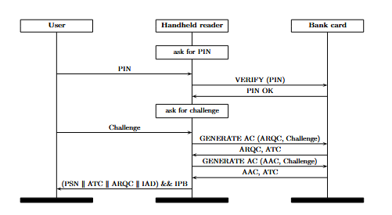
High-level design document
Clear and concise description of design & design rationale:
4. security protocols
  communication steps
  important actions (credit, debit, writing
  to log file, opening gate, displaying info, ...)
  As MSC or in Alice->Bob style
keys & certificates used in these protocols
2. security requirements that these protocols aim to achieve
1. attacker/threat model & trust assumptions underlying all this

Slide 3
Three levels of abstraction
assumption
Attacker/
Threat Model
Security requirements
Trust assumptions /TCB
design decision
assumption
Protocol specification
- Key & certificate distribution
- Security protocols
assumption
design decision
CODE.java

Slide 4
Your design document
Description of the first 2 levels, ie.
1) functional & security requirements
2) abstract design
explaining relation between them and motivation for them
This involves thinking about
Use cases
Security requirements, incl.
  attacker/threat model
  trust assumptions (eg. TCB, trusted insiders, etc. )
Abstract protocols to provide functionality & meeting security
Ideally making all design decisions explicit.
Later, at the code level, there may be with further design decisions.

Slide 5
Use cases
Briefly describe uses cases:
the various transactions (paying, entering, starting, …)
the parties/actors & terminals involved
Don’t forget: personalisation/issuance
For this you will need a personalisation terminal
with protocol & code to initialise keys, PIN codes, IDs, names, ...
Reporting a lost or stolen card can also be a use case

Slide 6
Persistent life cycle state
Card has to record some life cycle state
The card can record its state in persistent memory (ie EEPROM)
For simplicity you could merge initial states, even if a realistic system might need several personalisation & issuance steps
Beware of possible confusion:
1) blacklisting a card in the back-end
vs
2) blocking the actual card
blank
personalised
issued
blocked
end-of-life

Slide 7
Security requirements

Slide 8
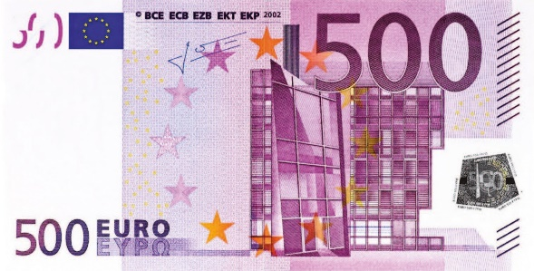
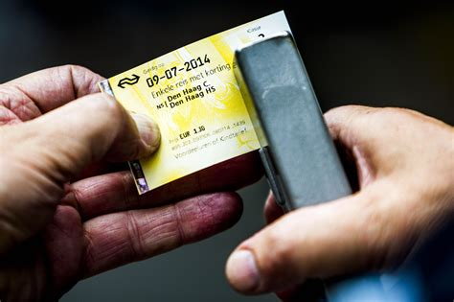
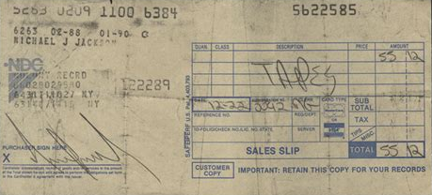

Tip: to articulate security requirements, remember the old-fashioned alternatives
and the security guarantees they make

Slide 9
Example security requirements
Eg
authentication of the card holder
authentication of smart card
authentication of all communication by party A
confidentiality of PIN code
non-repudiation
What is wrong with these?

Slide 10
Example security requirements
OF WHAT?
BY WHOM?
TO WHOM?

Slide 11
Example security requirements
Authentication of the card holder by the card
  Or by the terminal?
  Or by the back-end?
Authentication of all communication coming from the smartcard
  up to the terminal?
  up to the backend?
Confidentiality of data Z so that only parties A and B can read it

Slide 12
Authentication (of entities or of data)
Beware of the subtle differences between
authentication of smart card by the terminal
Authentication by the terminal of an individual message sent by card (or v.v.)
authentication of the entire communication session between card and terminal
2 does not prevent replay of an individual message, but 3 does.
Authenticity and freshness needed to prevent replays.

Slide 13
Extra tricky: (non-)repudiation
In Dutch: (on)weerlegbaarheid
Tricky to express & potentially confusing!
    Non-repudiation of some action X by some party B to another party A
is more clearly be expressed as
    A can prove that B performed/agreed to action X
  or A can prove to C that B performed action X
  or B cannot deny to C that action X took place

Slide 14
Ensuring security requirements in protocols
For a security requirement you can usually still make design decisions about HOW to ensure it in your security protocols
Eg
authentication of the card holder by party B using a PIN code
authentication of party A by party B using private key PrivKey_{A} and certificate Cert_{A} in a challenge-response protocol
non-repudiation of action X by having MAC or digital signature over data Z using key K

Slide 15
Pitfall: WHAT vs HOW
It is easy to mix up
WHAT security requirement you want to meet
  Eg.
  authentication of party A by party B
  authentication of message M
  ...
HOW you meet that security requirement
  Eg.
  some challenge-response protocol between A & B
  some digital signature on message M
  …
Try to separate the WHAT and the HOW

Slide 16
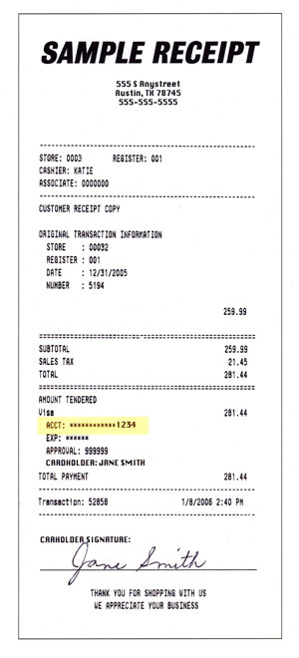
Tip: signed receipt
Signed receipts are great
for ensuring non-repudiation
If you store such signed messages in logs
then that ensures integrity of the log entries
Good rules of thumbs
The more info in the receipt, the better
The more parties sign the receipt, the better

Slide 17
Don’t forget detection & response
It’s natural to focus on preventing security problems, and forget about detecting or reacting to problems
Logging can be useful - or crucial - here !
Logs can serve different aims:
detecting that things went wrong
doing forensics and rolling back transactions if that happens
The ability to detect and/or analyse issues can be stated as security requirement.
Eg. even if you cannot prevent insider attacks, nice to be able to detect them or even identify the misbehaving person or terminal

Slide 18
Attacker model / Threat model
Trust assumptions

Slide 19
Threats vs attacks vs risks
Often used interchangeably, but these are different concepts
Threat
  Something bad that may happen; an attacker’s goal
Attack (or attack vector)
A way to realise a threat
Risk
∑_{attacks} probability * impact
To distinguish these, note that
There may be different attacks to achieve the same threat
Threats never really go away, no matter how good the defences,
but risk of threats can be reduced.
Some attack vectors do go away with a certain design.
Even if we cannot prevent some attack (eg insider attacks)
we may be able to detect & react to them, reducing their risk.

Slide 20
The dreaded word Trust
Beware of the word ‘Trust’ !
Rule of thumb:
if something has the word ‘trust’ in the name,
then it’s a scam or people have no clue what they mean by it
Trusted ≠ trustworthy
Trust is a negative quality, because
  trust implies that something bad can happen
So we want as little trust as possible, and a small TCB

Slide 21
Threat/attacker modelling
Attacker model can describe
the attacker’s capabilities
  knowledge, skills, expertise
  (physical or logical) access to places, systems, info
    insiders? malicious clients? ...
  time & money to buy equipment, expertise, or bribe people
the attacker’s motivation/goals
  ie. the bad things you do not want to happen
Complementary notion: trust assumptions about systems or actors
  We can make trust assumptions because we want to (e.g. because the risk is small and it simplifies the design) or because we have to

Slide 22
The attacker model
The attacker model (regarding capabilities) is largely specified for you, namely
Attackers can carry out MitM attack (incl. card tears) on any card-terminal interaction
Extracting key material from a single card should not be fatal for the entire system
You may be able to make goals of some attackers more concrete;
e.g. shop and petrol pump owners have specific goals in cheating.
You may be able to refine the attacker model:
Terminals and insiders often need to be trusted,
but you may be able to refine these trust assumptions:
  maybe compromised terminal or malicious insiders can be detected?
  maybe for some properties they do not need to be trusted?

Slide 23
Non-repudiation to reduce trust
Non-repudiation can be useful
to reduce the TCB (Trusted Computing Base)
for some specific security property
For example:
Bank may not want to trust POS terminals in shops
  for which properties?
  for which properties is this unavoidable?
Government may not want to trust equipment at petrol stations
  for which properties?
  for which properties is this unavoidable?

Slide 24
Specification:
1) key & certificate distribution
2) security protocols

Slide 25
Key & certificate distribution
Who has which keys & certificates for what purpose?
For example
smart card C has keys SK_{C}, PK_{C}, PK_{master} and certificate Cert_{C}
terminal T has keys K1, K2 and certificate C_{T}
Key AK_{C} is used to authenticate messages sent by the card
Certificate C_{ID} signed by X proves that ...
Key EK is used to ensure confidentiality (by encrypting … )
NB it is bad practice to use the same key for different security goals (e.g. integrity and confidentiality)
Include precise description of certificates
e.g. Cert_{C} = { card no, expiry date, PubKey_{C}} signed with PrivKey_{Master})

Slide 26
Transient protocol state? aka session state
Cards and terminals may need to maintain transient protocol state for each ‘session’
Eg
  with some actions only allowed in state 1 or 2
Restrictions on the order of messages can be enforced by
cryptographic relations between messages
recording & checking session state in transient memory (ie RAM)
0. new session
1. terminal authenticated
2. terminal & user authenticated

Slide 27
Design choice: symmetric vs asymmetric crypto?
Pros symmetric
Cost & Speed?
  Old cheap smartcards could only do symmetric crypto
  But modern cheap cards can do asymm. crypto, and fast enough, so not really an issue?
Quantum resistance
Pros asymmetric
Symmetric crypto cannot achieve proper non-repudiation, as verifying MAC requires access to the same key that created it
Key management is much more flexible with asymm. crypto, as you can use certificates
Security benefit: reduced risk of leaking keys, as parties only need to know a public key instead of a shared symmetric key
  eg some master public key to verify certificates

Slide 28
Key diversification for symmetric crypto
If each card has its own symmetric key, then the back-end (and terminals?) have to record all of them
If we use asymm. crypto, the use of certificates avoids this.
A standard trick to reduce this key management hassle:
Give terminals and/or central back-end some master key M
Give card with card number ID a diversified key derived from the master key M and ID, eg.
      M_{ID} = AES_{M}(ID)
This avoids the need of a database recording the key for every card. Still, the master key ending up in lots of places remains a security weakness.

Slide 29
Design pitfalls: encrypting vs signing
Encrypting data does not ensure integrity!!
  An attacker can flip bits in an encrypted message encrypt_{K}(M) with unpredictable – and undetectable – result
The only robust way to ensure authenticity of M is to append a Message Authentication Code (MAC) or a digital signature, ie. an encrypted hash of the message M
M ++ Enc_{Key}(hash(M))

Slide 30
Documentation pitfall: signature vs signed message
It’s easy to confuse signed messages and signatures
  Be clear in your report if you mean a signed message
  signed_{Key}(M) = M ++ Enc_{Key}(hash(M))
or just a signature
signature_{Key}(M) = Enc_{Key}(hash(M))
Certificates are a special case of signed messages

Slide 31
Design pitfalls: replay attacks

Slide 32
Logical chain of motivation
The logic chain of motivation is that
attacker model & trust assumptions
lead to
security requirements
lead to
design decisions - use of keys, protocols, PINs, ...
In practice & chronologically, things often happen in opposite order!
  eg you decide ‘let’s encrypt this’ or ‘let’s include a nonce’, then you consider why, and only then you discover some security requirement about confidentiality or non-repudiation that was implicit so far
That’s fine, as long as in the end the motivations and rationale are clear and explicit!

Slide 33
Design process
Typically a combination of
structured & methodological approach
  using standard lists of security objectives, attacks, etc.
creative chaos
  brainstorming about attacks, solutions, etc
  Brainstorming may work best if everyone first tries it on their own, to avoid tunnel vision
  As usual, thinking like an attacker is the only way to see if a design is secure
Either is fine, as long as the end result is clearly documented, and rationale are clear

Slide 34
Pitfalls
Implicit assumptions
  Could be invalid, or become invalid over time due to changing circumstances or new functionality (function creep)
  Better an unrealistic assumption than an implicit one!
Implicit or unmotivated design decisions
  These may hide implicit security requirements or implicit threats, or be totally pointless
It is fine to ignore some threats because you think the risk is negligible, or because they are too hard to defend against, but say so explicitly

Slide 35
Practical considerations
Model & implement as little of the back-office system as possible
Don't forget about personalisation & issuing of smartcards
  This will require another terminal application
Steal as many standard solutions as possible
  eg. crypto protocols, key management, key diversification
It is OK to have security flaws, or cut corners because you accept certain risks, as long as these are documented!
  esp. in the rush to meet the final deadline, you may have to cut corners

Slide 36
DEADLINE
Feb 27: high-level design document
  But sooner is better
You can read back what I told in the document in Brightspace

Slide 37
Checklist before handing it in
Your report MUST include
List of security requirements
Description of the life-cycle stages
A clear overview of the keys & certificates used
incl. description of who has which keys, what the purpose of a key is, and the precise content of certificates
Security protocols as messages sequence charts or in Alice->Bob style
  Explain notations for signing and encrypting used here!
Think about non-repudiation requirements, if you haven’t mentioned any
Check that you use consistent notation for the keys and parties throughout the document, and explain that notation
Number sections & pages
Numbering or labelling other things can be useful too: eg. use cases, the steps in a protocol, security requirements, ...

