Slide 1
Software Security
Secure _{INPUT} handling
Erik Poll
Digital Security
Radboud University Nijmegen

Slide 2

Recap: two types of input problems
1. Buggy, insecure parsing
a bug !
malicious
input
application
eg buffer overflow in PDF viewer
2. Injection attacks:
correct but unintended parsing
(abuse of)
a feature !
malicious
input
application
back-end service
eg SQL
query

Slide 3
Output encoding
Output encoding needs be tailored to the context:
  for HTML renderer < > & script
OnlineShop.nl
A
B2
HTML renderer
Notes:
restrict the language, enforce this in the front-end? validate/sanatise inputs? or outputs?

Slide 4

XSS attack
malicious input
victim’s
browser
Response with malicious HTML content

Slide 5
Encoding for the web
'<html>
<body>
<h1> ${name}&apos;s Blog! </h1>
${description}
<a href="https://ourdomain.nl/contact?user=${username}&lang=${lang}">Contact details for ${name} </a>
<b onmouseover=alert("Welcome to ${firstname}’s page")>Click here for a pop-up</b>
</body>
</html>'
HTML encoding (eg of < and > )
URL encoding (eg of ?)
JavaString literal encoded (eg of ' and " )

Slide 6
Some of the encodings for the web
HTML encoding
  < > & ” ’ replaced by &gt; lt; &amp; &quot &#39
  Complication: encoding of attributes inside HTML tags may be different
URL encoding aka %-encoding
  / ? = % # replaced by %2F %3F %3D %25 %23
  space replaced by %20 or +
  Try this out with e.g. https://duckduckgo.com/?q=%2F+%3F%3D
  Complication: encoding for query segment different than for initial part, eg for / aka %2F
JavaScript string literal encoding
  ’ replaced by \’
  Eg ’this is a JS string with a \’ in the middle’
  Complication: JavaScript allows both ' and " for strings
CSS encoding
...

Slide 7
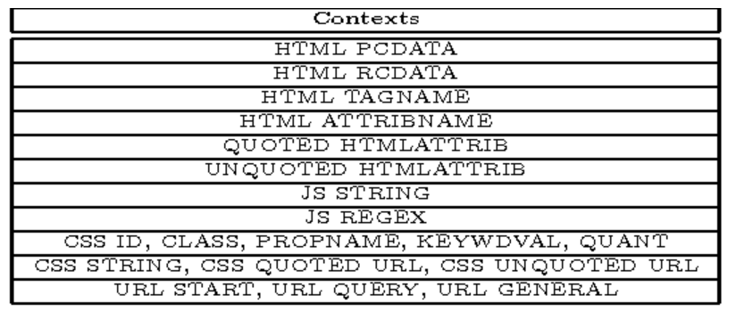
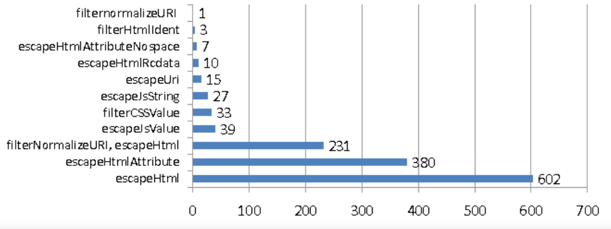
Context-sensitive auto-escaping
Context-sensitive auto-escaping web template engines try to figure out & insert the right encodings.
  E.g. Google Closure Templates, using context & encodings below
Many template engines are not context sensitive!
encodings inserted
contexts (type qualifiers)
[Samuel, Saxena, and Song, Context-sensitive auto-sanitization in web templating languages using type qualifiers, CCS 2017]

Slide 8
Extra complication: the DOM API
JavaScript inside a web page can dynamically alter that web page using the DOM API (or do other interactions with other Web APIs)
<html> <body>
<h1 id=title> ${name}&apos;s Blog </h1>
...
<script> let newName = getSomeData();
document.getElementById("title") .innerHTML = newName + "&apos;s Blog!";
<script>
</body> </html>
Spot the XSS!
A malicious newName could be Eve</h1><script someAttackScript();</script> //
If newName is untrusted user input, it needs to be encoded, by the JS code:
document.getElementById("title").innerHTML = htmlEscape(newName) + "&apos;s Blog!"
DOM API methods & fields
to inspect & alter the web page

Slide 9
DOM-based XSS attacks
JavaScript code in a webpage is fed some malicious input (client-side!) and uses that input to change the webpage (client-side!)
Malicious input can enter as 1) local user input, 2) URL parameters, 3) from the web server, 4) from another web server,...
Server cannot validate or encode such inputs! (Except in case 3?) It has to be done by JS code inside the web page.
web
server
bad
page.html
page.html
f(bad)
f(bad)
f.js
JS engine
bad.html
HTML renderer

Slide 10
Escaping inside JavaScript
Suppose we want JS code to create/change an HTML element elem into a link, labelled with a user-supplied name, that executes JS code createAlbum('name') when clicked, i.e. <a onclick="createAlbum('name')">name</a>
Insecure JS code to do this
elem.innerHTML = '<a onclick="createAlbum(\'' + name + '\')">' + name + '</a>';
Spot the XSS bug!
As malicious name insert ' '; someAttackScript(); //
How to escape name for the two different contexts here?
var escapedName = goog.string.htmlEscape(name); // HTML-encoding
var jsEscapedName = goog.string.escapeString(escapedName); // JS string literal encoding
elem.innerHTML = '<a onclick="createAlbum(\'' + jsEscapedName + '\')">' + escapedName + '</a>';
Spot the XSS bug!

Slide 11
Spot the XSS bug!
var escapedName = goog.string.htmlEscape(name); // HTML-encoding
var jsEscapedName = goog.string.escapeString(escapedName); // JS string literal encoding
elem.innerHTML = '<a onclick="createAlbum(\' ' + jsEscapedName + '\')">' + escapedName + '</a>';
Attack: enter malicious name ');attackScript();//
HTML-escaped this becomes &#39;);attackScript();//
JS-escaped this remains &#39;);attackScript();//
So innerHTML becomes
<a onclick= "createAlbum(' &#39;);attackScript();// ')">&#39;);attackScript();//</a>
The browser HTML-unescapes value of onclick attribute before evaluation as JS
createAlbum(' ');attackScript();//')
so attackScript(); will be executed
[Example from Christoph Kern, Securing the Tangled Web, CACM 2014]

Slide 12
Preventing DOM-based XSS
Writing JavaScript code that properly validates and encodes user input is hard!
  Modern web pages use a LOT of client side JS code, using large libraries, to provide fancy webpages
The DOM API methods take strings as arguments, but for these strings it is hard to trace
where they come from? (are they user input?)
have they been validated? if so, how exactly?
have been encoded? and if so, how exacty?
Here we can use the safe builder approach!

Slide 13
API hardening for the DOM API (aka Trusted Types)
Safe builder approach for JavaScript & DOM API
use TypeScript rather than JavaScript
use different types instead of just String, e.g. TrustedHtml, TrustedJavaScript, TrustedUrl, TrustedScriptUrl …
replace string-based DOM API with new typed API where operations take the right 'safe' type as parameter
  eg innerHTML takes TrustedHtml instead of a String
Typing guarantees proper escaping & validation ☺
  This is checked statically
DOM API must be replaced & all JS code needs to be rewritten ☹
but ... this can be done incrementally, using old & new APIs side by side
[https://github.com/WICG/trusted-types]
[Released as a Chrome browser feature in 2019
  https://developers.google.com/web/updates/2019/02/trusted-types]

Slide 14
Custom tweaks
The Trusted Types / API hardening approach can be customised/extended to specific application:
  For example, Brightspace allows a restricted set of HTML tags in forum postings.
  To do this we would introduce
  introduce a custom type, SafeForumPosting,
  specify which functions require input of this type
  define custom operations to generate data of this type,
    Using validation and/or encoding. This code should be rigorously reviewed to make sure it is bullet-proof!

Slide 15
Yet another complication: different kind of URLs
Suppose we let users add a link to jump to their homepage on another website
<html> <body>
<h1> ${name} &apos;s Blog! </h1>
${description}
...
<script> function goHome() { window.location.href = ${homeUrl} ;} </script>
<button type="button" onclick="goHome()">Click here to go to ${name} 's home page!</button>
...
Spot the XSS, if we allow users to specify any ${homeUrl}
Browsers support pseudo URLs starting with javascript:, e.g. javascript:alert('Hi!').
Assigning such a URL to location.href will execute the script!
User-supplied URLs have to be validated to check for javascript: URLs:
server-side, of if its passed around in JS, client-side in JS code
The Trusted Types API uses special type TrustedResourceUrl for sinks, such as location.href, where (pseudo) URLs can trigger execution of scripts

Slide 16
Conclusions

Slide 17
Languages & Parsing
Parsing of many languages (formats, representations, ...) is where input problems happen, due to
  insecure parsing
  incorrect parsing, i.e. parsing differentials
  unintended parsing, i.e. injection attacks
  especially if languages are complex, poorly defined, and very expressive
LangSec approach can prevent buggy - insecure or incorrect - incorrect parsing
Safe builder approach, which generalises parameterised queries, can prevent injection attacks
  Injection possibilities become type errors

Slide 18
Validation vs Sanitisation/Encoding/Escaping
Validation and sanitisation/encoding/escaping are two very different operations
Output encoding makes more sense than input sanitisation, because encoding/sanitisation depends on context
Ideally, don't validate but parse
Ideally, use ‘safe’ APIs that are immune to injection using types to enforce proper sanitisation & validation

Slide 19

Anti-pattern: string concatenation
Standard recipe for security disaster:
concatenate several pieces of data, some user input,
pass the result to some API
Note: string concatenation is inverse of parsing

Slide 20
Anti-pattern: strings
The use of strings in a warning sign
  not just String but also char*, char[], StringBuilder, ...
Strings are useful, because you use them to represent many things:
eg. username, file name, email address, URL, HTML, …
This also make strings dangerous:
Strings are unstructured data that still needs to be parsed
The same string may be handled & interpreted in many – possibly unexpected – ways
Strings may or may not be validated or encoded, ...
A single string parameter in an API call often hides an expressive & powerful language

Slide 21

Pattern: Use Types
Types can record & ensure various aspects of data
origin of data, and hence the trust we have in it
  special mention: compile-time constants
language/format it is intended for
validated or not, and how exactly?
encoded or not, and how exactly?
preventing ambiguity & confusion

Slide 22

To read
Wang et al., If It's Not Secure, It Should Not Compile: Preventing DOM-Based XSS in Large-Scale Web Development with API Hardening, ICSE'21, ACM/IEEE, 2021
Lectures notes on Secure Input Handling

Slide 23
Getting things wrong: double en/decodings
Chrome used to crash on the URL http://%%30%30
  %30 is the URL-encoding of the character 0
  So %%30%30 is the URL-encoding of %00
  %00 is the URL-encoding of null character
  So %%30%30 is a double-encoded null character
  Cause of the crash: code deep inside Chrome performs a second URL-decoding (as well-intended ‘service’ to its client code?) and then some other code crashes on the resulting null character.
How could this bug have been detected or prevented?
Having encoded data around makes validation harder! Double encoding is a common way to get past validation checks.
  Note that encoding is the opposite of canonicalisation: it introduces different representations of the same data.
Problem: keeping track of which data is encoded / may be decoded can be tricky in larger programs. Typing can help!

Slide 24
Recap: Why XSS is so tricky to prevent
Many sources & sinks, with complex data flows between them
Many different types of data
    URLs, URL parameters, javascript: pseudo URLs, (snippets of) HTML and JavaScript, JavaScript strings, CSS, …
  with different trust levels, eg
  HTML with scripts that we trust, unsafe HTML, possibly with scripts, safe HTML without scripts, links that we trust even in places where they might trigger scripts, links that we trust except in places where they might trigger scripts, ...
  and different association forms of encoding and validation, eg
  HTML-encoding, JavaString-literal encoding, URLs validated not to start with javascript:, ...
  that can be done server-side or client-side

