Slide 1
Software Security
Introduction
Erik Poll
Digital Security
Radboud University Nijmegen

Slide 2
Goals of this course
How does security typically fail in software?
Why does software often fail?
  What are the underlying root causes?
What are ways to make software more secure?
  principles, methods, tools & technologies
    incl. practical experience with some of these
Focus more on defence than on offense

Slide 3
Practicalities: form & examination
2-hrs lecture every week
  read associated papers & ask questions!
mandatory project work
  group project (with 4 people) on fuzzing
  smaller exercises (individual)
    static analysis with cppcheck for C/C++
    static analysis with semgrep
written exam
Group project grade counts toward final grade:
exam is 70%, project is 30%

Slide 4
Practicalities: prerequisites
Basic knowledge of programming
understanding code in any programming language:
    C, C++, JavaScript, PHP, Python, Java, C#, …
also low-level code in C(++) or assembly that uses
  pointers
  *(p++), &x, strings in C using char*, ...
  ‘manual’ memory management
  malloc(), free(), new, delete

Slide 5
The kind of C(++) code you’ll see next week
  char* copy_and_print(char* string) {
  char* b = malloc(strlen(string));
  strcpy(b,string); // copy string to b
  printf(”The string is %s.”, b);
  free(b);
  return(b);
  }
  int sum_using_pointer_arithmetic(int a[]) {
  int sum = 0;
  int *pointer = a;
  for (int i=0; i<4; i++ ){
  sum = sum + *pointer;
  pointer++; }
  return sum;
  }

Slide 6
Exam material
slides
my written lecture notes
(parts of) some articles
I’ll be updating this in Brightspace as we go along

Slide 7


Not exam material – but highly recommended
Join the student CTF group (https://radboudinstituteof.pwning.nl)
if you’re interested in the practical side of security
  They meet Tuesdays at 17:30 in Mercator
  and anytime on Discord https://discord.gg/bD8D7S5euv
  And then maybe participate in HackTheHague (Oct 5),
  HALON (Oct 8), or NymaCon aka HackNijmegen (Nov 5)
Follow the Risky Business podcast
to keep up with weekly security news
  https://risky.biz

Slide 8
Motivation & Background

Slide 9
Software
Software is what gives IT its power & flexibility
but…
it is also what causes cyber security problems
All cybersecurity incidents involve software
Most cybersecurity incidents are caused by software
If something contains software, it can probably be hacked
“Achilles only had an Achilles heel.
I have an entire Achilles body.” -- Woody Allen

Slide 10
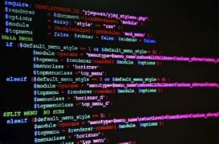

How do computer systems get hacked?
By attacking
software
users
  Or: interaction between software & humans
  NB programmers and sys-admins are also users,
  of programming languages, APIs, protocols, data formats, OSs, ...
crypto
hardware
Blaming 'stupid users' is victim blaming:
if users do not use a system securely,
this is usually an IT (software) design flaw

Slide 11
Software Security
Subfield of computer science studying how
how software becomes insecure?
how we can make software more secure?
  by preventing problems or mitigating their impact
Aka application security (AppSec)
Messy & sprawling field, as it involves
all aspects of software engineering
  incl. requirement engineering, user interface design, IT architecture, coding, testing, static analysis, programming language theory, API design, protocol design, CI/CD pipelines, software repos, IDEs, …
“platforms”
  OS, browser, CPU … with all the features & APIs they provide
security engineering

Slide 12
software security ≠ security software
We want all software to be secure,
not just security software that implements security controls
  eg. TLS, VPN, firewall, operating system, hard disk encryption,
  MFA authenticator apps, …
So also: graphics libraries, PDF viewers, Windows/LibreOffice, …

Slide 13
The problem

Slide 14
Scale of the software security problem
CVE list (Common Vulnerability Enumeration)
https://cve.org
organised in CWE categories
ranked with CVSS score
with weekly summaries by CISA
https://www.cisa.gov/news-events/bulletins
KEV list (Known Exploitable Vulnerabilies)
https://www.cisa.gov/known-exploited-vulnerabilities-catalog
Homework for the coming week: check out
  the latest CISA bulletin
  recent CVEs for the browser, PDF viewer, OS, and other software you

Slide 15
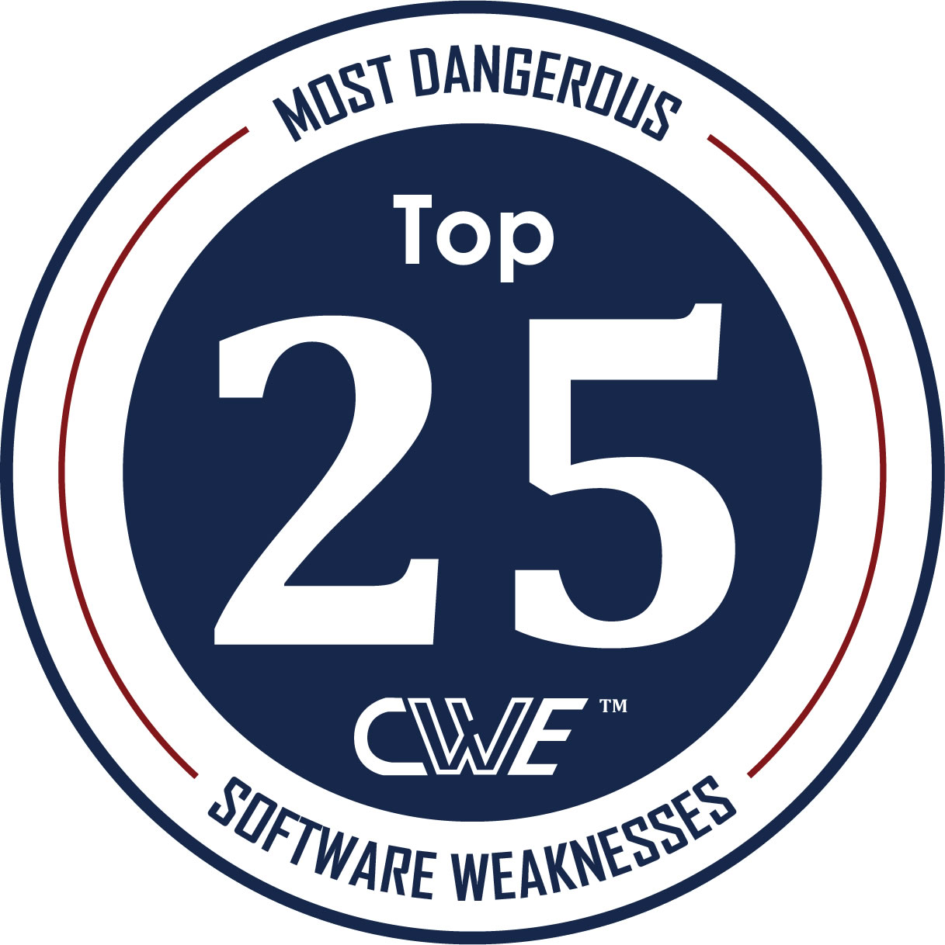
CWE Top 25 (2023 edition)
Out-of-bounds Write
(CWE-787)
10. Unrestricted Upload of Dangerous File Type (CWE-434)
18. Hardcoded Credentials
(CWE-798)
2. Cross Site Scripting (XSS) (CWE-79)
11. Missing Authorisation
(CWE-862)
19. Server-Side Request Forgery (CSRF) (CWE-918)
3. SQL injection
(CWE-89)
12. NULL Pointer Deference
(CWE-476)
20. Missing Authentication
(CWE-306)
4. Use After Free
(CWE-416)
13. Improper Authentication
(CWE-287)
21. Race Condiiton
(CWE-362)
5. OS Command Injection
(CWE-78)
14. Integer Overflow or Wraparound
(CWE-190)
22. Improper Privilige Management
(CWE-269)
6. Improper Input Validation
(CWE-20)
15. Deserialisation of Untrusted Data
(CWE-502)
23. Code Injection
(CWE-94)
7. Out-of-bounds Read
(CWE-125)
16. Command Injection
(CWE-77)
24. Incorrect Authorisation
(CWE-863)
8. Path Traversal
(CWE-22)
17. Improper Restriction of Operations on Memory Buffer Bounds (CWE-119)
25. Incorrect Default Permissions (CWE-276)
9. Client-Side Request Forgery (CSRF) (CWE-352)
[Source https://cwe.mitre.org/top25]
15

Slide 16
KEV Top 25 (2025 edition)
1. Command Injection
(CWE-78)
6. Path Traversal
(CWE-22)
2. Use After Free
(CWE-416)
7 Code Injection
(CWE-94)
3. Out-of-bounds Write
(CWE-787)
8. Authentication Bypass
(CWE-288)
4. Missing Authentication
(CWE-306)
9. Heap-based Bugger Overflow
(CWE-122)
5. Deserialisation of Untrusted Data
(CWE-502)
10. Cross Site Scripting (XSS) (CWE-79)
[Source https://cwe.mitre.org/top25/archive/2025/2025_kev_list.html]
16
16

Slide 17
The bad news
people keep making the same mistakes
The good news
people keep making the same mistakes
…… so we can do something about it!
“Every upside has its downside” [Johan Cruijff]

Slide 18
The vulnerability hunting perspective
Thinking about security in terms of vulnerabilities is useful,
but limited.
It tends to
overlook certain types of problems, esp. design level flaws
  E.g. problems due to
    phishing
    problematic features such as Word/Excell macros
    misconfigurations of (overly complex) systems
overlook more structural solutions
to prevent problems
    e.g. improving programming language or API to make them safer
  or to mitigate their impact
    e.g. compartmentalising a component instead of fixing its bugs

Slide 19
Perspectives on (in)security
We can think about security in terms of
(absence of) security vulnerabilities
  Eg no buffer overflows or SQLi
security requirements
  CIA: Confidentiality Integrity Availability
access control which, in broad sense, includes
    Authentication
    Autorisation – access control in narrow sense
    Logging & Monitoring
AAAA: Authentication Autorisation Auditing & Action
An ongoing and never-ending process for developing and maintaining applications with acceptable level of risk
We will come back to threat modelling as proper way to understand security later.

Slide 20
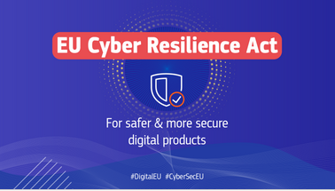
EU Cyber Resilience Act (CRA)
Adopted Dec 2024, fully applicable Dec 2027.
Reporting obligation comes into force Sept 11 2026.
https://digital-strategy.ec.europa.eu/en/policies/cyber-resilience-act
“Products with digital elements shall
be made available on the market
without known exploitable vulnerabilities “

Slide 21
Root causes of the problem

Slide 22
Why can software nearly always be hacked?
Specific causes for software
Complexity => bugs inevitable
  Software is the most complex artefact created humankind
Way in which digital systems fail
  A single bit flip can totally change behaviour
Programmability
  Attackers can re-program devices for their purposes
Generic problems, not just for software
People choosing functionality over security
Lack of awareness & knowledge

Slide 23
Root cause: security vs functionality
Primary goal of software is providing functionality & services
Managing associated risks is a secondary concern
Here there is often a trade-off - or even conflict - between
security
functionality, convenience, speed, …
then security typically looses out
Users complain about missing features or broken functionality, but not about insecurity
Developers like adding features, not thinking about security

Slide 24
Audience poll – C(++)
Did you ever take a course on C(++) programming ?
Were you taught C(++) as a first programming language?
Did this these courses
  warn about buffer overflows?
  explain why printf(s) can be insecure?
  explain how to avoid such problems?
Major causes of problems are
lack of awareness
lack of knowledge
irresponsible teaching of dangerous programming languages & practices

Slide 25
Audience poll – C++
Do you know C++?
Did you ever take a course on C++ programming ?
Do you know about smart pointers in C++?

Slide 26
Audience poll – web applications
Did you ever build a web-application?
  in which programming languages?
Do you know the secure way of doing a SQL query in this language (i.e. to prevent SQL injection)?
Did you use JavaScript ?
  If so, why not TypeScript?
Major causes of problems are
lack of awareness
lack of knowledge

Slide 27
Root cause: _{complexity}
A complex system is hard to
design
implement
configure
use
making security flaws more likely in each of these phases
Complexity of software itself is bad, but so is complexity in
programming languages and their APIs
‘platforms’ - i.e. OS, browser, ,.. - and their APIs
input languages (HTML, PDF, JPEG, …)
and protocols (TLS, OAuth2, … )
that software is built on/with.

Slide 28
The solution to the problem
How do we make software (more) secure?

Slide 29
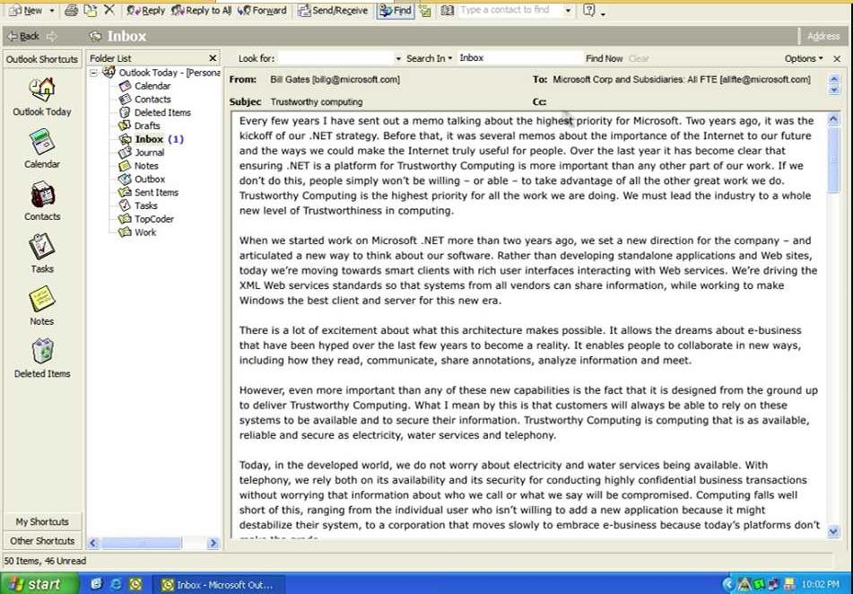

Birth of software security: early 2000s
IT community realises that (cyber)security is becoming a problem
and software is ‘to blame’
Highest priority for Microsoft:
... trustworthiness ...
Availability
Security
Privacy
founded 2001
2002 Email by Bill Gates to all Microsoft employees

Slide 30
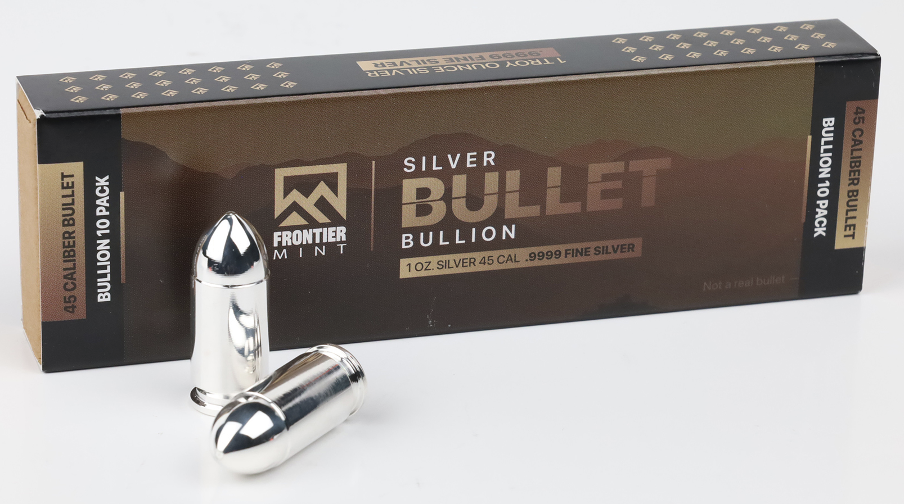
There are no silver bullets!
No single technology,
tool,
feature,
…
will make software secure
Adding security features - firewalls, anti-virus, crypto, .. - will not make software secure
  “If you think your problem can be solved by cryptography,
  you do not understand cryptography
  and you do not understand your problem” [Bruce Schneier]
Security is emergent property of entire system, like quality
Or maybe: emergent property of the ongoing process?

Slide 31
How do we make software more secure?
Knowledge about common problems & mistakes is crucial
  These depends on programming language, the ‘platform’, APIs & technologies used, …
  There is LOTS of info available on this nowadays
But this is not enough:
security should be taken into account from the start, throughout the whole development lifecycle

Slide 32
Security in Software Development Lifecycle
Shifting Left
TRAINING
Threat
Modelling
Choosing or designing safer
programming languages & APIs
VULNERABILITY MANAGEMENT
RISK
ANALYSIS
Coding
guidelines
Bug bounty
program
Security
Requirements
Patch
Abuse
Cases
Secure
design
Static
Analysis
Security
tests
Pen
testing
Security
incidents
Requirements
and use cases
Design
Coding
Testing
Deployment

Slide 33
Shifting left
Organisations always begin tackling security at the end of the SDLC, and then slowly evolve to tackle it earlier
First, do nothing
If security issue is discovered, then a) still do nothing, if there’s no (economic) incentive; b) sue the people who reported; or c) patch
If this happens often: make update mechanism for regular patching
Do security testing, maybe hire pen-testers or have bug bounty program
Use static analysis tools when coding
Give security training to programmers
Think of security in software design
Think of security when choosing programming language & APIs
Think of security when designing programming languages & APIs
Think of abuse cases, and develop security tests for them
Think about security before you start coding, eg with security architecture review
...

Slide 34
Security tools in the development lifecycle
DAST (Dynamic Application Security Testing)
  ie. security testing, incl. fuzzing tools
SAST (Static Application Security Testing)
  ie. static analysis
SCA (Software Composition Analysis)
  looking for known flawed software components
Secret Scanners
  for leaked credentials (eg API keys) in cloud infra or code repos

Slide 35
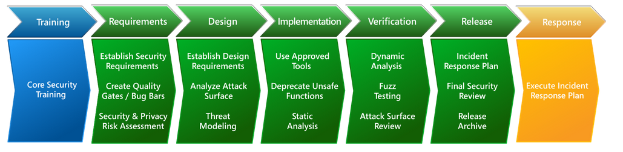
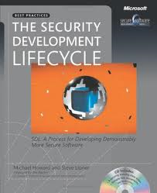
Microsoft SDL (2012 version)
5x3 activities in lifecycle
plus training & incidence response
with extension for secure DevOps (DevSecOps)

Slide 36
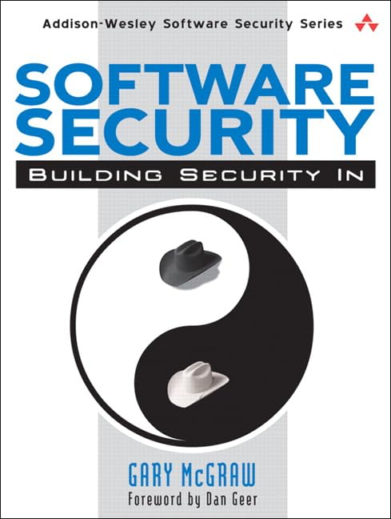
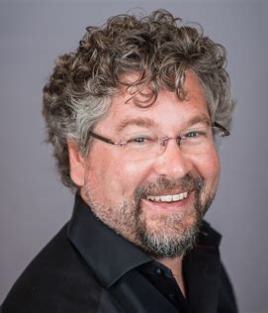
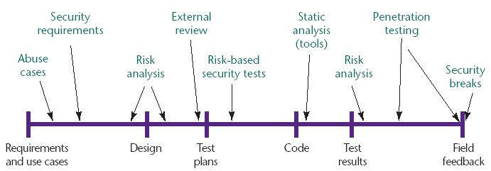
Gary McGraw’s Touchpoints
[Source: Gary McGraw, Software security, Security & Privacy Magazine, IEEE, 2004]

Slide 37
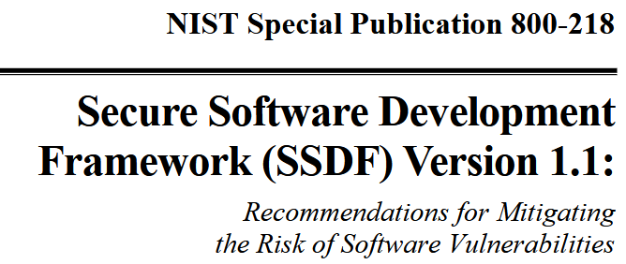
NIST SSDF [2022]
NIST Secure Software Development Framework
lists 20 practices in four groups
with a further breakdown into 43 actions
Practices & actions taken from 25 earlier standards, incl.
  Microsoft SDL, BSIMM12, ISA/IEC 62443, IDA SOAR, CNCF FSSCP,
  OWASP SAMM, OWASP ASVS, OWAPS SCVS, PCI SSLC,
  NIST IR8397, NIST SP800-52, SP 800-160, SP 800-161,
  NIST Cyber Security Framework (CSF),
  SafeCode Fundamental Practices For Secure Software Development, SafeCode SIC, SafeCode TPC,
  BSA Framework for Secure Software, EO 14028, ...

Slide 38

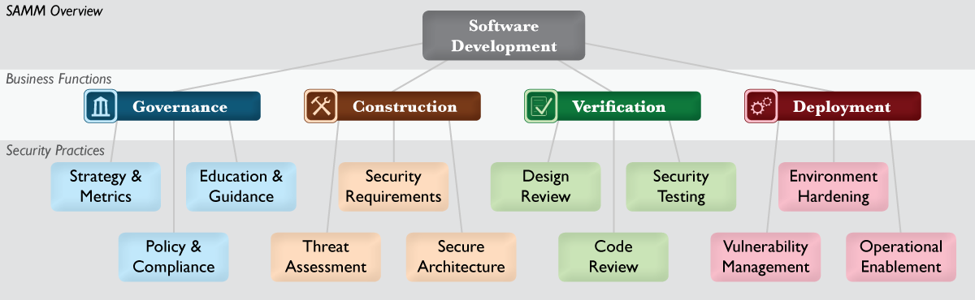
OpenSAMM maturity model
12 security practices grouped in 4 business functions

Slide 39
EU Cyber Resilience Act (CRA)
CRA requires manufacturers to use a secure development process spanning the entire development lifecycle
  “manufacturers shall undertake an assessment of the cybersecurity risks … and take the outcome of that assessment into account during the planning, design, development, production, delivery and maintenance phases”
Homework: read Article 6, 13, and Annex I
CRA is officially called “Regulation 2024/2847 of the European Parliament and of the Council of 23 October 2024 on horizontal cybersecurity requirements for products with digital elements and amending Regulations No 168/2013 and 2019/1020 and Directive 2020/1828”
https://eur-lex.europa.eu/eli/reg/2024/2847/oj

Slide 40
Recap: secure software development frameworks
Methodologies
Microsoft SDL [2004]
Touchpoints by Gary McGraw [2004]
…
NIST SSDF (Secure Software Development Framework) [2022]
Grip op SSD (Secure Software Development) by Dutch government organisations https://www.cip-overheid.nl/en/category/products/secure-software
Maturity models
SAMM (Software Assurance Maturity Model) by OWASP
BSIMM by Synopsys
Confusing new name for all this: Security by Design

Slide 41
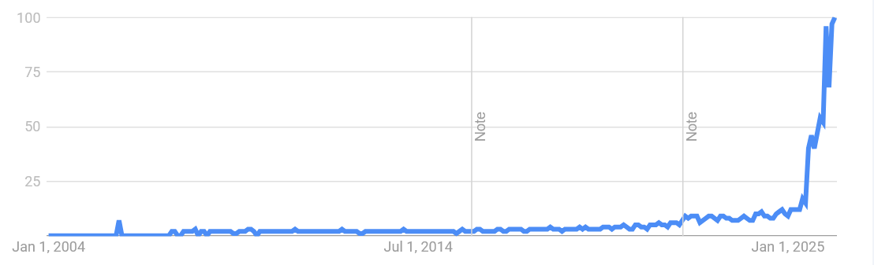
Google trends for ‘security by design’

Slide 42
Security by Design ≠ security in the design phase
Security by Design
(correct, broad definition)
Security by Design
(incorrect, narrow definition)
Threat
Modelling
Architectural
risk analysis
Coding
guidelines
Security
tests
Pen
testing
Static
Analysis
Patching
Requirements
High-level
Design
Design
Coding
Testing
Deployment

Slide 43
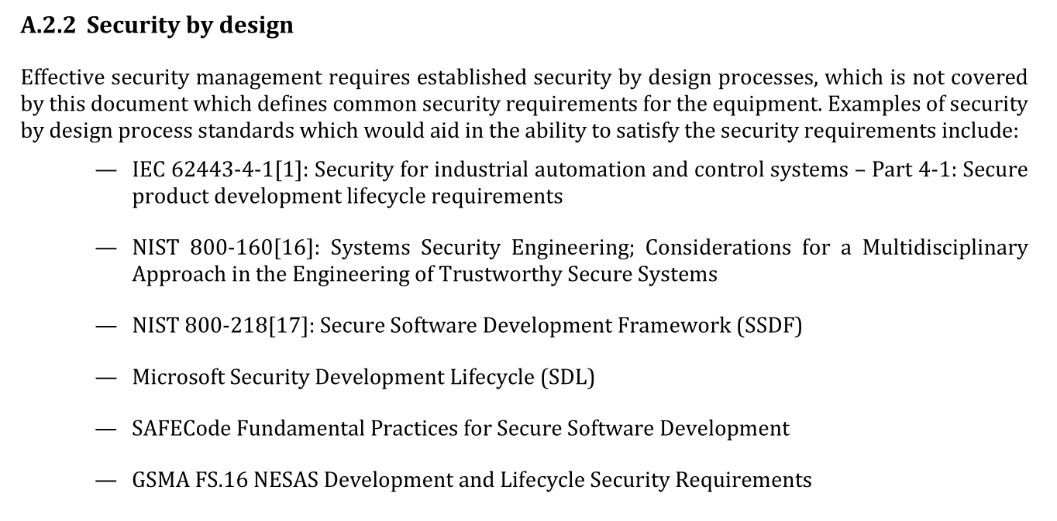







Security by Design as defined in EN 18031
EN 18031, the standard for the EU Radio Equipment Directive (RED),
refers to six other standards for the definition

Slide 44
Homework:
To do: check out
  the latest US-CERT bulletin
  recent CVEs for the browser, PDF viewer and other software you use on a regular basis
To read:
  Article 6, 13 and Annex I of the CRA
  Section 2 of Secure Software Lifecycle by Laurie Williams
  Sections 1-3 of Twenty Years of Secure Software Development
  You can already read the rest, but we’ll cover it later
To do: brush up on you C(++) knowledge

Slide 45
The kind of C(++) code you will see next week
  char* copy_and_print(char* string) {
  char* b = malloc(strlen(string));
  strcpy(b,string); // copy string to b
  printf(”The string is %s.”, b);
  free(b);
  return(b);
  }
  int sum_using_pointer_arithmetic(int a[]) {
  int sum = 0;
  int *pointer = a;
  for (int i=0; i<4; i++ ){
  sum = sum + *pointer;
  pointer++; }
  return sum;
  }
Only way to
understand this:
draw pictures!

Slide 46
Recurring themes

Slide 47
Recurring themes
There are common recurring themes - or anti-patterns - in (software) security
Complexity
Implicit Assumptions
Broken Abstractions
Mixing data & code
specific for software

Slide 48
How do we manage complexity?
Abstraction
Eg. higher level programming languages
Possible security risk:
abstractions may be broken
Divide & conquer
Splitting up application into components, eg libraries,
Possibly with adapted (reduced) access rights: sandboxing
Possible security risk:
interfaces between components may be abused;
input handling is critically important
A
B

Slide 49
Problems with abstraction
Abstractions are crucial in managing the complexity of software applications
BUT…
they can be a source of insecurity
if abstractions are not bullet-proof
if abstractions are confusing or misleading
if abstractions are a figment of our imagination
Often imperfect abstractions come with implicit assumptions

Slide 50
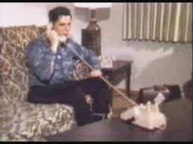

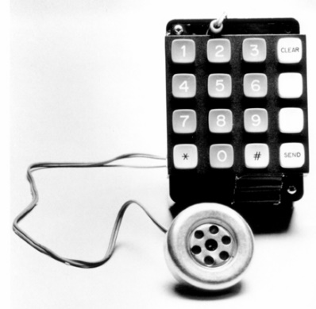
Phone Phreaking
In 1950s, Joe Engressia showed the telephone network could be hacked by whistling at 2600 Hz
http://www.youtube.com/watch?v=vVZm7I1CTBs
In 1970s, Steve Wozniak sold Blue Boxes for doing this at university
before founding Apple with Steve Jobs

Slide 51
Recurring theme: mixing code and data
Programmability makes flaws in software much worse than flaws in mechanical systems:
attacker-supplied data may end up being executed as code
Classic example: SQL injection or command injection
We will see many more examples:
having code & data next to each other on the stack
de-serialising data to produce objects
…

Slide 52
Software Security Bingo
Complexity
Mixing code and data
Broken abstraction
Incorrect implicit assumption

Slide 53
Spot the security flaws!
<= should be >=
int balance;
void decreaseBankBalance(int amount)
{ if (balance <= amount)
{ balance = balance – amount; }
else { println(”Insufficient funds\n”); }
}
void increaseBankBalance(int amount)
{ balance = balance + amount;
}
what if amount
is negative?
what if this sum is
too large for an int?

Slide 54
Different kinds of implementation flaws
Lack of input validation
  Maybe it is a design flaw to use
  signed integers?
  Root cause: implicit assumption
Logic error
Problem in interaction with underlying platform
  ‘Lower level’ than the flaws above
  Root cause: broken abstraction
what if amount
is negative?
<= should be >=
what if sum is too
large for a 64 bit int?

