Slide 1
Software Security Memory corruption public enemy number 1
Erik Poll
Digital Security
Radboud University Nijmegen

Slide 2


CWE Top 25 https://cwe.mitre.org/top25
Out-of-bounds Write (CWE-787)
10. Unrestricted Upload of Dangerous File Type (CWE-434)
18. Hardcoded Credentials (CWE-798)
2. Cross Site Scripting (XSS) (CWE-79)
11. Missing Authorisation (CWE-862)
19. Server-Side Request Forgery (CSRF) (CWE-918)
3. SQL injection (CWE-89)
12. NULL Pointer Deference (CWE-476)
20. Missing Authentication (CWE-306)
4. Use After Free (CWE-416)
13. Improper Authentication (CWE-287)
21. Race Condiiton (CWE-362)
5. OS Command Injection
(CWE-78)
14. Integer Overflow or Wraparound (CWE-190)
22. Improper Privilige Management (CWE-269)
6. Improper Input Validation (CWE-20)
15. Deserialisation of Untrusted Data (CWE-502)
23. Code Injection (CWE-94)
7. Out-of-bounds Read (CWE-125)
16. Command Injection (CWE-77)
24. Incorrect Authorisation (CWE-863)
8. Path Traversal (CWE-22)
17. Improper Restriction of Operations on Memory Buffer Bounds (CWE-119)
25. Incorrect Default Permissions (CWE-276)
9. Client-Side Request Forgery (CSRF) (CWE-352)

Slide 3
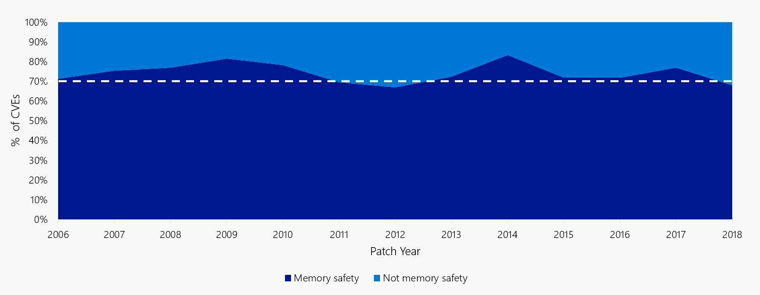
Memory corruption vulns vs the rest at Microsoft 2006-2018
[Source: https://msrc-blog.microsoft.com/2019/07/16/a-proactive-approach-to-more-secure-code
and “Trends, challenge, and shifts in software vulnerability mitigation”, presentation by Matt Miller at BlueHat IL 2019]

Slide 4
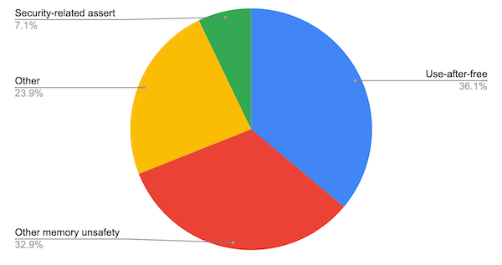





Memory corruption bugs in Chromium project – since 2015
70% of high severity & critical security bugs are memory unsafety problems
5 of the 130 critical security flaws in Chrome were not clearly due to memory corruption
[Source: https://www.chromium.org/Home/chromium-security/memory-safety ]

Slide 5
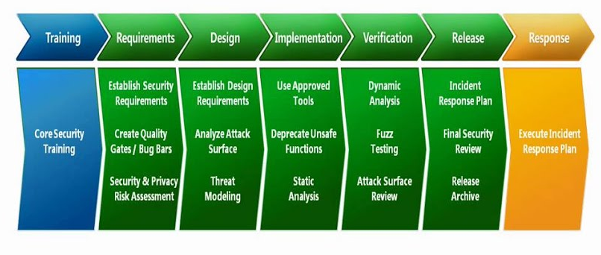


Security in the development lifecycle (Microsoft SDL version 5.2)
aka SAST
(Static Application Security Testing)
aka DAST
(Dynamic Application Security Testing)

Slide 6

Finding & fixing memory corruption – next weeks
week 3: exercise
Static analysis
with PREfast
week 4: group project
fuzzing afl
memory sanitizers ASan, MSan

Slide 7


More structural prevention – after week 4
Safer programming languages
LangSec for safer
parser code

Slide 8
Overview (this & next weeks)
How do memory corruption flaws work?
What can be the impact?
How can we spot such problems in C(++) code?
Tool-support for this
SAST: PREfast individual / pair project
DAST: Fuzzing group project
What can ‘the platform’ do about it?
ie. the compiler, system libraries, hardware, OS, ..
What can the programmer do about it?

Slide 9
Reading material (for coming weeks)
SoK article: ‘Eternal War in Memory’ IEEE S&P 2013
Excl. Section VII.
This article is quite dense. You are not expected to be able to reproduce or remember all the discussion here. It’s good enough if you can follow the article, with a steady supply of coffee while googling if the terminology is not clear.
‘Secure by Design: Google’s perspective on Memory Safety’ , technical report, 2024
Good to read 1 first. 2 gives a much broader perspective and some of the material will be covered next month.

Slide 10

Essence of the problem
What does the C program below do?
char buffer[4];
buffer[4] = 'a';
We don’t know!
This is defined to be
ANYTHING can happen

Slide 11

_{undefined} behaviour: anything can happen

Slide 12

_{undefined} behaviour: anything can happen

Slide 14
_{undefined} behaviour: nothing may happen

Slide 15
Anything attackers wants?
char buffer[4];
buffer[4] = 'a';
If we are lucky : program crashes with SEGMENTATION FAULT
If we are unlucky : program does not crash, but silently allows
data corruption or remote code execution (RCE)
which is especially dangerous if attacker controls the value 'a'

Slide 16
Nothing may happen
char buffer[4];
buffer[4] = 'a';
A compiler could remove the assignment above, ie. do nothing
Compilers actually do this (as part of optimisation) and this can cause security problems; examples later & in the lecture notes.

Slide 17
Solution to this problem
Check array bounds at runtime
Algol 60 proposed this back in 1960!
Unfortunately, C and C++ have not adopted this solution.
Why?
For _{efficiency}
Regrettably, people often choose performance over security
As a result, buffer overflows have been the no 1 security problem in software ever since
Check out CVEs mentioning buffer (or buffer%20overflow)
https://cve.mitre.org/cgi-bin/cvekey.cgi?keyword=buffer
Fortunately: Perl, Python, Go, Java, C#, PHP, Javascript, Swift, Visual Basic and Rust do check array bounds

Slide 18

Tony Hoare on design principles of ALGOL 60
In his Turing Award lecture in 1980
“The first principle was security : ... every subscript was checked at run time against both the upper and the lower declared bounds of the array. Many years later we asked our customers whether they wished an option to switch off these checks in the interests of efficiency. Unanimously, they urged us not to - they knew how frequently subscript errors occur on production runs where failure to detect them could be disastrous.
I note with fear and horror that even in 1980, language designers and users have not learned this lesson. In any respectable branch of engineering, failure to observe such elementary precautions would have long been against the law.”
[C.A.R. Hoare, The Emperor’s Old Clothes, Communications of the ACM, 1980]

Slide 19



Hope on the horizon?
especially thanks to Rust
https://www.cisa.gov/case-memory-safe-roadmaps

Slide 20
More memory corruption problems
Errors with pointers and with dynamic memory (aka the heap)
Have you ever written a C(++) program that uses pointers?
Have you ever had such a program crashing?
Have you even written a C(++) program that uses dynamic memory, ie. malloc() and free()?
Have you ever had such a program crashing?
In C/C++, the programmer is responsible for memory management and this is very error-prone
Technical term: C and C++ do not offer memory-safety

Slide 21
Spot all (potential) defects
1000 …
1001 void f(){
1002 char* buf, buf1, buf24;
1003 buf = malloc(100);
1004 buf[0] = ’a’;
...
98991 free(buf24);
98992 buf[0] = ’b’;
...
999991 free(buf);
999992 buf[0] = ’c’;
999993 buf1 = malloc(100);
999994 buf[0] = ’d’
999995 }
null dereference if malloc failed
potential use-after-free
if buf & buf24 are aliased
use-after-free; buf[0] points to de-allocated memory
memory leak; pointer buf1 to this memory is lost & memory is never freed
use-after-free, but now buf[0] may point to memory that has been re-allocated for buf1

Slide 22
Causes of memory corruption problems
Access outside array bounds aka buffer overflow
overread or overwrite
overreads are not a corruption issue, but confidentiality issue
Pointer trouble:
buggy pointer arithmetic,
dereferencing null pointer,
using a dangling pointer aka stale pointer
caused by e.g. use-after-free or double-free
Memory management problems:
Forgetting to check for failures in allocation
Forgetting to de-allocate, aka memory leaks
not a corruption issue, but an availability issue
Other ways to cause memory corruption:
type unsafety, incl. unsafe type cast

Slide 23
Exploiting this

Slide 24
Process memory layout
High
addresses
Arguments/ Environment
Stack
Stack grows
down,
by procedure
calls
Unused Memory
Heap (dynamic data)‏
Static Data
Program Code .text
Heap grows
up,
eg. by malloc
and new
.data
Low
addresses

Slide 25
Stack layout
The stack consists of Activation Records aka stack frames:
x
AR main()‏
return address
AR f()‏
buf[4..7]
buf[0..3]
Stack grows
downwards
void f(int x) {
char[8] buf;
gets(buf);
}
void main() {
f(…); …
}
void format_hard_disk(){…}
Buffer buf goes
upwards

Slide 26
Stack overflow attack - case 1
What if gets() reads more than 8 bytes ?
x
AR main()‏
return address
AR f()‏
buf[4..7]
buf[0..3]
void f(int x) {
char[8] buf;
gets(buf);
}
void main() {
f(…); …
}
void format_hard_disk(){…}

Slide 27
Stack overflow attack - case 1
What if gets() reads more than 8 bytes ?
Attacker can jump to arbitrary point in the code!
x
AR main()‏
return address
AR f()‏
buf[4..7]
buf[0..3]
void f(int x) {
char[8] buf;
gets(buf);
}
void main() {
f(…); …
}
void format_hard_disk(){…}
code reuse
attack

Slide 28
Stack overflow attack - case 2
What if gets() reads more than 8 bytes ?
Attackers can also jump to their own code (aka shell code)
x
AR main()‏
return address
AR f()‏
/bin/sh
exec
void f(int x) {
char[8] buf;
gets(buf);
}
void main() {
f(…); …
}
void format_hard_disk(){…}
code injection
attack

Slide 29
Stack overflow attack - case 2
What if gets() reads more than 8 bytes ?
Attacker can jump to his own code (aka shell code)
x
AR main()‏
return address
never use gets!
gets has been removed from
the C standard in 2011
AR f()‏
/bin/sh
exec
void f(int x) {
char[8] buf;
gets(buf);
}
void main() {
f(…); …
}
void format_hard_disk(){…}

Slide 30
Code injection vs code reuse
Two types of attacks in these examples
(2) is a code injection attack
attackers inject their own shell code in some buffer and corrupt return addresss to point to this code
In the example, exec('/bin/sh')
This is the classic buffer overflow attack
[Smashing the stack for fun and profit, Aleph One, 1996]
(1) is a code reuse attack
attackers corrupt return address to point to existing code
In the example, format_hard_disk
Lots of details to get right!
knowing precise location of return address and other data on stack, knowing address of code to jump to, ....

Slide 31
What to attack? Corrupting the stack
function pointer
void f(int x,
void(*error_handler)(int),
bool b) {
int diskquota = 200;
bool is_super_user = false;
char* filename = "/tmp/scratchpad";
char[8] username;
int j = 12;
...
}
Suppose attacker can overflow username
This can corrupt the return address, but also other data on the stack:
is_super_user, diskquota, filename, x, b, error_handler
But not j, unless the compiler chooses to allocate variables in a different order, which the compiler is free to do
Corruption function pointers such as error_handler is particularly interesting! Why?

Slide 32
What to attack? Corrupting data on the heap
struct BankAccount {
int number;
char username[20];
int balance;
}
Suppose attacker can overflow username
This can corrupt other fields in the struct
Which fields depends on the order of the fields in memory.
The compiler is free to choose this.

Slide 33
What to attack? Corrupting vtables on the heap
C++ code uses late binding to resolve (so-called virtual) method calls
Rectangle r;
Circle c;
Shape s;
_surface_area = r.area() + c.area() + s.area();
Which code to execute for s.area() is determined at runtime.
To do this, a table of function pointers, the vtable,
is maintained that tells which code to execute for each method
This provides many function pointers for attackers to mess with!

Slide 34

Recurring theme in attacks: breaking abstractions

Slide 35
Spotting the problem

Slide 36
Reminder: C chars & strings
A char in C is always exactly one byte
A string is a sequence of chars terminated by a NULL byte
String variables are pointers of type char*
char* str = "hello"; // a string str
Here strlen(str) will be 5
str
 |  |  | h | e | l | l | o | \0

Slide 37
Example: gets
char buf[20];
gets(buf); // read user input until
// first EoL or EoF character
Never use gets
gets has been removed from the C library so this code will no longer compile
Use fgets(buf, size, file) instead

Slide 38
Example: strcpy
char dest[20];
strcpy(dest, src); // copies string src to dest
strcpy assumes that 1) dest is long enough
and 2) src is null-terminated
Use strncpy(dest, src, size) instead
Beware of difference between sizeof and strlen
sizeof(dest) = 20 // size of an array
strlen(dest) = number of chars up to first null byte
// length of a string

Slide 39
Spot the defect! ‏
char buf[20];
char prefix[] = "http://";
char* path;
...
strcpy(buf, prefix);
// copies the string prefix to buf
strncat(buf, path, sizeof(buf));
// concatenates path to the string buf

Slide 40
Spot the defect! (1)‏
char buf[20];
char prefix[] = "http://";
char* path;
...
strcpy(buf, prefix);
// copies the string prefix to buf
strncat(buf, path, sizeof(buf));
// concatenates path to the string buf
strncat’s 3rd parameter is number of chars to copy, not the buffer size
So this should be sizeof(buf)-7

Slide 41
Spot the defect! (2)‏
char src[9];
char dest[9];
char* base_url = "www.ru.nl";
strncpy(src, base_url, 9);
// copies base_url to src
strcpy(dest, src);
// copies src to dest

Slide 42
Spot the defect! (2)‏
char src[9];
char dest[9];
char* base_url = "www.ru.nl";
strncpy(src, base_url, 9);
// copies base_url to src
strcpy(dest, src);
// copies src to dest
base_url is 10 chars long, incl. its null terminator, so src will not be null-terminated

Slide 43
Spot the defect! (2)
char src[9];
char dest[9];
char* base_url = ”www.ru.nl”;
strncpy(src, base_url, 9);
// copies base_url to src
strcpy(dest, src);
// copies src to dest
base_url is 10 chars long, incl. its null terminator, so src will not be null-terminated
so strcpy will overrun the buffer dest,
because src is not null-terminated

Slide 44
Example: strcpy and strncpy
Don’t replace
strcpy(dest, src)‏
with
strncpy(dest, src, sizeof(dest))‏
but with
strncpy(dest, src, sizeof(dest)-1)‏
dst[sizeof(dest)-1] = '\0';
if you want dest to be null-terminated!
NB: a strongly typed programming language would guarantee that strings are always null-terminated, without the programmer having to worry about this...

Slide 45
Better libraries
Keeping track of the space left in buffers when using strncpy and strncat is error-prone.
Another problem: strncpy and strncat are not guaranteed to return a null-terminated string.
FreeBSD introduced strlcpy(dst,src,size) and strlcat(dst,src,size) as safer alternatives:
Results are guaranteed be null-terminated strings
size is the size of destination array dst, not the maximum length copied
Microsoft introduced strncpy_s and strncat_s and a safe string library strsafe.h
glib.h provides Gstring type for dynamically growing null-terminated strings in C
C++ string objects are less error-prone than C strings
but data() and c-str()return a C string, ie. a char*, and result of data()is not always null-terminated on all platforms

Slide 46
Spot the defect! (3)‏
char *buf;
int len;
...
buf = malloc(MAX(len,1024)); // allocate buffer
read(fd,buf,len); // read len bytes into buf
What happens if len is negative?
The length parameter of read is unsigned!
So negative len is interpreted as a big positive one!
AAAAAAAAARGH!
(At the exam, you’re not expected to remember
that read treats its 3rd argument as an unsigned int)

Slide 47
Spot the defect! (3)‏
char *buf;
int len;
...
if (len < 0)‏
{error ("negative length"); return; }
buf = malloc(MAX(len,1024));
read(fd,buf,len);
Note that buf is not guaranteed to be null-terminated; we ignore this for now.

Slide 48
Spot the defect! (3)‏
char *buf;
int len;
...
if (len < 0)‏
{error ("negative length"); return; }
buf = malloc(MAX(len,1024));
read(fd,buf,len);
What if the malloc() fails,
because we ran out of memory ?

Slide 49
Spot the defect! (3)‏
char *buf;
int len;
...
if (len < 0)‏
{error ("negative length"); return; }
buf = malloc(MAX(len,1024));
if (buf==NULL) { exit(-1);}
// or something a bit more graceful
read(fd,buf,len);

Slide 50
Better still
char *buf;
i ...
nt len;
if (len < 0)‏
{error ("negative length"); return; }
buf = calloc(MAX(len,1024));
//to initialise allocate memory to 0
if (buf==NULL) { exit(-1);}
// or something a bit more graceful
read(fd,buf,len);

Slide 51
Spot the defect!
#define MAX_BUF 256
void BadCode (char* input)‏
{ short len;
char buf[MAX_BUF];
len = strlen(input);
if (len < MAX_BUF) strcpy(buf,input);
}

Slide 52
Spot the defect!
#define MAX_BUF 256
void BadCode (char* input)‏
{ short len;
char buf[MAX_BUF];
len = strlen(input);
if (len < MAX_BUF) strcpy(buf,input);
}
The integer overflow is the root problem, the (heap) buffer overflow it causes makes it exploitable
See https://cve.mitre.org/cgi-bin/cvekey.cgi?keyword=integer+overflow
What if in is longer than 32K ?
len may be a negative number,
due to integer overflow
hence: potential
buffer overflow

Slide 53
Spot the defect!
Just this strlen call is already a potential problem: if input is null or if it is not null-terminated then strlen(input) results in undefined behaviour
#define MAX_BUF 256
void BadCode (char* input)‏
{ short len;
...
len = strlen(input);
...
}

Slide 54
Spot the defect!
bool CopyStructs(InputFile* f, long count)‏
{ structs = new Structs[count];
for (long i = 0; i < count; i++)‏
{ if !(ReadFromFile(f,&structs[i])))‏
break;
}
}
And this integer overflow can lead to a (heap) buffer overflow
Since 2005 Visual Studio C++ compiler adds check to prevent this
effectively does a
malloc(count*sizeof(type))
which may cause integer overflow

Slide 55
NB absence of language-level security
In a safer programming language than C/C++, the programmer would not have to worry about
writing past array bounds
(because you'd get an IndexOutOfBoundsException instead)
strings not having a null terminator
implicit conversions from signed to unsigned integers (because the type system/compiler would forbid this or warn)
malloc possibly returning null (because you'd get an OutOfMemoryException instead)
malloc not initialising memory (because language could always ensure default initialisation)
integer overflow (because you'd get an IntegerOverflowException instead)
...

Slide 56
Spot the defect!
1. void* f(int start) {
2. if (start+100 < start) return SOME_ERROR_CODE;
3. // checks for overflow
4. for (int i=start; i < start+100; i++) {
5. . . . // i will not overflow
6. } }
Integer overflow is undefined behaviour! This means
You cannot assume that overflow produces a negative number; so line 2 is not a good check for integer overflow.
Worse still, if integer overflow occurs, behaviour is undefined:
So compiled code can do anything if start+100 overflows
So compiled code can do nothing if start+100 overflows
This means the compiler can remove line 2
Modern C compilers are clever enough to know that x+100 < x is always false, and optimise code accordingly

Slide 57
Spot the defect! (code from Linux kernel)
1. unsigned int tun_chr_poll( struct file *file,
2. poll_table *wait)
3. { ...
4. struct sock *sk = tun->sk; // take sk field of tun
5. if (!tun) return POLLERR; // return if tun is NULL
6. ...
7. }

Slide 58
Spot the defect! (code from Linux kernel)
1. unsigned int tun_chr_poll( struct file *file,
2. poll_table *wait)
3. { ...
4. struct sock *sk = tun->sk; // take sk field of tun
5. if (!tun) return POLLERR; // return if tun is NULL
6. ...
7. }
If tun is a null pointer, then tun->sk is _{undefined}
What this function does when tun is null is undefined: ANYTHING may happen then.
So compiler can remove line 5: the behaviour when tun is NULL is undefined anyway, so this check is 'redundant'.
Standard compilers (gcc, clang) do this 'optimalisation' !
This is code from the Linux kernel where removing line 5 led to a security vulnerability [CVE-2009-1897]

Slide 59
Spot the defect! (code from Windows kernel)
// TCHAR is 1 byte ASCII or multiple byte UNICODE
#ifdef UNICODE
# define TCHAR wchar_t
# define _tprintf _wprintf
#else
# define TCHAR char
# define _tprintf _printf
#endif
TCHAR buf[MAX_SIZE];
_tprintf(buf, sizeof(buf), input);
Switch from ASCI to UNICODE caused lots of buffer overflows
wide UNICODE character, > 1 byte
print-function for wide character strings
ASCI character, 1 byte
print-function for ASCI character strings
sizeof(buf) is the size in bytes, but this parameter should be the number of characters
[slide from presentation by Jon Pincus]

Slide 60
Spot the defect!
#include <stdio.h>
int main(int argc, char* argv[])
{ if (argc > 1)
printf(argv[1]);
return 0;
}

Slide 61
Spot the defect!
#include <stdio.h>
int main(int argc, char* argv[])
{ if (argc > 1)
printf(argv[1]);
return 0;
}
This program is vulnerable to format string attacks, where calling the program with strings containing special characters can result in a buffer overflow attack.

Slide 62
Format string attacks
Type of memory corruption discovered in 2000
Strings can contain special characters, eg %s in
printf("Cannot find file %s", filename);
Such strings are called format strings
What happens if we execute the code below?
printf("Cannot find file %s");
What can happen if we execute
printf(string)
where string is user-supplied ?
Esp. if it contains special characters, eg %s, %x, %n, %hn?

Slide 63
Format string attacks
If attacker can control malicious input s to printf(s) then this can
read the stack
%x reads and prints bytes from stack
so input %x%x%x%x%x%x%x%x%x%x%x%x%x%x%x%x%x%x
%x%x%x%x%x%x%x%x%x%x%x%x%x%x%x%x%x%x%x%x%x%x%x%x%x%x%x%x%x%x%x%x%x%x%x%x%x%x...
dumps the stack, including passwords, keys,… stored on the stack
corrupt the stack
%n writes the number of characters printed to the stack
so input 12345678%n writes the value 8 to the stack
read arbitrary memory
a carefully crafted input string of the form
\xEF\xCD\xCD\xAB %x%x...%x%s
print the string at memory address ABCDCDEF

Slide 64
Preventing format string attacks is EASY
-Wformat-overflow
Always replace printf(str)
with printf("%s", str)
Compiler or static analysis (SAST) tool could warn if the
number of arguments does not match the format string
As e.g. in printf ("x is %i and y is %i", x);
gcc has (far too many!) command line options for this:
-Wformat –Wformat-no-literal –Wformat-security...
If the format string is not a compile-time constant, we cannot decide this at compile time ☹
Would you then want your compiler or SAST tool to a give false positive or false negative?
Check https://cve.mitre.org/cgi-bin/cvekey.cgi?keyword=format+string
to see how common format strings still are

Slide 65
Recap: memory corruption
#1 weakness in C / C++
because these language are not memory-safe and programmer is responsible for memory management
Tricky to spot
Typical cause: programming with arrays, pointers, C strings, dynamic (ie heap-allocated) memory and type-unsafety
Related attacks
Format string attack: another way of corrupting stack
Integer overflows: useful a stepping stone to getting a buffer to overflows, or dangerous in its own right

Slide 66
Type unsafety => memory unsafety?
char *buf;
int i;
float f;
f = i;
i = f;
i = (int) buf;
i = i+42;
buf = (*char) i;
f = sqrt(3.14);
buf = (char*) f;

Slide 67
Platform-level defences

Slide 68
Platform-level defences
Defenses the compiler, hardware, OS,… can take, without the programmer having to know
Some defenses need OS & hardware support
Some defenses cause overhead
if this overhead is unacceptable in production code, we can still use it in testing phase
Some defenses may break binary compatibility
if the compiler adds extra book-keeping & checks, all libraries may need to be re-compiled with that compiler

Slide 69
Platform-level defenses
Stack canaries
Non-executable memory (NX, W⊕X)
Address space layout randomization (ASLR)
More advanced defenses
More randomisation: eg. pointer & memory encryption
More memory safety checks: eg. checks on bounds (spatial) or on allocation (temporal)
Checks on control flow
Execution-aware memory protection
History shows that all new defenses are eventually defeated...
now standard
on many
platforms

Slide 70
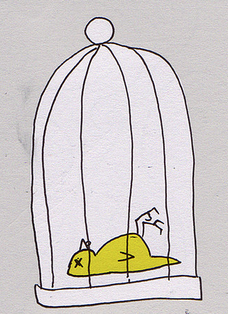
1. Stack canaries
Stack canary aka stack cookie is written on the stack in front of the return address and checked when function returns
A careless stack overflow will overwrite the canary, which can then be detected
first introduced in as StackGuard in gcc
only very small runtime overhead

Slide 71
Stack canaries
Stack without canary Stack with canary
x
x
return address
return address
canary value
buf[4..7]
buf[4..7]
buf[0..3]
buf[0..3]

Slide 72
Further improvements
More variation in canary values: eg not a fixed values hardcoded in binary but a random values chosen for each execution
Better still, XOR the return address into the canary value
Include a null byte in the canary value, because C string functions cannot write nulls inside strings
A careful attacker can still defeat canaries, by
overwriting the canary with the correct value
corrupting a pointer to point to the return address to then change the return address without killing the canary
eg changing to
return
return
canary value
canary value
char* ptr
char* ptr
buf[4..7]
buf[4..7]
buf[0..3]
buf[0..3]

Slide 73
Aside: corrupting pointers
Overwriting pointers is especially interesting because subsequent uses of that pointer then read/write data in another place that attacker can choose.
100 char* ptr;
101 char[8] buf;
...
200 fgets(buf, 12, stdin); // overflow corrupts ptr,
// e.g. to point to the position of return address
...
210 fgets(ptr, 100, stdin);
// corrupts any location chosen by the
// attacker when overflowing buf in line 200

Slide 74
Further improvements
Re-order elements on the stack to reduce the potential impact of overruns
swapping parameters buf and fp on stack changes whether overrunning buf can corrupt fp
which is especially dangerous if fp is a function pointer
hence it is safer to allocated array buffers ‘above’ all other local variables
First introduced by IBM’s ProPolice.
A separate shadow stack
with copies of return addresses, used to check for corrupted return addresses
Of course, the attacker should not be able to corrupt the shadow stack

Slide 75
Windows 2003 Stack Protection
Nice example of the ways in which things can go wrong...
/GS command line option in Visual Studio add stack canaries
When canary is corrupted, control is transferred to an exception handler
Exception handler information is stored ...
on the stack!
Attacker can corrupt the exception handler info on the stack, in the process corrupt the canaries, and then let Stack Protection transfer control to a malicious exception handler
[http://www.securityfocus.com/bid/8522/info]
Countermeasure: only allow transfer of control to registered exception handlers

Slide 76
tot hier

Slide 77
2. ASLR (Address Space Layout Randomisation)
Attacker needs detailed info about memory layout
eg to jump to specific piece of code
or to corrupt a pointer at known position on the stack
Attacks become harder if we randomise the memory layout every time we start a program
ie. change the offset of the heap, stack, etc, in memory by some random value
Attackers can still analyse memory layout on their own laptop, but will have to determine the offsets used on the victim’s machine to carry out an attack
NB security by obscurity, despite its bad reputation, is a really great defense mechanism to annoy attackers!
Once the offset leaks, we’re back to square one…

Slide 78
3. Non-eXecutable memory (NX, aka W⊕X, W^X, DEP)
Distinguish
X: executable memory (for storing code)
W: writeable, non-executable memory (for storing data)
and let processor refuse to execute non-executable code
Attackers can then no longer jump to their own attack code, as any input provide as attack code will be non-executable
aka DEP (Data Execution Prevention).
Intel calls it eXecute-Disable (XD)
AMD calls it Enhanced Virus Protection
Limitation:
this technique does not work for JIT (Just In Time) compilation, where e.g. JavaScript is compiled to machine code at run time.

Slide 79
Defeating NX: return-to-libc attacks
With NX, code injection attacks no longer possible,
but code reuse attacks still are...
Attackers can no longer corrupt code or insert their own code, but can still corrupt code pointers
Called control-flow hijack in SoK paper
So instead of jumping to own attack code
corrupt return address to jump to existing code
esp. library code in libc
libc is a rich library that offers lots of functionality, eg. system(), exec(),
which provides attackers with all they need...

Slide 80




(ROP)
Next stage in evolution of attacks, as people removed or protected dangerous libc calls such as system()
Instead of using a library call, attackers can
look for gadgets, small snippets of code which end with a return, in the existing code base
...; ins1 ; ins2 ; ins3 ; ret
chain these gadgets together as subroutines to form a program that does what they want
This turns out to be doable
Most libraries contain enough gadgets to provide a Turing complete programming language
ROP compilers can then translate arbitrary code to a sequence of these gadgets
A newer variant is Jump-Oriented Programming (JOP) which uses a different kind of code fragment as gadgets

