Slide 1
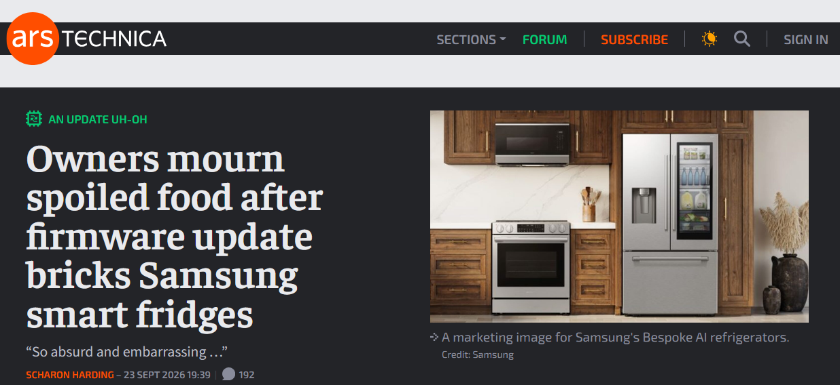
Security bug of the week?
But is this really a security problem? There is no attacker here…

Slide 2
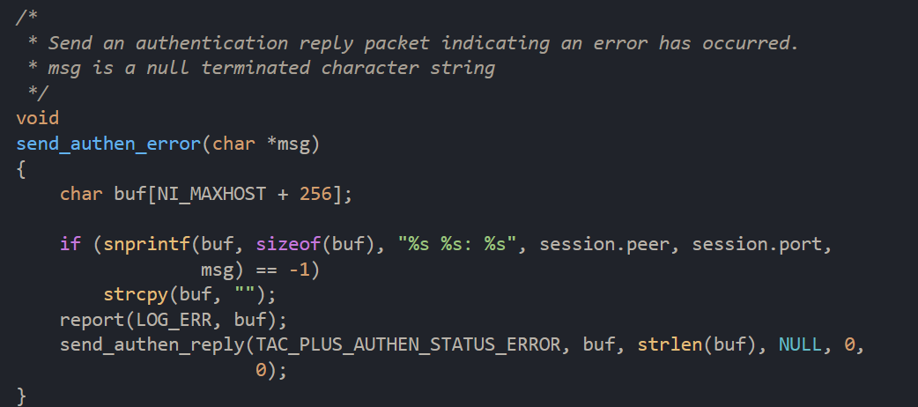
Security bug of the week - CVE pending
Pre-auth format string bug in tac_plus implementation of TACACS+ can lead to RCE and DoS
Bug
Fix
https://www.elttam.com/blog/att-cking-tacacs-to-pwn-your-network-via-a-pre-auth-rce
safe snprintf using a format string
unsafe if buf contains format characters

Slide 3
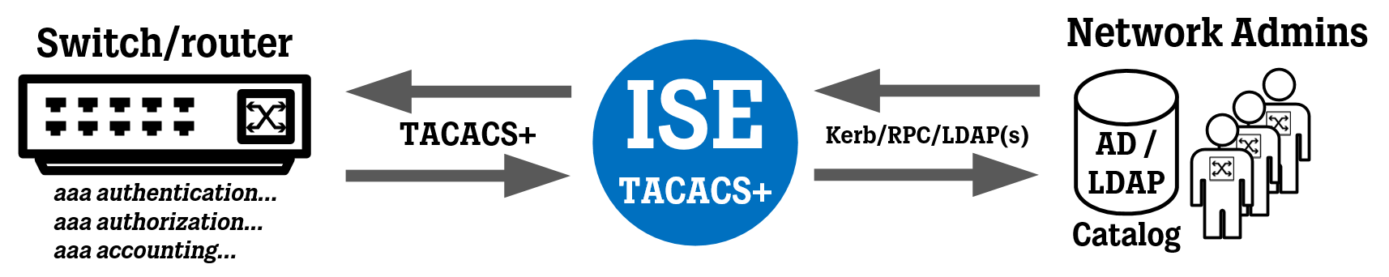
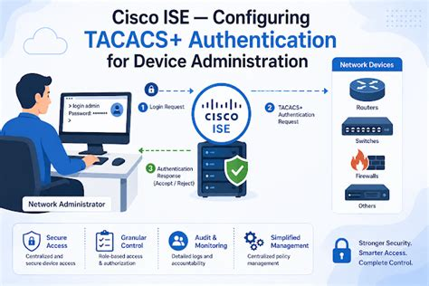

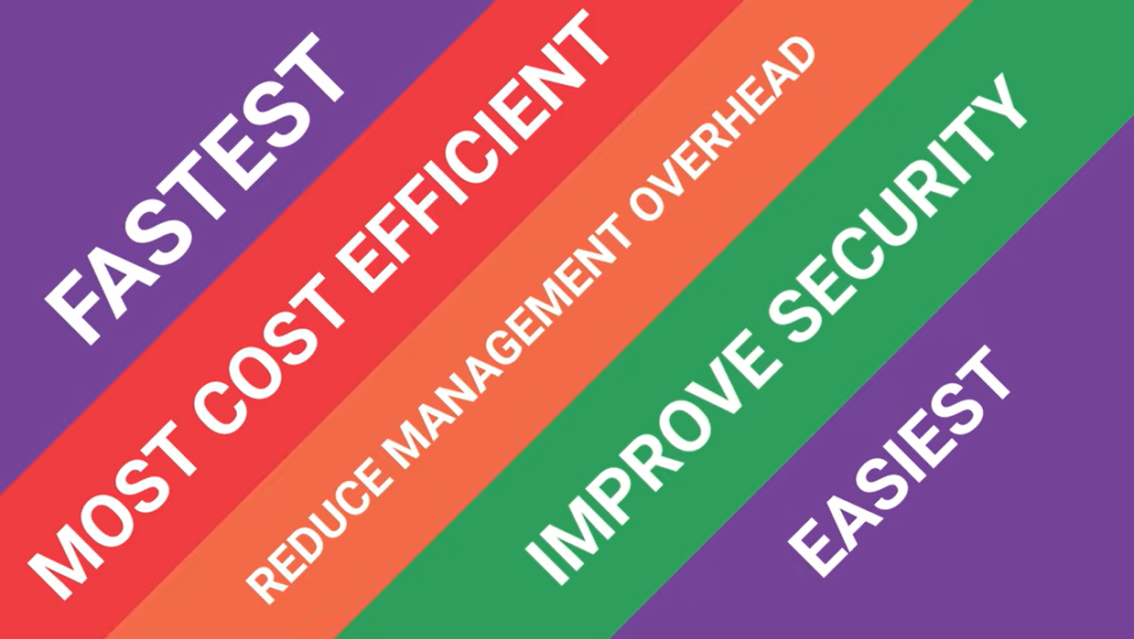
What the hell is TACACS+?
https://www.youtube.com/watch?v=S5oPlP4TRfY

Slide 4
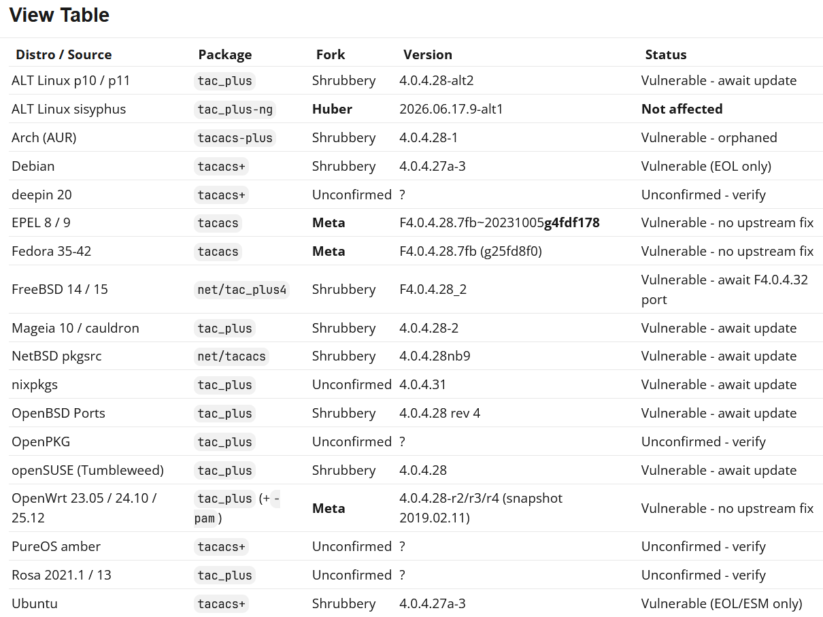
Affected systems - FOSS
https://ifin.network/t/cve-pending-pre-auth-format-string-bug-in-tac-plus-shrubbery-networks/859

Slide 5
Affected systems - commercial
https://ifin.network/t/cve-pending-pre-auth-format-string-bug-in-tac-plus-shrubbery-networks/859
Vendor | Product | Fork | Version | Status
Cisco | ISE (Device Admin license) | ? | All | Not affected per Cisco PSIRT
Cisco | Secure ACS (EOL) | ? | All | Not affected per Cisco PSIRT
DialWays | DialWays AAA | ? | ? | ?
Fortinet | FortiAuthenticator | ? | ? | ?
Fortinet | FortiGate / FortiOS | n/a | n/a | client-only?
HPE Aruba | ClearPass Policy Manager | ? | ? | ?
Juniper | Junos | n/a | n/a | client-only?
Meta | Tacquito | none | ? | Not affected?
NTTacPlus | NTTacPlus | ? | ? | ?

Slide 6
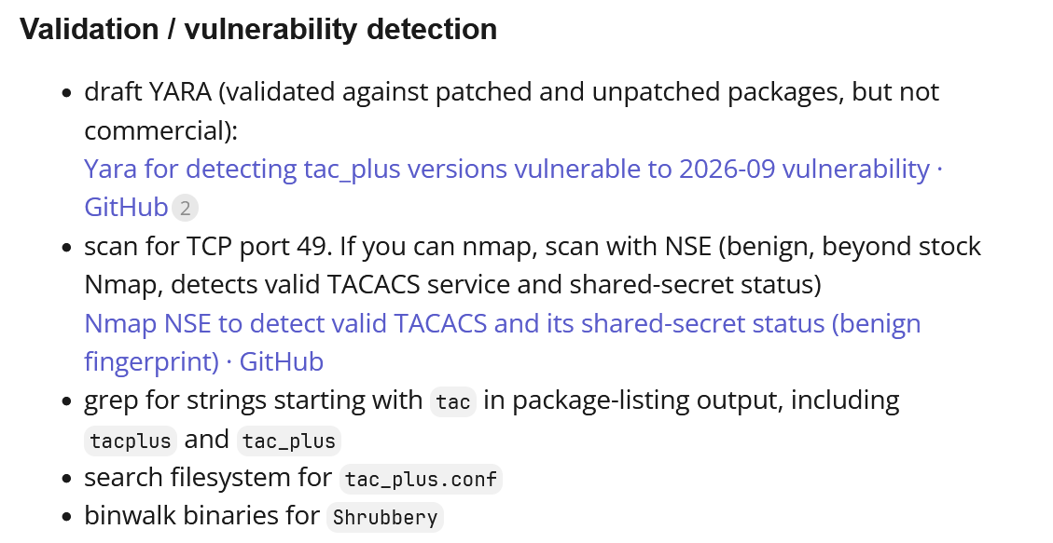
Threat Intel
https://ifin.network/t/cve-pending-pre-auth-format-string-bug-in-tac-plus-shrubbery-networks/859

Slide 7
Memory corruption
Application-level
Countermeasures
Erik Poll
Digital Security
Radboud University Nijmegen

Slide 8
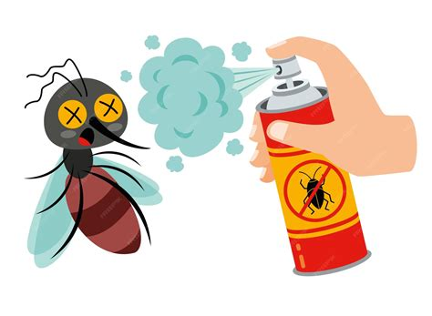

Application-level countermeasures
  Last week: what can the compiler do against memory corruption problems?
  This week: What can the programmer do?
application
PLATFORM

Slide 9
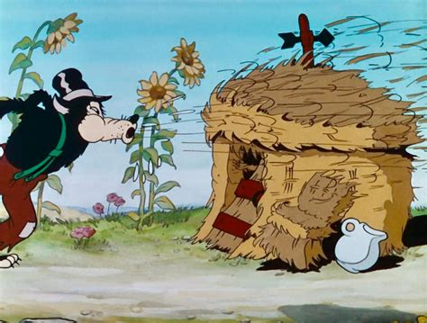

‘Generic’ application-level countermeasures
Dynamic Analysis aka DAST (Dynamic Application Security Testing)
  One very useful test technique: fuzzing
Static analysis aka SAST (Static Application Security Testing)
  By compiler gcc –Wall, clang –Wall, msvs /analyze
  or dedicated SAST tool ccpcheck, PRefast, Converity, SonarCube, CodeQL, ...
Using safer coding practices:
  safer libraries
  safer programming idioms
  safer coding style
  …
  These can be enforced with SAST
Switching to safer programming language
such as Rust, Swift or Go
Or: switching from C to Objective C or C++

Slide 10
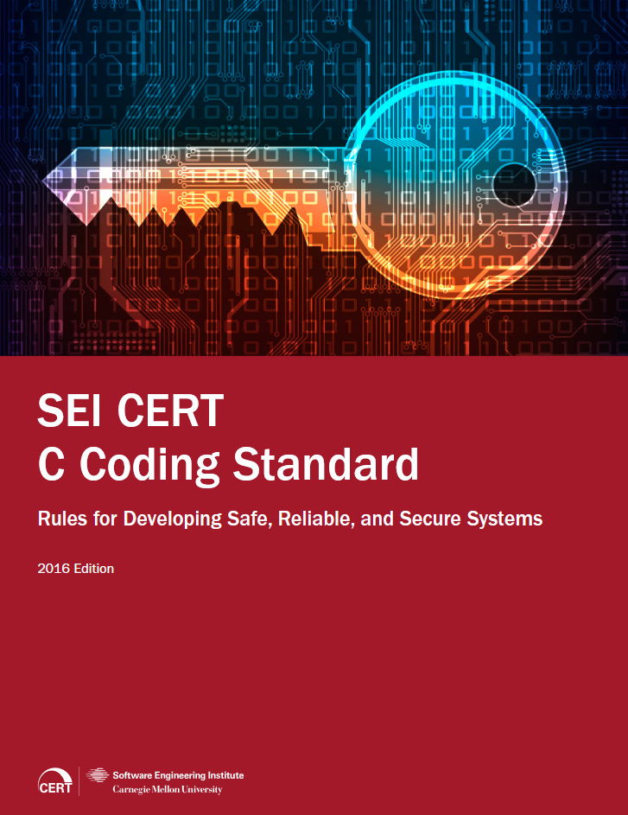
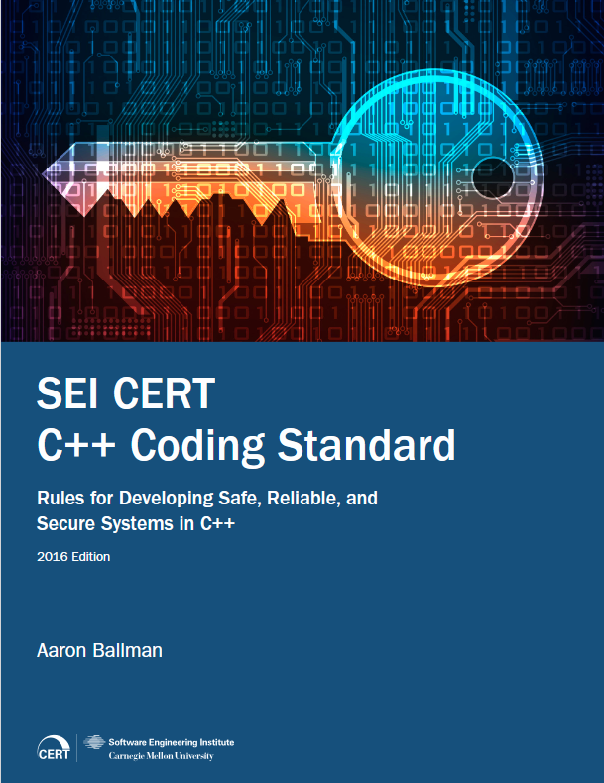
SEI CERT secure coding standards for C & C++
528 pages 429 pages
10 years old, so these won’t contain latest insights
Free to download at http://www.securecoding.cert.org

Slide 11
Example best practices (from OpenSSF)
Run compiler with following flags
  -O2 -Wall -Wformat -Wformat=2 -Wconversion -Wimplicit-fallthrough \
  -Werror=format-security -U_FORTIFY_SOURCE -D_FORTIFY_SOURCE=3 \
  -D_GLIBCXX_ASSERTIONS -D_LIBCPP_HARDENING_MODE=_LIBCPP_HARDENING_MODE_FAST \
  -fstrict-flex-arrays=3 -fstack-clash-protection -fstack-protector-strong \
  -Wl,-z,nodlopen -Wl,-z,noexecstack -Wl,-z,relro -Wl,-z,now \
  -Wl,--as-needed -Wl,--no-copy-dt-needed-entries
  ...
See eg https://best.openssf.org/Compiler-Hardening-Guides/Compiler-Options-Hardening-Guide-for-C-and-C++.html
Note: compilers can improve security in two ways:
by more static checks
by inserting dynamic defensive checks in binary
eg stack canaries, memory tagging, ENDBR instructions, …

Slide 12
Application-specific countermeasures
Countermeasures tailored to a specific (part of a) application,
as part of the higher level design
Identify high-risk components and apply the generic countermeasures there – or there first, or more thoroughly
  One common high-risk component: _{parsers}
  Here we can apply LangSec principles I will discuss later lecture
Split application up in multiple components/processes, to then
  run some with lower privileges
    compartmentalisation or sandboxing
  implement some in memory safe programming language?

Slide 13
Organisational aspects
Getting organisation & processes in place to make sure that all this happens!
adopt some process for secure development
(aka secure SDLC, e.g. Microsoft SDL or something home-grown)
  recall first lecture
  as required by CRA
embed measures from previous slides (and rest of this course)
in that process
  Risk analysis will be a first step, which helps to identify high risk components
Not forgetting the human factor!
Training
  Common good practice: set up a Security Champion program

Slide 14
Static Analysis

Slide 15
Static analysis aka source code analysis aka SAST
Automated analysis at compile time to find potential bugs
Broad range of techniques, from light- to heavyweight:
  simple syntactic checks, incl. grep or CTRL-F
    grep " gets(" *.cpp
  type checking
    eg. warning if an int is added to a bool
  more advanced analyses taking semantics into account using: data flow analysis, control flow analysis, abstract interpretation, symbolic evaluation, constraint solving, program verification, model checking, ...
All compilers do some static analysis
Lightweight static analysis tools also called source code scanners
Tools aiming at security: SAST

Slide 16
False positives & false negatives
Important quality measures for any static analysis:
rate of false positives
  tool complains about non-error
rate of false negatives
  tool fails to complain about error
Which do you think is worse?
False positives are worse, as they kill usability ! !
Alternative (confusing!) terminology: analysis can be called
sound
complete
it only finds real bugs, ie. no false positives
it finds all bugs, ie. no false negatives

Slide 17
Very simple static analysis: style checking
BOOL AddTail(LPVOID p) { ... if(queue.GetSize() >= this->_limit); { while(queue.GetSize() > this->_limit-1) { ::WaitForSingleObject(handles[SemaphoreIndex], 1); queue.Delete(0); } } ... }
Warning about bad names & violations of conventions, eg
  constants not written in ALL CAPS
  Java method starting with capital letter
  C# method starting with lower case letter
  …
Enforcing other (company/project-specific)
naming conventions and coding guidelines

Slide 18
More interesting static analyses
Warning about unused variables
Warning about dead/unreachable code
Warning about missing initialisation
  possibly as part of language definition (eg in Java) and checked by compiler
This may involve
    control flow analysis
if (b) { c = 5; } else { c = 6; } initialises c
if (b) { c = 5; } else { d = 6; } does not
    data flow analysis
d = 5; c = d; initialises c
c = d; d = 5; does not

Slide 19

Spot the defect!
OOL AddTail(LPVOID p) { ... if(queue.GetSize() >= this->_limit); { while(queue.GetSize() > this->_limit-1) { ::WaitForSingleObject(handles[SemaphoreIndex], 1); queue.Delete(0); } } ... }
BOOL AddTail(LPVOID p) {
...
if (queue.GetSize() >= this->_limit);
{
while(queue.GetSize() > this->_limit-1)
{
::WaitForSingleObject(handles[SemaphoreIndex],1);
queue.Delete(0);
}
}
}
Suspicious code in xpdfwin found by PVS-Studio (www.viva64.com).
V529 Odd semicolon ';' after 'if' operator.
Note that this is a very simple syntactic check!
You could (should?) use coding guidelines that disallow this, even though it is legal C++

Slide 20

Spot the security flaw! CVE-2014-1266
static OSStatus SSLVerifySignedServerKeyExchange (SSLContext *ctx, bool isRsa, SSLBuffer signedParams, uint8_t *signature, UInt16 signatureLen)
{ OSStatus err;
..
if ((err = SSLHashSHA1.update(&hashCtx, &serverRandom)) != 0)
goto fail;
if ((err = SSLHashSHA1.update(&hashCtx, &signedParams)) != 0)
goto fail;
goto fail;
if ((err = SSLHashSHA1.final(&hashCtx, &hashOut)) != 0)
goto fail;
...
fail:
SSLFreeBuffer(&signedHashes);
SSLFreeBuffer(&hashCtx);
}
Infamous goto bug in Apple iOS implementation of TLS
Dead code analysis would reveal this flaw!
Or a code style that insists you always use { } for branches

Slide 21



Spot the defects!
void start_engine_control() {
char* buf2 = malloc (2*SOME_CONSTANT);
char* buf = malloc (SOME_CONSTANT);
start_engine();
memset(buf2, 0, SOME_CONSTANT);
// initialise first half of buf2 to 0
// main loop
while (true) {
get_readings(buf,buf2);
perform_engine_control(buf,buf2);
}
}
Possible integer overflow
Can be hard to check statically, but for constant is should be doable
No check if mallocs succeeded!! (easier to check syntactically)

Slide 22
Check you mallocs!
void start_engine_control() {
...
char* buf = malloc (SOME_CONSTANT);
if (buf == NULL) { // now what?!?!?
exit(0); // or something more graceful??
}
...
start_engine();
...
perform_engine_control(buf);
Typically, the place where malloc fails is the place to think about what to do

Slide 23

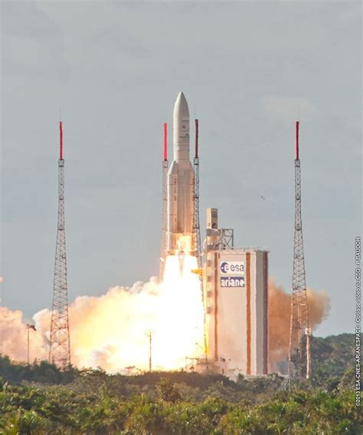
Spot the defect :-)
First Ariane V launch
integer overflow in conversion of 64 bit float to 16 bit int
https://www.youtube.com/watch?v=PK_yguLapgA

Slide 24
Limits of static analysis
Does
if (i < 5 ) { c = 5; }
if ((i < 0) || (i*i > 20 )){ c = 6; }
initialise c?
Many analyses become hard – or undecidable - at some stage
Analysis tools can then:
report that they “DON’T KNOW”
give a (possible) false positive
give a (possible) false negative

Slide 25
Example source code analysis tools
free tools for Java: CheckStyle, PMD, SpotBugs (formerly FindBugs)
for C(++) from Microsoft: PREfast, FxCop
outdated, but free tools focusing on security
ITS4 and Flawfinder (C, C++), RATS (also Perl, PHP)
commercial
  Coverity (C/C++) , PolySpace (C/C++, Ada), SparkAda (Ada),
  Fortify, Klocwork, PVS-Studio, IBM AppScan, VeraCode, CheckMarx, SonarQube,
  CodeQL (aka Semmle), semgrep
Some tools focus on C/C++, others on web applications
Such tools can be useful, but… a fool with a tool is still a fool
easy & fun
to download
and try out!

Slide 26
Safer C

Slide 27
Safer string libraries in C
strcpy(dst,src), strcat(dst,src)
Error prone! Memory corruption if strings are not null-terminated or too long
strncpy(dst,src,n), strncat(dst,src,n)
Better: takes max # of bytes to be copied as parameter
But: can result in non-null-terminated strings if strings don’t fit ☹
strscpy(dst,src,dst_len), strscat(dst,src,dest_len)
  Result is guaranteed to be null-terminated string
  Size of destination array as parameter, not # of chars to be copied,
  which gives simpler code when e.g. concatenating multiple strings
Another alternative: here strlcpy and strlcat

Slide 28
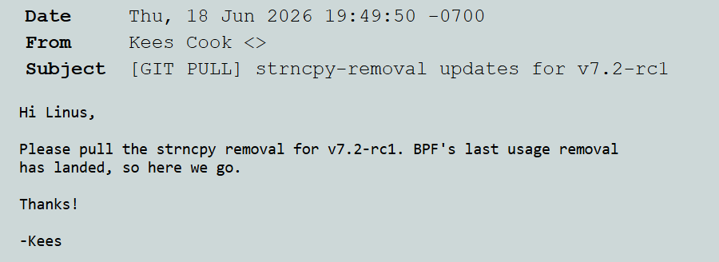

Slide 29
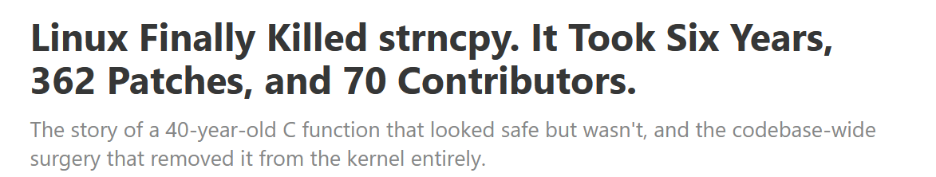
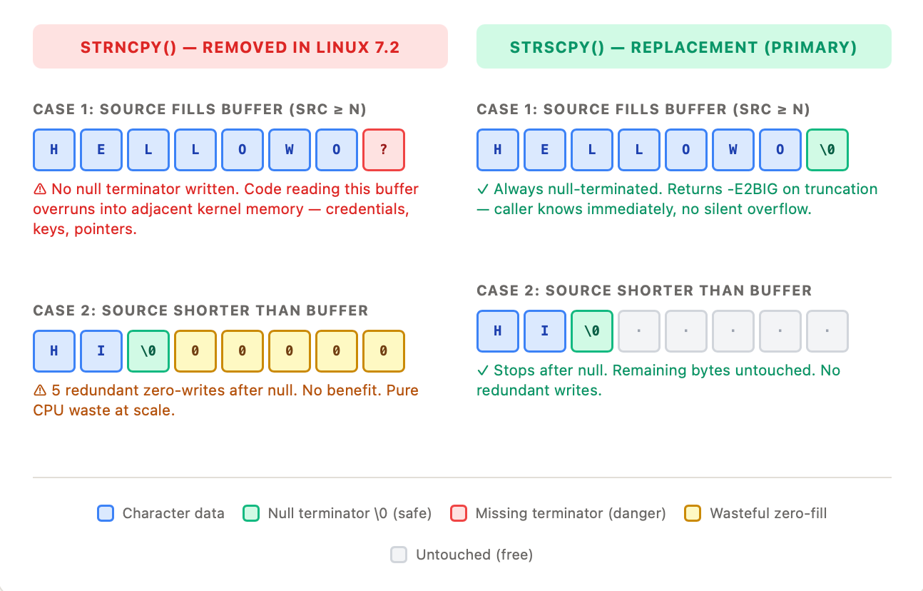
To read: https://chessman7.substack.com/p/linux-finally-killed-strncpy-it-took

Slide 30
More type information: Nullability qualifiers
LLVM/Clang introduced type qualifiers
__nullable
__nonnull
for more precise typing & hence better static analysis for bugs
Compiler can then warn about missing null-checks
  Example: char *strchr(char *str, int c), which finds the first occurrence
  of (char)c in null-terminated string str , becomes
  __nullable char *strchr(__nonnull char *s, int c)
gcc has a clumsier nonnull attribute
void my_memcpy (__attribute__((nonnull)) char *dest,
__attribute__((nonnull)) char *src, int len)
__attribute__((returns_nonnull))

Slide 31
Spot the (potential) bugs!
void zero(int a, size_t len) {
for (int i = 0; i <= len; i++) { a[i] = 0; }
}
--------------------------------------------------------------------------------------------------------
typedef struct {
int* buf;
size_t count;
} sized_buf;
void zero_sb(sized_buf* ptr) {
sized_buf sb = *ptr; // the sized_buf struct that ptr points to
for (int i = 0; i <= sb.count ; i++) { sb.buf[i] = 0; }
} // for C programmers: sb.count could be written as ptr->count
-------------------------------------------------------------------------------------
int main() {
int[10] a; int* b; ... b = a++; ...
sized_buf* ptr; ... ptr++; ... zero_sb(ptr); ...
}

Slide 32
Spot the (potential) bugs!
void zero(int a, size_t len) {
for (int i = 0; i <= len; i++) { a[i] = 0; }
} // ^^ n is probably the length of a, so <= should be <
--------------------------------------------------------------------------------------------------------
typedef struct {
int* buf;
size_t count;
} sized_buf;
void zero_sb(sized_buf* ptr) {
sized_buf sb = *ptr; // the sized_buf struct that ptr points to
for (int i = 0; i <= sb.count ; i++) { sb.buf[i] = 0; }
} // ^^ count is probably the length of buf, so <= should be <
--------------------------------------------------------------------------------------------------------
int main() {
int[10] a; int* b; ... b = a++ ; .. // a++ makes sense because a is array
sized_buf* ptr; ... ptr++; ... zero_sb(ptr); ...
} // ^^ makes no sense if ptr does not point to array

Slide 33
-fbounds-safety annotations
void zero(int *__counted_by(len) a, size_t len) {
for (int i = 0; i <= len; ++i) {a[i] = 0;}
// Clear out of bounds access now
}
typedef struct {
int *__counted_by(count) buf;
size_t count;
} sized_buf;
sized_buf *__single ptr;
// For pointers to single (non-array) objects
// So p++ or p[2] will result in error
These annotations 1) let programmers express their intent, 2) can improve static analysis, and 3) can be used to insert compile-time checks

Slide 34
-fbounds-safety in LLVM/clang (since 2024)
C compiler inserts bound checks made possible by annotations
notably __counted_by( )
  Compiler can infer some annotations automatically.
  Compiler can be made to complain about missing annotations
Checks are meant to be left in production code
Runtime overhead & developer effort to annotate code acceptable
Binary compatible aka preserves ABI (Application Binary Interface)
so usage can be introduced gradually
Supported for C and Swift, not (yet?) Objective C and C++
Developed by & heavily used at Apple
    Not exam material but more info at
    EuroLLVM 2025 talk ‘Adopting -fbounds-safety in practice’
    https://www.youtube.com/watch?v=rlevLn831R4

Slide 35
-fbounds-safety annotations
Some variants of __counted_by
__counted_by_or_null(...)
for arrays that can be null; compiler will add null-checks
__sized_by(...) __sized_by_or_null(...)
to express size in bytes instead of elements
Eg
void* __sized_by_or_null(len) malloc(size_t len);

Slide 36
__null_terminated strings
-fbounds-safety also has an annotation for null-terminated strings
char *__null_terminated s;
void process_string(char *__null_terminated str);
Note that char* is overloaded: to pass arrays as parameters to functions,
we have to use char*
char[8] udp_header1; // UDP header on stack
char* str = ”Welcome”; // 8-byte string
process_header(udp_header);
void process_header(char* x) {
// x could be an array or a string
... }
This is an unavoidable ambiguity in C.

Slide 37
-fbounds-safety inferred annotations
Often annotations can be left implicit
void f(int n) {
int[12] a; // Compiler infers __counted_by(12)
a[n] = 1234; // Out-of-bounds access will result
// in runtime-error
}

Slide 38
-fbounds-safety wide pointers
Wide pointer with upper & lower bound,
instead of a length field as discussed for fat pointers last week
typedef struct {
    int *pointer;
    int *upper_bound;
    int *lower_bound;
    } wide_pt;
Clang compiler inserts bound checks on use of wide pointers
Obvious downside: not binary compatible

Slide 39
(weaker) gcc alternative: -D_FORTIFY_SOURCE
Compiler flag to insert some lightweight defensive checks for some memory and string operations.
Introduced in gcc in 2004
Version -D_FORTIFY_SOURCE=3 since 2022

Slide 40
Microsoft alternative: SAL
Microsoft SAL annotation language, not for dynamic instrumentation,
but for static analysis with PREfast tool
void zero(_Out_writes_(len) int* a, int len) {
for (int i = 0; i < len; ++i) { a[i] = 0; }
}
_checkReturn _Ret_opt_bytecount_(len) void* malloc(size_t len);
// _opt_ signals possible nullness
// _checkReturn forces caller to check return value for nullness
PREfast does static analysis for spatial memory vulnerablities, incl. reading of uninitialised memory, and null-dereferences, plus some ad-hoc checks
SAL annotations improve precision & enable analysis per procedure
PREfast is included in Visual Studio as /analyze flag since 2005

Slide 41
Safer C (or C++): Custom allocators
Custom implementations of malloc & free can improve security
e.g. by
keeping deallocated memory in quarantine for a while
randomising freelist
using different partitions for different types to prevent type-confusion bugs
using memory tagging, esp. ARM MTE
surrounding memory chunks with guard pages
Examples:
Google PartitionAlloc used in Chrome
Scudo Hardened Allocator used in Android
IsoHeap GigaCage in WebKit
AUTOSlab by grsecurity
Apple’s iBoot

Slide 42
Safer C++

Slide 43
array and vector in C++
Instead of C strings char* and C arrays int[],
C++ has safer alternatives:
  std::string s;
  std::array<int,N> a;
  std::vector<int> v;
Not 100% memory safe, but a lot memory-safer,
esp. against spatial bugs
a[i] is still not bounds-checked, but a.at(i) is
data() gives raw pointer access to internal data representation
std::array preserves its type & length when passed to function
Note that in C an int[] can only be passed as argument as an int* pointer
Built-in function for copying and iteration (without having to worry about lengths)
  But iterators can easily become dangling pointers

Slide 44
Next week: smart pointers in C++ to help prevent temporal bugs
Notes:
https://www.youtube.com/watch?v=RK9bfrsMdAM

Slide 45
tot hier

Slide 46
Spot the bug!
void f(double* data, int N) {
double* tmp = new double[N];
setup(data, tmp, N);
if (not_needed(data, tmp, N))
return;
calculate(data, tmp, N);
delete[] tmp;
}
This is not nice C++ code: we should use a C++ style array for data
and not a double* data pointer to a C style array, but ignore that
Notes:
Examples from https://www.youtube.com/watch?v=YokY6HzLkX

Slide 47
Potential memory leak
void f(double* data, int N) {
double* tmp = new double[N];
setup(data, tmp, N);
if (not_needed(data, tmp, N))
return;
calculate(data, tmp, N);
delete[] tmp; // not freed if we return early
}

Slide 48
Fixing this
void f(double* data, int N) {
double* tmp = new double[N];
setup(data, tmp, N);
if (not_needed(data, tmp, N)) {
delete[] tmp;
return;
}
calculate(data, temp, N);
delete[] tmp;
}
Spot the bug
What if setup(data,tmp,N) throws an exception?

Slide 49
Fixing this
void f(double* data, int N) {
double* tmp = new double[N];
try {
setup(data, tmp, N);
}
catch (int err) {
delete[] tmp ; throw err;
}
if (not_needed(data, tmp, N)) {
delete[] tmp;
return;
}
calculate(data, temp, N);
delete[] tmp;
}
Spot the bug
maybe calculate can throw an exception

Slide 50
Better still – if calculate() can throw an exception
void f(double* data, int N) {
double* tmp = new double[N];
try {
setup(data, tmp, N);
if (not_needed(data, tmp, N)) {
delete[] tmp;
return;
}
calculate(data, temp, N);
delete[] tmp;
}
catch (int err) {
delete[] tmp ; throw err;
}
}

Slide 51
Much nicer: unique_ptr
void f(double* data, int N) {
unique_ptr <double[]> tmp
= make_unique <double[]> (N);
setup(data, tmp, N);
if (not_needed(data, tmp, N))
return;
calculate(data, temp, N);
// delete tmp;
}
Unique pointer: automatic deletion when owner - here tmp -
goes out-of-scope
Note: this secure code is simpler than the original insecure code!

Slide 52
C++ smart pointers
unique_ptr
share_ptr
weak_ptr
To prevent temporal memory corruption:
memory management is automated
More generally it improves code quality

Slide 53
Safe?
void f(double* data, int N) {
double* tmp1 = new double[N];
double* tmp2 = new double[N];
calc(data, tmp1, tmp2, N);
// calc is guaranteed not to throw an exception
delete[] tmp1;
delete[] tmp2;
}
Notes:
Examples from https://www.youtube.com/watch?v=YokY6HzLkX

Slide 54
Remember: memory allocation may fail
void f(double* data, int N) {
double* tmp1 = new double[N];
double* tmp2 = new double[N]; // may fail
calc(data, tmp1, tmp2, N);
delete[] tmp1; // not reached if tmp2 allocation fails
// => memory leak
delete[] tmp2;
}
Notes:
Examples from https://www.youtube.com/watch?v=YokY6HzLkX

Slide 55
Fix using unique pointers (and auto)
void f(double* data, int N) {
auto tmp1 = make_unique<double[]>(N);
auto tmp2 = make_unique<double[]>(N);
calc(data, tmp1, tmp2, N); // guaranteed not to throw
// delete[] tmp1; clean-up is automatic
// delete[] tmp2;
}
Notes:
Examples from https://www.youtube.com/watch?v=YokY6HzLkX

Slide 56
What’s suspicious here?
float* suspicious(float* x, float* y, int N) {
float* tmp = new float[N];
process(3.1415, x, y, tmp, N);
delete[] x;
delete[] y;
return tmp;
}
Again, we should be using C++-style float arrays,
not these float* C-style arrays
Notes:
Examples from https://www.youtube.com/watch?v=YokY6HzLkX

Slide 57
What’s suspicious here ?
float* suspicious(float* x, float* y, int N) {
float* tmp = new float[N];
process(3.1415, x, y, tmp, N);
delete[] x; // Does caller expect us to delete x
delete[] y; // and y?
return tmp; // Caller responsible for freeing tmp
}
Notes:
Examples from https://www.youtube.com/watch?v=YokY6HzLkX

Slide 58
Improved code using unique pointers
unique_ptr<float[]> suspicious
( unique_ptr<float[]> x,
unique_ptr<float[]> y, int N)
{ auto tmp = make_unique<float[]>(N);
process(3.1415, x, y, tmp, N);
// delete[] x; clean-up is automatic
// delete[] y;
return tmp;
}
Note that
It is clear to the caller that the function suspicious takes over ownership of x and y, and hence responsibility for freeing them
The caller of the function becomes owner of the return value tmp
Freeing tmp is automatic, when it eventually goes out-of-scope

Slide 59
C++ smart pointers
unique_ptr: only one pointer to an object, which owns the object
  automatic de-allocation when owner dies
  created using make_unique
  move semantics to transfer ownership

Slide 60
move operation for unique pointers
namespace std; // so we don’t have to write std:: everywhere
unique_ptr<int> a = make_unique<int>(42);
unique_ptr<int> b = a; // illegal
unique_ptr<int> b { move(a) }; // legal
// b is now owner, a is set to null

Slide 61
C++ smart pointers
unique_ptr: only one pointer to an object, which owns the object
  automatic de-allocation when owner dies
  created using make_unique
  move semantics to transfer ownership
share_ptr: possible many pointers to same object
  reference counting to free object when all references are gone
    intuition: shared pointers collectively own the object they point to
  created using make_shared

Slide 62
Using shared_ptr
void g(){
unique_ptr <int> u1 = make_unique<int>(42);
shared_ptr <int> u2 = u1; // illegal
shared_ptr <int> sp1 = make_shared<int>(42);
shared_ptr <int> sp2 = sp1; // reference count increased
f(ss); // maybe function f will store ss somewhere, increasing ref-count
} // object that sp1 points to will be freed,
// except if f stored ss somewhere

Slide 63
C++ smart pointers
unique_ptr: only one pointer to an object, which owns the object
  automatic de-allocation when owner dies
  created using make_unique
  move semantics to transfer ownership
share_ptr: possible many pointers to same object
  reference counting to free object when all references are gone
    intuition: shared pointers collectively own the object they point to
  created using make_shared
weak_ptr
  a weak pointer is ignored for reference counting,
    so a weak pointer may point to an object that no longer exists
  mandatory lock before using it

Slide 64
Using weak_ptr - with expired() with lock()
shared_ptr <int> sp1 = make_shared<int>(42);
shared_ptr <int> sp2 = sp2; // reference count increased
weak_ptr <int> wp = sp2; // allowed, but reference count not increased
int i = *sp; // using shared pointer is always allowed
int j = *wp; // using weak pointer without locking is NOT allowed
if ( wp.expired() ) {
. . . // object wp points to has been de-allocated
}
// to use wp, we have to lock it to obtain a shared pointer
if (shared_ptr <int> sp = sw.lock() ) {
// w is alive, and we can access it via shared pointer sp
int k = *sp;
...
}

Slide 65
RAII
Smart pointers are example of RAII
(Resource Acquisition is Initialisation)
RAII is programming idiom where ownership of some ‘resource’ is given to reference and ‘clean-up’ is automatic when unique owner disappears.
  Bit of a misnomer, because it’s also about clean-up, not just initialisation
The resource can be heap-allocated object, but also
file descriptor
port
lock or mutex
…

Slide 66
Example: RAII for files
void proc(){
FILE* fp = fopen("readme.txt", "r");
// lots of complicated code using fp
..; fread(buffer, 1, N, fp); ...
// we are done using fp
fclose(fp);
}
If an exception is thrown before we get to fclose()
then the file may not be closed

Slide 67
Example: RAII for files using smart pointers
void proc(){
unique_FILE fp = fopen("readme.txt", "r");
// lots of complicated code using fp
..; fread(buffer, 1, N, fp); ...
// we are done using fp
// fclose(fp); clean up automatic if fp goes out of scope
}
if we define unique_FILE as unique pointer type with a custom clean-up operation
unique_FILE = unique_ptr<FILE, file_cleanup>;
struct file_cleanup{
void operator()(FILE* fp) const { fclose(fp); }
};

Slide 68
Recap
To prevent spatial bugs in C, we can use
  safer string libraries
  –fbounds-safety
To prevent spatial bugs in C++,
we can use C++-style strings, arrays, and vectors
To prevent temporal bugs in C++,
we can use smart pointers

Slide 69
Compartmentalisation

Slide 70
Compartmentalisation, esp.sandboxing
Compartmentalisation: chop up system in isolated components,
so that flaw in one component does not affect others
Very general security principle!
  Eg used in government departments, terrorist organisations, banks, universities, OSs, CPUs, TEEs, phones with SIM cards,…
Sandboxing is a specific form of compartmentalisation, where one component is run in a restrictive environment, the sandbox
Different ways to use sandboxing for applications:
sandbox an entire application – on ‘inside’ or ‘outside’
split it into multiple applications & sandbox some of those, or
  eg web browser splitting browser & renderer, and then splitting renderer process into renderer process per origin

Slide 71


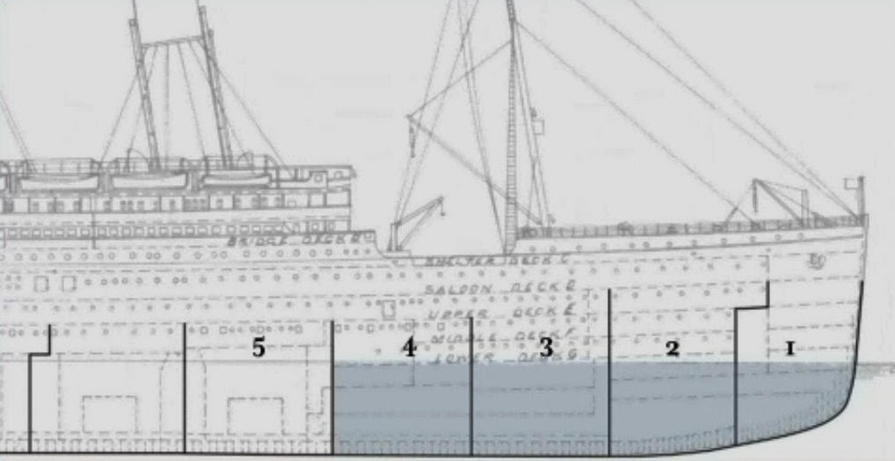
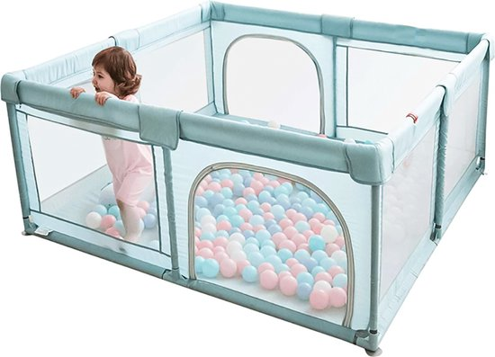
Examples

Slide 72

Titanic
Does this mean compartmentalising is a bad idea?
No, but the attacker model was wrong: making vessel double-hulled would have been a better (additional) form of compartmentalising.

Slide 73



Two ways to use compartments
Compartmentalisation can be used for the bad guys or the good guys
to contain a untrusted process from attacking others – or the ‘platform’
  aka sandboxing
to protect a trusted process from outside attacks
  Eg SIM card or Secure Enclave
  Possible with some TEE technologies
1. is more common. In essence, it is what any OS does

Slide 74
Eexample: web browser compartmentalisation
browser
Windows Internet Explorer 8 (2009) introduced option to have separate process for each tab
Chrome introduced Site Isolation (2019) has renderer per origin, even for indiviual iframes. Firefox introduced this in 20201.
The foundation of the security model of web browsers – with Same Origin Policy (SOP) to separate content - is also a form of compartmentalisation
monolithic
browser process
browser
renderer
renderer
per origin
renderer
per origin
renderer
per origin
renderer
per origin

Slide 75
chroot
Early sandboxing mechanism for the file
Eg running an application you just downloaded with
chroot /home/sos/erik/trial ; /tmp
restricts access to just these two directories
Simple but coarse
More modern, flexible & powerful mechanisms on Linux include
csgroups – to limit & measure resource usage such as memory, CPU, network traffic, for a set of OS processes
namespaces – to limit visibility of many resources - network, users, procces IDs, filesystem system mounts, … - in a tree of processes

Slide 76
chroot jail
chroot - change root - is nice example of compartmentalisation (of file system) in UNIX/Linux. It is coarse but simple.
restricts access of a process to a subset of file system, ie. changes the root of file system for that process
Eg running an application you just downloaded with
chroot /home/sos/erik/trial ; /tmp
restricts access to just these two directories
Using traditional OS access control permissions for this would be very tricky! It would require getting permissions right all over the file system.

Slide 77
SECCOMP BFP (SECure COMPuting with BPF)
Sandbox mechanims in Linux
Filters system calls that a process can do using
Filter is expressed using BPF (Berkely Packet Filter)
EXAMPLE

Slide 78
Example: sandboxing C/C++ libraries using SAPI
Google SAPI for sandboxing third-party (or less trusted) C/C++ libraries
Library + stub runs as separate process, accessed via RPC, within Sandbox2 sandbox (which uses a.o. Namespaces and SECCOMP-BPF)
application
Third-party
library
SAPI library
Sandbox2 sandbox
application
sandboxee
SAPI
object
RPC calls
RPC
stub
Third-party
library

