Slide 1

Software Security
Security Testing (aka DAST)
especially
Fuzzing
Erik Poll

Slide 2
Testing for memory corruption bugs
Suppose some C(++) binary asks from some input
Please enter your username
>
What would you try?
ridiculous long input, say a few MB
  If there is a buffer overflow, a long input is likely to trigger a SEG FAULT
or a ridiculousky short one: the empty username
%x%x%x%x%x%x%x%x
  To see if there is a format string vulnerability
  On the command line, we cannot include a null terminator \0 in an input,
  but in other situations we may be able to
Other malicious inputs, depending on technologies used
eg SQL, XML, JSN, Unicode character encodings,…

Slide 3
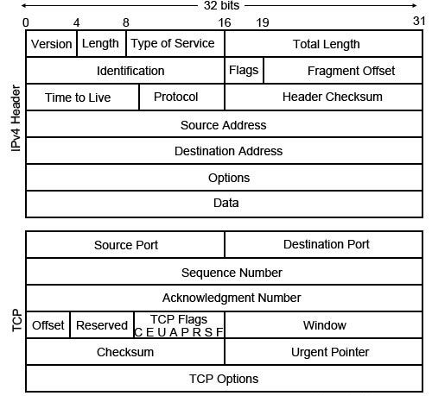
Testing for memory corruption bugs
Suppose a program processes TCP/IP. How would you test it?

Slide 4






Testing for memory corruption bugs
Suppose a program processes TCP/IP. How would you test it?

Slide 5
Testing for memory corruption bugs
Is a (small) buffer overflow likely to crash a program with a segmentation fault?
No ☹
Is a use-after-free bug likely to crash a program?
No ☹
Is reading uninitialised memory likely to crash a program?
No ☹
Can we make it more likely – or even guarantee - that these cause a crash?
Yes, by deploying The platform-level defences discussed 2 weeks ago

Slide 6
Security testing
Testing basics
Abuse cases & negative tests
Fuzzing

Slide 7
Testing basics

Slide 8
SUT, test suite & test oracle
To test a SUT (System Under Test) we need two things
test suite, ie. collection of input data
test oracle to decide if response is ok or reveals an error - ie. some way to decide if the SUT behaves as we want
Both defining test suites and test oracles can be a lot of work!
In the worst case, a test oracle is a long list which for every individual test case, specifies exactly what should happen
A simple test oracle: just looking if application doesn’t crash
Moral of the story: crashes are good ! (for testing)

Slide 9
Code coverage criteria
Code coverage criteria can measure how good a test suite:
statement coverage
branch coverage
  Statement coverage does not imply branch coverage; eg for
void f (int x, y) { if (x>0) {y++};
y--; }
Statement coverage needs 1 test case, branch coverage needs 2
More complex coverage criteria exists, eg MCDC (Modified condition/decision coverage), commonly used in avionics
Code coverage metrics can also be used to guide test case generation (as afl does)

Slide 10
Possible perverse effect of coverage criteria
High coverage criteria may discourage defensive programming, eg.
void m(File f){
if <security_check_fails> {log (...);
throw (SecurityException);}
try { <the main part of the method> }
catch (SomeException) { log(...);
<some corrective action>;
throw (SecurityException); }
}
If defensive code, ie. the if- & catch-branches, is hard to trigger in tests, programmers may be tempted (or forced?) to remove this code to improve test coverage...

Slide 11
Annotations as test oracle
Annotations, eg assert statements or -fbound-safety annotations in code, can be used as test oracle by doing runtime assertion checking
  So annotations provide a test oracle for free! You can test by sending random inputs & checking if annotations are violated

Slide 12
Security testing:
Abuse cases & Negative test cases

Slide 13
testing vs security testing
Difference in focus
Normal (functional) testing focuses on correct, desired behaviour for sensible inputs (aka the happy flow), plus some inputs for borderline conditions
Security testing also – especially – looks for wrong, undesired behaviour for really strange inputs
Normal use of a system is more likely to reveal functional problems than security problems

Slide 14
Security testing is HARD
space of all possible inputs
. some input
. input that triggers
security bug
.
.
.
.
normal
inputs
.
.

Slide 15
The security testing paradox
Security testing is harder than normal, functional testing
  We have no idea what we are looking for! A bizarre input may trigger an obscure exploitable bug, and finding that input is hard
  Normal users are good testers
    they will complain about functional problems
  but not good security testers
    they will (usually) not find or complain about security flaws
Security testing is easier than normal, functional testing
  If we have a test oracle for a class of security flaws,
  then we can test for that class in automated way, using fuzzing
  Fuzzing is the great success story in software security in the past 15 years

Slide 16
Abuse cases → negative test cases
Thinking about abuse cases is a useful way to come up with security tests
  what would an attacker try to do?
  where could an implementation slip up?
This gives rise to negative test cases,
  i.e. test cases which are supposed to fail
  as opposed to positive test cases, which are meant to succeed

Slide 17
iOS goto fail SSL bug
...
if ((err = SSLHashSHA1.update(&hashCtx, &clientRandom)) != 0)
goto fail;
if ((err = SSLHashSHA1.update(&hashCtx, &serverRandom)) != 0)
goto fail;
if ((err = SSLHashSHA1.update(&hashCtx, &signedParams)) != 0)
goto fail;
goto fail;
if ((err = SSLHashSHA1.final(&hashCtx, &hashOut)) != 0)
goto fail;
err = sslRawVerify(...);
. . .

Slide 18
Negative test cases eg. for flawed certificate chains
David Wheeler's 'The Apple goto fail vulnerability: lessons learned' gives a good discussion of this bug & ways to prevent it, incl. the need for negative test cases
http://www.dwheeler.com/essays/apple-goto-fail.html
The FrankenCert test suite provides (broken) certificate chains to test for flaws in the program logic for checking certificates.
  [Brubaker et al, Using Frankencerts for Automated Adversarial Testing of Certificate Validation in SSL/TLS Implementations, Oakland 2014]
Code coverage requirements on the test suite would also have helped.

Slide 19
Fuzzing

Slide 20

Fuzzing
(semi) automatically generate ‘random’ inputs and check if an application crashes or misbehaves in observable way
Great for certain classes of bugs, esp. memory corruption bugs
fuzzer
test case
generation
observation
set of test inputs
SUT
System Under Test

Slide 21
How to fuzz: test case generation
Depending on input type
very long inputs, very short inputs, or completely blank input
min/max values of integers, zero and negative values
depending on what you are fuzzing, include special values, characters or keywords likely to trigger bugs, eg
  nulls, newlines, or end-of-file characters
  format string characters %s %x %n
  semi-colons, slashes and backslashes, quotes
  application specific keywords halt, DROP TABLES, ...
  ....
Good validation and/or sanitisation would catch these problems.
More on this in later lecture on secure input handling.

Slide 22
How to fuzz: error detection
Making systems crash on errors is useful for testing!
When security testing C(++) code, all memory safety checks discussed in previous weeks can be deployed to make a crash in the event of a memory corruption more likely
  Tools for this include
    ASan - AddressSanitizer (spatial & temporal bugs)
    MSan – MemorySanitizer (access to uninitialised memory)
    UBSan – UndefinedBehaviorSanitizer

Slide 23
Some pros and cons of fuzzing & DAST
Pros
Relatively little effort
test cases are automatically generated and test oracle is trivial
  Fuzzing a C/C++ binary gives a quick indication of code quality
Limitations
Only finds ‘shallow’ bugs and not ‘deeper’ bugs
  but ‘smarter’ fuzzing tools can go deeper, as we will see
General advantage of DAST over SAST:
a crash by a DAST tool is a true positive that something is wrong

Slide 24
History of fuzzing
Random fuzzing
random inputs, incl. very long & very short inputs, and inputs with
special characters & keywords: \0 %x %n DROP
Mutational fuzzing
mutate normal inputs (eg network packets)
Grammar-based fuzzing
use grammar of input format to generate inputs & mutate these
SAGE: white box fuzzing using symbolic execution
The real breakthrough!
afl: grey box fuzzing using evolution
(aka coverage-guided grey box fuzzing)
1-3 are forms of black box fuzzing.
Beware that terminology for various forms of fuzzing can messy.

Slide 25
1. Random Fuzzing

Slide 26
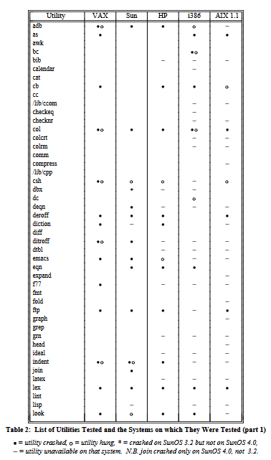


Random fuzzing of UNIX utilities [1988]
Barton Miller let students fuzz UNIX utilities
as part of his Operating System course
https://pages.cs.wisc.edu/~bart/fuzz/
Barton P. Miller, Lars Fredriksen, Bryan So,
An empirical study of the reliability of UNIX utilities,
Communications of the ACM, Vol 33, Issue 12, 1990

Slide 27
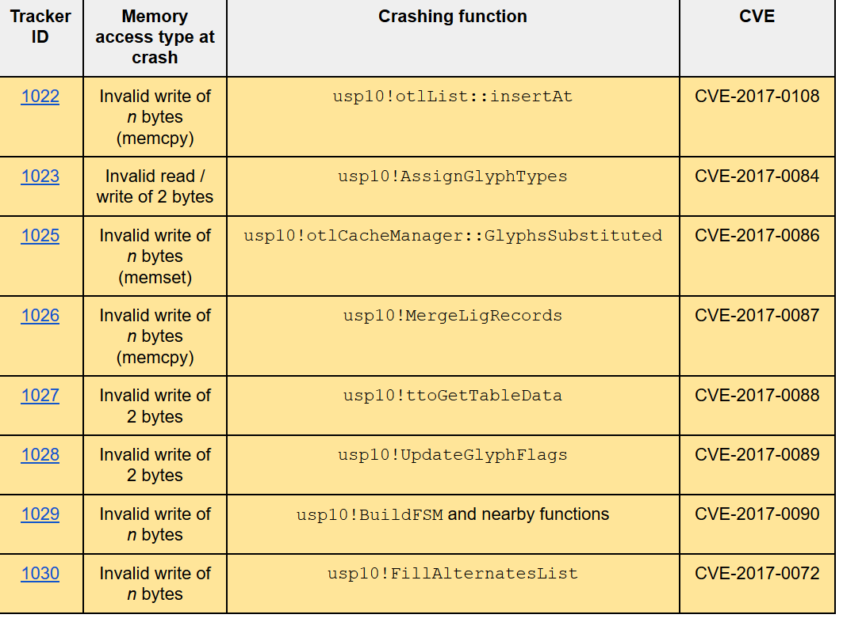
Four decades later, OS utilities still have problems
Google Project Zero found 119 CVEs by fuzzing fonts in the Windows kernel
https://googleprojectzero.blogspot.com/2017/04/notes-on-windows-uniscribe-fuzzing.html

Slide 28
Mutational fuzzing

Slide 29

Example: Fuzzing OCPP [research internship Ivar Derksen]
OCPP is a protocol for charge points to talk to a back-end server
OCPP can use XML or JSON messages
Example message in JSON format
{ "location": NijmegenMercator215672,
"retries": 5,
"retryInterval": 30,
"startTime": "2018-10-27T19:10:11",
"stopTime": "2018-10-27T22:10:11" }

Slide 30
Example: Fuzzing OCPP
1 malformed JSON
Classification of messages into
malformed JSON/XML eg missing quote, bracket or comma
well-formed JSON/XML, but not legal OCPP eg with field names not in OCPP specs
well-formed OCPP
can be used for a simple test oracle:
The application should never crash
Malformed messages (type 1 & 2) should generate generic error response
Well-formed messages (type 3) should not
Note: this does not require any understanding of the protocol semantics!
For functional testing we would need to know the exact correct response for well-formed messages.
2 correct JSON
3 valid OCPP

Slide 31
Test results with fuzzing OCPP server
Mutation fuzzer generated 26,400 variants from 22 example OCPP messages in JSON format
Problems spotted by this simple test oracle:
  945 malformed JSON requests (type 1) resulted in malformed JSON response
  Server should never emit malformed JSN!
  75 malformed JSON requests (type 1) and 40 malformed OCPP requests (type 2) result in a valid OCPP response that is not an error message.
  Server should not process malformed requests!
One root cause of problems: the Google’s gson library for parsing JSON by default uses lenient mode rather than strict mode
  Why does gson even have a lenient mode, let alone by default?
Fortunately, gson is written in Java, not C(++), so these flaws do not result in exploitable buffer overflows

Slide 32
Postel’s Law aka Robustness Principle [RFC 1958]
“Be conservative in what you send,
be liberal in what you accept”
[Named after Jon Postel, who wrote early version of TCP]
Is this good or bad?
Good for getting interoperable implementations up & running ☺
Bad for security, as it leads to implementations with non-standard behavior, deviating from the official specs,
which may lead to weird behaviour and bugs ☹ ☹
Counterargument to this principle is discussed in RFC 9413 from 2023

Slide 33
Generational fuzzing aka
Grammar-based fuzzing

Slide 34
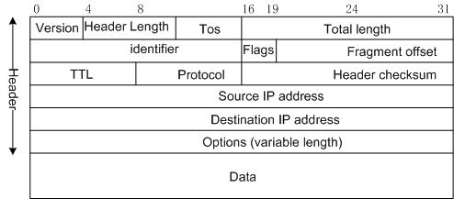
Generation/grammar/model-based fuzzing
Generate inputs based on knowledge of input format/protocol
Eg using regular expression
context free grammar, or
some other description
Typical things to fuzz:
many/all possible value for specific fields esp undefined values, or values Reserved for Future Use (RFU)
incorrect lengths, lengths that are zero, or payloads that are too short or too long
Fuzzing tools: SNOOZE, SPIKE, Peach, Sulley, antiparser, Netzob, ...

Slide 35
CVEs as inspiration for fuzzing file formats
Microsoft Security Bulletin MS04-028 Buffer Overrun in JPEG Processing (GDI+) Could Allow Code Execution Impact: Remote Code Execution
Maximum Severity Rating: Critical
Root cause: a zero sized comment field, without content
CVE-2007-0243 Sun Java JRE GIF Image Processing Buffer Overflow Vulnerability Critical: Highly critical Impact: System access Where: From remote
Description: A vulnerability has been reported in Sun Java Runtime Environment. … The vulnerability is caused due to an error when processing GIF images and can be exploited to cause a heap-based buffer overflow via a specially crafted GIF image with an image width of 0. Successful exploitation allows execution of arbitrary code.
Note: a buffer overflow in (native library of) a memory-safe language
For more of these bugs, see https://www.cve.org/CVERecord/SearchResults?query=%22zero+length%22

Slide 36
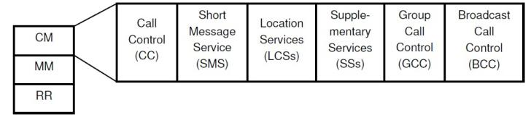
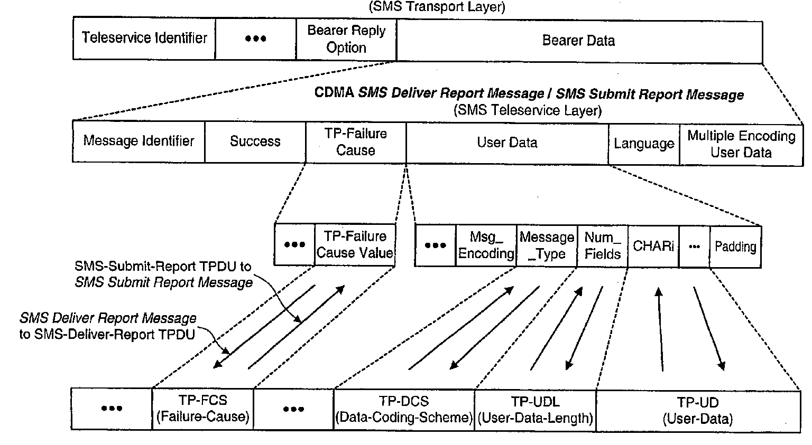
Example: generation based fuzzing of GSM
[Master theses of Brinio Hond and Arturo Cedillo Torres]
GSM is a extremely rich & complicated protocol

Slide 37
SMS message fields
Field | size
Message Type Indicator | 2 bit
Reject Duplicates | 1 bit
Validity Period Format | 2 bit
User Data Header Indicator | 1 bit
Reply Path | 1 bit
Message Reference | integer
Destination Address | 2-12 byte
Protocol Identifier | 1 byte
Data Coding Scheme (CDS) | 1 byte
Validity Period | 1 byte/7 bytes
User Data Length (UDL) | integer
User Data | depends on CDS and UDL

Slide 38
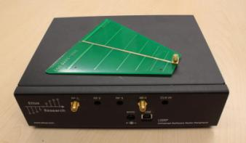
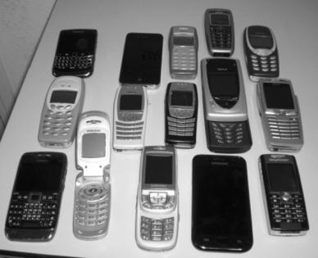
Example: GSM protocol fuzzing
Lots of stuff to fuzz!
We can use a USRP
with open source cell tower software (OpenBTS)
to fuzz any phone

Slide 39
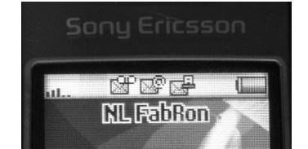
Example: GSM protocol fuzzing
Fuzzing SMS layer of GSM reveals weird functionality in GSM standard and in phones

Slide 40
Example: GSM protocol fuzzing
Fuzzing SMS layer of GSM reveals weird functionality in GSM standard and in phones
  eg possibility to receive faxes (!?)
  Only way to get rid if this icon; reboot the phone
you have a fax!

Slide 41
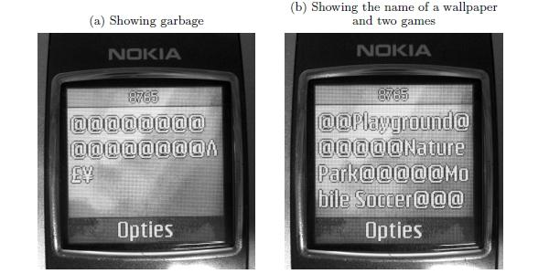
Example: GSM protocol fuzzing
Malformed SMS text messages showing raw memory contents, rather than content of the text message

Slide 42
Our results with GSM fuzzing
Lots of success to DoS phones: phone crashes, disconnects from network, stops accepting calls,…
  eg requiring reboot or battery removal to restart, to accept calls again, or to remove weird icons
  after reboot, the network might redeliver the SMS message, if no acknowledgement was sent before crashing, re-crashing phone
  But: not all these SMS messages could be sent over real network
There is surprisingly little correlation between problems and phone brands & firmware versions
  how many implementations of the GSM stack did Nokia have?
The scary part: what would happen if we fuzz base stations?
[Fabian van den Broek, Brinio Hond and Arturo Cedillo Torres, Security Testing of GSM Implementations, ESSOS 2014]
[Mulliner et al., SMS of Death, USENIX 2011]

Slide 43
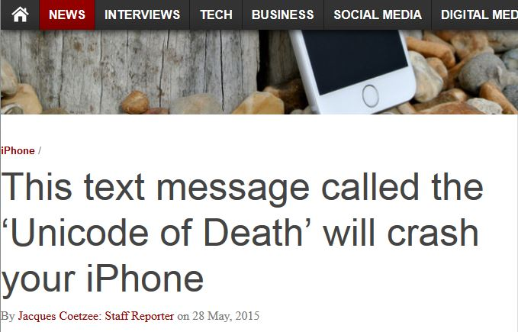
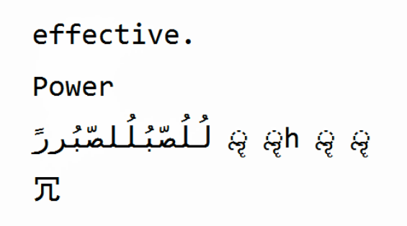
Security problem with more complex input formats
Example dangerous
SMS text message
This message can be sent over the network
Different characters sets & characters encodings are a recurring source of problems.

Slide 44
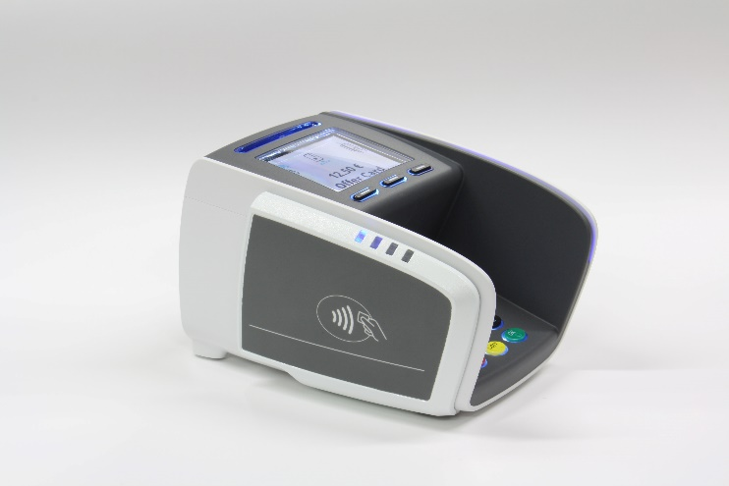
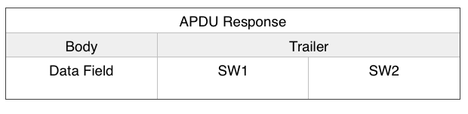
Even handling simple input languages can go wrong!
Sending an extended length APDU can crash a contactless payment terminal.
Found accidentally, without even trying to fuzz, when sending legal (albeit non-standard) messages
  [Jordi van den Breekel, A security evaluation and proof-of-concept relay attack on Dutch EMV contactless transactions, MSc thesis, 2014]

Slide 45
So far
Dumb, random fuzzing
Mutation-based - apply random mutations to valid inputs
  Eg OCPP
  Tools: Radamsa, zzuf, ...
Generation-based aka grammar-based
  Eg GSM
  Pro: can reach ‘deeper’ bugs than 1 & 2 ☺
  Con: but lots of work to construct fuzzer or grammar ☹
  Tools: Boofuzz, SNOOZE, SPIKE, Peach, Sulley, antiparser, Netzob, ...
Less
shallow

Slide 46
Whitebox fuzzing with SAGE

Slide 47
Whitebox fuzzing using symbolic execution
The central problem with fuzzing: how can we generate inputs that trigger interesting code executions?
  Eg fuzzing the procedure below is unlikely to hit the error case
  int foo(int x) {
  y = x+3;
        if (y==13) abort(); // error
        }
The idea behind whitebox fuzzing: if we know the code, then by analysing the code we can find interesting input values to try.
SAGE from Microsoft Research that uses symbolic execution of x86 binaries to generate test cases.

Slide 48
m(int x,y){
x = x + y;
y = y – x;
if (2*y > 8) { ...
}
else if (3*x < 10){ ...
}
}
Can you provide values for x and y that will trigger execution of the two if-branches?

Slide 49
Symbolic execution
m(int x,y){
x = x + y;
y = y – x;
if (2*y > 8) { ...
}
else if (3*x < 10){ ...
} }
Given a set of constraints, an SMT solver (Yikes, Z3, ...) produces values that satisfy it, or proves that it are not satisfiable.
This generates test data (i) automatically and (ii) with good coverage
SMT solvers can also be used for static analyses as in PREfast, or more generally, for program verification
Suppose x = N and y = M.
x becomes N+M
y becomes M - (N+M) = -N
if-branch taken if 2 * -N > 8, i.e. N < -4
Aka the path condition
2nd if-branch taken if N ≥ -4 AND 3 *(M+N) < 10

Slide 50
Symbolic execution for test generation
Symbolic execution can be used to automatically generate test cases with good coverage
Basic idea instead of giving variables concrete values (say 42), variables are given symbolic values (say α or N), and program is executed with these symbolic values to see when certain program points are reached
Downsides of symbolic execution?
  Very expensive (in time & space)
  Things explode if there are loops or recursion, or if you make heavy use of the heap
  You cannot pass symbolic values as input to some APIs, system calls, I/O peripherals, …
  SAGE mitigates these by using a single concrete execution to obtain symbolic constraints to generate many test inputs for many execution paths

Slide 51
SAGE example
Example program
void top(char input[4]) {
int cnt = 0;
if (input[0] == 'b') cnt++;
if (input[1] == 'a') cnt++;
if (input[2] == 'd') cnt++;
if (input[3] == '!') cnt++;
if (cnt >= 3) crash();
}
What would be interesting test cases?
Do you think a fuzzer could find them?
How could you find them?

Slide 52
SAGE example
Example program
void top(char input[4]) {
int cnt = 0;
if (input[0] == 'b') cnt++;
if (input[1] == 'a') cnt++;
if (input[2] == 'd') cnt++;
if (input[3] == '!') cnt++;
if (cnt >= 3) crash();
}
SAGE executes the code for some concrete input, say 'good'
It then collects path constraints for an arbitrary symbolic input of the form i₀i₁i₂i₃
path contraints:
i₀ ≠ 'b'
i₁ ≠ 'a'
i₂ ≠ 'd'
i₃ ≠ '!'

Slide 53
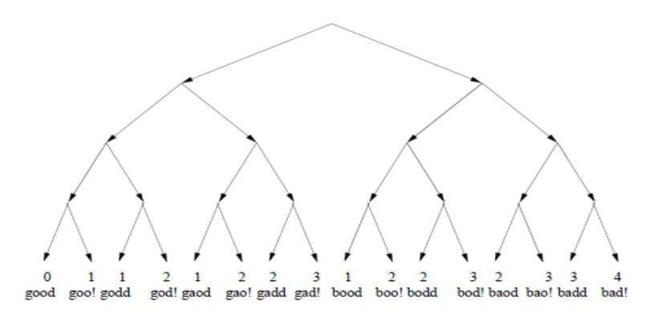
Search space for interesting inputs
Based on this one execution, combining the 4 constraints found & their negations, yields 2⁴ = 16 test cases
Note: the initial execution with the input ‘good’ was not very interesting, but some of these others are
i₀ ≠ 'b'
i₀ = 'b'
i₁ ≠ 'a'
i₁ = 'a'
i₁ ≠ 'a'
i₁ = 'a'
i₂ ≠ 'd'
i₂ = 'd'
i₃ ≠ '!'
i₃ = '!'

Slide 54
SAGE success
SAGE was very successful at uncovering security bugs, eg
  Microsoft Security Bulletin MS07-017 aka CVE-2007-0038: Critical
  Vulnerabilities in GDI Could Allow Remote Code Execution
  Stack-based buffer overflow in the animated cursor code in Windows ... allows remote attackers to execute arbitrary code … via a large length value in the second (or later) anih block of a RIFF .ANI, cur, or .ico file, which results in memory corruption when processing cursors, animated cursors, and icons
Root cause: vulnerablity in _{parsing} of RIFF .ANI, cur, and ico-formats.
NB SAGE automatically generates inputs triggering this bug without knowing these formats
[Godefroid et al., SAGE: Whitebox Fuzzing for Security Testing, ACM Queue 2012]
[Patrice Godefroid, Fuzzing: Hack, Art, and Science, Communications of the ACM, 2020]

Slide 55
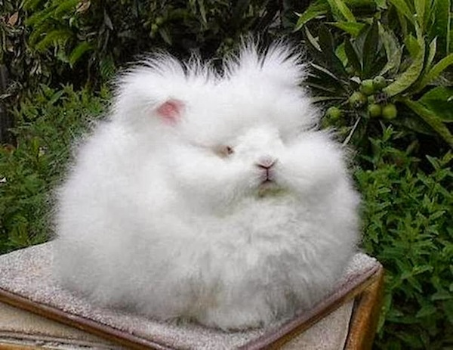
Coverage-guided evolutionary fuzzing with afl
(American Fuzzy Lop)

Slide 56
Evolutionary Fuzzing
Use evolution:
  try random input mutations, and
  observe the effect on some form of coverage, and
  let only the interesting mutations evolve further
  where “interesting” = resulting in ‘new’ execution paths
Aka coverage-guided evolutionary greybox fuzzing,
but terminology is a bit messy/non-standard

Slide 57
alf: observing jumps to find interesting inputs/input changes
input
code
line | instruction
1 | JMP 6
2 | ..
3 | ..
4 | ..
5 | JZ (Jump If Zero) 7
6 | ..
7 | arraycopy (dst, input[i..j] );
8
9 | ..
10 | JCXZ 2
11 | ..
12 | ..
13 | println (part of input);
14 | ..
15 | JNE 103131
16 | ..
17 | ..
18
19 | sfdsf
afl bitmap shared_mem
 | 1 | 2 | 3 | 4 | 5 | 6 | 7 | 8 | 9 | 10 | 11 | 12
1
2
3
4
5
6
7
8
9
10
11
12
13
14
15
☑¹
☑³
☑²

Slide 58
afl [http://lcamtuf.coredump.cx/afl]
Code instrumented to observe execution paths:
  if source code is available, by using modified compiler
  if source code is not available, by running code in an emulator
Code coverage represented as a 64KB bitmap: each control flow jumps is mapped to a change in this bitmap
  different executions could result in same bitmap, but chance is small
Mutation strategies include: bit flips, incrementing/decrementing integers, using pre-defined interesting values (eg. 0, -1, MAX_INT,....) or user-supplied dictionary, deleting/combining/zeroing input blocks, ...
The fuzzer forks the SUT to speed up the fuzzing
Big win: no need to specify the input format, but still good coverage

Slide 59
afl’s instrumentation of compiled code
Code is injected at every branch point in the code
cur_location = <SOME_RANDOM_NUMBER_FOR_THIS_CODE_BLOCK>;
shared_mem[cur_location ^ prev_location]++;
prev_location = cur_location >> 1;
where shared_mem is a 64 KB memory region
Intuition: for every jump from L₁ to L₂ a different byte in shared_mem is changed (increased).
  Which byte is determined by random values chosen at compile time inserted at source and destination of every jump

Slide 60
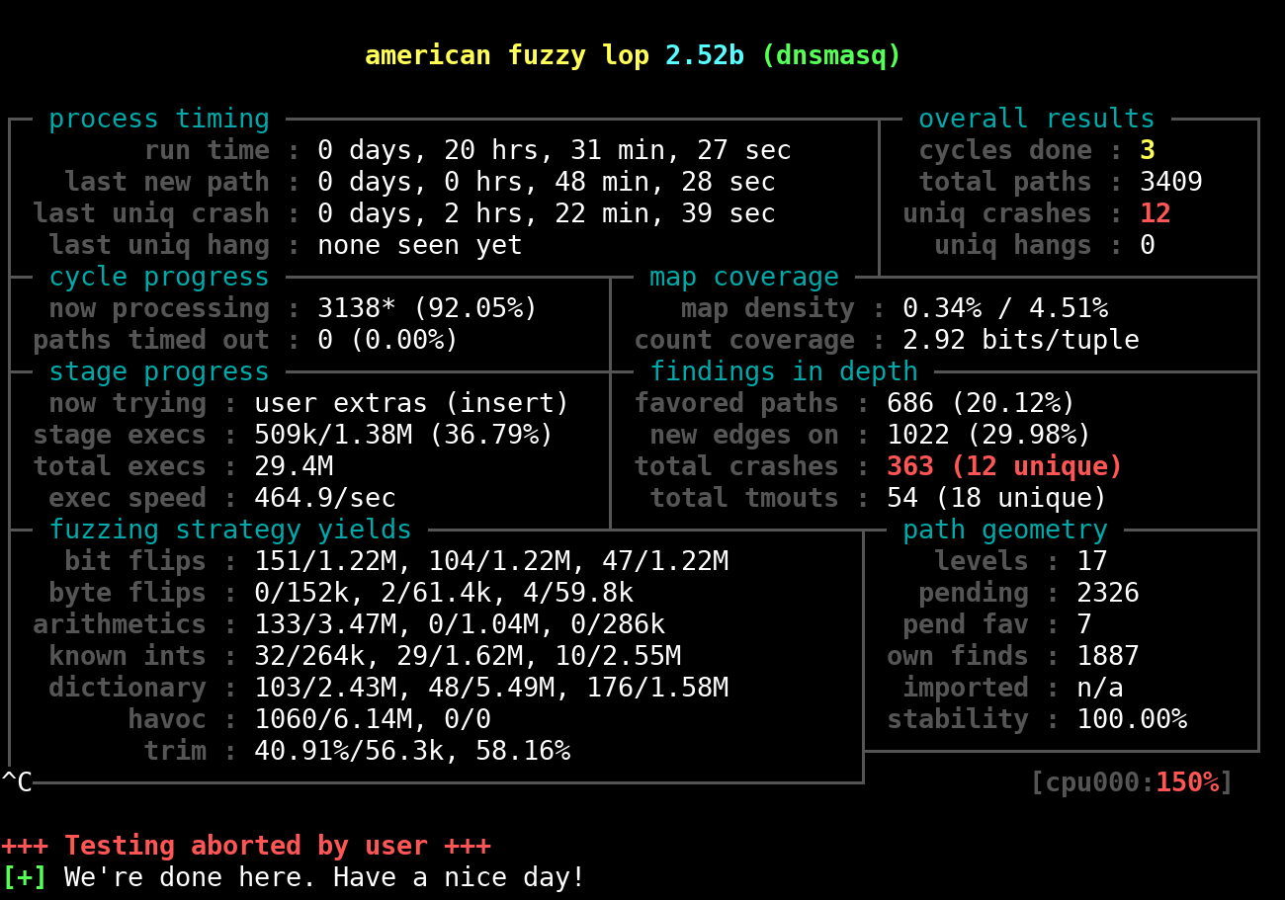

Slide 61
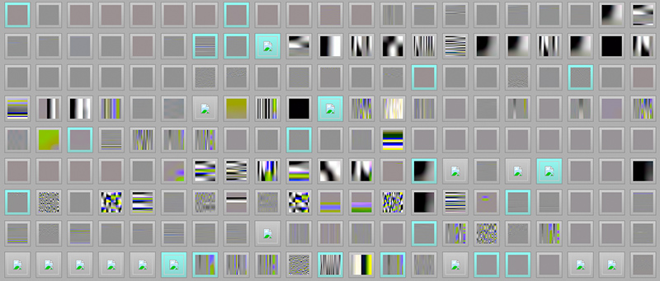
Cool example: learning the JPG file format
Fuzzing a program that expects a JPG as input, starting with 'hello world' as initial test input, afl can learn to produce legal JPG files
along the way producing/discovering error messages such as
  Not a JPEG file: starts with 0x68 0x65
  Not a JPEG file: starts with 0xff 0x65
  Premature end of JPEG file
  Invalid JPEG file structure: two SOI markers
  Quantization table 0x0e was not defined
and then JPGs like
[Source http://lcamtuf.blogspot.nl/2014/11/pulling-jpegs-out-of-thin-air.html]

Slide 62
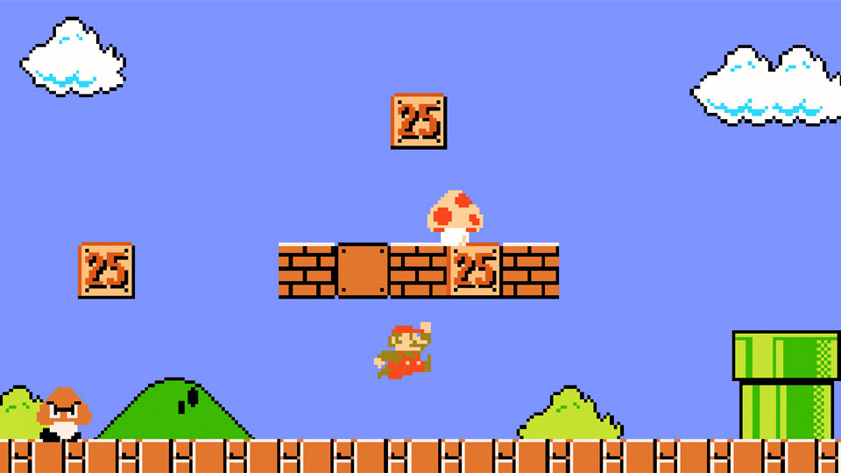
Other strategies in evolutionary fuzzing
Instead of maximizing path/code coverage, we can also let inputs evolve to maximize some other variable or property
Code may need to instrumented to let fuzzer observe that property
Eg the x-coordinate of Super Mario
[Aschermann et al., IJON: Exploring Deep State Spaces via Fuzzing, IEEE S&P 2020]
https://www.youtube.com/watch?v=3PyhXlHDkNI

Slide 63
Conclusions
Fuzzing is great technique to find (some) security flaws!
If you ever write or use C(++) code, you should fuzz it.
Challenge: getting good coverage fuzzing without too much effort
Successful approaches include
  White-box fuzzing based on symbolic execution with SAGE
  Evolutionary fuzzing aka coverage guided greybox fuzzing with afl
Does fuzzing makes sense for code in other programming languages?
Yes, but the bugs found may have lower security impact
To read (see links on the course page)
Michal Zawleski, technical white paper for afl
Patrice Godefroid, SAGE: Whitebox Fuzzing for Security Testing, ACM Queue 2012

Slide 64

Quick security assessment of C/C++ code
crashes with a dumb fuzzer
crashes with afl
crashes with afl & ASan
does not crash with any fuzzer

Slide 65
Fuzzing web-applications
How could a fuzzer detect SQL injections or XSS weaknesses?
  For SQL injection: monitor database for error messages
  For XSS, see if the website echoes HTML tags in user input
There are various tools to fuzz web-applications: Spike proxy, HP Webinspect, AppScan, WebScarab, Wapiti, w3af, RFuzz, WSFuzzer, SPI Fuzzer Burp, Mutilidae, ...
Some fuzzers crawl a website, generating traffic themselves, other fuzzers modify traffic generated by some other means.
Can we expect false positives/negatives?
  false negatives due to test cases not hitting the vulnerable cases
  false positives & negatives due to incorrect test oracle, eg
    for SQL injection: not recognizing some SQL database errors (false neg)
    for XSS: signaling quoted echoed response as XSS (false pos)

