Slide 1
Privacy

Slide 2


Slide 3
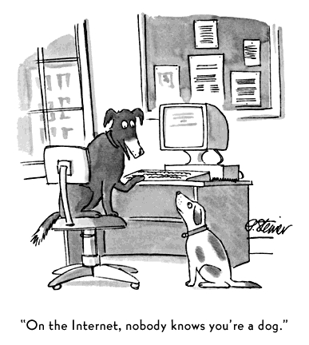
[Peter Steiner,1993]

Slide 4
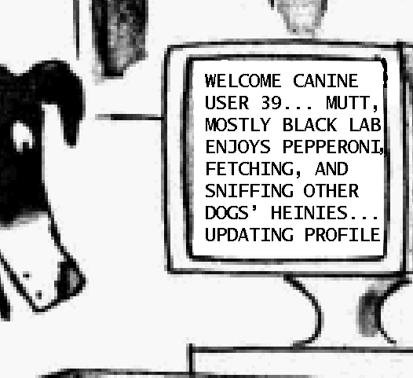

myth reality
Welcome user29.
(IP address: 131.174.16.131)
RU Nijmegen, NL; male german shepherd,
4 yrs old,
neutered,
interests:
dogfood, cats
[Peter Steiner,1993]

Slide 5
To understand privacy risks
What information is leaked?
How is information leaked?
Who are the parties that might get this information?
What will they do with it?
Why are parties interested in this information?
What are the legal rules?

Slide 6
Parties involved
user
website visited
websites providing 3rd party content
internet service provider (ISP)
browser
  producer of the browser, eg Microsoft for IE, Google for Chrome
  producer of browser plug-ins, eg Adobe for Flash
public authorities and national security agencies
  AIVD and MIVD, eg. via CIOT (Centraal Informatiepunt Onderzoek Telecommunicatie)
  NSA eg. via PRISM
(organised) criminals, hacktivists, and random hackers
legislators (national and EU level), government regulators (ACM) and watchdogs (CPB), privacy advocates, scientific researchers....

Slide 7


Privacy
ISP
wifi network
3rd party website
provided to
authorities
browser
website
stolen by hacker
(un)wanted
information leaks
sold to
commercial parties

Slide 8
Beyond the web and the internet
Privacy is just issue for web and internet, but more generally
for computing devices and systems storing information, eg
(mobile) telephones and telephone networks
other transactions involving identification:
public transport, payment with bank card, customer card at shops,…
other information digitally recorded:
  number plate registration, CCTV security cameras, ..
Issue of growing importance, with the explosion of digital
information and the merging of the virtual & physical world
into one cyber-physical world

Slide 9
What information?
Possible information leaks
visits to certain web site
browser history
“content”, entered certain data at web site
  search queries
  look at certain subpages, topics,...
  email addresses, email content, telephone number
video & sound via camera and microphone
geographical location
...
content vs meta-data

Slide 10
What motive?
commercial
  or `service’ to the customer
law enforcement
criminal

Slide 11
HOW: internet basics

Slide 12




IP basics
Home PC and website identified by IP address: unique address of individual computer
Web browers requests webpage, web server returns webpage
IP packet
with source
and destination
IP address
IP packet
as reply back to
source ID address
IP address 123.123.123.45
web site IP address 234.234.234.56

Slide 13
Third party content
A web page returned by a website will usually contain content
from other website, which the browser will immediately fetch
www.nu.nl/pagina.html
contains images from
youtube.com,
facebook like button, ...
lots of other
requests to
other websites
IP address 123.123.123.45
web site IP address 234.234.234.56

Slide 14
(Lack of) anonymity in normal internet use
any website you visits knows your IP address
  as do all websites that provide third-party content to this website
ISPs and telcos report which person uses which IP address & telephone number to a central point for law enforcement
In Netherlands: Centraal Informatiepunt Onderzoek Telecommunicatie (CIOT);
consulted 2.9 million times/year in 2009
[Source: Bits of Freedom, bof.nl]

Slide 15

Cookies
Cookies installed by website in browser to
maintain a session after the user logs in
  after logging in to gmail or facebook, a cookie stored on your machine to authenticate you, so that you don’t have to login for the next N hours
record user preferences
  eg information in English or Dutch
track a user across many websites
  eg for targetted aka behavourial advertising

Slide 16

Cookies
After first visit to facebook.com to login you receive a cookie
IP packet
to login to
facebook.com
IP packet
as reply,
including cookie
will store the facebook cookie
facebook.com

Slide 17

Cookies
Cookie is sent along to every IP request to facebook.com.
Also when you visit any page with a facebook like button
Viewing one website you get & send cookies from & to many others!
IP packet to
facebook.com
IP packet
as reply
facebook.com

Slide 18
Cookies vs IP addresses
Why use cookies instead of IP addresses to track users?
Cookies allow sites to track users across different IP addresses
  connecting to different Wifi points with your smartphone or laptop will result in different IP addresses
Legally, an IP address is personal information, and there are legal restrictions on what you can do with this
  personal information = information that can be related to one human individual

Slide 19
privacy threats on the internet

Slide 20
IP addresses
Any eavesdropper on the network will also see source and destination IP addresses of internet communication
Server logs will at least record the IP information
IP address usually gives accurate country & town information
In Dutch law, IP address counts as persoonsgegeven (personal information), so processing it is subject to Wet bescherming persoonsgegevens (WBP)
Using HTTPS does not help; this hides the content, but not the source & destination

Slide 21
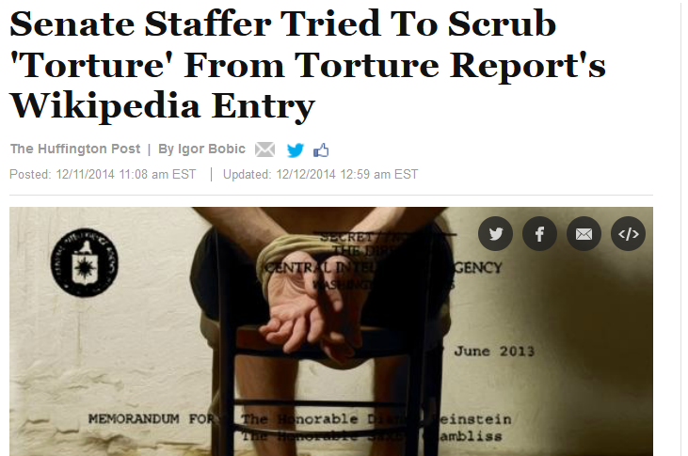
Leaking your IP address

Slide 22

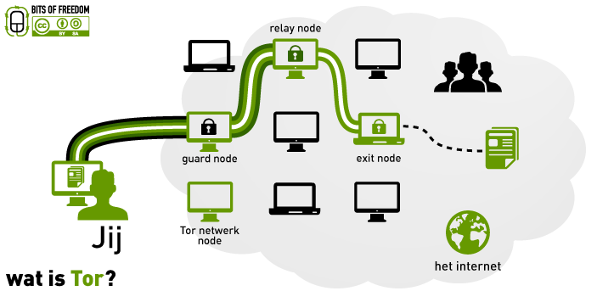
Countermeasure: Tor
Tor works with layered encryption, which traffic relayed via multiple nodes, with each node `peeling off’ one layer of encryption

Slide 23
Tor
Tor (The Onion Router) networks aims to provide anonymity on the internet:
No single node knows both source & destination IP address
Started by US Naval Research Laboratory, and still partly US funded
Has both legitimate and illegitimate use
  eg used by Edward Snowden to leak information
Not immune to all attacks

Slide 24
cookies & 3rd party cookies
Most websites will include 3rd party content from eg
social networks
advertising networks
web analytic services (eg google-analytics)
...
Of course, borders between categories above are vague/non-existent.
Very little 3rd party content is actually useful to users,
apart from google-maps?
Using cookies, these 3rd party websites can track users across web
Browser plugins such as Lightbeam or Ghostery provide insight in the large numbers of 3rd parties that are following your browsing!

Slide 25


Example 3rd party content: Facebook Like button
Facebook tracks members across sites that have Like or Share buttons
  because the Facebook cookie that identifies user is included with all requests to facebook.com
  Note: this happens before the user clicks the Like button.
Facebook even tracked non-members
  the Connect button installed a cookie, with a life time of 2 years
    when button is shown, not only after it is clicked
    the Like button did not install cookie; for both Facebook receive any cookies already set
  if non-member joins facebook later, histories can be linked
  similary, if a facebook member surfs anonymously (for Facebook), because he’s not logged in, his browsing can be linked as soon as he does log in

Slide 26
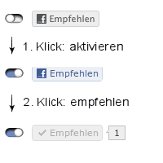
Example 3rd party content: Facebook Like button
Initiative for a privacy-friendly two-click Like button: 1st click downloads real like button; 2nd click clicked it
Facebook claimed this violated their copyright to Facebook logos

Slide 27
Why: behavioural advertising & profiling
Data can be used for
targetted aka behavioural advertising
targetted pricing
  eg online shop asking higher prices from rich people
  or slowly in/decreasing price to see how customers react
targetted offering of products and services
  eg online shops not offering insurance to people in certain profiles ...
What profiles are being used to categorise people?

Slide 28
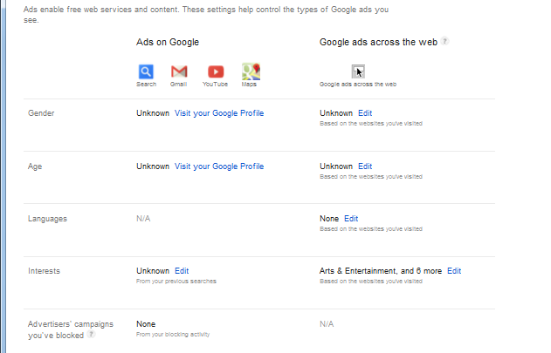
Google Ads settings

Slide 29
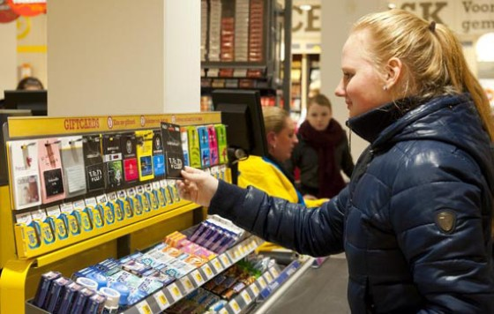
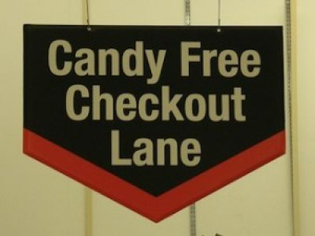

Slide 30
3rd parties & their cookies: countermeasures
Deleting cookies regularly
Using private browsing modes
Blocking (all) 3rd party cookies
  or some plugin for finer-grained cookie control
Block (some) 3rd party content
  eg by an AdBlocker
Browser plugins to reduce tracking, such as Ghostery
Some browser support for controlling tracking and opt-out initiatives like http://donottrack.us/

Slide 31
  if you are not paying for it,
  then you are the product being sold
  All ‘free’ services (gmail, facebook, twitter, WhatsApp..) are paid with ads and collecting personal information for marketing

Slide 32
Flash cookies
aka LSO (Locally Shared Objects) or supercookies
information stored & used by Adobe Flash Player
Characteristics
  stored in hidden folder on the OS file system
  no expiry date
  up to 100 Kbyte
  work across multiple browsers
In 2009, 50% of common websites used Flash cookies
Flash cookies have been used to restore deleted HTTP cookies, so-called zombie cookies
Flash cookies can be controlled in Adobe Website Storage Settings Panel
https://www.adobe.com/support/documentation/en/flashplayer/help/settings_manager07.html
but nowadays also from most browsers

Slide 33
Web beacons
aka web bugs aka tracking bugs aka pixel tags
aka JavaScript tags if they use JavaScript
invisible 1x1 pixel image included in document (eg web page or
email) via a link to remote server
  image will be downloaded from server when document is read
used in emails
  to see when an email is being read, from which IP address, ...
  used by spammers to see if spam is read, meaning that email address is real and email gets past the spam filter
used in web pages
  to gather web statistics
  if 3rd party cookies are blocked, then web beacons cannot directly be used to track visitors across website

Slide 34
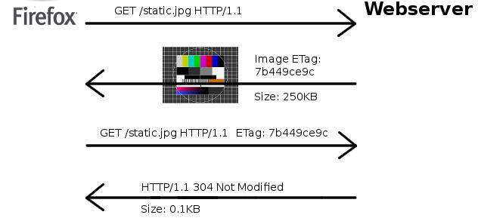
Cookieless cookies using ETags
ETags are identifiers added to resources to enable caching
When browser ask for a resource, it can say which version of that
resource it already has in its cache, by giving the ETag
This allows a server to identify the browser...
  See http://lucb1e.com/rp/cookielesscookies/

Slide 35
Cookieless tracing via URLs
Of course, the simplest form to trace someone a cross websites is by including a unique ID paramters in the URL
Eg
http://www.google.com.br/settings/ads?hl=pt‒BR&sig=ACi0TCjkFq1TS2cz_RFuc_KqcHfC7mp_iJR_uRA_G6UvcHcoFt4d6IEFTU4xuggdkY4DlBz7pr0ToFe8S9vYXrVKVeFVnrdzrYcb84KJZpi0Ffsl2ppZWGGthblqoxeLnab5YDaUHC0rxMzVXp8nxvHnlL0YGjBIY8iKzRIUsPT8iBF4uEzVI_YmichoYgV3vBEXza3

Slide 36
Browser fingerprinting
Browsers are complex pieces of software that have with many characteristics
  versions, language, OS, screen size, fonts, plugins,...
These characteristics leak lots of information, and may even uniquely identify a browser.
Eg see https://panopticlick.eff.org/

Slide 37
spying on browsing history
A largely historic attack, as modern browsers have good mechanisms to prevent this, but nice illustration of unexpected power of complex content
Using executable content in a webpage, the page can reveal the browser history
  ie which sites have been visited
This was possible using JavaScript, or just CSS
This could be used for good purposes (eg checking which social network someone is active on, and then presenting right links for that visitor), but it can also be a privacy threat.

Slide 38
spying on browser history: HTML vs CSS
CSS (Cascading Style Sheets) are used to improve HTML by separating presentation & layout from the content
  HTML specifies the content of a web page
  CSS specifies style, ie how that content is displayed

Slide 39
Example CSS
To underline links, and give visited links a different colour from unvisited links:
:link, :visited { /* for all links */
text-decoration: underline;
}
:link { /* for unvisited links */
color: blue;
}
:visited {/* for visited links */
color: purple;
}
Using JavaSacript and the DOM we can now see if a link is visited.
How? JavaScript code can check the color of links!

Slide 40
Example: JavaScript to spy browser history
var links = document.links;
for (var i = 0; i < links.length; ++i) {
var link = links[i];
/* exact strings to match actually need to be
auto-detected using reference elements */
if (getComputedStyle(link, "").color == "rgb(0,0,128)") {
// we know link.href has not been visited
} else {
// we know link.href has been visited
}
}
Modern browsers no longer allow this sort.

Slide 41
privacy threats in the physical world

Slide 42
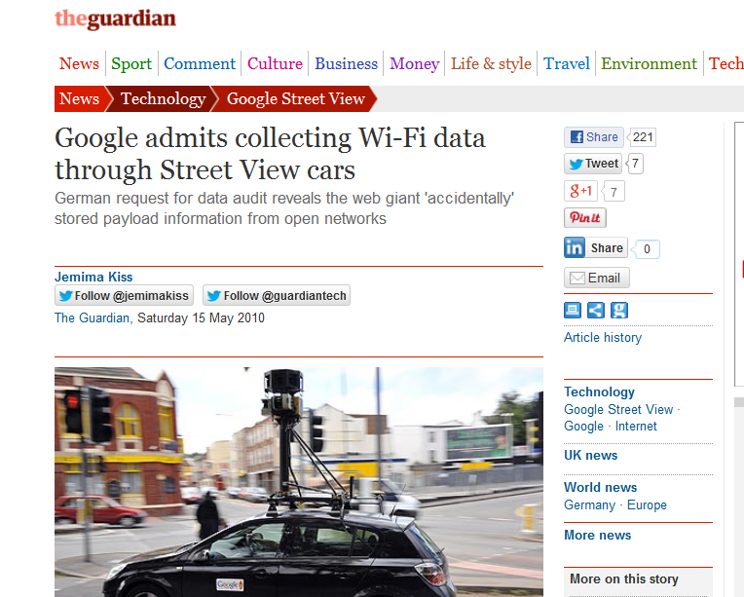

Slide 43
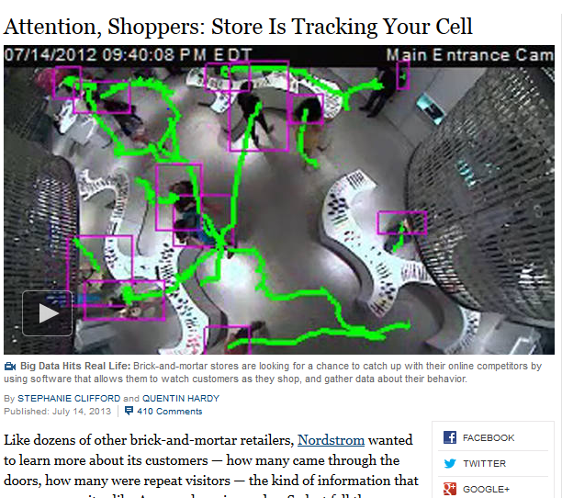
wifi tracking

Slide 44
Legal context

Slide 45
Legal context (1): Data Protection law
Dutch/EU Data protection laws governs the collection
and use of personal data by data controllers.
Three basic ingredients:
citizen should consent to personal information be collected & used
citizen should be informed
  that data is collected, and what data is being collected
  for what purpose
  if it is shared with third parties
citizen has right to see which personal data is collected about them, and the right to have this corrected in case of errors
CBP (College Bescherming Persoonsgegevens) supervises compliance with law

Slide 46
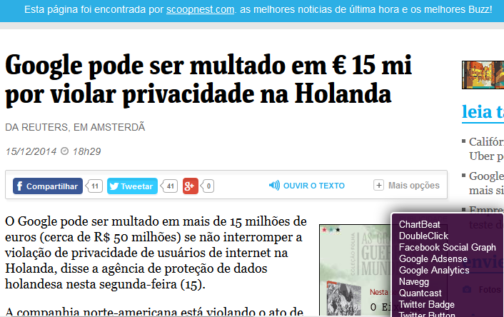

Slide 47
Legal context (2): Data Retention law
Dutch data retention act (Wet bewaarplicht telecommunicatiegegevens)
governs the collection of telecom and internet data by telco’s and ISPs.
Motivation: law enforcement and anti-terrorism
What information is kept?
For telephone: who is phoning or SMS-ing who, where, when, for how long
Not the content of call or text message.
For email: who is emailing who, when
Not the content of emails
For internet: time of logging on/off and IP address of client
Not the IP addresses visited or IP traffic
Note: email sent via gmail and text messages via WhatsApp not recorded
How long?
12 months, but reduced to 6 months for email & internet
Additionally, public transport card data is kept for 2 years (original plan: 7 years )

Slide 48
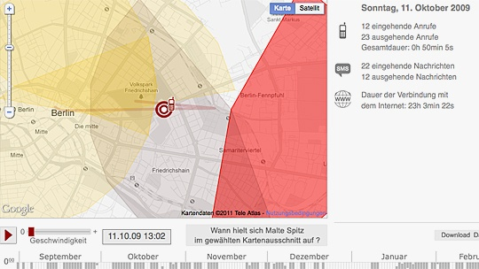
Data protection in action
Malte Spitz obtained all the data T-mobile had on him, after long legal battle See http://www.zeit.de/datenschutz/malte-spitz-vorratsdaten

Slide 49
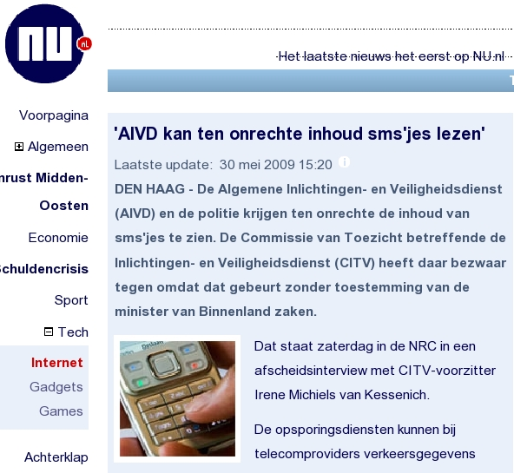
Data retention in action. Oops...
Some telcos
gave the Dutch
authorities also
the content of
all SMSs
- by accident

Slide 50
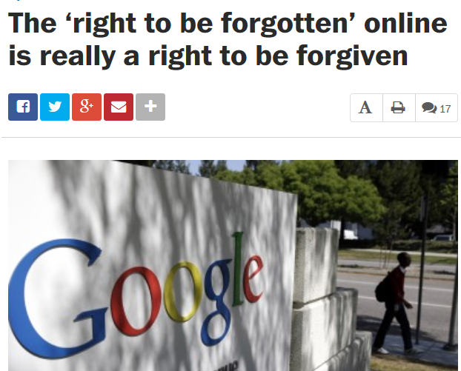
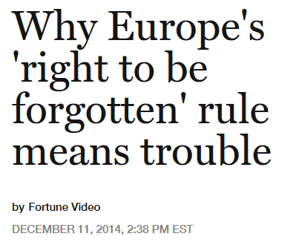
Right to be forgotten?

Slide 51
General observations on privacy & anonymity

Slide 52
Privacy threats
On the web & internet
IP addresses, cookies, esp. 3rd party cookies, Flash cookies, Web beacons, Etags, …
In physical world
mobile phone tracking in shops, transport cards, electronic payments, ..
Growing issue in general, with ever more Big Data
lots of data, and lots of computing power to use it
Future issues:
Google glasses
growing power of social networks
online image search using upload picture of someone face,
...

Slide 53
Privacy & Function creep
Privacy is an obvious first casualty in function creep.
Once people have data, they will use it!
Examples:
Dutch car navigation system TomTom sold customer data to police for optimal placement of speed cameras...
  So even if you do pay, you may still be one of the products …

Slide 54
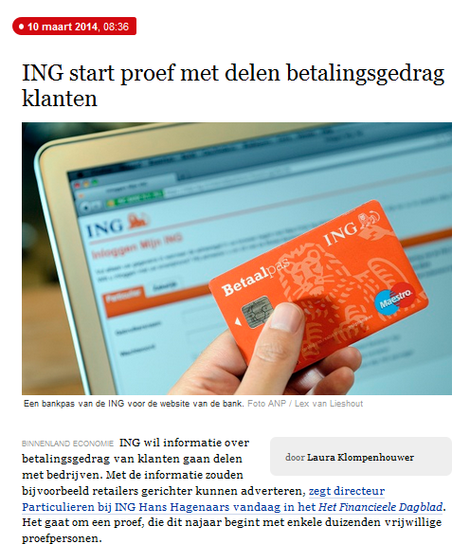

Slide 55
Anonymisation is hard!
It may be harder to anonymise data then you think!
Classic example:
In 2006, AOL released 2 Gbyte of anonymised search data for research purposes
  twenty million search queries for over 650,000 users over a 3-month period
Research then quickly could identify some users, because the search queries contained personally identifying information.
It also revealed some amusing, sad, and highly disturbing search histories of individuals.

Slide 56
Oops, meta-data…
The file on Iraq of UK government, produced by UK intelligence services
prior to the 2nd Gulf War, was distributed as .doc file.
Meta-data in this document included
Rev. #1: "cic22" edited file "C:\DOCUME~1\phamill\Temp\AutoRecovery save of Iraq - security.asd" ..
..
Rev. #6: "ablackshaw" edited file "C:\ABlackshaw\Iraq - security.doc" ..
Rev. #10: "MKhan" edited file "C:\WINNT\Profiles\mkhan\Desktop\Iraq.doc" ..
leaking some of the political people, not experts, who edited it
Paul Hamill - Foreign Office official
Alison Blackshaw - personal assistant of the Prime Minister's press secretary
Murtaza Khan - junior press officer for the Prime Minister

Slide 57
Questions for the future
Battle of and in the browsers:
  What will be the default policies & configurations of web-browsers and apps?
  eg wrt. 3rd party cookies
What parties are controlling this, and what are their motives & business models?
  The evolution of Google Chrome is steered by different (market) incentives than Mozilla Firefox
Will web-sites have unique identifiers, even if you block or frequently delete cookies?
  eg IP address
  note that web sites are keen to collect unique identifiers, eg phone number (in WhatsApp, or for Google account recovery) or credit card number

Slide 58
Risks

Slide 59
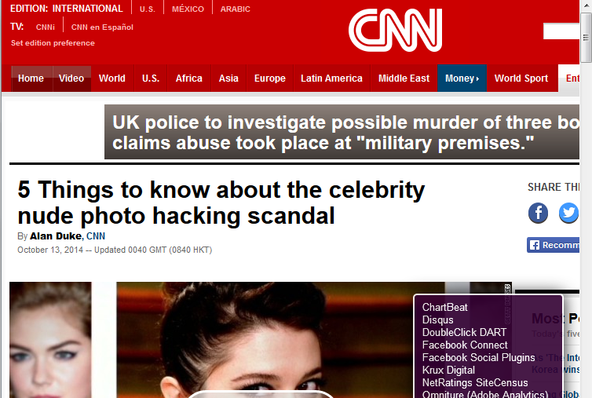
sd

Slide 60
Privacy risks? profiling
Some people will claim they have nothing to hide.
They may even claim that they like targetted advertising.
But the risks of profiling go further:
you may pay a higher price than someone else
because your profile shows that you are richer
you may not be offered the same product as someone else
eg no insurance because your profile indicates higher risks
you may not get the same information as someone else,
eg your online newspaper will filter contents you don’t like to read
so getting objective information gets harder

Slide 61
Privacy risks?
Apart from the fundamental loss of privacy & profiling
other risks include
stolen personal information used for other attacks , eg
  attacks on your friends, colleagues
  blackmailing, eg of children for webcam sex
  ...
especially useful for social engineering attacks.
identity theft
  reported to be the fasted growing form of crime

Slide 62

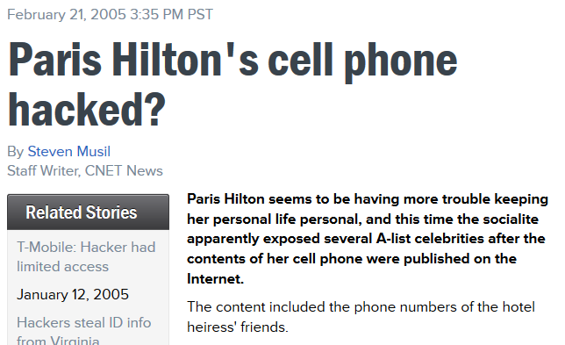
Privacy risk: more hacking

Slide 63
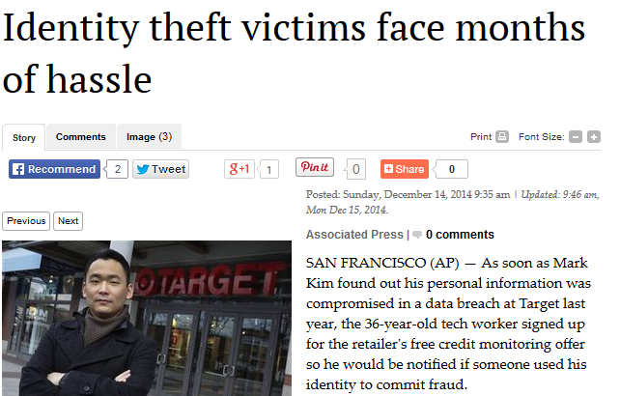
Privacy risk: identity theft

Slide 64
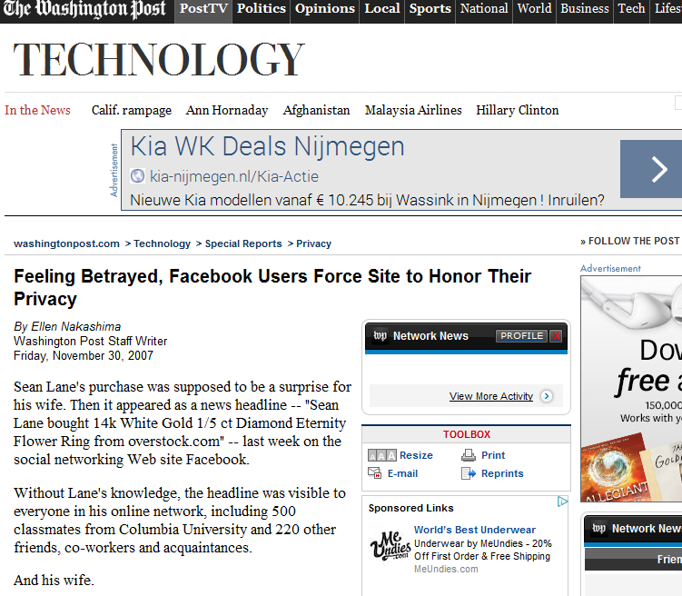
Facebook’s Beacon ruining Christmas

Slide 65
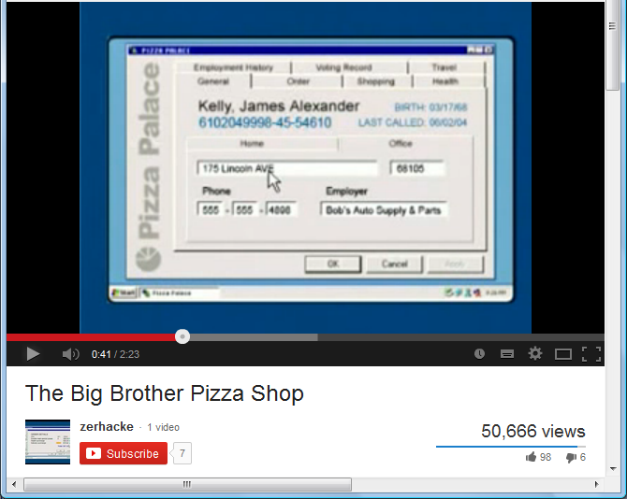
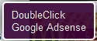
Big Brother Pizza Shop

Slide 66
Browser plugins to try out!
lightbeam Firefox
ghostery Firefox, Chrome, Safari, Opera en IE
DNTM (DoNotTrackMe) Chrome, Firefox, IE en Safari

Slide 67
Trust
In Ken Thompson’s Turing award acceptance speech
he revealed a backdoor in UNIX and Trojan in C-compiler.
backdoor in login.c:
if (name == "ken") {don't check password;
log in as root}
code in C compiler to add backdoor
when recompiling login.c
code in C compiler to add code (2 & 3!)
when (re)compiling a compiler
Moral of the story: you are trusting more than you expect!

