Slide 1
Web Security
Encoding, validating & sanitizing
Sessions & Authentication
G&#252;ne&scedil; Acar & Erik Poll
Digital Security group
Radboud University Nijmegen
websec
1

Slide 2
Web Security
Encoding, validating & sanitizing
Sessions & Authentication
Güneş Acar & Erik Poll
Digital Security group
Radboud University Nijmegen
websec
2

Slide 3
Last week & today
Last week
Web clients & servers interact using HTTP.
The HTTP traffic contains URLs (for ‘addressing’) and HTML (for the ‘content’) which can contain JavaScript as code to be executed client-side
HTTP requests are usually GET or POST requests
  GET: parameters in URL
  POST: parameters in HTTP body
Today
The languages & encodings of data in HTTP traffic
Two notions of sessions for security:
  TLS / HTTPS at network level
  cookies at application level

Slide 4
Exercises for this week
Check input sanitisation in Brightspace
    How is input encoded & sanitised in Discussion Forums, at the client side and/or at the server side?
Check security settings for some sites where you have a login, incl. whether it support HTTP(S), HSTS and Certificate Transparency( CT) and which cookies flags it uses.
One more WebGoat lesson
  Authentication Flaws - Authentication Bypasses
A & B to be handed in (in pairs) via Brightspace
Deadline Monday Sept 15, 23:59

Slide 5
Languages & encodings
(continued from last week)

Slide 6
Web pages contain HTML, CSS, JavaScript and URLs
<html><title>The various languages and formats used inside web pages</title>
<body>
<h1 style="color:blue;">Sample exam question<h1> is 3 &lt; 4?
<a href="https://duckduckgo.com/?q=how+to+encode+<+in+HTML%3F">A link with special characters</a>
<a href="https://duckduckgo.com/?q=how+to+encode+%2F+in+a+URL%3F">And another one</a>
<script> var x = 'a string with a single quote \' and double quote ".';
alert(x);
</script>
</body>
</html>
Special characters may need to be encoded aka escaped to prevent unintended effects or preserve intended effect
Which characters have to encoded, and how, depends on the context.
  Eg < is a special character in HTML, but not in a URL
Within a single language there can be several contexts. Eg
  / is a special character in URLs, but not in the query string (i.e. after the ?)
  For a JavaScript strings inside JavaScript the outer quotes ( ' or " ) determine which quotes inside the string need to be escaped.
websec
6

Slide 7
URL encoding aka %-encoding
Replaces reserved characters that have a special meaning in URLs
/?!*';:@&=+$,#()[]
with their ASCII value in hex preceded with escape character %
Try this out with eg https://duckduckgo.com/?q=%3F
Encoding space as + comes from older x-www-form-urlencoded format
Possible sources of confusion (and bugs or security issues?)
The reserved characters are different for different parts of the URL.
Eg / in the path of a URL must be encoded, in the query it need not be
What happens if you URL-encode unreserved characters? eg A -> %41
What happens if you double URL-encode? eg % -> %25 -> %2525
/ | # | space | = | ? | % | …
%27 | %23 | %20 or + | %3D | %3F | %25 | …
websec
7

Slide 8
HTML encoding
Replaces HTML special characters with similar looking ones
HTML encoding and URL encoding are needed in different contexts
  Things can get confusing: what about URLs inside HTML or vv?
HTML also has the notion of character encoding: which character set is used, eg ASCI or UTF-8 (default)
Browser engines can be sloppy or forgiving, and let you get away with not encoding e.g. & as &amp; in webpages
  http://validator.w3.org checks if a page is correct HTML
On top of HTML-encoding, websites may apply additional input sanitisation to remove or replace tags it wants to disallow in user input;
  eg <script> tags are commonly stripped from user input
< | > | & | “
&lt; | &gt; | &amp; | &quot;
websec
8

Slide 9
base64 encoding
HTTP is text-based, so all data transmitted has to be text
– ie. printable, displayable characters
Base64 encoding turns ‘raw’ binary data - bytes - into text
so that it can be transferred via HTTP
6 bits coded up as one of the 64 standard characters
a-z A-Z 0-9 + /
Groups of 3 bytes (ie 24 bits) represented as 4 characters
Padding with = or == to make sure results is multiple of 4 characters long
websec
9

Slide 10
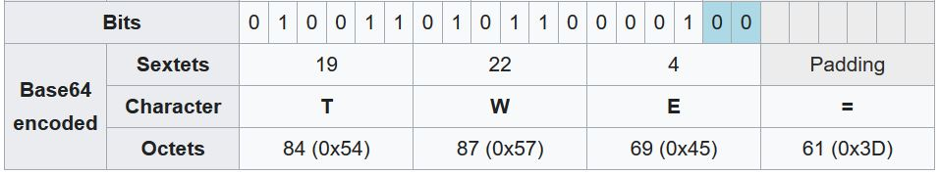
base64 encoding
groups of 6 bits coded up as one of the standard characters
a-z A-Z 0-9 + /
So 3 bytes represented as 4 characters
Padding with zeroes to make the input a multiple of 6 bits
Padding with = or == to make sure results is multiple of 4 characters long
Details not that important for this course, but you may come across base64-encoded data
websec
10

Slide 11
Encoding user content for security
User-supplied content in webpages may need to be encoded or sanitised to prevent malicious content from triggering unwanted effects.
<html><title>Mallory’s Radboud Student Homepage</title>
<body>
<h1 color ="color:red;">Welcome to Mallory’s homepage</h1>
Some text that Mallory provided.
<a href="https://ru.nl/Mallory">My contact information</a>
<img=https://bla.com/common/view/my_profile_image.jpg</img>
<a href="https://brightspace.ru.nl/d2l/home/427025">My favourite course</a>
<a href="https://ru.osiris-student.nl/grades.html?uid=s123456">My grades</a>
<script> someJavaScriptFunction(someOtherString+'Mallory’); </script>
</body>
</html>
websec
11

Slide 12
Beware of confusion
encoding
changing the representation of data
no information is lost or changed
eg HTML or URL encoding
sanitisation and validation
removing or changing ‘problematic’ data
some information is lost; possibly an entire request is rejected as invalid
eg removing <script> tags or rejecting incorrect date 31/2/2024
Encoding can also be called escaping or quoting, and
validation is sometimes called filtering
Common distinction: validation rejects entire inputs, whereas sanitisation changes them or removes problematic parts of inputs
Beware: some people use alle these terms interchangeably

Slide 13
Exercise to hand in this week
Figure out how Brightspace encodes and/or sanitises user input in Discussion Forums
  client-side in the browser and/or server-side
  for header and body of forum posts
  NB try to describe this as concise as possible, eg in terms of URL or HTML encoding.

Slide 14
Web Security
Authentication &
Session Management

Slide 15
Security shortcomings of internet
“No security built into the internet”
But what does that mean?
No way of knowing who you are communicating with, apart from an IP address
  ie no authentication
Any party along the way (wifi router, ISP, ...) can read or modify the communication
  ie no integrity & confidentiality of communication

Slide 16
Adding security: two security
Two security requirements we want to add
Authentication
      of the web site by user
      of the user by the web site
  How?
  For a) TLS certificates aka X509 certificates
  For b) username/password or more secure solutions, eg MFA (Multi-factor Authentication)
Integrity & confidentiality of communication
  How?
    TLS, which adds encryption and integrity protection with
      MACs (Message Authentication Codes)
      digital signatures

Slide 17
Today: two notions of sessions
HTTPS at the network layer
  by TLS, on top of TCP or inside QUIC
  includes authentication of the server
Session management at the application layer
  by web application using sessions IDs and/or cookies
  includes authentication of the user
server
HTTP
HTTPS
DNS
TCP
UDP
IP
...

Slide 18
HTTPS

Slide 19




Attacker models for the internet & the web
Passive eavesdropper
Active Man-in-the-Middle (MitM) attacker
  Eg a malicious or compromised ISP, router, or WiFi access point
  WiFi security (eg WPA2) should prevent attackers eavesdropping on Wifi traffic
Malicious or vulnerable end points (browser or server)
  A malicious server (eg fakebank.com) can act as MitM by relaying traffic to real website bank.com
bank.com

Slide 20

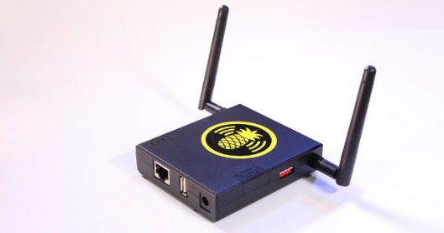

(partial) security solution: TLS
HTTPS
bank.com

Slide 21

TLS
Server sends X509 server certificate to client
  Signed by a Certificate Authority (CA) or self-signed
  Browsers come pre-configured with list of trusted CAs a
  server’s public key PK list of trusted CAs
Client checks that certificate has not been revoked
  by requesting Certificate Revocation List (CRL) from CA
Client authenticates the server, with a challenge-response protocol
Client and server then agree a session key
Subsequent HTTP traffic in a secure tunnel
Does a self-signed certificate provide any security guarantee?
  Yes, because at least clients knows they keep talking to the same server

Slide 22
TLS – crypto details; not important for this course
Server sends X509 server certificate to client
    includes server’s public key PK
Client checks that certificate has not been revoked
Client authenticates the server, with a challenge-response protocol
    Client sends nonce n encrypted with public key PK, and checks if server response includes n which proves knowledge of corresponding private key
Client and server then agree a session key
  Typically an AES key
Subsequent HTTP traffic in a secure tunnel
  Traffic encrypted and MACed with session key
    encryption for confidentiality, MACing for integrity
  Periodically the session key is refreshed

Slide 23
HTTPS: HTTP over TLS
HTTP
TLS
Security guarantees :
Confidentiality & integrity of the session
  Attacker on the network can still see that two IP addresses communicate (an example of meta-data), but not what
    All HTTP content, incl. headers & URL parameters are protected inside TLS tunnel
  Attacker cannot change any traffic or replay it
Server authentication, using certificates
Possibly, but uncommon: Client authentication with a client certificate
  Usually servers use another means to authenticate clients: often passwords ☹
The same holds if TLS is used as part of QUIC
HTTP
QUIC
TLS

Slide 24
Aside: name confusion TLS vs SSL
TLS (Transport Layer Security) used to be called SSL (Secure Sockets Layer)
  TLS version 1.0 is SSL version 3.1
  Latest TLS version is 1.3
This explains why X509 certificates are sometimes called SSL certificates and a well-known TLS implementation is called OpenSSL
We’ll come back to TLS later in this lecture to discuss its limitations.

Slide 25
Mixing http & https
A web page can mix http & https content, but this is a bad idea!
Why would you never want to have an frame loaded via http inside a webpage loaded via https?
Web browsers nowadays warn about or block mixed http/https content.
Demo: check out how this works in your browser, by visiting
  http://www.cs.ru.nl/~erikpoll/websec/demo/mixed_content.html
  https://www.cs.ru.nl/~erikpoll/websec/demo/mixed_content.html
This demo no longer still works in Firefox, but it does in Chrome

Slide 26
Sessions
(at application level)

Slide 27
Functional shortcoming of HTTP
HTTP is stateless and has no notion of session, ie
No state is recorded about history of previous requests
(Hence) no notion of a sequence of requests belonging together in one conversation between client and server
This is very clumsy for interaction between a client and server
Has this user logged in?
Did the user select English or Dutch as language for the site?
Has the user put items in their online shopping basket?
Did the user already agree to our privacy policy?

Slide 28
Why can’t we use IP address for this?
Different clients may share the same IP address
Eg different browsers & apps on the same device,
different users on lilo.science.ru.nl,
or different users on a local wifi network (esp for IPv4)
Multiple web applications can share the same IP address
  especially web applications hosted in the cloud
Clients and servers can change IP address
  eg. clients on mobile devices, when switching from mobile network to WiFi or v.v.
  also: web applications hosted in the cloud, if they are migrated to other server

Slide 29
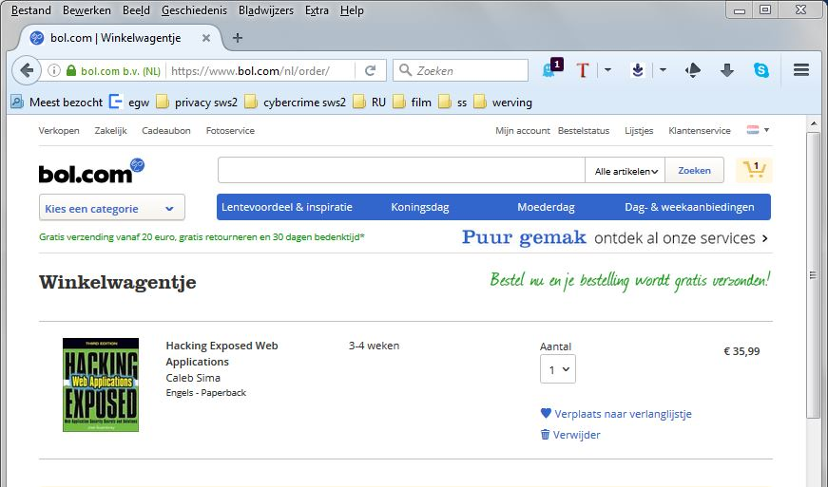
Session & session data
There is usually session data associated with a session that needs to be remembered.
Eg: content of online shopping basket
Ways to keep track of such data:
send it back & forth between server and browser with each request and response eg using hidden parameters
record it at the client side using HTML local storage
record it at the server side and just send back & forth a unique identifier
Pros & Cons ?
Con 3: server has to record lots of info for many sessions
Con of 1 & 2: client could mess with this data

Slide 30
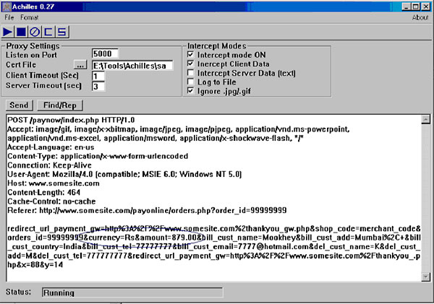
Things that can go wrong with session data
Classic security flaw: the price is recorded in a hidden form field, as shown in the proxy output above.
The client can change this...

Slide 31
Misplaced trust in the client
For data for which integrity is important (eg prices)
the server should never trust the client
to provide this data or to return this data unaltered
Instead, the server should
store such data server-side
or
add a cryptographic integrity check
  eg using a MAC (Message Authentication Code) or Digital Signature
  Such a check should also include a time stamp or some session id that frequently changes, to avoid replay or roll-back attacks.

Slide 32
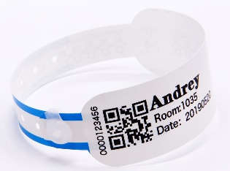


Session data for authentication
Authentication often involves a notion of session, and then goes in two steps
Actual authentication, say with a username/password plus the response of an MFA token
Creating a session, with session identifier aka session token
  for fast & easy (re)authentication without repeating step 1
Most web applications use session cookies for this purpose
Such cookies provide identity and proof that this identity has verified (aka authenticated)
These cookies are just as valuable for attacker as original credentials used to authenticate, eg username/password plus MFA response

Slide 33
Sessions managed by the web application
Typical steps
Web application creates & manages sessions
  Session data is stored at server and associated with a unique session ID
Client is informed of session ID
  and client attaches session ID to subsequent requests
so server knows about previous requests
Web application frameworks usually provide built-in support for session management, but web application developers can implement their own
NB it is better to use existing solutions than inventing your own
Still, don’t underestimate the complexity of using these correctly

Slide 34
Solution 1: session ID in URL
Web page returned by the server contains links with session ID as
extra parameter
<html>
Example web page with session IDs in the URL.
The user can now click
<a href=”http://demo.net/nextpage.php?sid=1234”>here</a>
or
<a href=”http://demo.net/anotherpage.php?sid=1234”>here</a>
passing on its session id back to the server
wherever he goes next.
</html>
Hence: every user gets their own unique copy of a web page.

Slide 35
Solution 2: session ID in hidden parameter
<htm>
The form below uses a hidden field
<form method="POST" action= "http://ru.nl/register.php">
Email: <input type="text" name=“Your email address">
<input type="hidden" name="sid" value=“s1234">
<input type="submit" value="Click here to submit">
</form>
Hidden means hidden from the user by browser, not hidden from a proxy like ZAP.
A hidden form field could also be used to track user preferences, eg
<input type="hidden" name="Language" value="Dutch">

Slide 36
Session ID in URL vs hidden parameter
Can you think of a downside of a session ID in the URL?
  If you give a link with your session ID to someone else, then that person might continue with your session!
  Also, bookmarking a URL incl. the session ID does not (or should not) make sense, as the next time you use the bookmark you should start a different session

Slide 37
Solution 3: sessionID in a cookie
Standard solution built into HTTP and browser
Cookie is piece of information that is set by the server and stored by the browser
  namely when HTTP response includes Set-Cookie field in header
  It belongs to some domain, eg www.test.com
  It includes expiry date, domain name, optional path, optional flags
    eg secure , HTTPOnly , and SameSite flags
Cookie is automatically included in any HTTP request by the browser, for any request to that domain
  in the Cookie field of HTTP request
Cookie can include any type of information
  sensitive information, such as session ID
  less sensitive information, such as language preferences

Slide 38
Example cookie traffic
Setting a cookie set with an HTTP response
  HTTP/1.0 200 OK
  Content-type text/html
  Set-Cookie: language=Dutch
  Set-Cookie: sessionID=123; Expires=Tue, 26 Apr 2021 11:30:00 GMT ...
Sending a cookie in an HTTP request
  GET someurl.html HTTP/1.0 200 OK
  Host: example.com
  Cookie: language=Dutch, sessionID=123

Slide 39
Different types of cookies
non-persistent cookies
  only stored while current browser session lasts
persistent cookies
  preserved between browser sessions
  useful for maintaining login and user preferences across sessions
  bad for privacy

Slide 40
Domains, subdomain, and top level domains
The domain in a cookie can be a subdomain of a website (eg cs.ru.nl is a subdomain of ru.nl) which raises questions, such as
  Are cookies for cs.ru.nl sent with requests to ru.nl? Or v.v.?
  Can ru.nl set a cookie for cs.ru.nl ?
Complex rules restrict cookie access across (sub)domains [RFC 6265]
Overall rationale: subdomains need not trust their superdomain
Subdomains can access cookie for domain, but not vice versa
Subdomains can set cookie for direct superdomain, but not vv
With the HostOnly flag, cookies can further restrict access
  For details, check [RFC6265] and hope browsers do not still implement outdated parts of [RFC 2109] or [RFC 2965].
For top level domains, eg .nl, there are additional rules,
to prevent say ru.nl from setting a cookie for .nl
But does this work as intended for countries using 3 level domain names? Eg for somecompany.co.uk, where co.uk is not a top level domain

Slide 41
Different ways to provide session ID
Encoding it in the URL
  Downsides: 1) stored in logs (eg browser history), 2) can be
  cached & bookmarked, 3) visible in the browser location bar.
Hidden form field
  Better: won’t appear in URLs, so cannot be bookmarked, and less likely to be logged
Cookies
Best choice: automatically handled by browser; easier & more flexible.
But such automation has downsides, as we’ll see: CSRF

Slide 42
Now: attacking this!

Slide 43
Session attacks
Aim of attacker: get the session ID
  This can be session cookie, or other form of session ID
  If the victim is logged in, this is just as good as stealing his username and password!
How would you do this?

Slide 44
Eavesdropping & MiTM attack
If traffic is not protected with TLS
(or Wifi protection on lower network layers)
then someone sniffing the network traffic can obtain session IDs.
Attacker can also set up a (fake) network access point to do this
and then even do active Man-in-the-Middle attack.
There are some variants to by-pass TLS protection, as we will see later.

Slide 45
Session ID prediction attack
Suppose you can check your grades in blackboard on page
brightspace.ru.nl/grades.php?s=s776823
Is this a security problem?
If s776823 is your student number and also the session id (in the URL in this case) then it is!
Attacker could try other student IDs or – better still – the university employee number of a teacher.

Slide 46
Session ID prediction attack
Suppose you can check your grades in blackboard on page
brightspace.ru.nl/grades.php?s=s776823
Is this a security problem?
If s776823 is your student number and also the session id (in the URL in this case) then it is!
Attacker could try other student IDs or – better still – the university employee number of a teacher.

Slide 47
Session fixation attack (aka Login CSRF)
If the sessionID is in the URL, an attacker can
start a session with bank.com and obtain a session ID;
craft a link with that session ID and gets victims to click it, by
  emailing victims with that link in the email; or
  luring victims to a webpage with that link
The victim now goes to the website using a known session ID;
If victim logs in, and session ID is not changed, then attacker can join the session & abuse the user’s rights!
Therefore: web server should change session ID on login actions
If the session-ID is a hidden form field, it does not end up in URL, attacker cannot email a link, but option 2b) is still possible, with a POST request
Variant: attacker has already logged in, so victim joins the attacker’s session and may enter confidential data (eg credit card number) for attacker’s account

Slide 48
Making these attacks on sessions harder
Use long enough, random session IDs – ie with enough entropy
  prevents session prediction and brute forcing
Change session ID after any change in privilege level
  eg after logging in
  prevents session fixations
Expire sessions
eg by setting expiration time on cookies
  reduces the attack surface in time
Use HTTPS
for all requests & responses that include session ID, not just the login
  prevents networking sniffing of session ID
Let clients re-authenticate before important actions
  reduces the value of any stolen session ID

Slide 49

CSRF: the downside of browser automatically adding cookies
https://bank.nl
interaction that sets cookie
<a href=“https://bank.nl/pay?...”>pay</a>
bank.nl
server
pay request
https://mafia.com
<a href=“https://bank.nl/pay?...”>pay</a>
pay request
Browser attaches cookie to cross-domain requests from any site

Slide 50
Abusing cookies without stealing them (CSRF)
Suppose for a bank transfer a website bank.com contains the URL
<a href=”transferMoney?amount=1000
&toAccount=52.12.57.762”>
Suppose attacker sets up a malicious website mafia.com with
<a href=”https://bank.com/transferMoney?amount=1000
&toAccount=52.12.57.762”>
If attacker tricks users to click on second link while they are logged on at bank.com, the browser automatically attaches the bank’s cookies to both requests! And money will be transferred...
This is called a Cross-Site Request Forgery (CSRF)
Root cause of the problem: browser automatically attaches cookies to all requests, regardless of which page the link is on.

Slide 51
CSRF
CSRF is only possible if we use cookies for sessions, not if we have session ID in URLs or in hidden forms fields
CSRF is an example of feature interaction, namely of the features that:
any web page can link to another other web page
browser automatically attaches the cookies of A.com to any requests to A.com
The combinations of these features can be abused
  by attackers creating a webpage or HTML email with links to bank.com, where the browser will automatically attach the bank’s cookies with the correct value to authenticate these requests (assuming victim is logged on)

Slide 52
Countermeasure: (anti)CSRF token
https://bank.nl
interaction that sets cookie
<a href=“https://bank.nl/
pay?token=32451...”>pay</a>
page.html with fresh token
bank.nl
server
pay request
plus fresh token
https://mafia.com
<a href=“https://bank.nl/pay?...”>pay</a>
pay request

Slide 53
Standard solution to prevent CSRF
Use two special numbers to identify a session
a fixed session ID stored in a cookie
a changing anti-CSRF token, as URL parameter or hidden form field, that changes to a new random value for each request
For any malicious cross-site requests, say from mafia.com to bank.com, the browser will attach the right session ID cookie, but these requests will not have the right CSRF token.
Confusingly, anti-CSRF tokens sometimes called CSRF tokens or anti-XSRF token

Slide 54
Other countermeasures against CSRF
Check Refer(r)er or Origin headers
    Browser includes these in HTTP requests to indicate where a request is made from (eg mafia.com or bank.com), so bank.com can check which webpage made the request
    Origin is just the domain, Referer the domain plus the path
  But these headers may be absent ☹ because
  Browsers can be configured not to include these headers, for privacy reasons
  Websites can specify a Referrer Policy to tell browser not to include them under certain conditions (eg when making HTTP request from HTTPS context, only for requestions within the same site, ...)
  https://developer.mozilla.org/en-US/docs/Web/HTTP/Headers/Origin
  https://developer.mozilla.org/en-US/docs/Web/HTTP/Headers/Referer
  https://developer.mozilla.org/en-US/docs/Web/HTTP/Headers/Referrer-Policy

Slide 55
tot hier

Slide 56
Other countermeasures against CSRF
Let client re-authenticate before important actions
  eg. when resetting their password, or making big bank transfer
Set SameSite flag of the cookie (since 2017)
  strict cookie never attached to cross-site requests
  lax cookie not attached to cross-site requests that load images or iframes, but is attached if user navigates away from say mafia.com to bank.com
  None cookie is attached to cross-site requests
  https://developer.mozilla.org/en-US/docs/Web/HTTP/Headers/Set-Cookie/SameSite
Let browser add Sec-Fetch-Site header to distinguish cross site requests (since 2019).

Slide 57
Sec-Fetch-Site
Browser includes Sec-Fetch-Site:<value> in HTTP requests
  where <value> is
  none if user types in URL or selects bookmark
  cross-site if user clicks link to bank.com on page from say mafia.com
  same-site or same-origin if user clicks link to bank.com on page from bank.com
    same-site if scheme (ie https vs http) and domain are the same; same-origin if port number is also the same
Note: similar to Referer or Origin, but without privacy drawbacks
Check if your browser support this on https://developer.mozilla.org/en-US/docs/Web/HTTP/Headers/Sec-Fetch-Site

Slide 58
Next week
More attacks & countermeasures, incl.
The secure cookie flag to prevent leaking cookies in HTTP traffic
SSL stripping as attack
HSTS & Certificate Transparency (CT) as additional countermeasure

Slide 59
tot hier

Slide 60

Cookie stealing by MitM without breaking TLS tunnel
Without breaking the HTTPS tunnel, a Man-in-the-Middle attacker may be able to steal cookies
HTTPS
bank.com

Slide 61
Stealing cookies without breaking the TLS tunnel
User logs on to https://bank.com
Server sets session ID for bank.com in cookie
  which is encrypted in HTTPS-traffic, so attacker cannot steal it
User does their banking ….
User asks for unencrypted HTTP link (eg http://nu.nl)
MitM attacker replies with a redirect to http://bank.com
Browser follows redirect and sends the bank’s cookie over HTTP
Bingo! Attacker has the cookie
Solution: cookie has be declared as secure, which disallows the browser to ever send it over HTTP
HTTPS
HTTP
bank.com

Slide 62
Recap: cookie flags
Note that the three cookie flags
  secure only ever sent cookie over HTTPS, never over HTTP
    Encrypting the cookie itself, when it is sent over HTTP, is pointless.
    Why?
  Attackers can simply replay a stolen encrypted cookie!
  SameSite not added to links from different sites
  HTTPonly inaccessible to scripts, discussed later
protect against different attacker models
  protects against eavesdropping and MitM
  protects against malicious sites that link to a benign site
  protects against client-side scripts injected into the ‘real’ website (discussed in later lecture)

Slide 63
Recap: session attacks
If the victim is logged in, stealing the session id (often kept in a session cookie) is just as good as stealing his username and password
Attacks:
Sniffing network traffic
  prevented by TLS
Session Prediction
  try to guess a session ID
Brute Force
  try many guesses for the session ID, until you get lucky
Session Fixation
  make the victim use a known session ID
CSRF
  let the browser automatically attack the session cookie
XSS (discussed later)

Slide 64
Other ways to steal session IDs
With CSRF the attacker tricks the browser to add the right session ID
  the attacker does not get to know the session ID value, and does not need to, as the browser adds it
Alternatively, the attacker could try to steal session IDs values (stored in cookies, passed in URLs parameters, or as hidden parameters) to take over the session, for instance using JavaScript...

Slide 65
2) Stealing cookies with scripts (XSS)
If the attacker can sneak a piece of JavaScript into the bank’s website, the script can inspect the cookies and send them anywhere on the internet, including to https://mafia.com
Such an attack, called Cross Site Scripting (XSS) attacks will be discussed in two weeks
Solution: cookie has be declared as HttpOnly
  This means the cookie is only used for sending along with HTTP requests & not accessible to scripts in the webpage
More structural solutions against users inserting scripts: validation and/or sanitisation of user input to remove dangerous letters (eg <) or keywords (eg script).

Slide 66
Attacking HTTPS

Slide 67



What are we trusting? And for what?
eg
CA
checking
revocation list
obtaining
certificate
Certificate
for domain bank.com
issued by CA
to bank.
Public key XYZ
bank.com

Slide 68
TCB
TCB = Trusted Computing Base
TCB of a security control or security guarantee is everything (people, software, computers, ...) that we have to trust for that control or guarantee
There will be different TCBs for different controls/guarantees

Slide 69
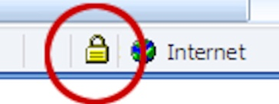
Trusted Computing Base (TCB) for HTTPS
The TCB for HTTPS is huge: it includes assuming
the TLS software is correct
the web-server protects its private key
the browser checks the certificate correctly, including the CRL
the Certificate Authorities (CAs)
  For Firefox, https://ccadb-public.secure.force.com/mozilla/IncludedCACertificateReport
the user checks for lock icon (and maybe the content of the certificate?)
there is no malware in our browser or on our machine that is faking the display
....

Slide 70
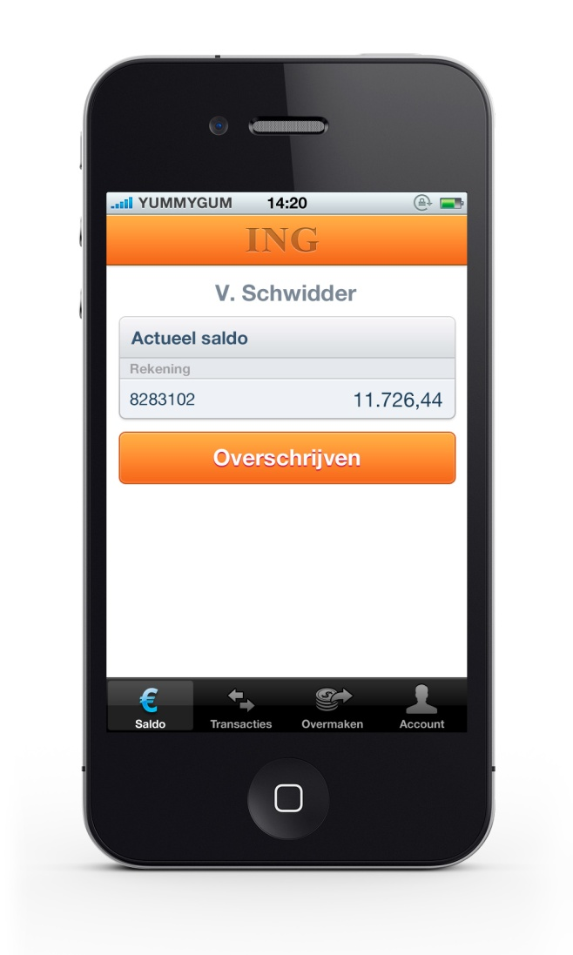
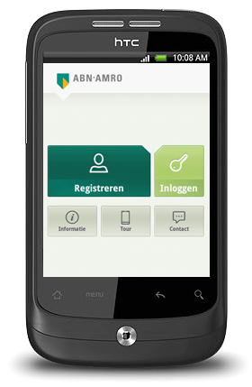
Things that go wrong ...
March 2012: ING banking app does not check TLS certificate
December 2012: ABN-AMRO app does not check TLS certificate
Questions to consider:
Is the built-in HTTPS support in a browser more likely to be correct than TLS support built into some app?
But is TLS really such an important countermeasure for an app, given that the app is hardcoded only to communicate with a fixed webserver?

Slide 71


Things that go wrong ...
Certificate Authority DigiNotar
was hacked in 2011.
Fake certificates for google.com
were issued, presumably for
use in Iran
DigiNotar provided all the
certificates for the NL government...
Problem detected because the Chrome browser checks for
suspicious certificates for google.com
Darknet Diaries has a great podcast episode on this:
https://darknetdiaries.com/episode/3/

Slide 72
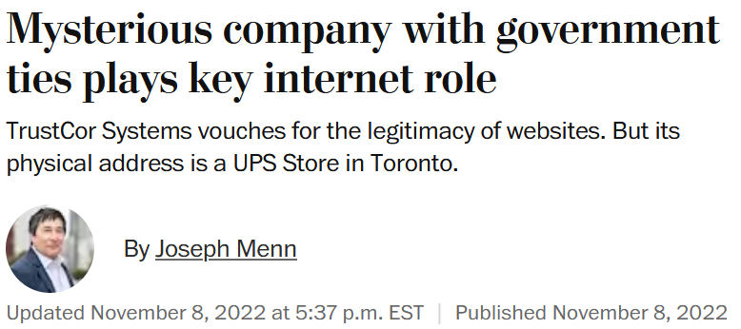
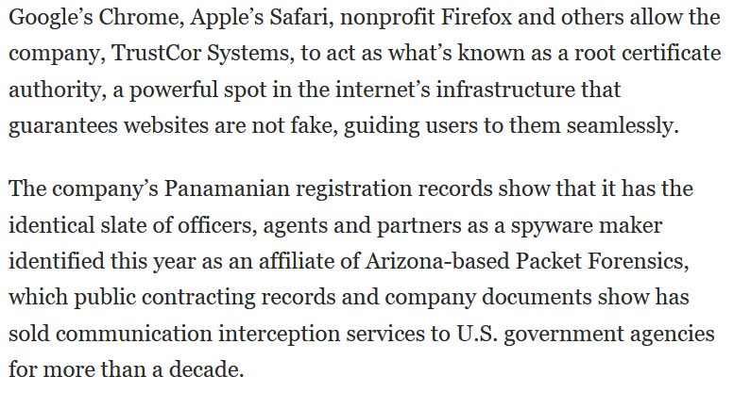
Things that go wrong
https://www.washingtonpost.com/technology/2022/11/08/trustcor-internet-addresses-government-connections/

Slide 73

Countermeasures
HPKP (HTTP Public Key Certificate Pinning)
  browser remembers the public key for a domain, and refuses new certificates for that domain with a different key
  Not a big success & abandoned in 2017, because of risks it introduces: if a wrong public key ends up in the browser, there is NO way to recover from this
Certificate Transparency (CT)
  Public log of on all certificates issued by all CAs
  See eg https://crt.sh
  Organisations can use this log to spot rogue certificates issued in their name. Eg someone at Radboud should periodically (daily?) for certificates for ru.nl that Radboud did not request
  Browsers can use this log to spot rogue certificates

Slide 74
Attacking HTTPS with Man-in-the-Middle attack
Attacker model, i.e capabilities of the attacker
  eavesdrop on traffic & modify traffic
Goals of the attacker can be
  seeing plaintext data
  modifying traffic without user noticing
  or just: seeing the cookie
Different attack scenarios for realising a MitM attack:
malicious wireless access point
fake website, which redirects the traffic to the real website
by the ISP, e.g. nation state intercepting all internet traffic

Slide 75
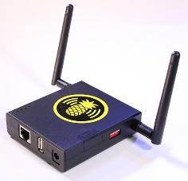
Simple SSL stripping : HTTP + HTTPS
The idea: the attacker forces the browser to fall back to HTTP and hopes the user won’t notice the missing s
When can the attacker do this? If the user
types in rabobank.nl, without https in front of it
begins a HTTPS session by clicking on a link in a webpage that was retrieved with HTTP
HTTP
HTTPS
bank.com

Slide 76
Normal start of HTTPS session via HTTP request
user website
user types in
rabobank.nl
request for
http://rabobank.nl
redirect (302) to
https://rabobank.nl
browser
follows redirect
https://rabobank.nl
user connected
with HTTPS

Slide 77
MitM attack on this start of HTTPS session
user MitM website
user types in
rabobank.nl
request for
http://rabobank.nl
redirect (302) to
https://rabobank.nl
attacker follows redirect
https://rabobank.nl
change HTTPS links
to HTTP links
server thinks
there is nothing wrong!
careful user will
notice missing s in browser toolbar

Slide 78

Simple SSL stripping
The MitM attacker
  strips S from HTTPS in links in traffic from server to user
  puts this S back in traffic from the user to the server
The result
The attacker can now intercept a username and password that the user sends
After intercepting this information, the attacker could stop the MitM attack
  and the user can then no longer see anything wrong!
Attacker could also make arbitrary alterations to the web page
bank.com
HTTP
HTTPS

Slide 79
Won’t secure cookies help?
Secure cookies won’t be sent by the client’s browser over HTTP
But attacker can defeat this
by removing the secure bit from Set Cookie instruction
when forwarding traffic from the server to user

Slide 80
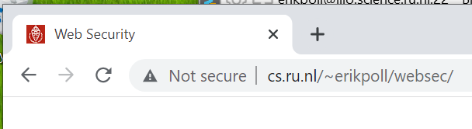
Spotting this attack?
Modern browsers will warn about “insecure website”
In older browsers, only very careful users would spot this attack by noticing that the URL misses an s in https

Slide 81
Countermeasures to SSL stripping
HTTPS Everywhere browser plugin
  ie. simply never use HTTP
  https://www.eff.org/deeplinks/2021/09/https-actually-everywhere
HSTS (HTTP Strict Transport Security)

Slide 82
HTTP Strict Transport Security (HSTS) [RFC6797]
Protection against SSL stripping
website (e.g. bank.nl) tells the browser that it only ever wants to use HTTPS, in HTTP response header
  Strict-Transport-Security: max-age=15768000; includeSubDomain
the browser remembers this, and will in future turn http requests for that domain into https requests
  Eg browser will turn http://bank.nl/rekening/...
  into https://bank.nl/rekening/...
HSTS is now supported by all browsers.

Slide 83
HSTS
On very first visit to bank.com, the browser stores some information, recording that bank.com wants to talk HTTPS only.
For subsequents visits
bank.nl
browser changes this to HTTPS
user types in bank.nl,
or clicks http link
request for
https://bank.nl
user connected
with HTTPS

Slide 84
Checking for HSTS usage
In browser
  In Firefox:
    type about:support in the address bar. In the Application Basics section, you will see Profile Folder. Click Open Folder, an look for file SiteSecurityServiceState.txt
  In Chrome:
    type chrome://net-internals/#hsts in address bar
In HTTP traffic: look for HSTS field in HTTP header, of the form
  Strict-Transport-Security: max-age=15552000; preload
  On Linux, with curl -si "https://www.ru.nl" | grep Strict

Slide 85
Remaining problem with HSTS
There remains risk with the very first request to a site
  a MitM attacker could SSL strip that first request, and remove the HSTS header in the HTTP response
Solution HSTS preload list: browsers come with preloaded HSTS info for some sites, so even the very first requests to these sites will never be with HTTP
  See https://hstspreload.org/
There remains a privacy risk with HSTS: the HSTS info stored in your browser can reveal which sites have been visited… even if you do this in private browsing mode?

