Slide 1
Attacking sessions (continued),
at application level
&
at HTTPS/TLS level
Güne&scedil; Acar & Erik Poll
Digital Security group
Radboud University Nijmegen
websec
1

Slide 2
Recap: sessions at application level
https://bank.nl/page.html
1. page.html
bank.nl
server
<a href=“https://bank.nl/pay?...”>pay</a>
2. pay request
Pay request needs to include session information aka session token(s)
Two ways to do this:
Bank provides user with webpage page.html that includes this info
  as URL parameter (eg below) or in body of HTTP request
  https://bank.nl/pay?sessionID=XYZ123&amount=1.00&dest=12.34.56
Bank sets a cookie and browser automatically adds this info

Slide 3
NB: identification vs authentication
Session information serves two distinct purposes:
identification
  who is the web server talking to
authentication
  verifying that this person is who they claim to be
Could Brightspace use your student-nr for this?
For 1, but not for 2
Different pieces of information can be used for 1 and for 2

Slide 4

Attack 1) CSRF - the downside of cookies
https://bank.nl
<a href=“https://bank.nl/pay?...”>pay</a>
bank.nl
server
pay request
https://mafia.com
<a href=“https://bank.nl/pay?...”>pay</a>
pay request
Browser attaches cookie to cross-domain requests from any site

Slide 5
Countermeasure: (anti)CSRF token
https://bank.nl
page.html with fresh token
<a href=“https://bank.nl/
pay?token=32451...”>pay</a>
bank.nl
server
pay request
plus fresh token
https://mafia.com
<a href=“https://bank.nl/pay?...”>pay</a>
pay request

Slide 6
Other countermeasures against CSRF
Let client re-authenticate before important actions
  eg. when resetting their password, or making big bank transfer
Set SameSite flag for the cookie (since 2017)
  strict cookie never attached to cross-site requests
  lax cookie only attached to top-level GET requests i.e. GET requests which change the address bar to bank.nl (so not for loading an iframe from bank.nl on mafia.com)
  https://developer.mozilla.org/en-US/docs/Web/HTTP/Headers/Set-Cookie/SameSite
Check Refer(r)er or Origin headers
    Browser includes these in HTTP requests to indicate where request is made from (eg mafia.com or bank.nl), so bank.nl can check which webpage made the request; but these headers may be absent
    Origin is just the domain, Referer the domain plus the path
Let browser add Sec-Fetch-Site header to distinguish cross site requests (since 2019)

Slide 7
Attack 2) Stealing cookies with scripts (XSS)
If attacker can malicious JavaScript into pages of bank.nl website, this code can inspect the cookies and send them anywhere on the internet, including to https://mafia.com
Such an attack, called Cross Site Scripting (XSS) attacks will be discussed in next weeks
Solution: cookie has be declared as HttpOnly
  This means the cookie is only used for sending along with HTTP requests & not accessible to scripts in the webpage

Slide 8





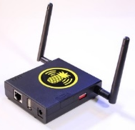
Attack 3) Stealing cookies as MitM
HTTPS prevents eavesdropper from observing cookies
(and other session info)
But: active MitM attacker can so more...
How can you do a MitM attack?
attacker on (wired/wireless) network
ISP
fake website eg. bank.ni
HTTPS
bank.nl

Slide 9
Stealing cookies as MitM
User logs on to https://bank.nl
Server sets session ID for bank.nl in cookie
  which is encrypted in HTTPS-traffic, so attacker cannot steal it
User does their banking ….
User asks for unencrypted HTTP link (eg http://nu.nl)
MitM attacker replies with a redirect to http://bank.nl
Browser follows redirect and sends the bank’s cookie over HTTP
Bingo! Attacker has the cookie
Solution: set secure flag for cookie which disallows browser to ever send it over HTTP
HTTPS
HTTP
bank.nl

Slide 10
Recap: cookie flags
The three cookie flags
  secure only ever sent cookie over HTTPS, never over HTTP
    Encrypting the cookie itself, when it is sent over HTTP, is pointless.
    Why?
  Attackers can simply replay a stolen encrypted cookie!
  HTTPonly inaccessible to scripts
      Confusing name: HTTP(S)Only would be better
  SameSite not added to links from different sites
protect against three different attacker models
  protects against eavesdropping and MitM
  protects against XSS: client-side scripts injected into the ‘real’ website (discussed in later lecture)
  protects against malicious sites that link to a benign site (CSRF)

Slide 11
Attacking HTTPS

Slide 12




What are we trusting? And for what?
Certificate
Authority (CA)
eg
CRL
(certificate revocation list)
Certificate
Certificate
for domain bank.nl
issued by CA
to bank.
Public key XYZ
bank.nl

Slide 13
TCB
TCB = Trusted Computing Base
TCB of a security control or security guarantee is everything (people, software, computers, ...) that we have to trust for that control or guarantee
There will be different TCBs for different controls/guarantees

Slide 14
DV, OV and EV SSL certificates
Certicate Authority (CA) can validate who is requesting a certificate for a domain in different ways:
DV (Domain Validation) certificates
  Email check to validate that this is the owner of that domain, using whois information (eg via https://www.sidn.nl/whois)
  Free via Let'sEncypt since 2016
OV (Organisation Validation) certificates
  Additional check on identity & existence of the organisation eg against Chamber of Commerce records
EV (Extended Validation) certificates
  More rigorous check on identity of the organisation
  How much extra security EV gives over OV brings is debatable...
Certificates can be wild-card certificates,
eg for *.ru.nl instead of www.ru.nl

Slide 15


Things that go wrong ...
Certificate Authority DigiNotar
was hacked in 2011.
Fake certificates for google.com
were issued, presumably for
use in Iran
DigiNotar provided all the
certificates for the NL government...
Problem detected because the Chrome browser checks for
suspicious certificates for google.com
Darknet Diaries has a great podcast episode on this:
https://darknetdiaries.com/episode/3/

Slide 16
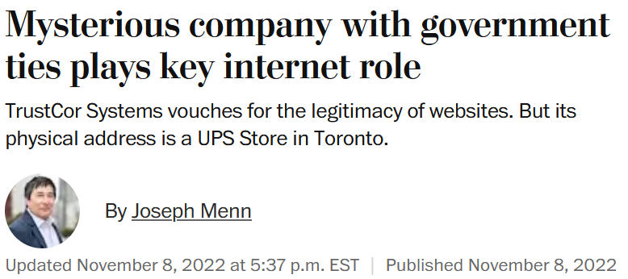
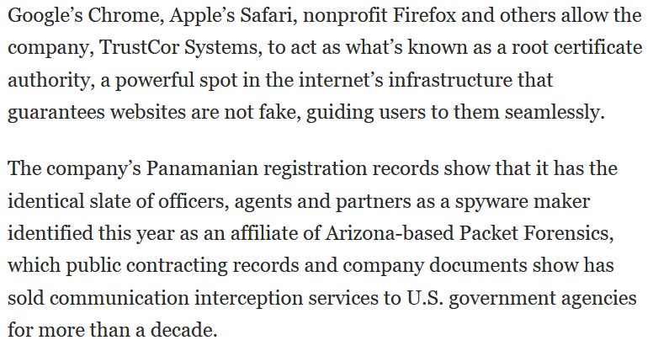
Things that go wrong
https://www.washingtonpost.com/technology/2022/11/08/trustcor-internet-addresses-government-connections/

Slide 17
Certificate Transparency (CT)
Solution to detect mis-issued certificates
issued by corrupt insider, by a hacked CA, or by mistake
CT log is public append-only ledger of all issued certificates by all CAs
  See https://crt.sh
Two ways to use it
Organisations can spot if a rogue certificate is issued in their name
  i.e. someone at Radboud could/should periodically check there are no rogue certificates issued for ru.nl
Certificate submitted for inclusion in CT log gets signed timestamp to prove it has been included. So browser can check this
  Different browsers use different policies to accept or warn about certificates that miss such a proof

Slide 18
Mixing http & https
A web page can mix http & https content, but this is a bad idea!
Why would you never want to have an frame loaded via http inside a webpage loaded via https?
Web browsers nowadays warn about or block mixed http/https content.
Demo: check out how this works in your browser, by visiting
  http://www.cs.ru.nl/~erikpoll/websec/demo/mixed_content.html
  https://www.cs.ru.nl/~erikpoll/websec/demo/mixed_content.html
This demo no longer works in Firefox, but it does in Chrome

Slide 19

Simple SSL stripping : HTTP + HTTPS
The idea: the attacker forces the browser to fall back to HTTP and hopes the user won’t notice the missing s
When can the attacker do this? If the user
types in rabobank.nl, without https in front of it
begins a HTTPS session by clicking on a link in a webpage that was retrieved with HTTP
HTTP
HTTPS
bank.nl

Slide 20
Normal start of HTTPS session via HTTP request
user website
user types in
rabobank.nl
request for
http://rabobank.nl
redirect (302) to
https://rabobank.nl
browser
follows redirect
https://rabobank.nl
user connected
with HTTPS

Slide 21
MitM attack on such a session
user MitM website
user types in
rabobank.nl
request for
http://rabobank.nl
redirect (302) to
https://rabobank.nl
attacker follows redirect
https://rabobank.nl
change HTTPS links
to HTTP links
server thinks
there is nothing wrong!
careful user will
notice missing s in browser toolbar

Slide 22

SSL stripping
The MitM attacker
  strips S from HTTPS in links in traffic from server to user
  puts this S back in traffic from the user to the server
The result
The attacker can now intercept a username and password that the user sends
After intercepting this information, the attacker could stop the MitM attack
  and the user can then no longer see anything wrong!
Attacker could also make arbitrary alterations to the web page
bank.nl
HTTP
HTTPS

Slide 23
Won’t secure cookies help?
Secure cookies won’t be sent by the client’s browser over HTTP
But attacker can defeat this
by removing the secure bit from Set Cookie instruction
when forwarding traffic from the server to user

Slide 24
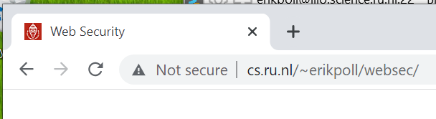
Spotting this attack?
Modern browsers will warn about “insecure website”
In older browsers, only very careful users would spot this attack by noticing that the URL misses an s in https

Slide 25
Countermeasures to SSL stripping
HTTPS Everywhere browser plugin
  ie. simply never use HTTP
  https://www.eff.org/deeplinks/2021/09/https-actually-everywhere
HSTS (HTTP Strict Transport Security)

Slide 26
HTTP Strict Transport Security (HSTS) [RFC6797]
Protection against SSL stripping
website (e.g. bank.nl) tells browser that it only ever wants to use HTTPS, in HTTP response header
  Strict-Transport-Security: max-age=15768000; includeSubDomain
the browser remembers this, and turn future http requests for that domain into https requests
  Eg browser will turn http://bank.nl/rekening/...
  into https://bank.nl/rekening/...
HSTS is now supported by all browsers.

Slide 27
HSTS
On very first visit to bank.nl, the browser stores some information, recording that bank.nl wants to talk HTTPS only.
For subsequents visits
bank.nl
browser changes this to HTTPS
user types in bank.nl,
or clicks http link
request for
https://bank.nl
user connected
with HTTPS

Slide 28
Checking for HSTS usage
In browser
  In Firefox:
    type about:support in the address bar. In the Application Basics section, you will see Profile Folder. Click Open Folder, an look for file SiteSecurityServiceState.txt
  In Chrome:
    type chrome://net-internals/#hsts in address bar
In HTTP traffic: look for HSTS field in HTTP header, of the form
  Strict-Transport-Security: max-age=15552000; preload
  On Linux, with curl -si "https://www.ru.nl" | grep Strict

Slide 29
Remaining problem with HSTS
Remaining risk with very first request to a site
  a MitM attacker could SSL strip that first request, and remove the HSTS header in the HTTP response
Solution: HSTS preload list included in browser that specifies HSTS for some sites, so even first request cannot be with HTTP
  Check https://hstspreload.org/
New privacy risk with HSTS: HSTS info stored in your browser can reveal which sites have been visited…
  even if you do this in private browsing mode?

Slide 30
Recap
HTTPS protection fails if attacker can obtain mis-issued certificate
  CT (Certificate Transparency) can help to detect this
Active MitM attacker could SSL strip
  But modern browsers given prominent warnings
  HTTPS-only and HSTS prevent this
    Without being on HSTS preload list an HSTS website could still be SSL stripped on a very first visit.
  Use of HSTS mandatory for Dutch government websites since July 1st, 2023 (Wet digitale overheid)

