Slide 1
Brightspace input sanitisation in discussion form
websec
1

Slide 2
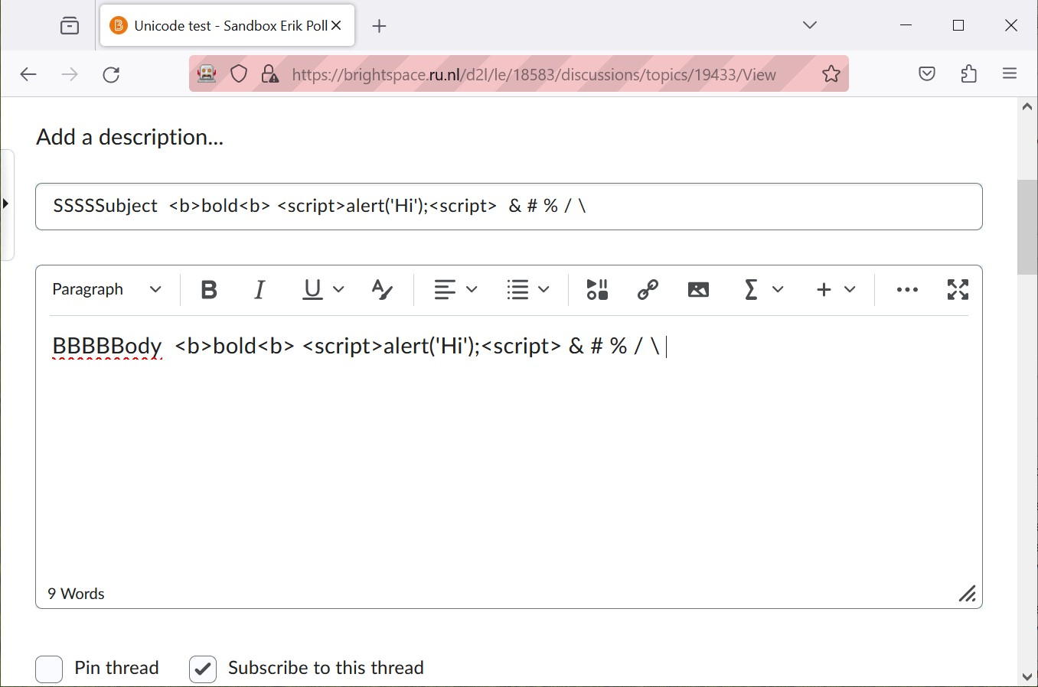
Post with special characters & keyword in subject & body
websec
2

Slide 3
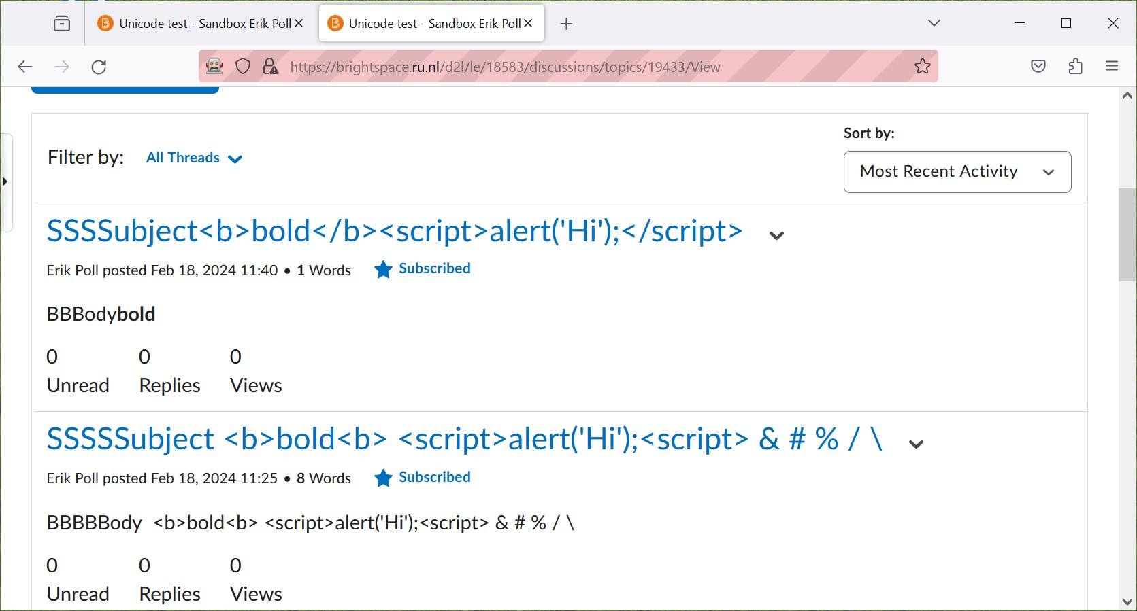
Result
websec
3

Slide 4
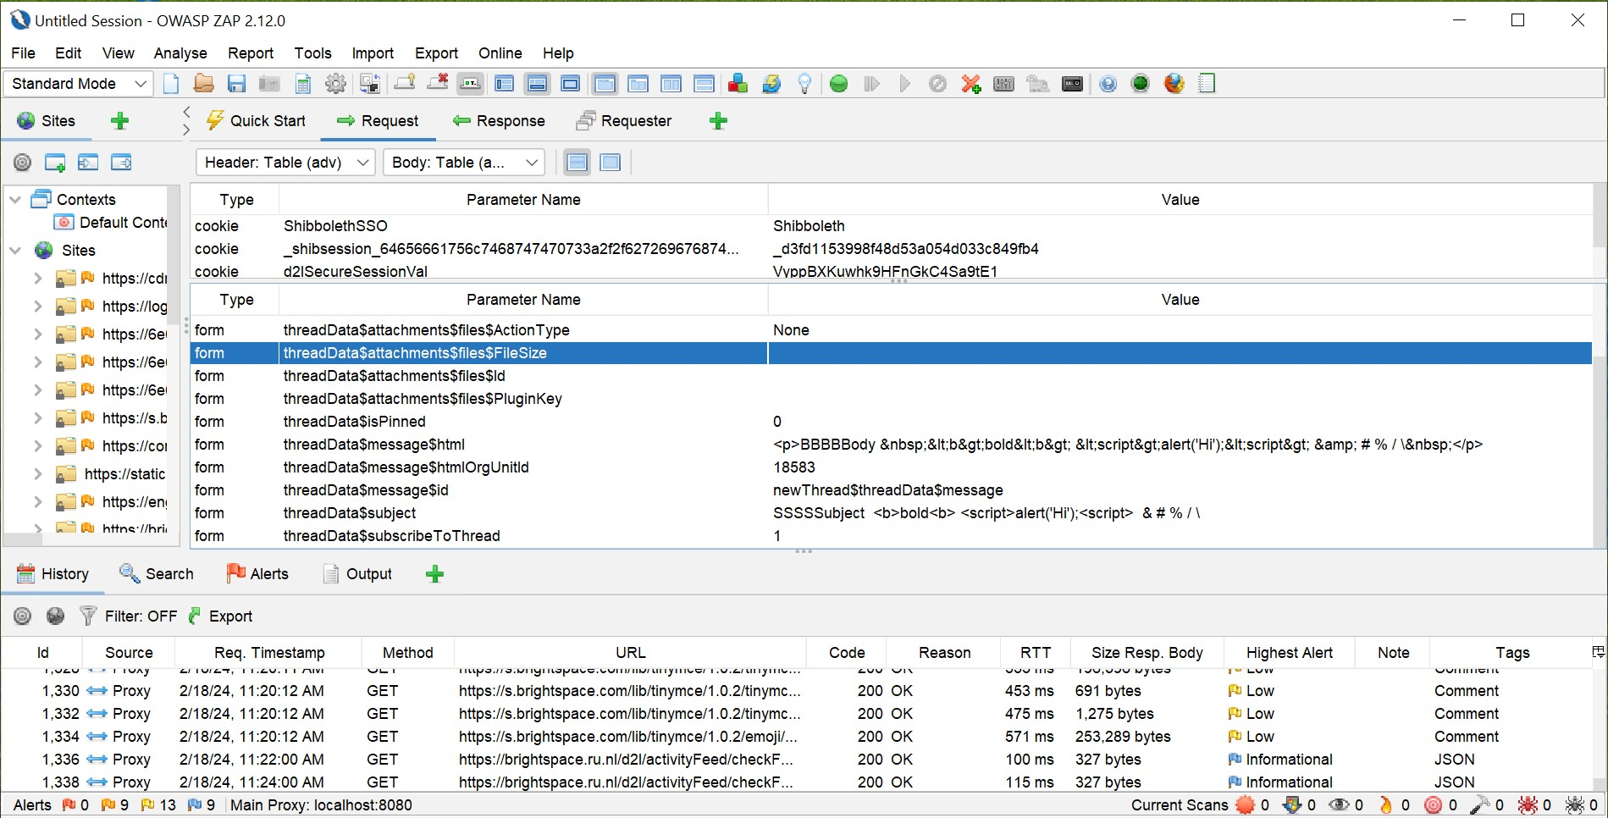
Resulting HTTP request in ZAP
blah
websec
4

Slide 5
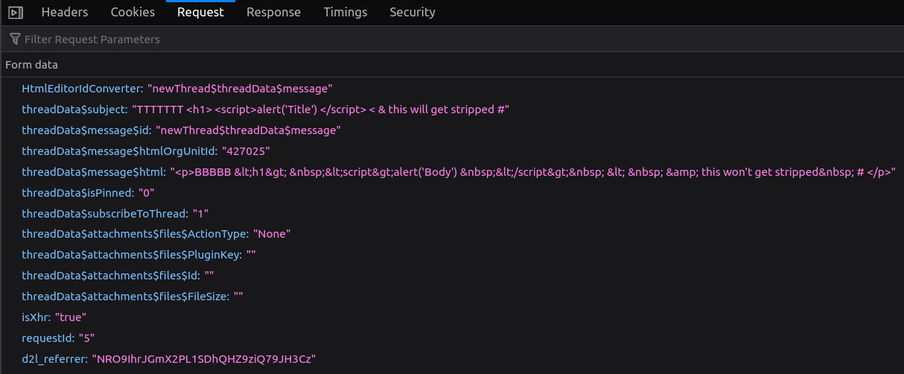
Resulting HTTP request in Firefox
You can look at HTTP request nicely formatted
or at the raw request
websec
5

Slide 6
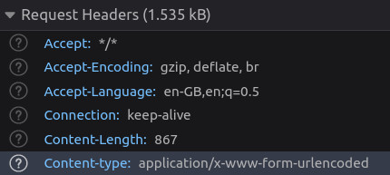
Headers in resulting HTTP request
So content is URL encoded
websec
6

Slide 7
Resulting HTTP request in Firefox – Raw
websec
7

Slide 8
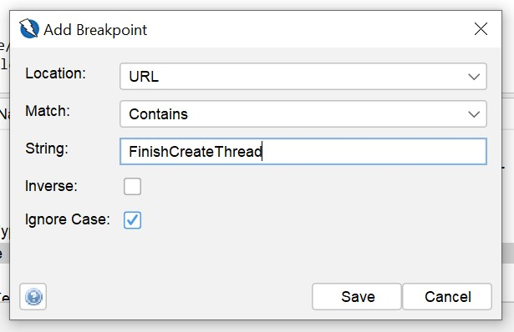
Setting breakpoint
websec
8

Slide 9
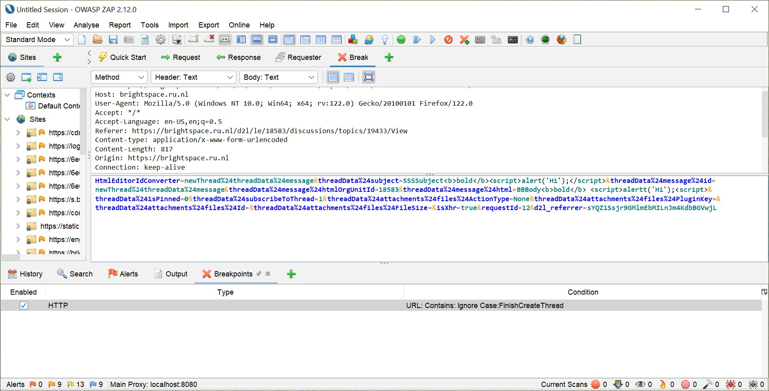
Intercepting at breakpoint to edit
blah
websec
9

