Slide 1
Today:
More attacks on clients, esp. the user
URL obfuscation,
Click-jacking/UI redressing,
CSRF revisited

Slide 2
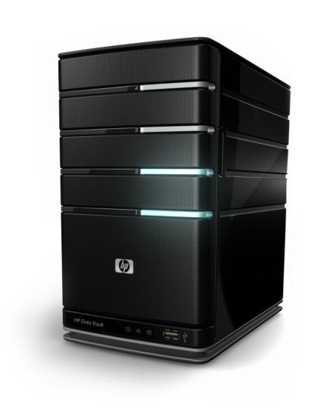
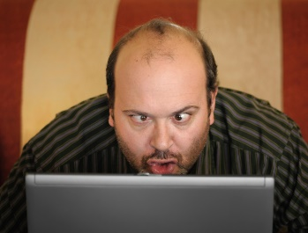
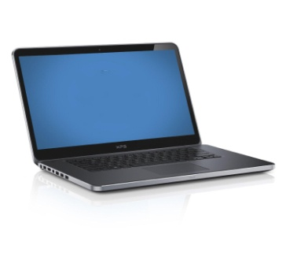
Securing the last 30 centimeter...
30 cm
1000s of miles
We can secure connections between computers 1000s of miles apart, eg using TLS,
but the remaining 30 cm between user and laptop remain a problem
Beware: blaming the ‘dumb user’ is victim blaming.
We should blame computer scientists & software engineers for making poor solutions

Slide 3

Securing the last 30 centimeter...
30 cm
1000s of miles
We can secure connections between computers 1000s of miles apart, eg using TLS,
but the remaining 30 cm between user and laptop remain a problem
Beware: blaming the ‘dumb user’ is usually unfair victim blaming.
We should blame computer scientists & engineers for making poor solutions

Slide 4

Different classes of attacks
Phishing
Clickjacking
UI redressing
SQLi,
path traversal,
...
XSS
browser
(or app)
web server
3rd party
online API
Can you trust what you see

Slide 5
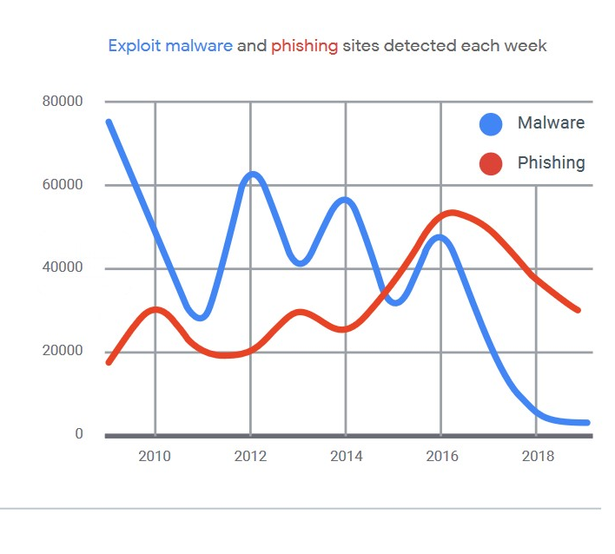
[Christiaan Brand, BlackHat 2019; data from Google Transparency Report]

Slide 6
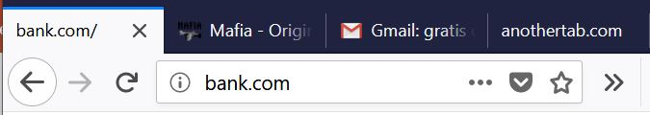

Last week:
Attacker model - malicious content on benign site
benign content
Does
SOP
help?
malicious
content
Such malicious content can be
3rd party iframe
  (intentionally included, separated with SOP)
user-provided content
  (e.g. Instagram post; same-origin, so SOP offers no protection)
special case of 2: HTML-injection or XSS
(same-origin, so SOP offers no protection)

Slide 7
Today:
Attacker model 1 - malicious website
Malicious site could phish for logins & passwords.
It could also include malicious links to the attacked website, eg for CSRF attacks

Slide 8
Today:
Attacker model 2 - malicious site with benign iframe
benign
content
Does SOP help here?
Yes, SOP protects against malicious site from observing or messing
with trusted content – and vice versa
but, as we will see, user can still be misled

Slide 9
Would you trust these URLs?
https://www.paypal.com:get_request%2Eupdate&id=234782&
Recall that a URL can have the form
https://username:password@www.domain.nl/....
So what is the domain we are accessing?
https://www.paypal.com
How do you know that the first p is not a Cyrillic character?
Browser bugs may offer more opportunities to confuse users.
Eg a bug in Internet Explorer displayed URLs with a null character,
such as http://paypal.com%00@mafia.com, incorrectly...

Slide 10
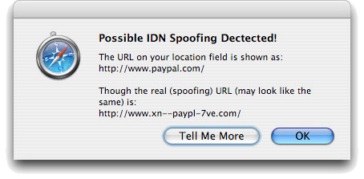
Browser warnings – about strange character sets
Punycode encoding of unusual characters

Slide 11
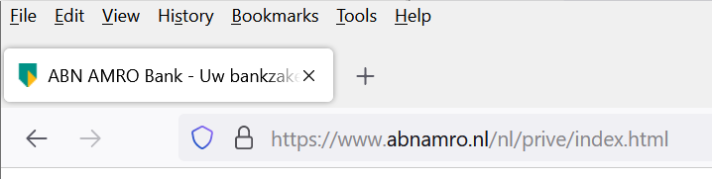
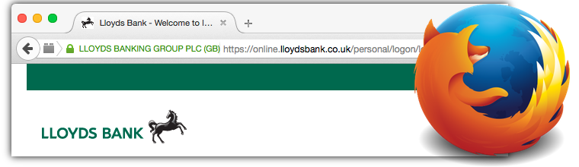
Highlighting domain name in the address bar
Alternative: show the organisation name from the certificate

Slide 12
Summary: URL obfuscation attacks
Attacker tries to confuse the user (in e.g. phishing attack) by
including a username before the domain name
  https://www.visa:com@%32%32%30%2E%36%38%2E%32%31%34%2E...
  which translates to the IP address 220.68.214.213
using strange Unicode characters in a homograph attacks
  https://paypal.com with a Cyrillic p
Countermeasures:
Punycode: encode Unicode as ASCII to reveal funny characters
  www.xn-pypal-4ve.com
Domain highlighting: show which part of URL is the domain name
Using password manager in browser?
  which would not fill in the password for the phishing site

Slide 13
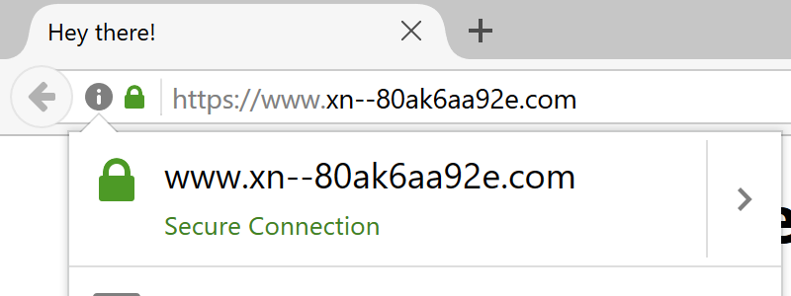
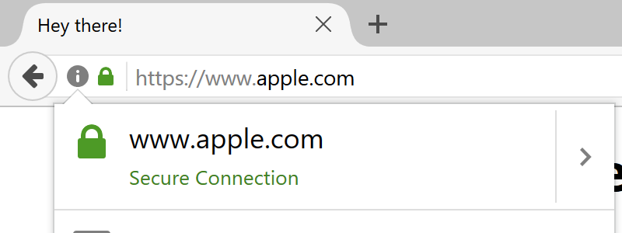
Newer homograph attack [2017, still works in some browsers?]
Some browsers display https://xn--80ak6aa92e.com
as apple.com
Problem:
browser only uses puny encoding if URL mixes several characters sets
not if all characters are from one - unusual - character set
See https://www.xudongz.com/blog/2017/idn-phishing/
For you to do: check if this attack works in the browser(s) you use.

Slide 14
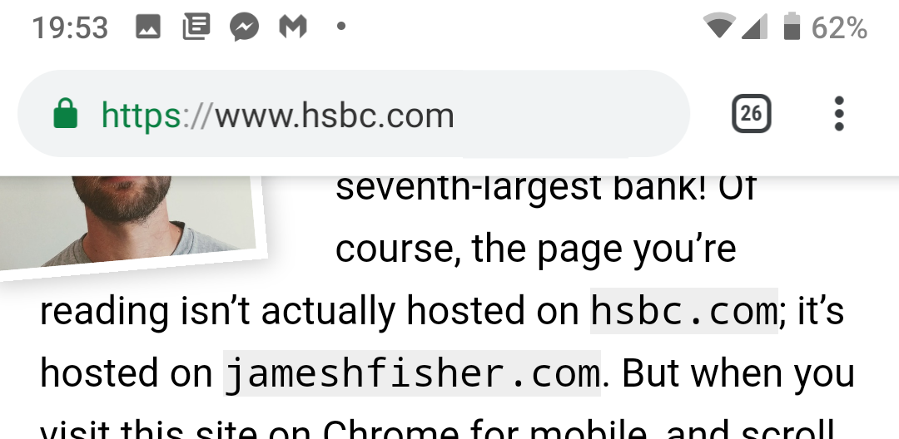
UI confusion on mobile phones [2019]
Chrome on mobile phone hides the URL bar when you scroll down.
Attacker can abuse this feature to display a fake URL bar.
See https://jameshfisher.com/2019/04/27/the-inception-bar-a-new-phishing-method/

Slide 15
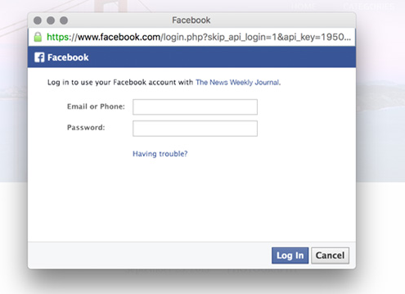
UI confusion on desktops [2019]
Is this pop-up window legit?
The URL is a https-link
to facebook.com;
clicking the lock shows a
valid certificate
No, this is not a pop-up window displayed by your browser, but a fake pop-up rendered inside a malicious webpage
How can you tell?
  You can move this ‘pop-up window’ inside the webpage window but you cannot drag it outside of the browser window
See https://youtu.be/nq1gnvYC144

Slide 16
Other ways to obtain passwords
stealing password file after a data breach
  This contains password hashes (hopefully), not plaintext passwords, but these can be brute forced
or simply buying username/passwords from a criminal
dictionary attack
  Try common passwords
password spraying
  Try one password across many accounts
  to prevent detection & lockout
credential stuffing
  Try one username/password combination across many systems
  to prevent detection

Slide 17
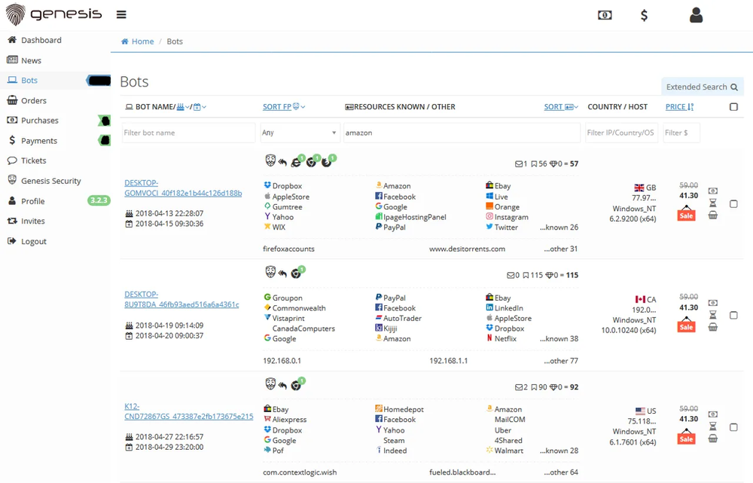
Criminal business models: selling user profiles

Slide 18
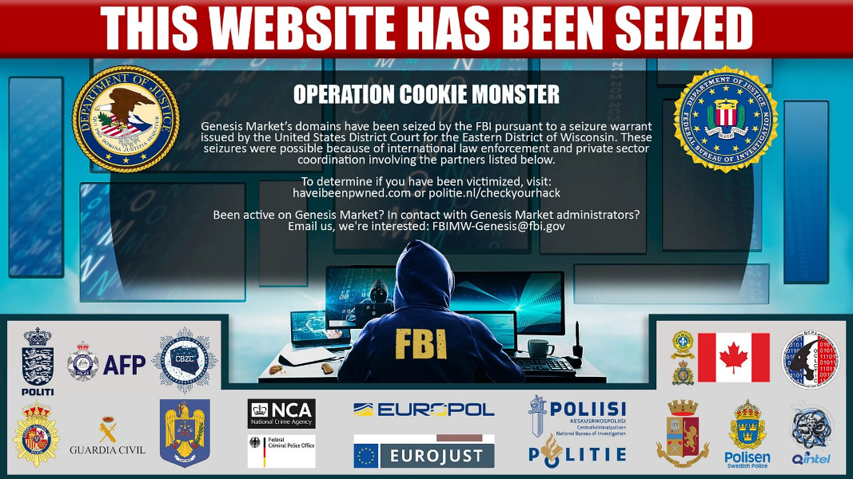
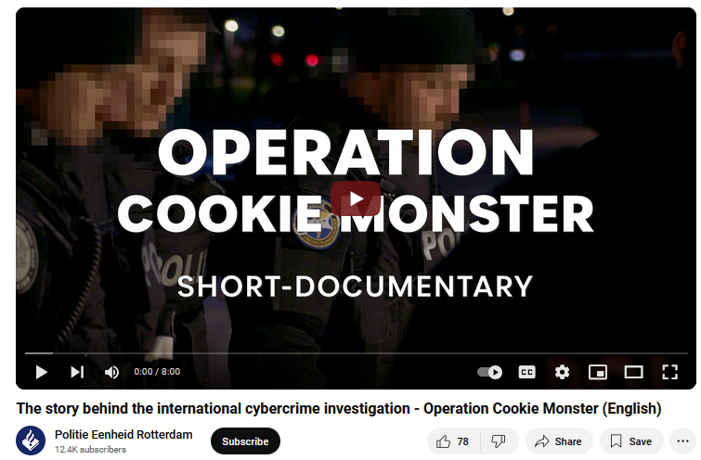
Genesis market & Operation Cookie monster
Genesis market sold user profiles not only usernames & passwords,
but also session cookies and
browser & device fingerprints (why?)
Taken down in 2024
https://www.troyhunt.com/seized-genesis-market-data-is-now-searchable-in-have-i-been-pwned-courtesy-of-the-fbi-and-operation-cookie-monster/

Slide 19
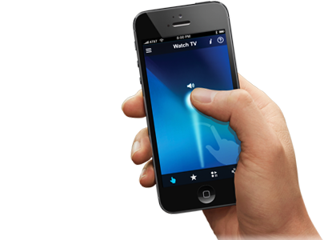
Multi-Factor Authentication (MFA, aka 2FA)
Additional One Time Password (OTP) time-based OTP
OTP via SMS
OTP via push notification
1. username
password
3. OTP
web server
OTP
2. OTP via SMS or push notification
or: 2. app generating
time-based OTP
Can this be phished?

Slide 20
Phishable MFA ☹
genuine
web server
1. username
password
1’. username
password
3’. OTP
3. OTP
phishing
site
OTP
2. OTP via SMS or push notification
or: 2. app generating
time-based OTP
A phishing website can simply relay username & password,
wait for user to provide OTP,
and then relay that ...

Slide 21
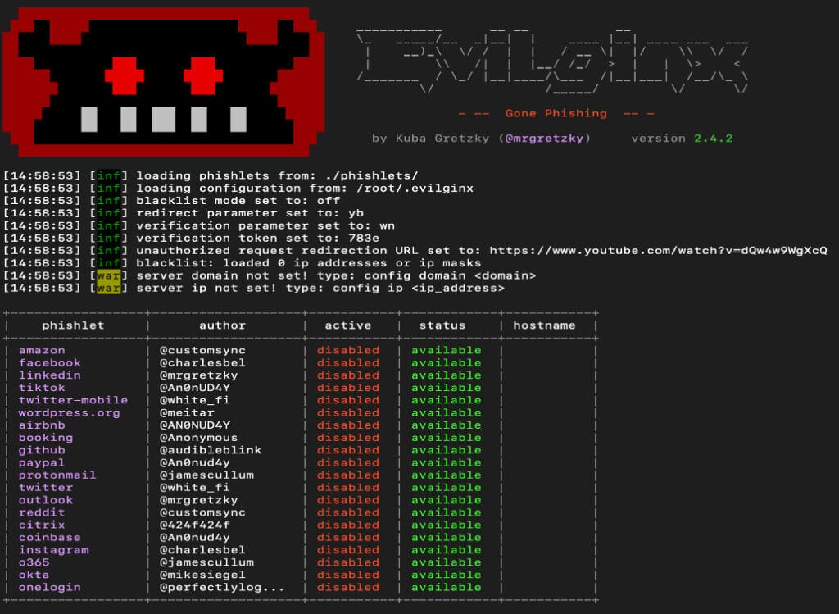
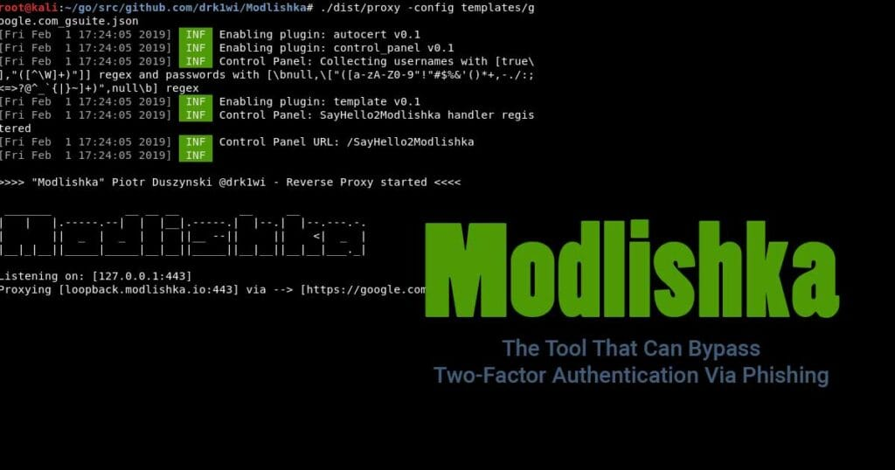

Phishing proxy software
Eg EvilGinx, Muraena, Modlishka, ...

Slide 22
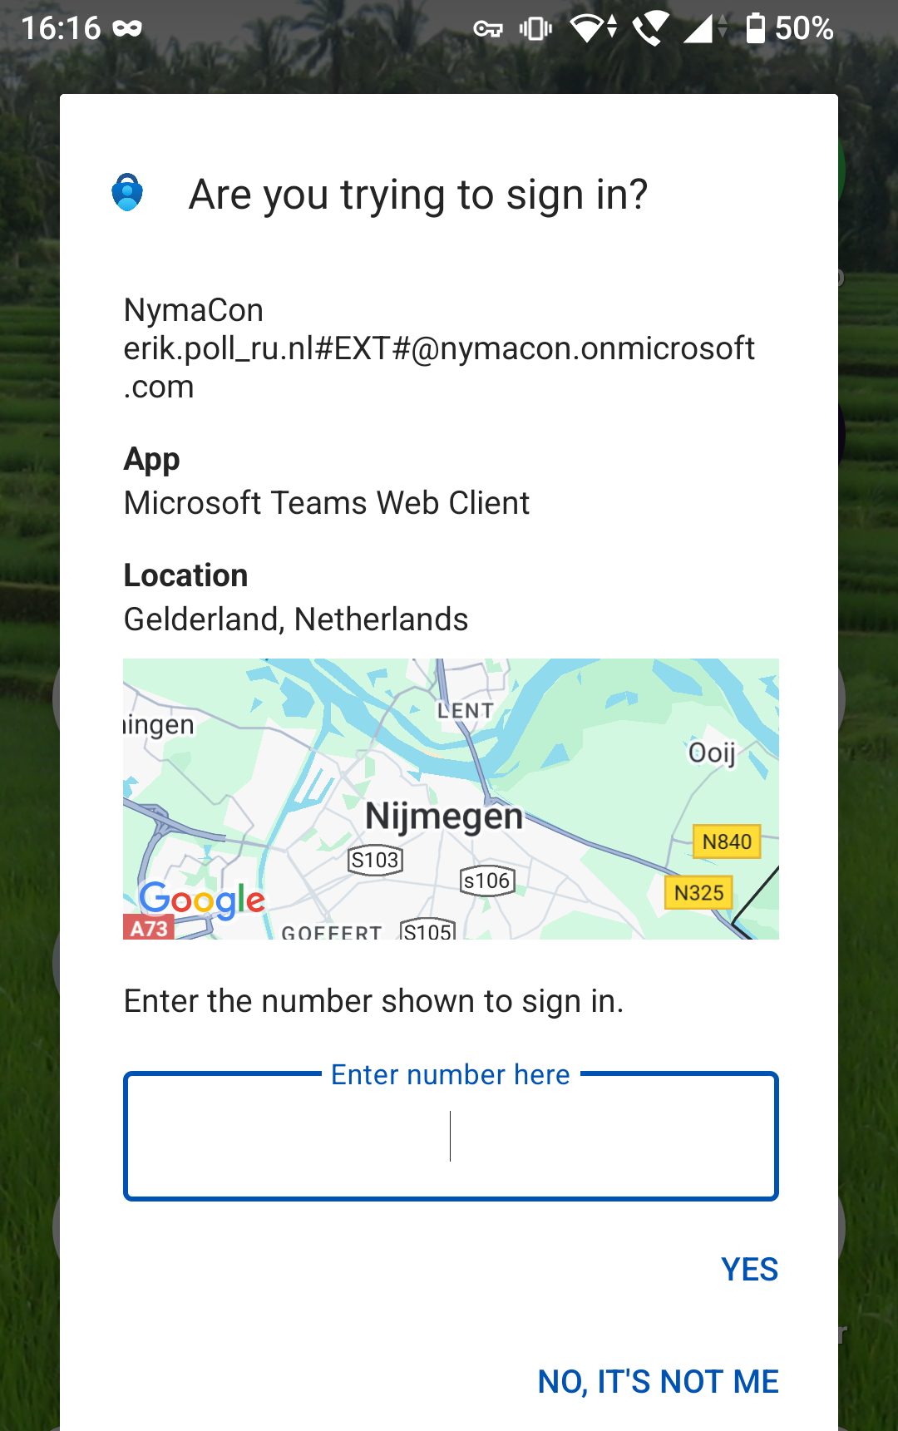
Countermeasure 1 – extra location check in app
App for entering push notification
shows client
& location of the user
If this shows wrong location or
different client victim can spot
an attack

Slide 23
Countermeasure 2
https//:bank.com
genuine
site
1. username
password
1’. username
password
3’. OTP
3. OTP
https//:bank.c0m
OTP
cloned
site
Scripts in the site that is cloned could check the domain name and
warn user, and/or
report back to the bank that the site is cloned
This could be defeated, but that’s more work for the attacker

Slide 24
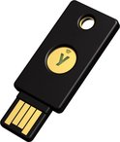
Phishing-resistant MFA
FIDO2 token or Passkey
1. username
password
1.
web server
2. OTP request
3. OTP
Key idea: token authenticates that it is talking with the real website

Slide 25
Click-jacking & UI redressing
UI = User Interface
aka
UX = User Experience
HMI = Human-Machine Interface

Slide 26
Click-jacking & UI redressing
These attacks try to confuse the user into unintentionally doing something, such as
  clicking some link – aka click-jacking
  providing text input to some field
If this involves re-using components of the targeted website, this is called UI re-dressing
The simplest forms of click-jacking are just CSRF
Beware: terminology can be messy in discussions of these attacks
benign
content

Slide 27
Basic click-jacking
Make the victim unintentionally click on some link
<a onMouseUp=window.open("http://mafia.org/")
href="http://www.police.nl">Trust me, it is safe to
click here, you will simply go to police.nl</a>
See demo http://www.cs.ru.nl/~erikpoll/websec/demo/clickjack_basic.html
Why would attacker want to do this?
Some unwanted side-effect of clicking the link
Especially if user is automatically authenticated by the target website (thanks to cookie), ie. CSRF
  Click fraud

Slide 28
Business model for click jacking: click fraud
Web sites that publish ads are paid for the number of click-throughs (ie, number of visitors that click on these ads)
Click fraud: attacker tries to generate lots of clicks on ads,
that are not from genuinely interested visitors
Motivations for attacker
  generate revenue for web site hosting the ad
  generate lots of likes on YouTube, Insta,...

Slide 29
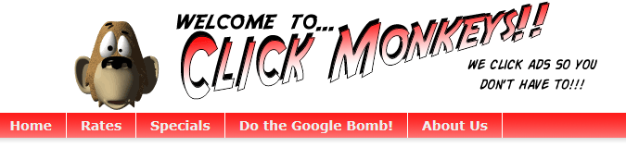
Other forms of click fraud - apart from tricking people:
Click farms
hiring people to manually click ads
Click bots
running software to automate clicking,
often hijacked computers in botnet,

Slide 30
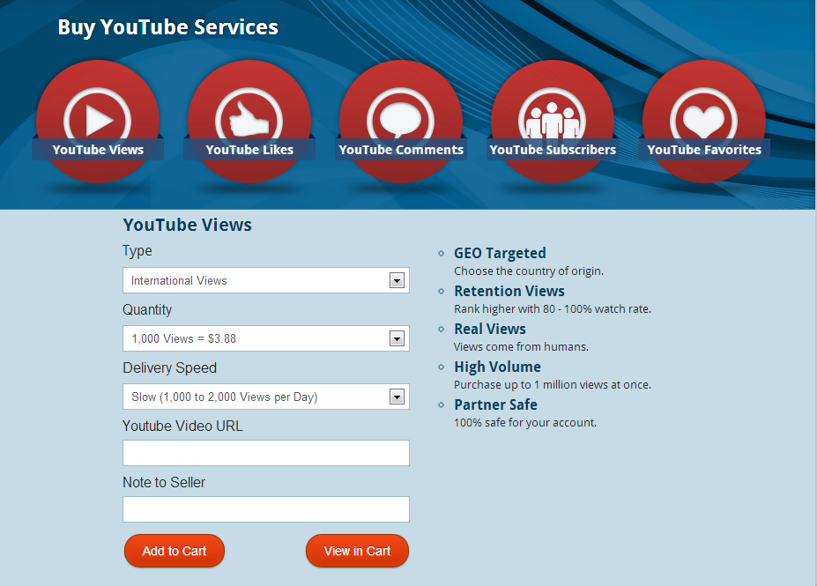
Criminal business models: YouTube views
generate & sell views, likes, ... for websites that ranks results based on views, likes, ...

Slide 31
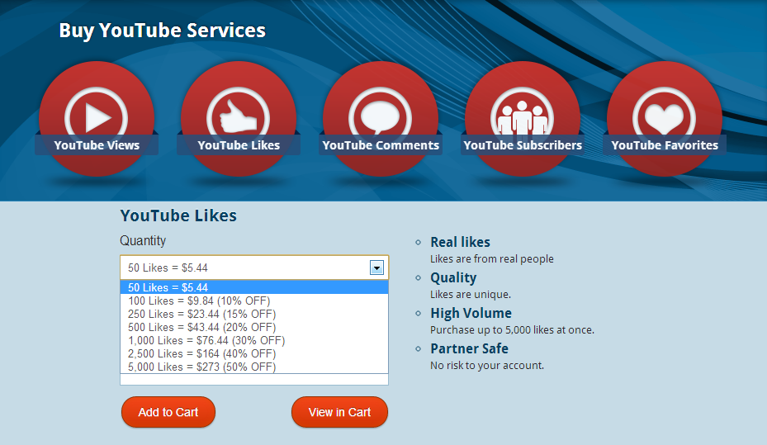
Criminal business models: YouTube likes

Slide 32



UI redressing
Attacker creates a malicious web page that includes elements of a target website, esp. links victims can click.
With iframe (inline frame) with content from attacked website
  iframes allow flexible nesting, cropping, and overlapping
Two approaches
“steal” a button with non-specific text
make a iframe transparent

Slide 33
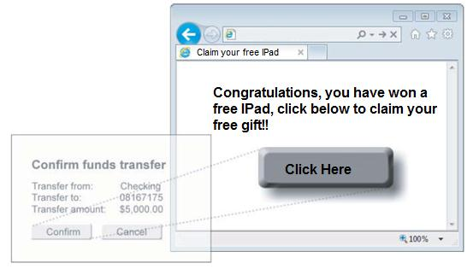
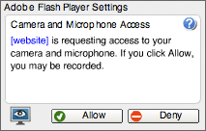
Old UI redressing example
Tricking users into altering security settings of Flash
Load Adobe Flash player settings into an invisible iframe
Click will give permission for any Flash animation to use the computer's microphone and camera

Slide 34
UI redressing example
Trick users into confirming a financial transaction

Slide 35
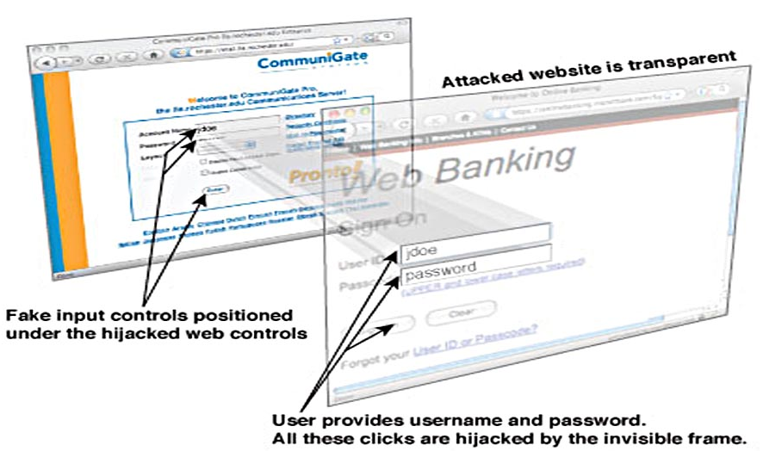
UI redressing example
Trick users to login to a banking website

Slide 36
Click-jacking and UI redressing: abusing trust
These attacks abuse trust users have in a webpage
  in what they see in their browser
These attacks also abuse trust a web server has in the browser:
    the web server trusts that all actions from the browser are performed willingly & intentionally by the user
Some browser will prevent users from interacting with transparent content
Check if your browser does at
  http://www.cs.ru.nl/~erikpoll/websec/demo/clickjack_some_button.html
  http://www.cs.ru.nl/~erikpoll/websec/demo/clickjack_some_button_transparent.html

Slide 37
Countermeasures against
UI redressing

Slide 38
Frame busting
Countermeasure to prevent being included as iframe: webpage tries to bust any frames it is included in
Example JavaScript code for frame busting
if (top!=self){
top.location.href = self.location.href
}
  top is the top (or outer) window in the DOM; self is the current frame
  If an iframe executes this code, it will make itself the top window.
  For a demo, see
    https://www.cs.ru.nl/~erikpoll/websec/demo/framebusting1.html
  which includes a frame-busting iframe
  https://www.cs.ru.nl/~erikpoll/websec/demo/framebuster.html
Lots of variations possible, some more robust than others

Slide 39
Busting frame busting
Recall HTML sandboxing of iframes (discussed 2 weeks ago):
This allows attacker to restrict capabilities of a victim iframe
eg. iframe be disallowed to change top.location
This can block framebusting scripts
Example HTML code for this:
  <iframe sandbox="allow-scripts allow-forms"
  src="facebook.html"> </iframe>
  allow-scripts: allow scripts
  allow-forms: allow forms
  there is no allow-top-navigation, so the iframe is not allowed to change of top.location
  Attacker could also disallow script, to prevent framebusting scripts from running at all, but this would break more functionality.
For a demo, see https://www.cs.ru.nl/~erikpoll/websec/demo/framebusting2.html

Slide 40



Better solution: X-Frame options
X-Frame-Options in HTTP response header introduced to indicate if webpage can be loaded as iframe
Possible values
  DENY never allowed
  SAMEORIGIN only allowed if other page has same origin
  ALLOW-FROM <url> only allowed for specific URL (Only ?)
Simpler than using JavaScript for frame busting, and cannot be disabled with HTML sandboxing
CSP (Content Server Policy) also provides ways to do this, but given the complexity of CSP, many sites continue to use X-Frame-Options

Slide 41
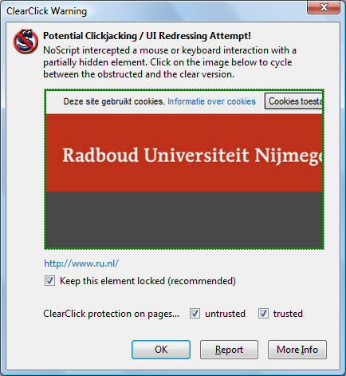
Browser protection against UI redressing
Firefox extension NoScript has a ClearClick option,
that warns the user when clicking or typing on hidden elements
How this works:
Activated when user clicks on
object in an iframe
Comparison made between
screenshots of
  the web page
  the web page with any
  opaqueness/transparency
  in iframe turned off
If screenshots differ, user is warned
and screenshot is shown so user can
evaluate it themselves

Slide 42
CSRF protection & UI re-dressing
Many UI re-dressing attacks try to trick users into clicking link on re-dressed iframes
Couldn’t some of the protection measures against CSRF help here?

Slide 43
Recall: Countermeasures against CSRF [week 2 & 3]
Let client re-authenticate before important actions
Keep sessions short
Anti-CSRF token [aka Tokenization]
  an unpredictable CSRF token as hidden parameter in requests
  that changes every time
Looking at the Referer or Origin headers
Setting SameSite flag for cookies
Check Sec-Fetch-Site header to spot cross site requests server-side
Which of these help against UI redressing?
1&2 obviously help
3 does not help: if mafia.com webpage loads ‘fresh’ iframes from bank.com, links inside those iframes probably have valid tokens.
4-6 help, but what counts as same site for SameSite or cross-origin for Sec-Fetch-Site gets confusing! See example on next slide.

Slide 44
CSRF vs UI redressing: defenses
CSRF attack: suppose a webpage from mafia.com (or HTML email sent by mafia) includes a link to bank.com
<html> . . .
  <img scr=“http://bank.com/transfer?amount=1000 &toAccount=52.12.57.76”></img>
</html>
Do SameSite , Sec-Fetch-Site and anti-CSRF tokens help?
If bank cookies are declared as SameSite, browser will not attach these cookies if link is clicked
Also, browser will mark this request as cross-origin with Sec-Fetch-Site
If bank includes anti-CSRF tokens in links, e.g. the link should be
http://bank.com/transfer?amount=1000 &toAccount=52.12.57.76&token=097123571
the mafia people have no way of predicting a valid value for that token
So all these defences help against this CSRF attack.
(Btw, it is unlikely that a bank transfer could be done with a simple GET request.)

Slide 45
CSRF vs UI redressing: defenses
UI redressing: suppose a webpage from mafia.com includes iframe from bank.com
<html> . . .
<iframe src=http://bank.com/somepage.html?param=...></iframe>
</html>
Do SameSite , Sec-Fetch-Site and anti-CSRF tokens help?
For the request to retrieve this iframe:
if bank cookies are declared as SameSite, browser will not attach these cookies to that request
Also, the browser will mark this request cross-origin as Sec-Fetch-Site
Suppose that there are links inside the iframe, i.e. inside somepage.html
These links may have a valid value for the anti-CSRF token
If user click these links, the browser will not attach SameSite cookies and declare the request as cross-origin with Sec-Fetch-Site.
This may seem counterintuitive, as the iframe comes from bank.com, but the domain of the webpage, here mafia.com, not the domain of the iframe, determines how the browser deals with SameSite and Sec-Fetch-Site

Slide 46
CSRF revisited

Slide 47
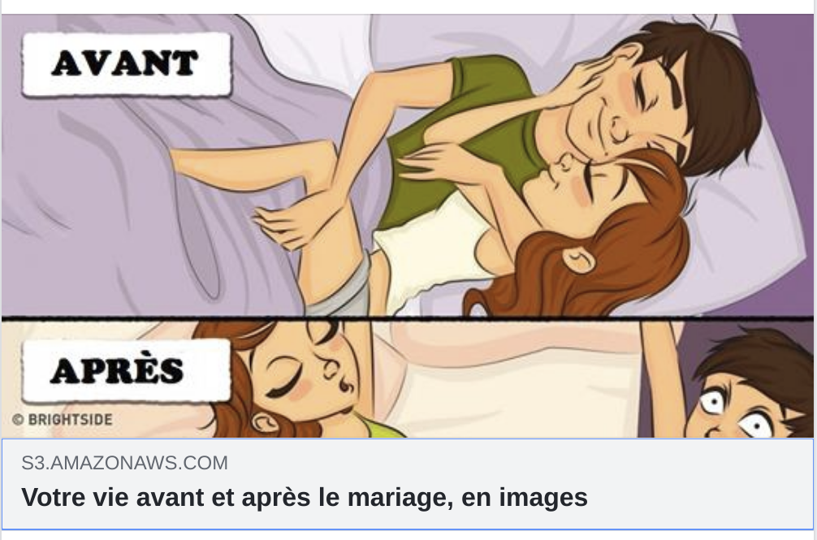
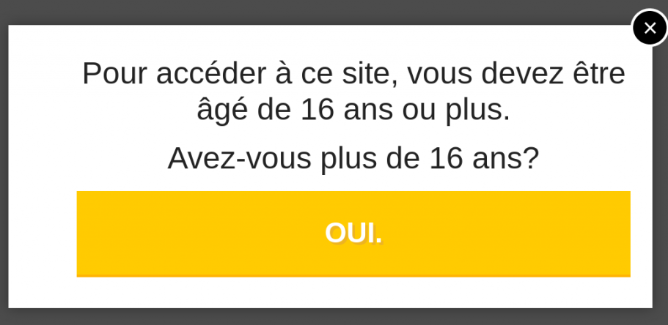
Example clickjacking attack: with age confirmation check

Slide 48
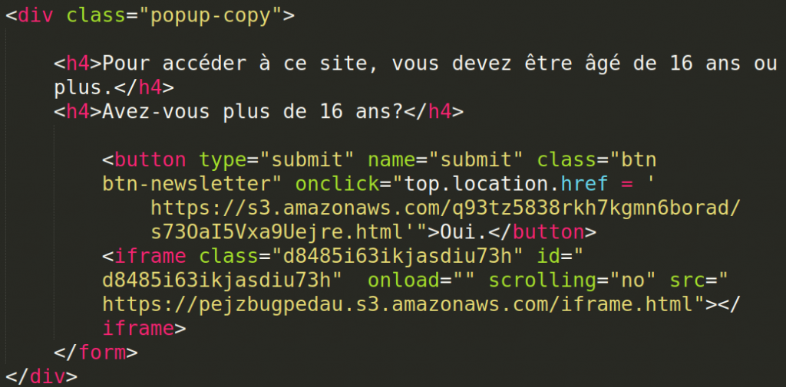
Example clickjacking attack
Inspecting HTML source to see what you are actually clicking
Inspecting contents of these Amazon S3 buckets leads to
  https://mobile.facebook.com/v2.6/dialog/share?app_id=283197842324324 &locale=en_US&mobile_iframe=1
Clicking age confirmation shares a post on Facebook.
Such clickjacking can get the attacker many likes or shares!
So this clickjacking attack is just (obfuscated) CSRF

Slide 49
Recall : CSRF abuses cookies without stealing them
Attacker sets up malicious website mafia.com with link to bank.com
<a href=“https://bank.com/transferMoney?amount=1000
&toAccount=52.12.57.762”>
If victim visits mafia.com and click this link,
then if they are logged in to the back,
this request will be sent with the victim’s cookies for bank.com

Slide 50
CSRF on GET vs POST requests
Action on the targeted website might need a POST or GET request
Recall: GET parameters in URL, POST parameters in body
For action with a GET request:
  Easy!
  Attacker can even use an image tag <img..> to execute request
  <img scr=“http://bank.com/transfer?amount=1000
&toAccount=52.12.57.762”>
For action with a POST request:
  Trickier!
  This cannot be done with a simple link.
  Instead, attacker can use JavaScript on their own website to make a form which will results in a POST request to the target website

Slide 51
CSRF of a POST request using JavaScript
If bank.com uses
<form action=”transfer.php” method=”POST”>
To: <input type=”text” name=”to”/>
Amount: <input type=”text” name=”amount”/>
<input type=”submit” value=”Submit”/>
</form>
attacker could use
<form action=”http://bank.com/transfer.php” method=”POST”>
<input type=”hidden” name=”to” value=”52.12.57.762”/>
<input type=”hidden” name=”amount” value=”1000” />
<input type=”submit”/>
</form>
<script> document.forms[0].submit(); </script>
Note: no need for victims to click anything!
The JavaScript code clicks it for them

Slide 52
CSRF
Ingredients
  malicious link or JavaScript on attacker’s website
  automatic authentication by a cookie at targeted website
Requirements
  the victim must have a valid cookie for the attacked website
  that site must have actions which only require a single HTTP request
This could be used for click-jacking, except
  it does not involve UI redressing
  if JavaScript is used, maybe there is no click

Slide 53
DoS
(Denial of Service)

Slide 54
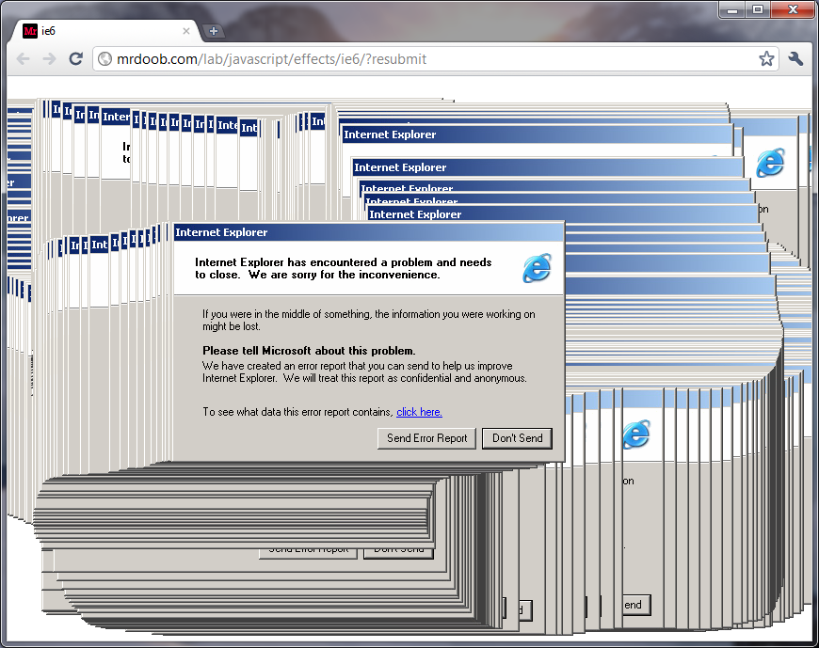
Example browser bug: client-side DoS vulnerability

Slide 55
Example browser bug
  <HTML><BODY>
  <img src=”a.jpg” width =”999999999”
  height=”999999999”></img>
  </BODY><HTML>

Slide 56
Example browser bug: Internet Explorer image crash
Image with huge size used to crash Internet Explorer and freeze the whole Windows machine
Malicious payload
  <HTML><BODY>
  <img src=”a.jpg” width =”999999999”
  height=”999999999”></img>
  </BODY><HTML>
  Such a payload is easy to enter in a Brightspace forum…
  It abuses the basic rendering process in the browser

Slide 57
ZIP bomb
Web servers may accept zipped input, and unzip this
This allows DoS attacks using ZIP bombs, aka the Zip of Death:
  a 42 Kb Zip file can unzip to > 4 Gb
  [See http://www.unforgettable.dk for examples]

Slide 58
XML bomb
XML files can also cause Denial-of-Service:
  There can be recursive references inside an XML document
  XML parsers often unfold such references, to turn the document to its canonical form
  Files can explode in size: a 1Kb XML file can become > 3GB
Aka Billion Laughs Attack, as the original XML bomb replicated the string LOL
  [See https://msdn.microsoft.com/en-us/magazine/ee335713.aspx]

Slide 59
XXE
XML processing can be abused in other ways,
incl. with XXE (XML External Entities) attacks
  <?xml version="1.0" encoding="UTF-8"?>
  <!DOCTYPE attack [
  <!ELEMENT foo ANY >
  <!ENTITY xxe SYSTEM "file:///dev/urandom" >]>
  <foo>&xxe;</foo>
This should remind you of a path traversal

Slide 60
More attacks

Slide 61


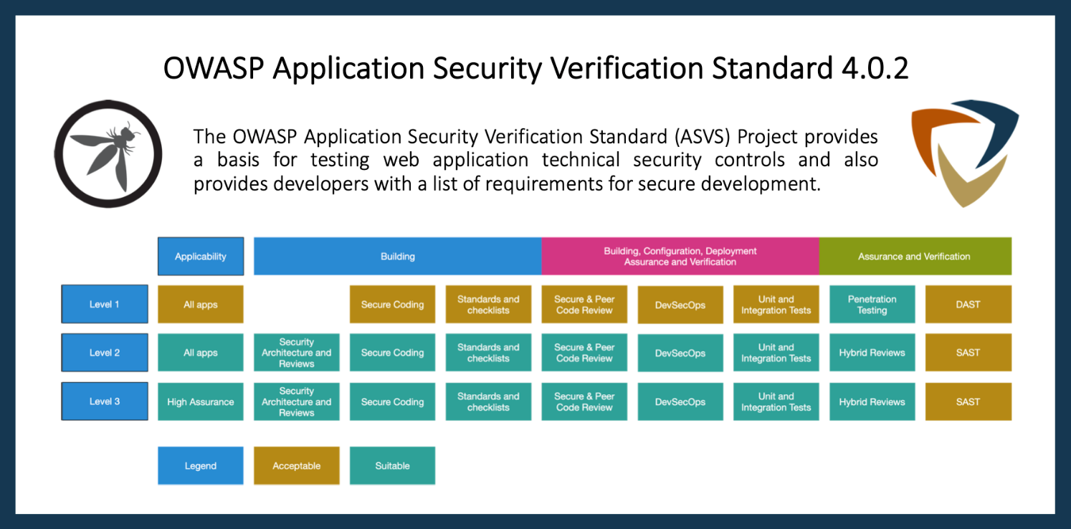

Slide 62

OWASP Top10 & ASVS
There are more attacks than we discussed, but many are variations on the same theme (notably some form of injection)
OWASP produces a well-known OWASP Top 10 of web applications security vulnerabilities
Knowing this Top 10 helps develop more secure applications
But better, more structural approach to produce secure web applications: OWASP ASVS (Application Security Verification Standard)
  For Dutch speakers & Dutch government agencies, CIP-overheid.nl provides similar standards for ‘Grip op SSD (Secure Software Development)’

