Slide 1
Privacy is Hard and Some Other Myths
Achieving Privacy through Careful Design
Notes:
Langzaam, duidelijk en rustig spreken
Beperk miemiek in gezicht
Sta rechtop
We live in an increasingly digital world. We shop online. We share our lives digitally. We are tethered twenty-four hours a day through our smartphones, wearables, and tablets, connected to our family, friends, work, and everything that happens in the world. The 2020 COVID-19 pandemic has spurred this transition from the real to the virtual world.
Governments apply new digital technologies to perform their tasks more efficiently, to increase our safety and security, improve our well-being, and to combat fraud. Businesses similarly embrace these technologies for new systems and services that are more efficient and more personalized, disrupting existing brick-and-mortar businesses in the process.
All these systems collect huge amounts of personal data and use that information to monitor or influence us, without many of us being fully aware of this. Common myths (“You have zero privacy anyway”; “You’ve got nothing to hide”) trouble our vision and lull us into indifference. We need to wake-up, learn to recognize poorly designed systems, and challenge them.
We fail to see that the way systems are designed has a tremendous impact on our privacy—and that we, as a society, actually have a choice here. Technology does not develop in isolation, does not have an independent, inherent purpose or destiny of its own. Instead, technology is made by people and is shaped according to their agendas and beliefs. These beliefs are embedded in how technology functions and determine what technology affords us to do, what it prevents us from doing, and what it does regardless of our own intents and wishes. Systems can be designed in a privacy-friendly fashion, with respect for our autonomy and human dignity, without a negative impact on their functionality or usability. If we want this to happen, though, we need to get involved and influence these agendas and beliefs.
Privacy is often ignored when designing systems. Sometimes this is out of ignorance. More often, it is on purpose because of the huge economic value of all that personal data. This approach is no longer sustainable. Stricter regulations and growing privacy concerns among the general public call for a different approach. But purely regulatory approaches to protect our privacy are not enough. Privacy-friendly design is essential.
A little bit of effort and consideration can prevent a lot of privacy harm. In fact, just as technology can be used to invade our privacy, it can also be used to protect our privacy by applying privacy by design. There are many privacy-friendly technologies and privacy by design approaches that are applicable to many systems we commonly use today.
Privacy is like safety or sustainability. Today we take safe cars, energy- efficient buildings, and environmentally friendly production more or less for granted. Like safety and sustainability, privacy is a reasonable and natural civil demand. A demand that businesses and governments can and should comply with, through careful design. As I will show you today, this is not hard.

Slide 2
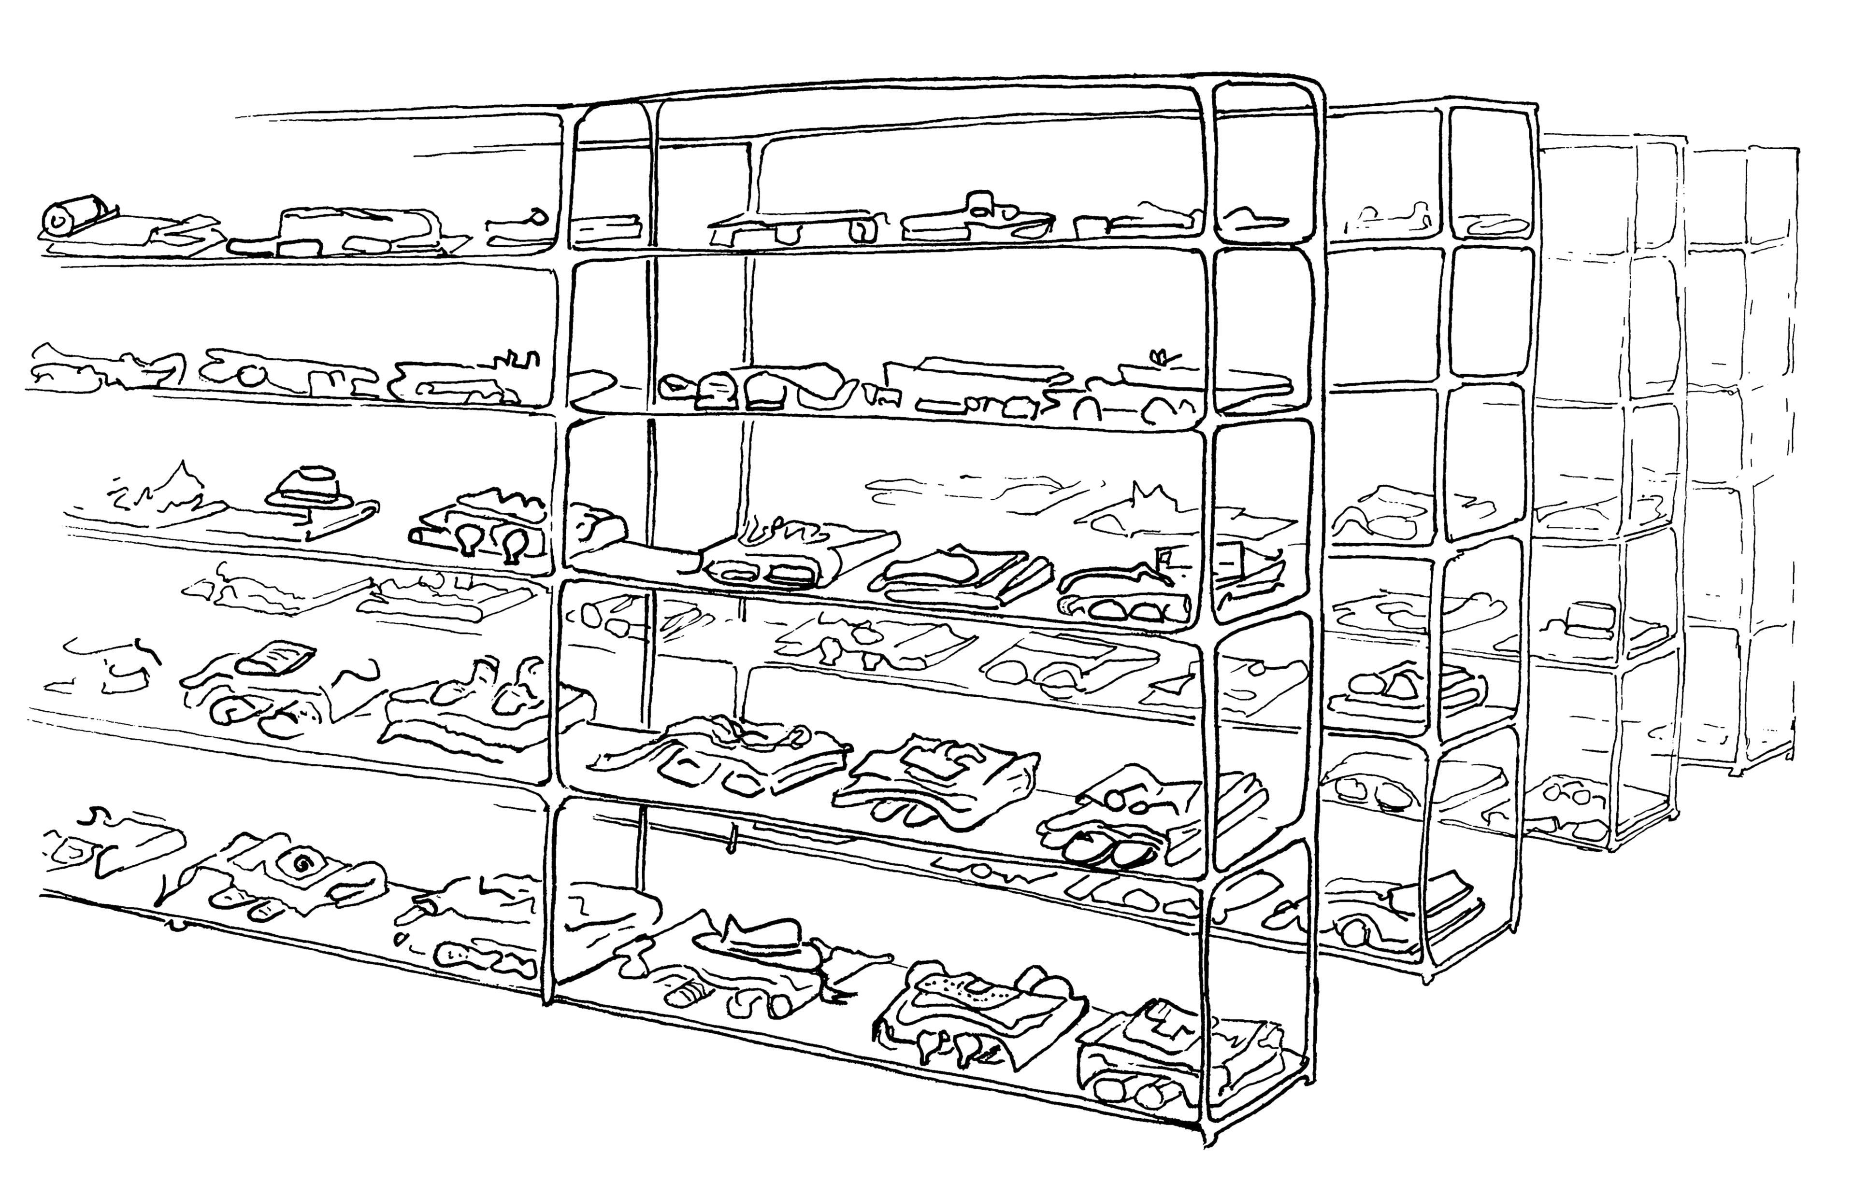
#1: We Are Not Collecting Personal Data
All drawings © Gea Smidt, https://www.geasmidt.com
Notes:
Car park example

Slide 3
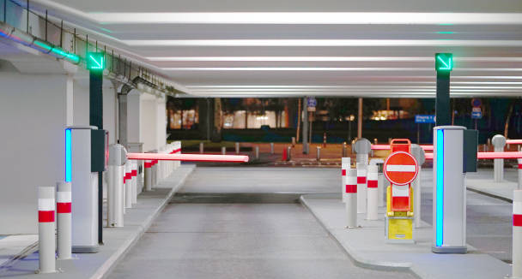

Slide 4
You can observe a lot by just watching
—Yogi Berra
Notes:
Cruijff
Many other day to day activiteis collect huge amounts of data (travelling, payment, reading, etc)

Slide 5
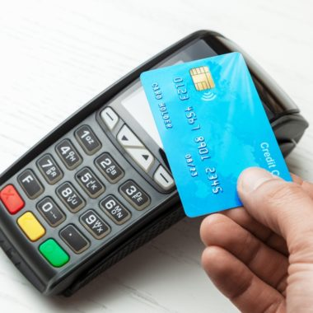
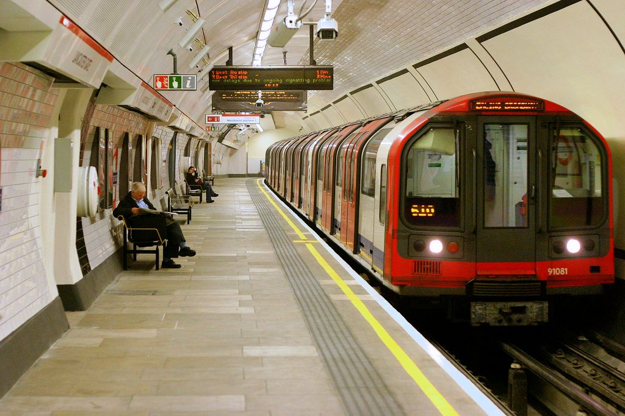

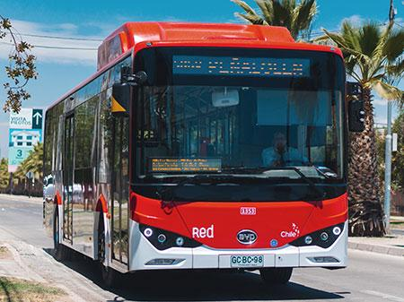
Personal data collected during many activities

Slide 6
Necessity =
Purpose +
Proportionality +
Subsidiarity

Slide 7

#1: We Are Not Collecting Personal Data
Notes:
Car park example

Slide 8
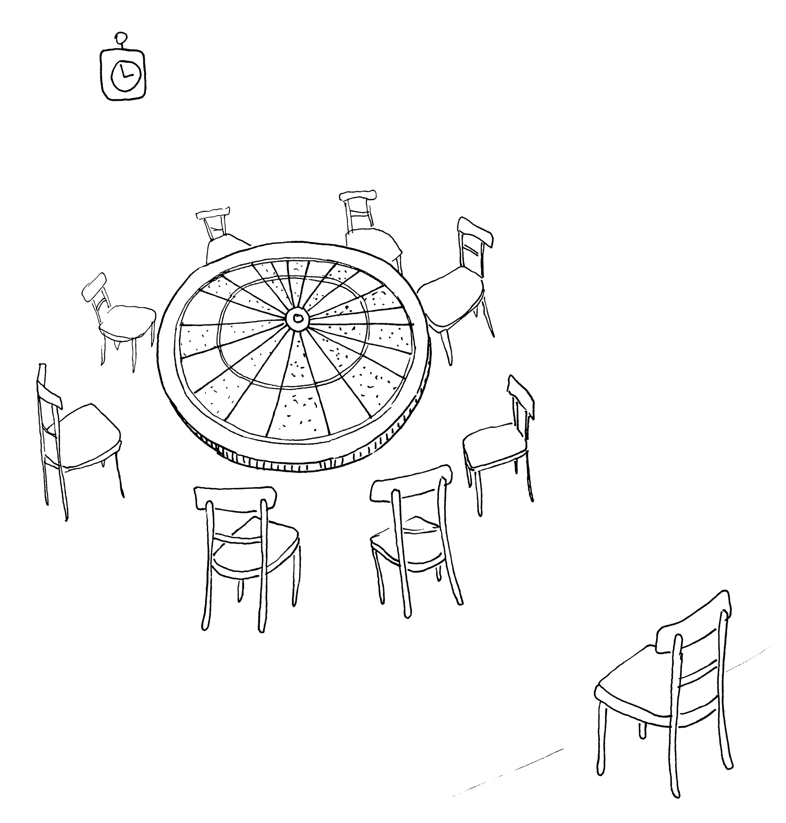
#2: You Have Zero Privacy Anyway – Get Over It

Slide 9
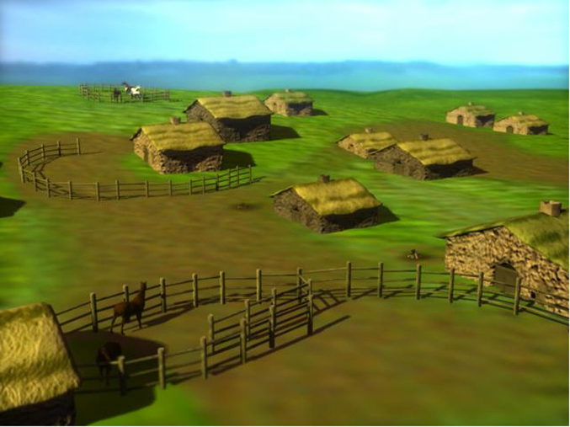
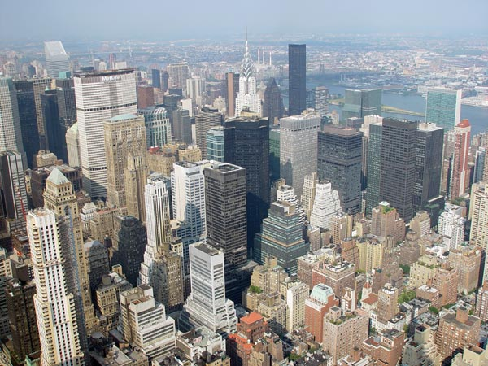

Technology & Privacy
The right to be let alone
[Warren & Brandeis, 1890]
Informational self-determination: The right to determine for yourself when, how and to what extend information about you is communicated to others
[Westin, 1967]
The freedom from unreasonable constraints on the construction of one’s identity
[Agre, 1998]
Contextual integrity: the right to prevent information to flow from one context to another
[Nissenbaum, 2004]
computing
(1950-)
networking
(1980-)
searching becomes efficient
data kept forever
datasharing becomes easy
data accessible on-line
“network effect”

Slide 10
Technology is neither good nor bad; nor is it neutral.
—Melvin Kranzberg, 1985
Architecture is politics. —Mitch Kapor, 1991
Notes:
In other words: technology can not only be used to infirnge our privacy, but also to protect our privacy
=>
We need to get a seat at the table

Slide 11

Leaky design
Computers
Logging
Poor separation
Left to the mercy of the Operating System
Smartphones
Sensors (GPS, mic, cam, etc.)
Contacts
Healthdata (wearables)
The internet
IP addresses
MAC addresses
WWW
Browser fingerprinting
Cookies
Javascript

Slide 12
The value of privacy
As a personal right
As a societal need
Protect
Personal freedom
Autonomy
Restore power balance
Kafka’s “The Trial”
Protect democratic process
Prevent meddling with elections
Freedom to vote without interference
Consistent public political campaign
Debate status quo
Labour rights
Women voting rights
Gay rights

Slide 13
How the law protects privacy
Privacy as a fundamental right
Art 12 United Nations’ Universal Declaration of Human Rights (UNHR)
Art 8 European Convention on Human Rights (ECHR)
Data protection
A separate fundamental right in the EU
General Data Protection Regulation (GDPR)
Notes:
Art 12 UNHR: No one shall be subjected to arbitrary interference with his privacy, family, home or correspondence, nor to attacks upon his honour and reputation. Everyone has the right to the protection of the law against such interference or attacks.
Art 8 ECHR
1. Everyone has the right to respect for his private and family life, his home and his correspondence.
2. There shall be no interference by a public authority with the exercise of this right except such as is in accordance with the law and is necessary in a democratic society in the interests of national security, public safety or the economic well-being of the country, for the prevention of disorder or crime, for the protection of health or morals, or for the protection of the rights and freedoms of others.

Slide 14
Legal protection insufficient
Territorial scope
Many offenders out of law’s reach
Dependence on DPA enforcement
Function creep
“the gradual widening of the use of a technology or system beyond the purpose for which it was originally intended”
Legal protection can be (and regularly is) lifted at the stroke of a pen
Notes:
So: law is not enough

Slide 15
Privacy by design: use technology to protect privacy

Slide 16
#2: You Have Zero Privacy Anyway – Get Over It

Slide 17
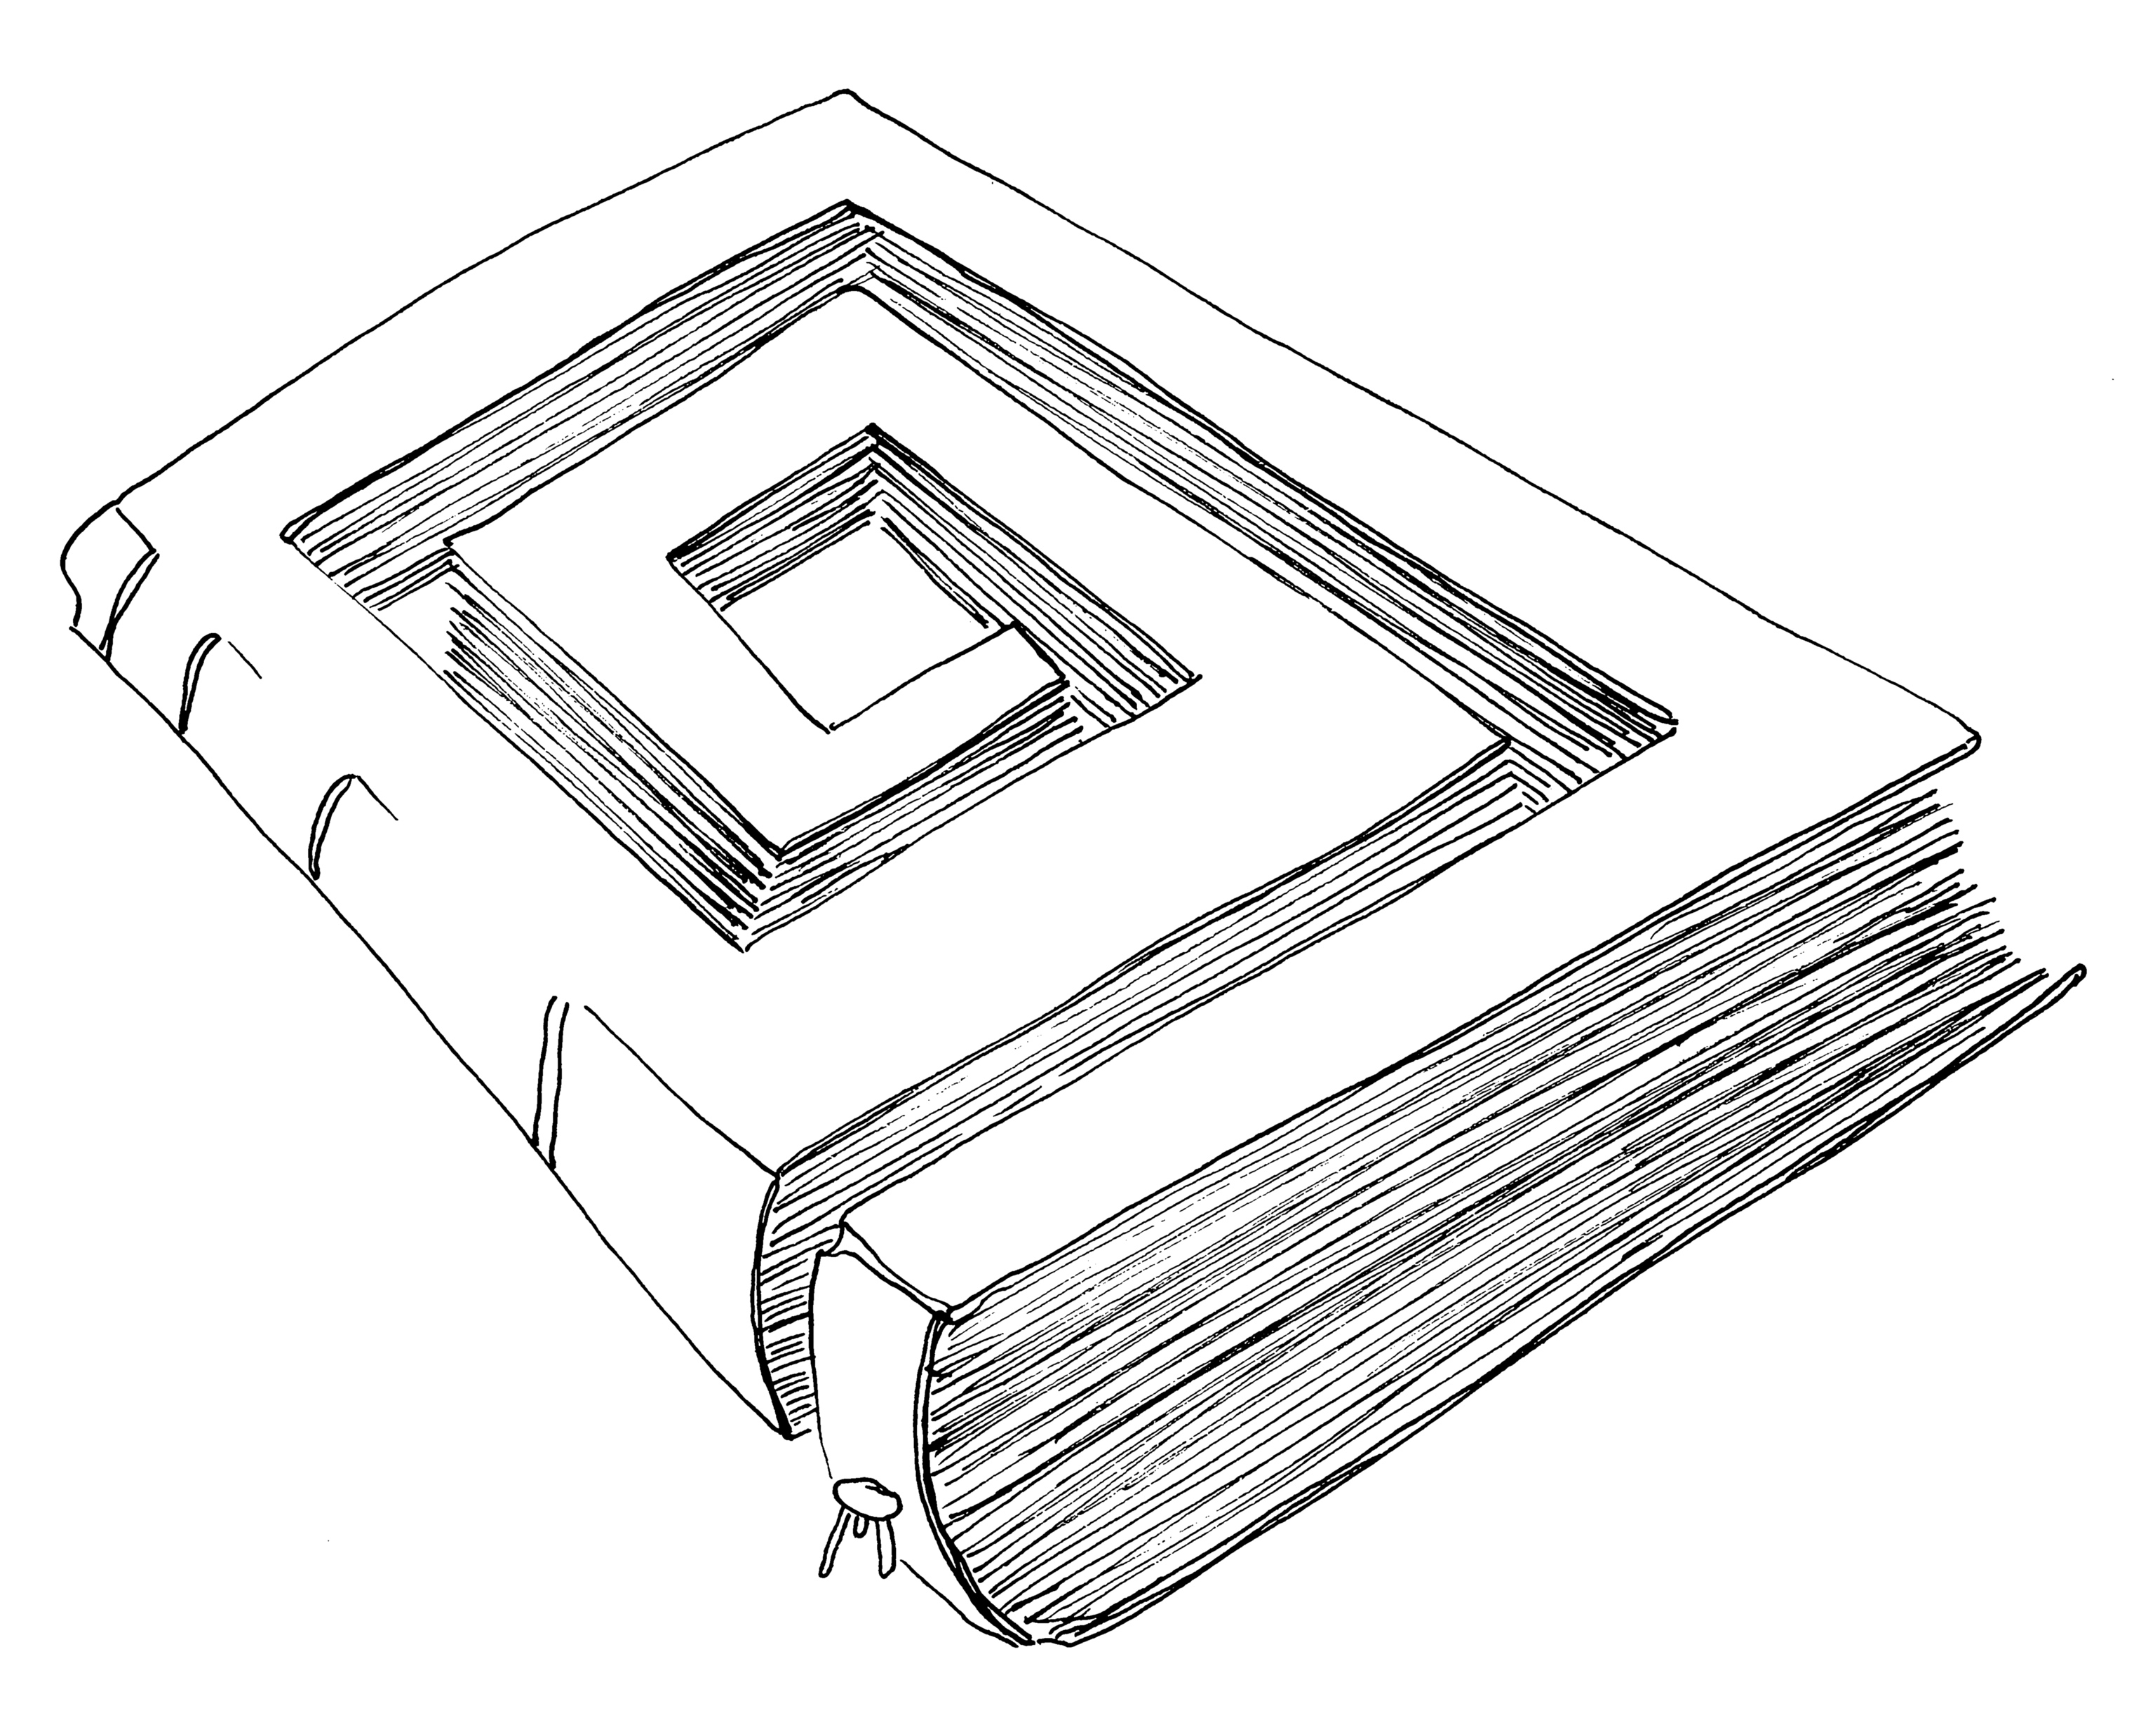
#3: I’ve Got Nothing To Hide
Devious frame
Hiding is human, unavoidable
Full transparency impossible
Privacy also of societal value
Using encryption to hide
Communications: VPN, TLS, E2E
Storage: disc encryption
Privacy in databases
Polymorphic encryption
Statisitical disclosure control
Differential privacy

Slide 18
#3: I’ve Got Nothing To Hide

Slide 19
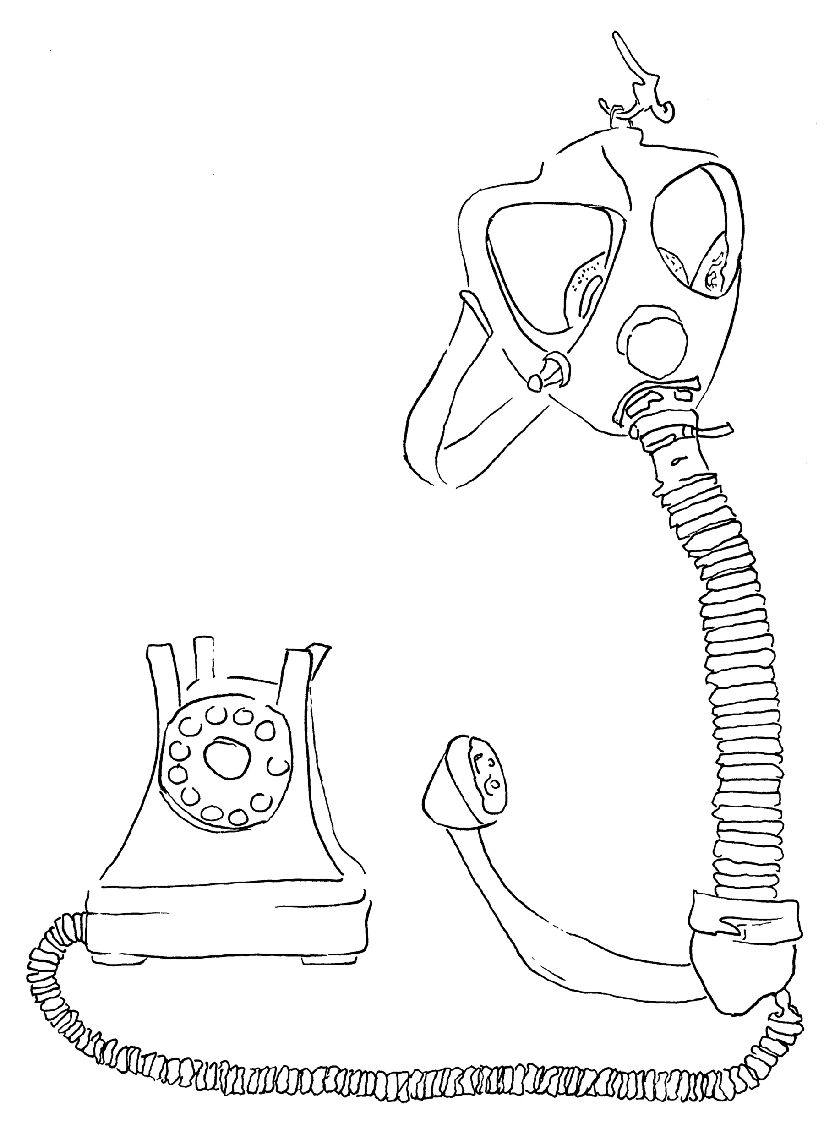
#4: It’s Merely Metadata
Sources of metadata
Local, network, remote
Importance of metadata
Compact data about behaviour, collected surreptitiously
Privacy in technical terms:
CIA + Unlinkability, Transparancey, Intervenabiltiy
Mix networks and onion routing

Slide 20
#4: It’s Merely Metadata

Slide 21
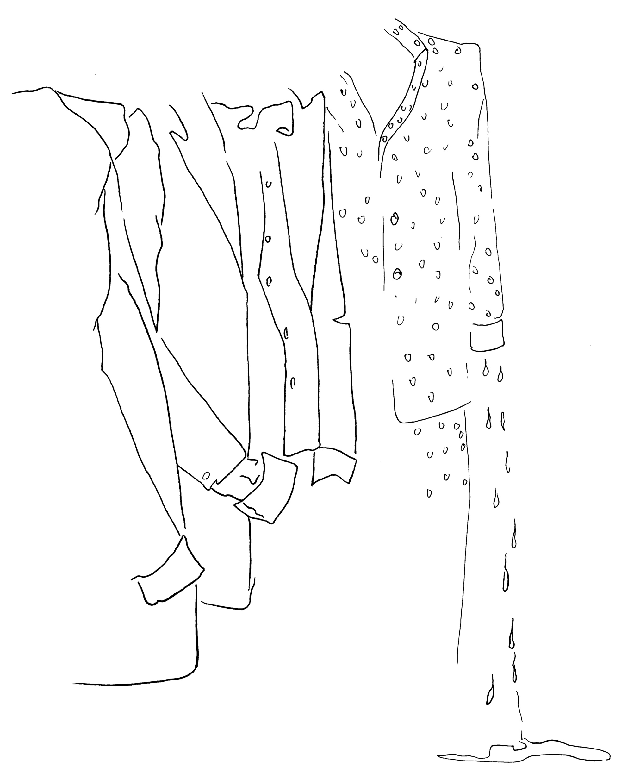
#5: We Always Need To Know Who You Are

Slide 22

Really???
Pass

Slide 23
Attribute Based Credentials (ABCs)
The Dutch government claims that Jaap-Henk Hoepman has the
Dutch nationality
Issuer I claims that
Person P has
Value V for
Attribute A
The bank claims that
Jaap-Henk Hoepman has a good credit rating
The land registrar claims that Jaap-Henk Hoepman has a PhD in law
!

Slide 24
Attribute Based Credentials: Issuing
!
service
credential
issuer
“User”
service
!
credentials
credential
issuer
service

Slide 25
Attribute Based Credentials: Showing
!
service
credential
issuer
“User”
service
!
credentials
credential
issuer
service

Slide 26

ABC in practice
https://privacybydesign.foundation

Slide 27
Zero knowledge proofs: Ali Baba’s Cave

Slide 28
#5: We Always Need To Know Who You Are

Slide 29
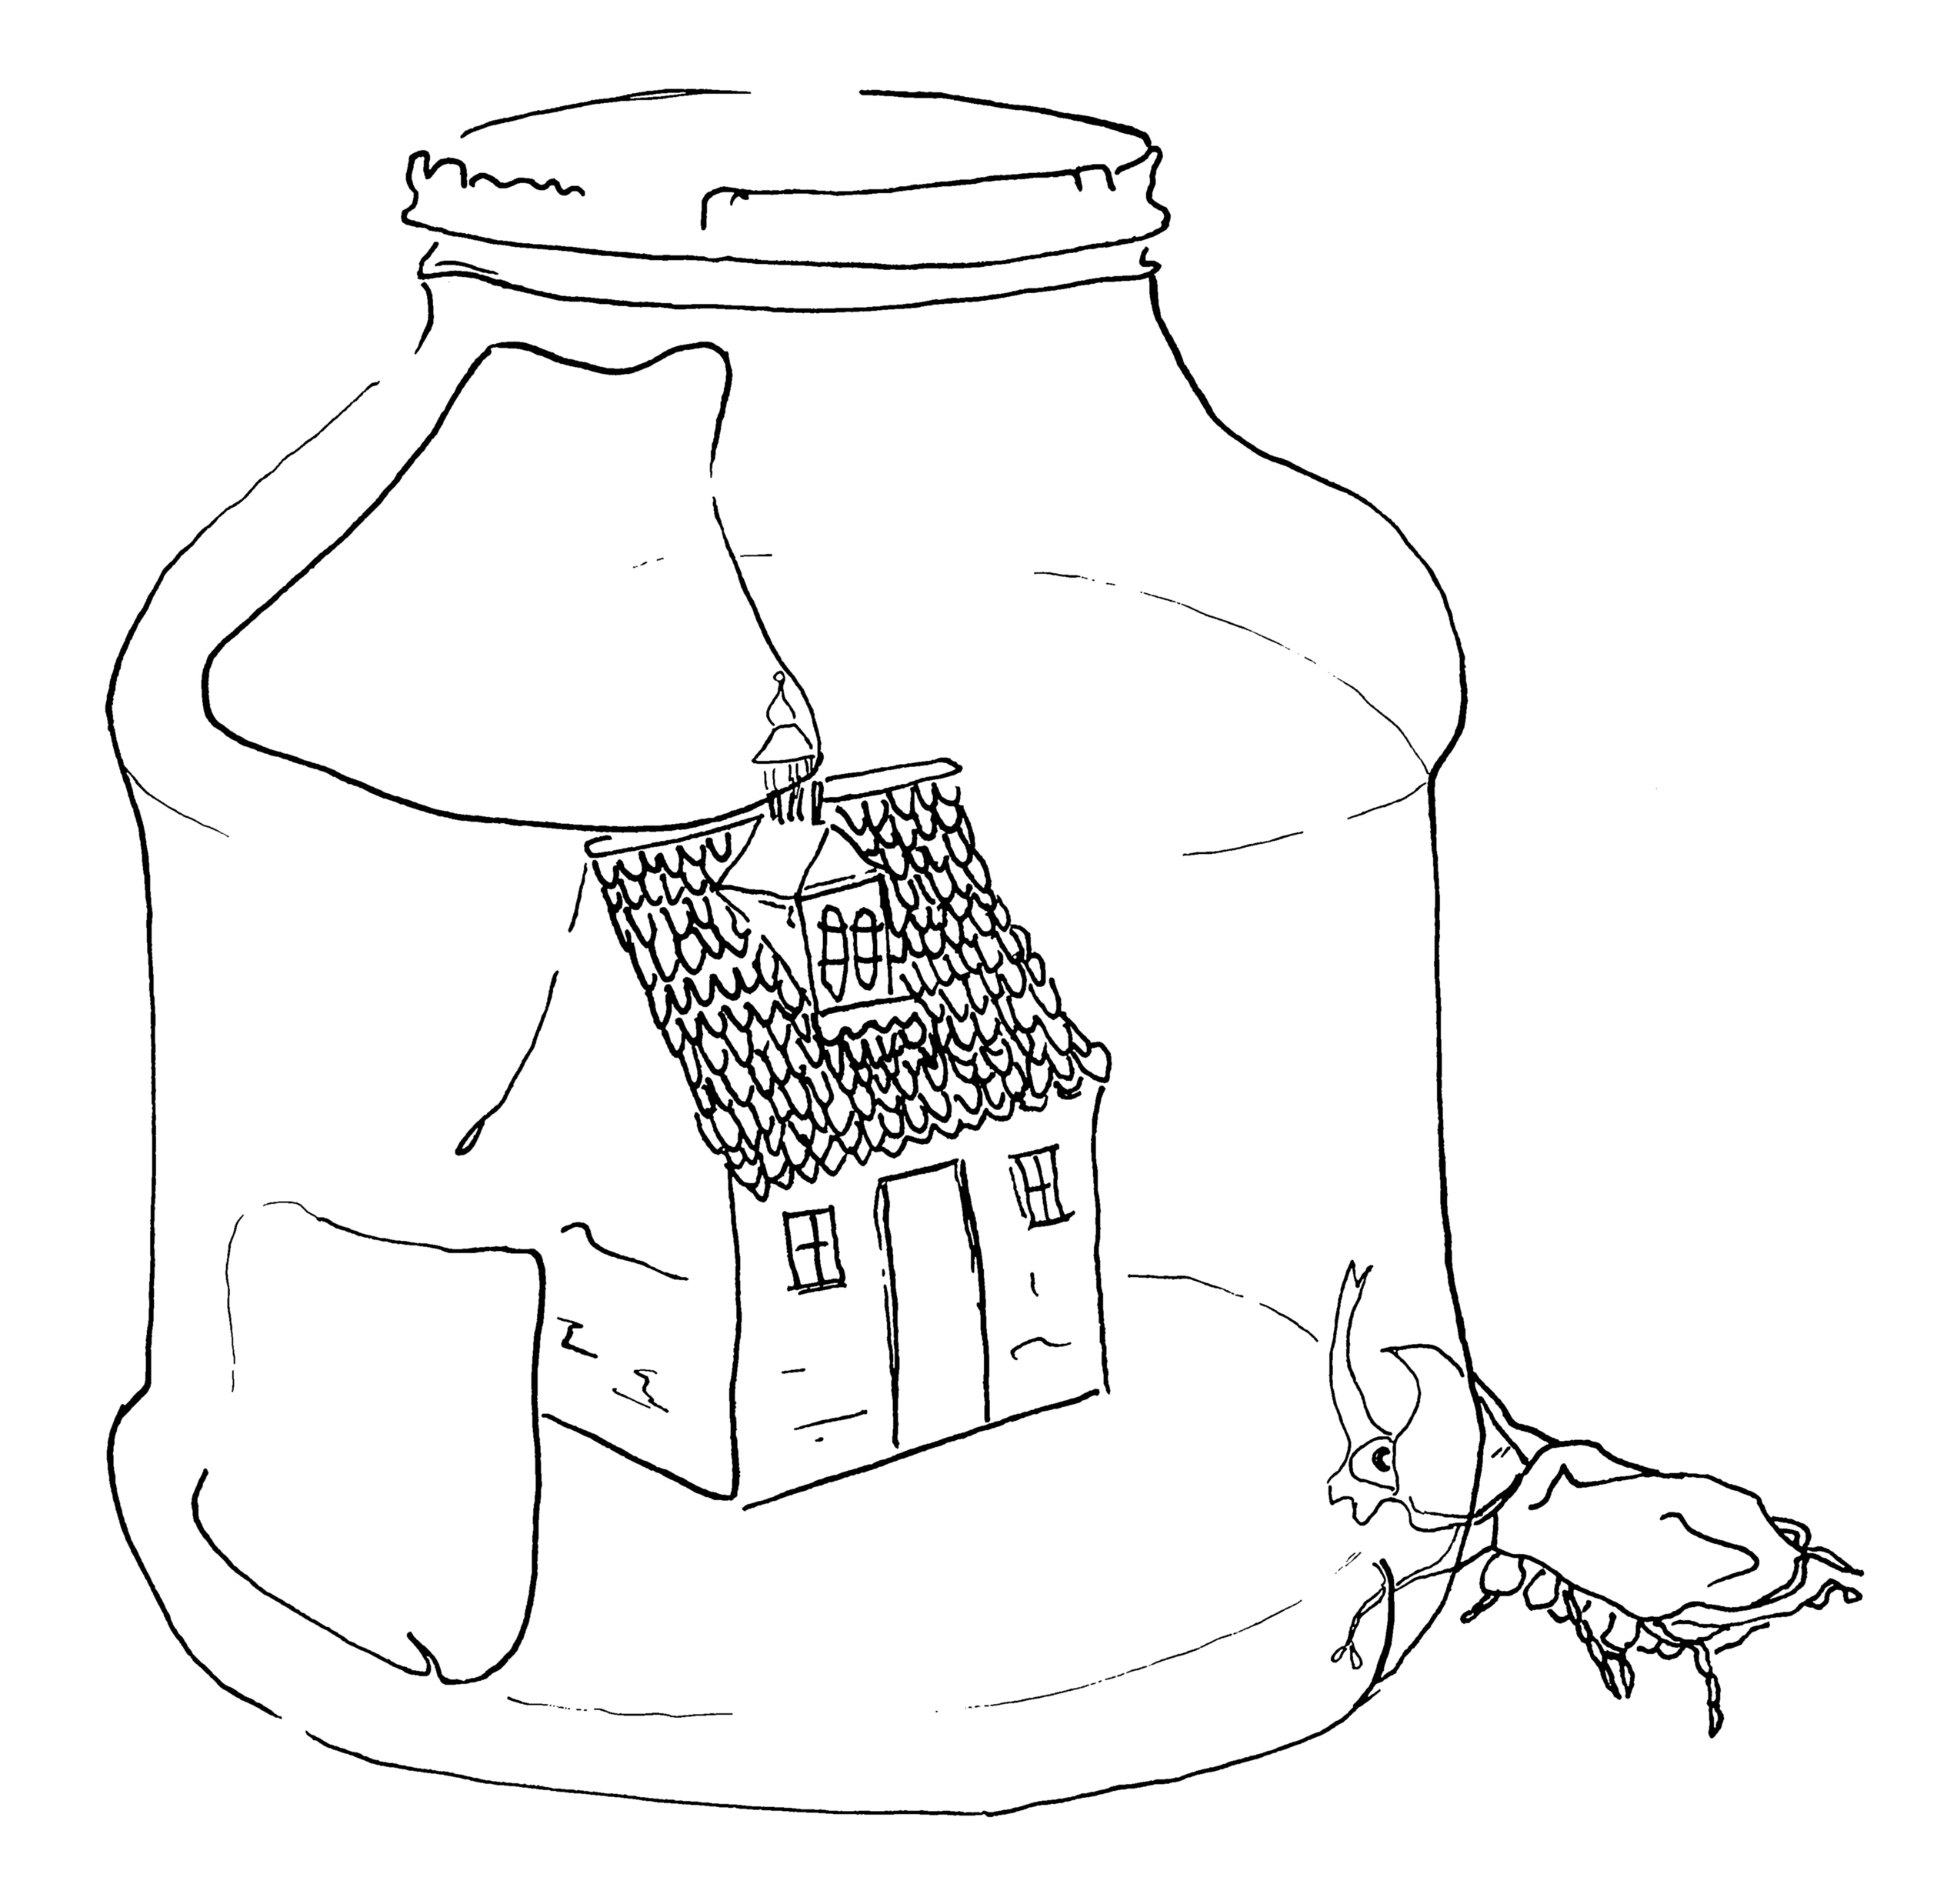
#6: Your Data Is Safe With Us
Google, Facebook campaign
Your data is safe with us
Centralised, decentralised, distributed
Client server (the norm)
Personal data stores (the shift)
P2P/edge computing (the future)
Make local processing the default
Many apps don’t need a server
Elephant in the room: business models

Slide 30
Personal data stores

Slide 31
Distributed, peer-to-peer, processing

Slide 32
#6: Your Data Is Safe With Us

Slide 33
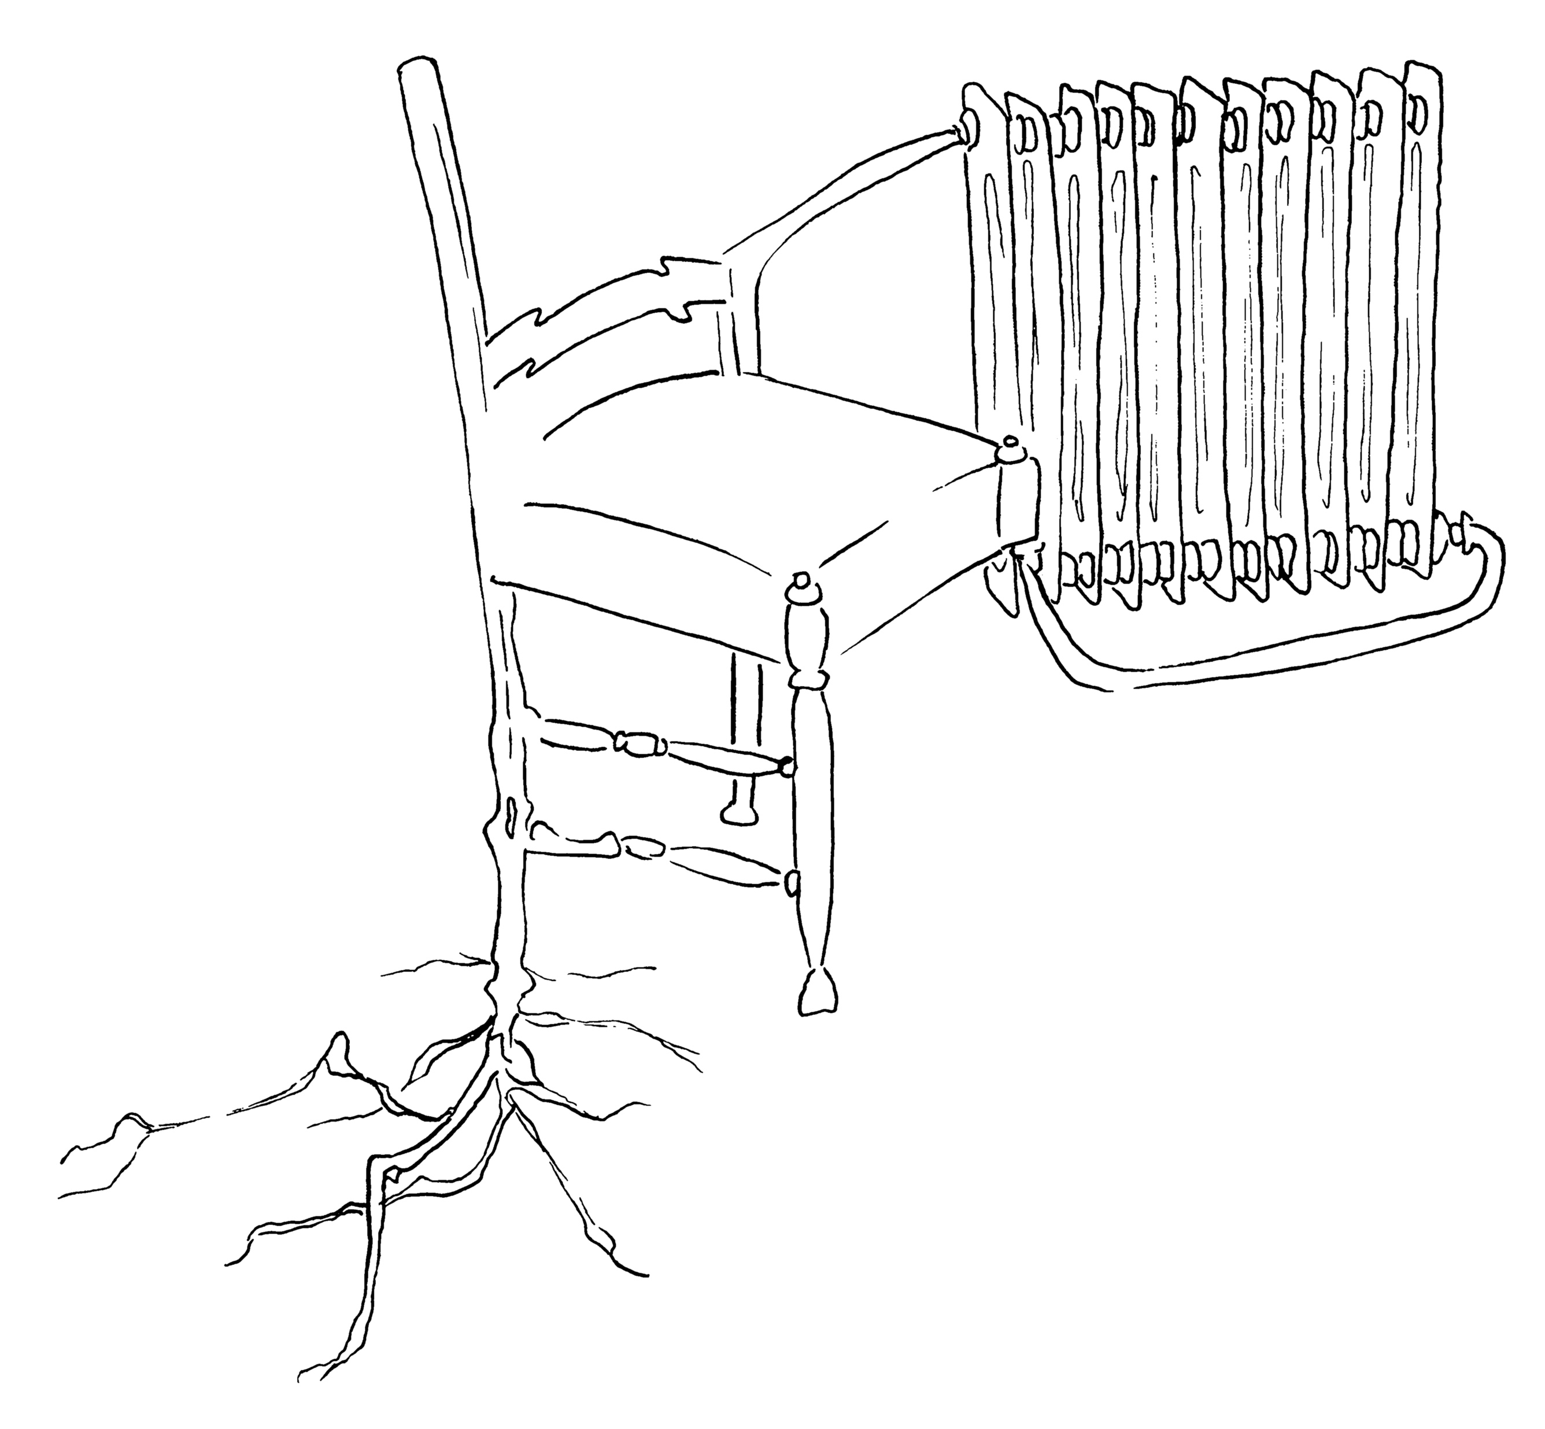
#7: Privacy And Security Are A Zero-Sum Game
Trench warfare
“It is highly unlikely that either extreme—total surveillance or total privacy—is good for our society.”
Bridging the gap
David Chaum: DigiCash
Revocable Privacy

Slide 34
#7: Privacy And Security Are A Zero-Sum Game

Slide 35
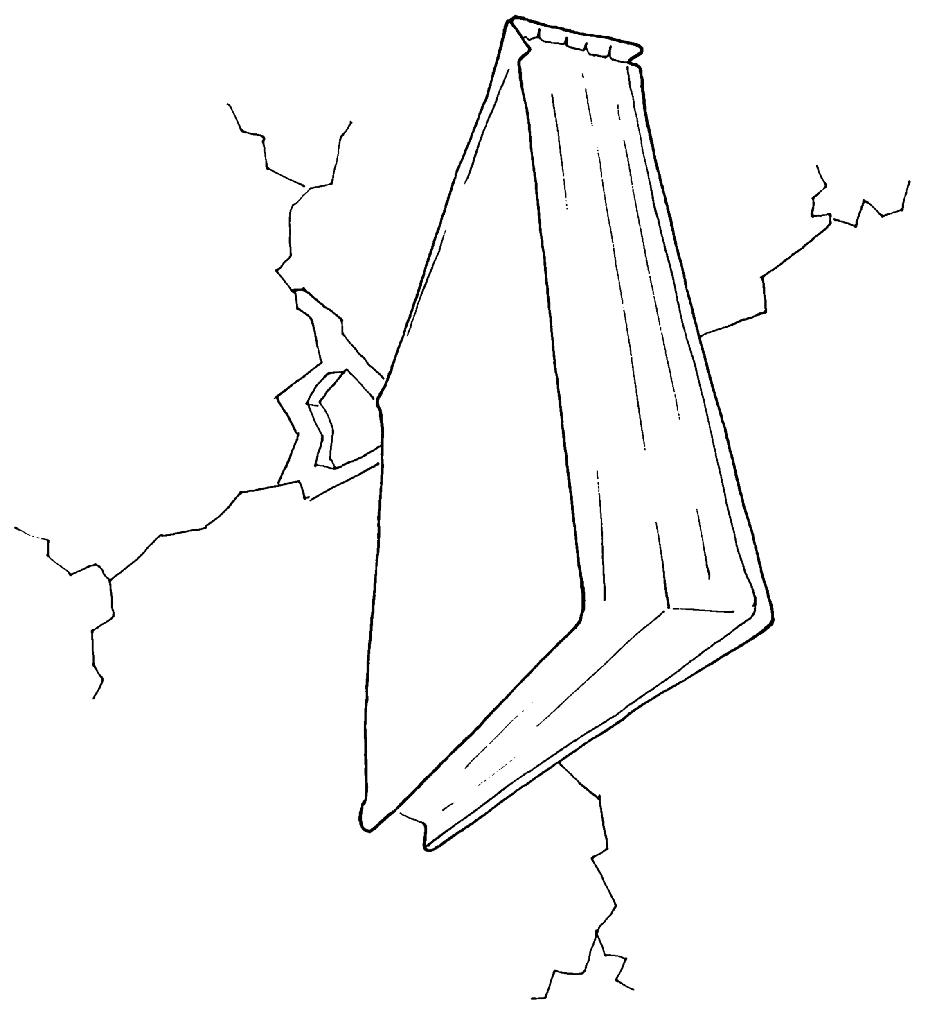
#8: Privacy Is Hard

Slide 36
Society
Law
Technology
Notes:
multidisciplianry

Slide 37
Business
DPO
Engineering
Notes:
multidisciplianry

Slide 38

How?
Notes:
Big gap : law -> tech and from concept -> design

Slide 39
Privacy design strategies map
fuzzy legal concepts to
concrete data protection goals
to help control data processing
Legal norms
(Technical) design requirements

Slide 40
Life cycle approach

Slide 41
The core idea
Attributes
Individuals
minimise
separate
abstract
hide

Slide 43
Privacy by design
System development cycle
Privacy design strategies

Slide 44
Eight privacy design strategies
Data oriented
Process oriented
Minimize
Limit as much as possible the processing of personal data.
Separate
Separate the processing of personal data as much as possible, to prevent correlation.
Abstract
Limit as much as possible the detail in which personal data is processed.
Hide
Prevent personal data to become public or known.
Inform
Inform data subjects about the processing of their personal data.
Control
Provide data subjects control about the processing of their personal data.
Enforce
Commit to processing personal data in a privacy friendly way, and enforce this.
Demonstrate
Demonstrate you are processing personal data in a privacy friendly way.

Slide 46
Design pattern : e.g. how to cross a river?
Bridge
Ferry

Slide 47
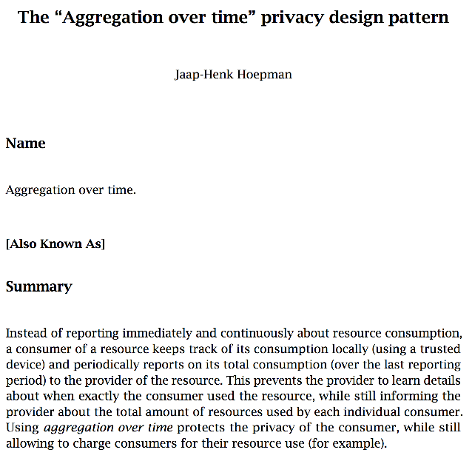
Privacy design patterns
Describes a recurring pattern of communicating components that solve a general problem in a specific context
Summary
Context
Problem
Solution
Structure
Consequences
Requirements
http://privacypatterns.org
https://github.com/p4pnl/patterns

Slide 48
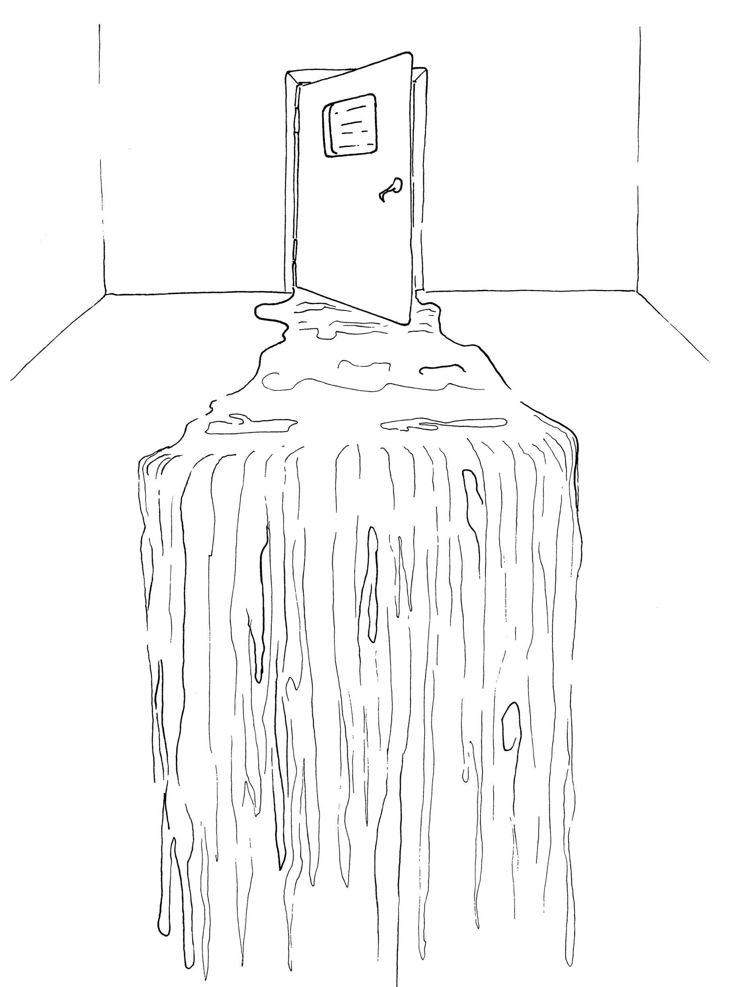
#8’: Privacy Isn’t Hard If You Try
All drawings © Gea Smidt, https://www.geasmidt.com

Slide 49
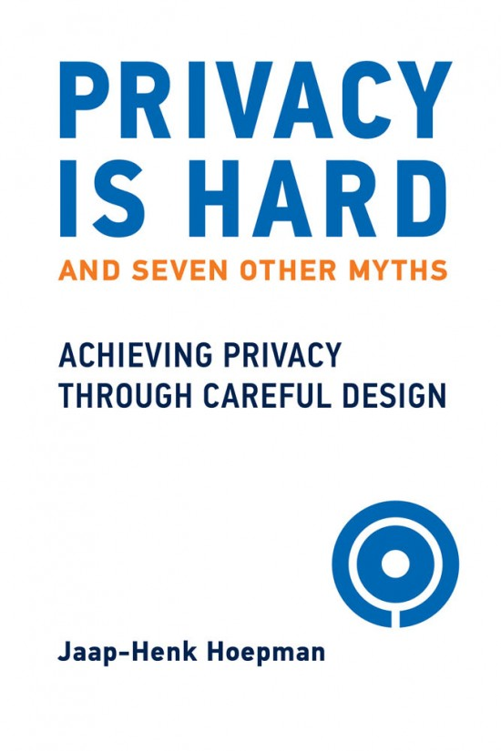
Publisher:
MIT Press
Release date:
October 5, 2021
https://mitpress.mit.edu/books/privacy-hard-and-seven-other-myths

