Slide 1
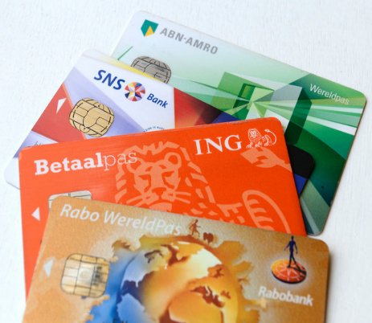
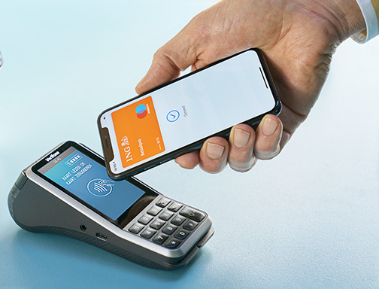
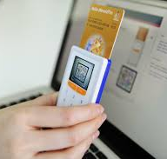

EMV
Erik Poll
Digital Security

Slide 2
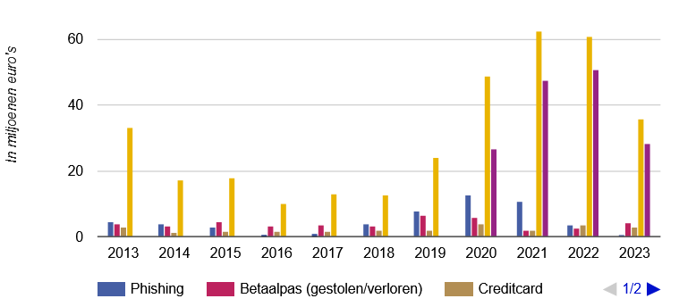
Payment fraud in Netherlands
Sources: Dutch Payment Association Nederlandse Vereniging van Banken (NVB)
https://factsheet.betaalvereniging.nl https://www.bankinbeeld.nl/thema/veiligheid

Slide 3
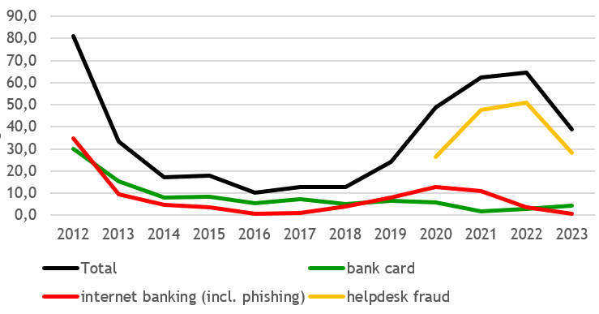
Payment fraud in Netherlands – longer term trends
incl. skimming, stolen
& lost cards
incl. malware & phishing
Sources: Dutch Payment Association Nederlandse Vereniging van Banken (NVB)
https://factsheet.betaalvereniging.nl https://www.bankinbeeld.nl/thema/veiligheid

Slide 4
Overview
The EMV standard
  Known issues with EMV
EMV contactless
Formalisation & Verification of EMV using F# and ProVerif
EMV-CAP for internet banking
Conclusions

Slide 5





EMV
Started 1993 by EuroPay, MasterCard, Visa
Common standard for communication between
  smartcard chip in bank card (aka ICC)
  terminal (POS or ATM)
  issuer back-end
Specs controlled by which is owned by
Billions of cards in use
Also contactless and on mobile phone

Slide 6
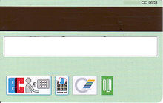
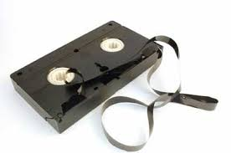
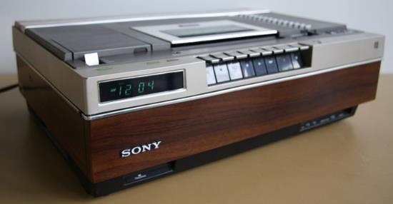
Motivation for EMV chip: skimming
Magnetic stripe (mag-stripe) on bank card can contain digitally signed information
but... this info can be copied

Slide 7
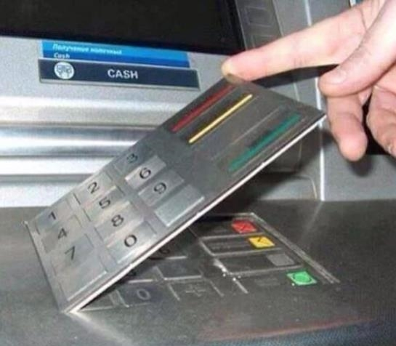
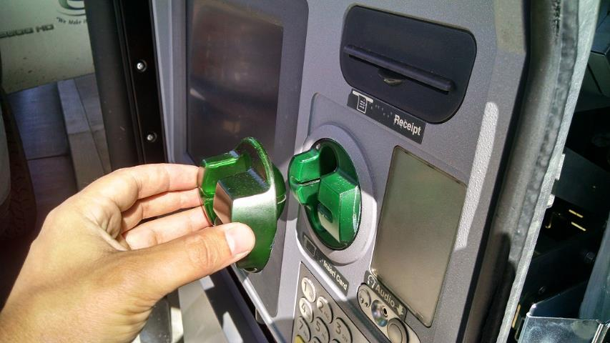
Skimming equipment
Fake keyboard
to intercept PIN code
Fake cover
that copies magnetic stripe

Slide 8
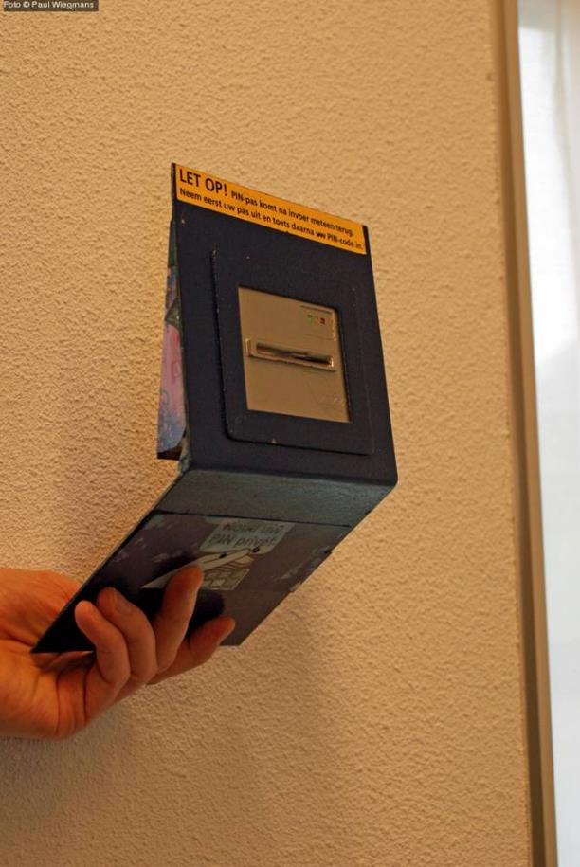
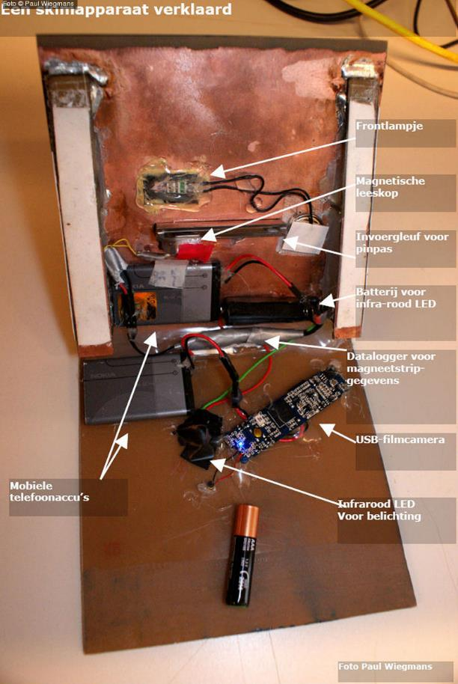
Skimming equipment for NS terminals

Slide 9

Skimming in the Netherlands
    [Source: NVB/Betaalvereniging]
Drop due to
better monitoring, detection, and reaction (esp. blocking cards)
introduction of EMV (2012)
geoblocking (2013)

Slide 10
Does EMV chip reduce skimming?
UK introduced EMV in 2006
USA is still migrating to EMV, and criminals have moved there...
 | 2005 | 2006 | 2007 | 2008
domestic | 79 | 46 | 31 | 36
 | 2005 | 2006 | 2007 | 2008
domestic | 79 | 46 | 31 | 36
foreign | 18 | 53 | 113 | 134
Skimming fraud with UK cards, in millions ₤ [Source: Payments UK]

Slide 11
Liability shifts
Move to EMV chip involves liability shifts
Customer liable for fraud with their PIN code
Vendors liable for fraud if they still use magstripe
    In the USA, for POS starting Oct 2015, for ATMs starting Oct 2017, for petrol stations starting Oct 2020

Slide 12
The EMV standard

Slide 13
The EMV protocol suite
EMV is not a protocol, but a toolkit of building blocks for protocols with
  3 card authentication mechanisms
    SDA, DDA, CDA
  5 cardholder verification mechanisms
    online PIN, offline plaintext PIN, offline encrypted PIN, handwritten signature, no card holder verification
  2 types of transactions: offline, online
  All mechanisms again parameterised by Data Object Lists (DOLs)
Specs public but very complex (4 books, >750 pages)
  Specs do not motivate design or mention security objectives…

Slide 14

EMV protocol phases
Initialisation
  Terminal reads some data from the card, incl. several DOLs
Card Authentication (using SDA, DDA or CDA)
Cardholder Verification (optional, for instance using PIN)
Terminal & Card Risk Management
Transaction
  where the card produces Application Cryptogram (AC)
  with HMAC calculated with shared symmetric key
  NB terminal does not have this key, so it cannot authenticate cryptograms when it is offline

Slide 15
Parameterisation using DOLs
Data Object Lists specify a list of data elements
  eg amount, currency, primary account number (PAN), application transaction counter (ATC), card/terminal-generated nonce (UN), …
Cards contain several DOLs that specify
  data elements required as input to the card
  data elements included in HMACs produced by the card
NB this means the protocol is still fully configurable. Eg including the amount and currency in the HMAC makes sense, but is not required.

Slide 16


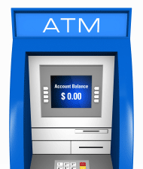
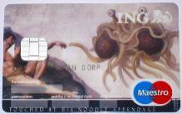









EMV key set-up
Card & issuer have a shared symmetric key (3DES or AES) used to compute HMACs on transactions
  Terminal does not have this key, so cannot check these
Issuer has private RSA key and terminal knows public key
  This allows SDA: terminal authenticates static signed data on the card
(Optional) DDA & CDA cards have a private RSA key and associated certificate, signed by issuer
  Card can now sign dynamic data that terminals can authenticate
    to authenticate card or transaction

Slide 17


II. Card Authentication: SDA
SDA – Static Data Authentication
  SDA card cannot do asymmetric crypto
  Card presents static data (card no, expiry date etc) signed by issuer ie. card no, expiry date, ...++ { hash(card no, …) }_{PRIVKEY-ISSUER}
  Problem: can be replayed, so card can be cloned
    Of course, clone will always say offline PIN check succeeded
  Hence: offline terminal can be fooled
    Transaction is signed (MACed) using symmetric key, but terminal cannot check this MAC
    Issuer will spot this fraud later
SDA is being phased out; Visa & Mastercard forbid issuance of offline capable SDA cards since 2011

Slide 18

II. Card Authentication: DDA
SDA – Static Data Authentication
DDA – Dynamic Data Authentication
  Card has (Pub,Priv) keypair and does challenge-response
    This requires more expensive card than SDA: one that can do asymmetric crypto
  Security flaw : card authenticated, but not the transaction
  Hence: offline terminal can still be fooled
    Attacker can let the terminal authenticate the card but then spoof the subsequent transaction data with its HMAC using some MitM device
    Issuer will spot fraud later

Slide 19
II. Card Authentication: CDA
SDA – Static Data Authentication
DDA – Dynamic Data Authentication
CDA – Combined Data Authentication
  Card has (Pub,Priv) keypair, as in DDA
  Signature now added over all the transaction data
    so now an offline terminal can check the authenticity of the card and of the transactions

Slide 20
II. Card Authentication
SDA – Static Data Authentication
DDA – Dynamic Data Authentication
CDA – Combined Data Authentication
Most cards in use today are DDA

Slide 21
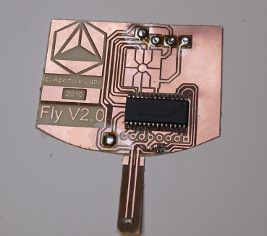
III. Cardholder Verification Methods (CVMs)
PIN
  online: PIN checked by the issuer
  offline: PIN checked by the chip
    b1. unencrypted
    PIN could be eavesdropped using shim
    b2. encrypted
    requires a card that can do asymmetric crypto
Handwritten signature
Nothing
NB: only offline PIN involves the smartcard chip; Dutch bank cards typically do online PIN

Slide 22
Cardholder Verification Methods (CVM)
Terminal and smartcard negotiate which CVM is used
  given their list of rules that specify allowed/supported method, in order of preference, with conditions
  Eg. transactions at tollroads do not require PIN, (contactless) payments under certain aim do not require PIN, …
Potential for trouble: forcing terminal/card to fall back to a weak CVM

Slide 23
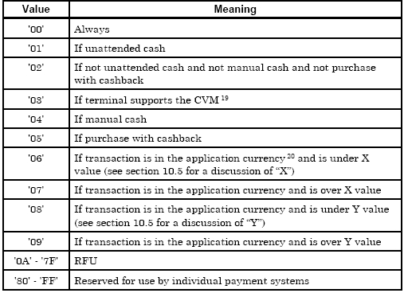
conditions for applying specific CVM method

Slide 24
V. Transaction
For the transaction the card generates cryptograms
  ie data with HMAC, and for CDA-cards, also a digital signature
For offline transactions the card just generates one cryptogram (TC)
For online transactions the card generates 2 cryptograms
  Card generates a first cryptogram (ARQC) that the terminal forwards to the issuing bank
  Bank sends a reply which the terminal forwards to the card
    telling the card to go ahead or not
  Card generates second cryptogram (TC) confirming the transaction, provided the bank gave approval

Slide 25
V. Transaction
The data is included in the cryptograms is configured by DOLs (Data Object Lists)
It typically includes
  the amount
  a terminal-generated nonce (aka Unpredictable Number)
  the card’s Application Transaction Counter (ATC)
    a counter that is increased with each transaction
currency | amount | ATC | UN | HMAC = Enc(hash(currency, amount, ATC, UN))

Slide 26
EMV limitations & troubles…

Slide 27
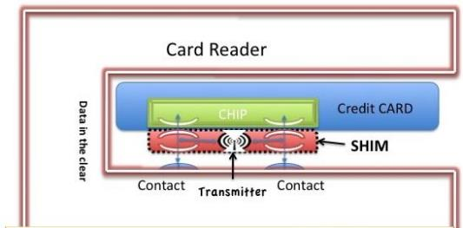
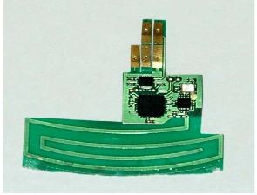
Man-in-the-Middle attacks
Passive eavesdropping and active MitM possible with a shim
Two abuse scenarios
  tampering with a terminal
  shim invisible in terminal for MitM attack
  tampering with a card, which is then used at normal terminal
eg acting as relay of (stolen?) genuine card to a terminal

Slide 28
Already discussed
SDA cards can be cloned
  Fundamental limitation due to absence of asymmetric crypto on SDA cards
  NB back in the 1990s it was, but nowadays speed or costs are no longer valid excuses not to use asymmetric
DDA card cannot be cloned, but with a DDA card we can fool the terminal into accepting a bogus offline transaction
  Stupid design decision to only use the asymmetric key to authenticate the card and not also the transaction

Slide 29
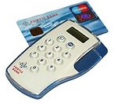
3. Backwards compatibility...
Track 2 magstripe data is also used by the EMV chip, so after eavesdropping on (unencrypted!) chip-terminal communication an attacker can reconstruct the magstripe
If the card uses offline plaintext PIN, attacker can also eavesdrop the PIN, so attacker does not need a camera
First incident with tampered EMV-CAP readers inside Dutch ABN-AMRO bank branches
  Criminals caught & convicted in 2011
EMV specs have been updated to avoid this

Slide 30

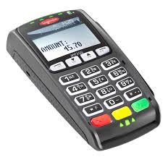
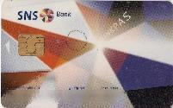
4. Offline PIN: spot the security problem!
Terminal can choose to do offline PIN, ie. ask the card to check the PIN
The OK response is simply the status word 0x9000
PIN
PIN
OK!

Slide 31
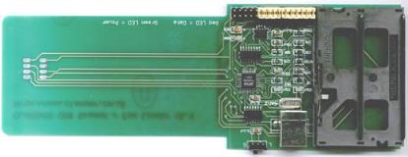
4. Offline PIN: spot the security problem!
Terminal can choose to do offline PIN, ie. ask the card to check the PIN
The OK response is simply the status word 0x9000
Problem: OK response is not authenticated so terminal can be fooled by a Man-in-the-Middle attack
The cryptogram will reveal the transaction was PIN-less, so the bank will later know the PIN was not entered
[Stephen Murdoch et al., Chip & PIN is broken, FC’2010]
Reportedly won’t work in NL, as Dutch cards always go online for PIN check
PIN
PIN
OK!

Slide 32
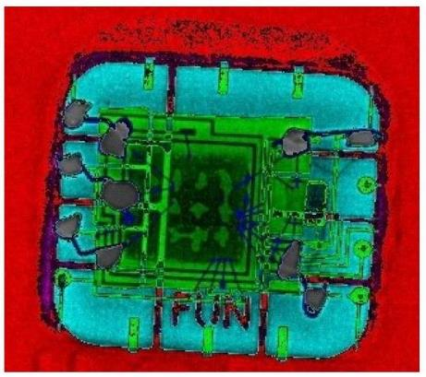
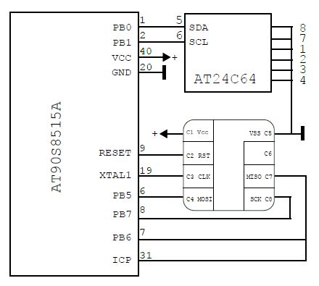
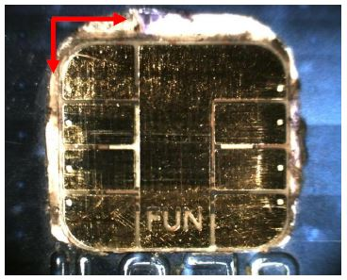
Criminal use of this ‘PIN OK’ attack
Tampered cards used by criminal gang: chips from stolen cards inserted under another chip that carries out MitM attack to fake ‘PIN OK’ response
[Houda Ferradi et al., When Organized Crime Applies Academic Results: A Forensic Analysis of an In-Card Listening Device, Journal of Cryptographic Engineering, 2015]
xray reveals
green stolen chip under
blue microcontroller

Slide 33
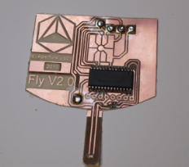
5. Rollback to unencrypted PIN
Shim can force a rollback to unencrypted PIN, by modifying card response to indicate the card does not support it
Strangely, the terminal can tell the card is lying, as the signature over static card data is incorrect, but it does not abort the transaction!
[Barisani et at, Chip & PIN is definitely broken, DEFCON 2011]
Impact limited because
  just having the PIN of a DDA card is useless without the card
  the attack is detectable in the back-end
Reportedly, most terminals in NL patched to disallow this rollback
We tried this attack, and bank detected it almost in real time
  the one terminal we tried had not been patched…

Slide 34
6. Bad random number generation
Successive 32 bit random numbers in the log of a Maltese ATM
F1246E04
F1241354
F1244328
F1247348
This weak random number could be abused:
attacker with temporary access to card can copy static data and
record enough responses to make a clone (pre-play attack)
[Bond et al. , Chip and Skim: cloning EMV cards with the pre-play attack, CHES 2012]
More information about criminal ATM hacks:
https://blog.kaspersky.com/sas-2017-atm-malware/14509, April 2017
https://darknetdiaries.com/episode/35/

Slide 35
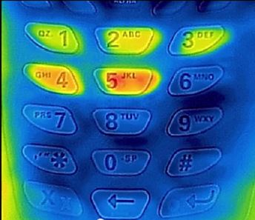
Stealing PIN codes using infrared?
Claims of attacks using infra-red camera to observe PIN
[Source: iPhone ATM PIN code hack, https://www.youtube.com/watch?v=8Vc-69M-UWk]

Slide 36
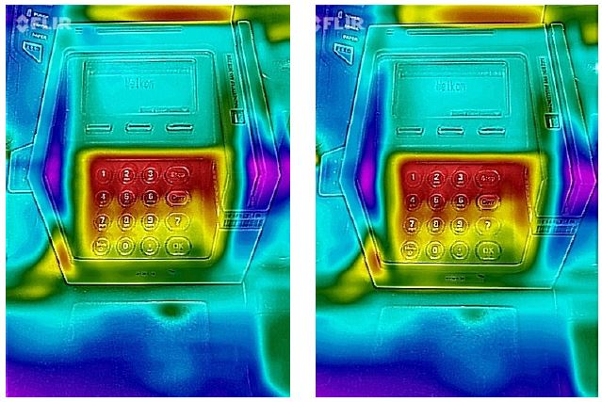
Stealing PIN codes using infrared?
These claims are bogus!
Dutch police and national TV programs (Tros Opgelicht & Opsporing Verzocht) believed this bogus story.
https://www.politie.nl/gezocht-en-vermist/gezochte-personen/2016/januari/09-oost-brabant/09-diefstal-pinpas-en-nieuwe-methode-pinpasfraude.html
For computer keyboards it has proven possible: ‘Thermanator: Thermal Residue-Based Post Factum Attacks on Keyboard Data Entry’, Asia CCS 2019, https://doi.org/10.1145/3321705.3329846
Thermal images we took after entering 2 different PINs

Slide 37
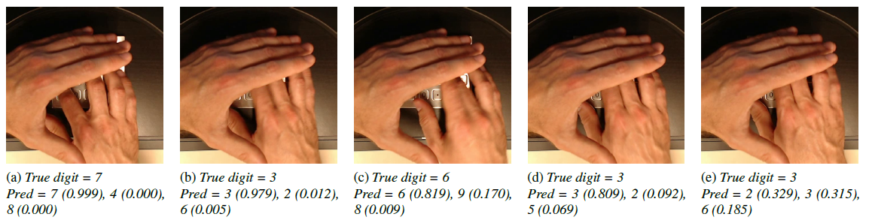

Inferring PIN code from (covered) hand movements
Machine Learning models can be trained to recover PIN code from movements of covered hand
Matteo Cardaioli, Stefano Cecconello, Mauro Conti, Simone Milani, Stjepan Picek, and Eugen Saraci ‘Hand Me Your PIN! Inferring ATM PINs of Users Typing with a Covered Hand’, USENIX Security, 2022

Slide 38
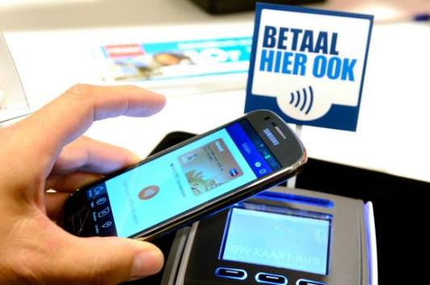
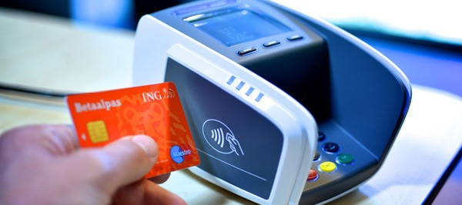
Contactless payments

Slide 39

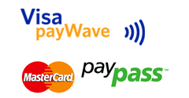
Contactless EMV
with ISO/IEC 14443 contactless or dual contact card
or NFC mobile phone
Instead of one generic spec, as for contact payments, there are
individual specs for each of the 10 versions
  in 10 books, > 2000 pages
Same building blocks as original contact spec, but some efforts to minimize the number of messages

Slide 40
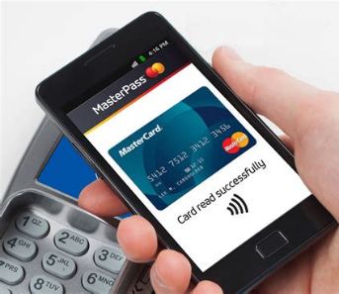
Security challenge with mobile phones
Where to securely store keys & PIN?
Where do compute MACs & signatures using these keys?
Solutions include
Use the SIM card Briefly tried by Rabobank, but national scheme with all banks & telcos abandoned
Using secure hardware in the phone: Apple Secure Enclave on iPhone, hardware-backed keystore (aka Strongbox Keymaster) on Android
Store keys in main memory & use the normal processor
  Possible security enhancements:
  using white-box crypto to obfuscate key material
  have symmetric key that can only be used for one transaction, so that app needs a new key for each transaction, aka EMV Tokenization
Use of biometric authentication on phones can offer security advantage over smartcard.

Slide 41
Security & privacy worries
Contactless payments, without PIN, seem insecure…
Who uses a metal container to shield their contactless bank card?
Who has asked their bank to disable contactless payments for their card?
Who thinks that contactless payments without PIN is less secure than contact payment with PIN?

Slide 42
Passive attacks on contactless cards
Eavesdrop on wireless communication between terminal & card
  This is possible at 10-20 meters
Eavesdropping only poses a small privacy risk:
  The communication reveals eg. your bank account nr
  (Recall that most EMV communication is unencrypted)

Slide 43
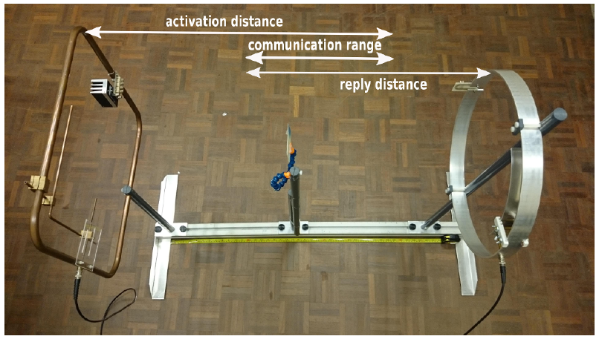

Active attacks on contactless cards
Secretly activate card in someone’s pocket (aka digital pickpocketing)
  This is only possible at 40-50 cm because activating the card requires a strong magnetic field
        [René Habraken et al., An RFID Skimming Gate Using Higher Harmonics, RFIDSec 2015]

Slide 44
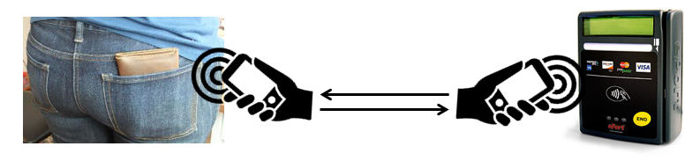
Active relay attack on EMV contactless
Active attacker can do a relay attack
But is there a good criminal business model? Probably not…
Relay attacks normally require very fast relay (< 200 msec) or else a time-out occurs.
Time-out of contactless payment terminal:
> 50 seconds
Improvement in EMV protocol now includes distance bounding - ie. time-critical - step, but it will be many years before this ever gets implemented in cards & terminals

Slide 45
Risks of PIN-less contactless payments?
Risks of contactless payment without PIN
  You loose max. € 50 if your card is stolen
  You loose max. € 25 euro if you fall victim to a relay attack
  Dutch banks typically cover these losses.
Risks of contact payment with PIN
  You don’t loose any money if your card is stolen
  You can loose €1000 or more if your card is stolen after attacker snooped your PIN code
  Banks will typically not cover these losses…
So the ‘extra security’ of the PIN probably increases risk for customers.
As always: technical security weakness ≠ risk
where risk = likelihood x impact

Slide 46
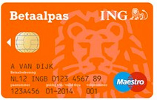
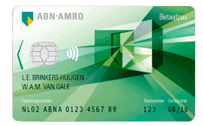


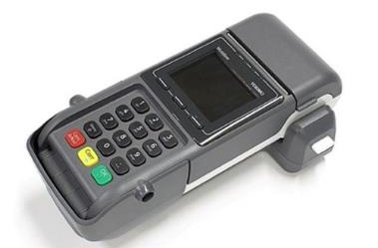
Some flaws our students found
A Security Evaluation and Proof-of-Concept Relay Attack on Dutch EMV Contactless Transactions
Mistake in most first generation Dutch contactless cards:
  functionality to check the PIN code offline, which should only be accessible via the contact interface was also accessible via the contactless interface
Possible risk for DoS attacks, rather than financial fraud?
Flaw discovered by Anton Jongsma, Robert Kleinpenning, and Peter Maandag.
Contactless payment terminals of one manufacturer could be crashed with a legal – but unusual – input
  namely an extended length APDU
  Flaw discovered by Jordi van den Breekel
  Why are terminals not tested better as part of certification?

Slide 47
EMV contactless: Backwards compatibility
Early contactless cards suffered from two problems due to backwards compatibility problems
Very early contactless credit cards reported magstripe data unencrypted over the air, so magstripe clone can be made
  [Heydt-Benjamin et al, Vulnerabilities in First-Generation RFID-enabled Credit Cards, FC 2007]
Later contactless credit cards use a dynamically generated 3 digit code to replace the 3 digit CVC code. But 3 digits is not a lot of entropy, so codes can be harvested & replayed
  [M. Roland et al. Cloning Credit Cards: A combined pre-play and downgrade, WOOT 2013]

Slide 48
Formalising & Verifying EMV
[Joeri de Ruiter and Erik Poll, Formal analysis of the EMV protocol suite, TOSCA 2011]

Slide 49
Complexity of the EMV specs
Specs too complex to understand
  long specs, split over 4 books, > 750 pages
    for contactless: another 10 books, > 2000 pages
  little or no discussion of security goals or design choices
  little abstraction or modularity

Slide 50
Problem: complexity
One sample sentence taken from these thousands of pages
  “If the card responds to GPO with SW1 SW2 = x9000 and AIP byte 2 bit 8 set to 0, and if the reader supports qVSDC and contactless VSDC, then if the Application Cryptogram (Tag '9F26') is present in the GPO response, then the reader shall process the transaction as qVSDC, and if Tag '9F26' is not present, then the reader shall process the transaction as VSDC.”

Slide 51
Formalising EMV ?
Can formal techniques for security protocol analysis with tools like ProVerif cope with EMV?
First attempt: formalising EMV in ProVerif
Horrible! Case distinctions in applied pi-calculus cause lots of duplication
Beware: real protocols always involve multiple variants, so in ProVerif people typically only verify one variant, leaving out options & abstracting away from lots of messy details…
Second attempt: formalising EMV in F#
Much better! F# allows sequential if-statements & functions

Slide 52
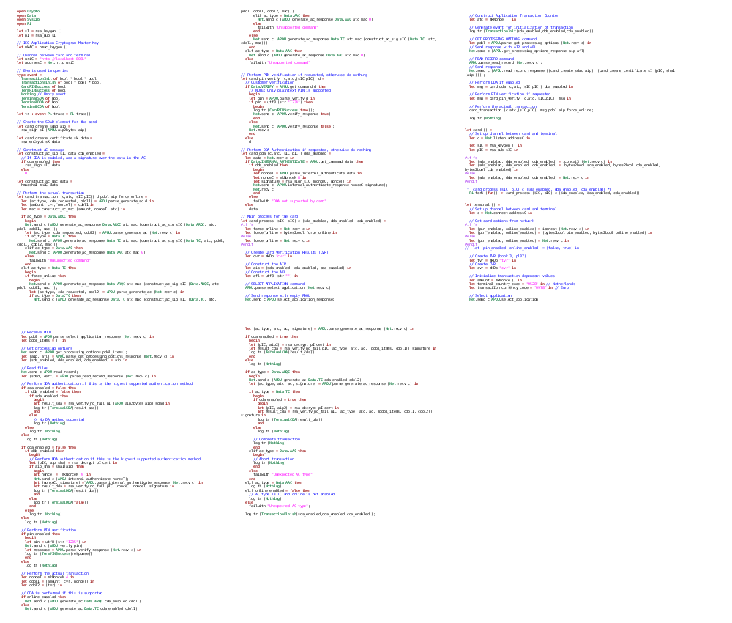
Formalisation of EMV
(Known) security flaws can now be found automatically by
FS2PV & Proverif tool for security protocol verification

Slide 53
Formalisation of EMV in F#
EMV can be formalised in 370 lines of F# code
  including all options
    SDA, DDA, CDA
    any card holder verification mechanism
    off/online transations
  But DOLs has to be fixed
    Model uses minimal assumptions on DOLs taken from Dutch bank & credit cards
    Hardcoded in the model, but could easily be changed

Slide 54
Part of EMV model: DDA
// Perform DDA Authentication if requested, otherwise do nothing
let card_dda (c, atc, (sIC,pIC), nonceC) dda_enabled =
let data = Net.recv c in
if Data.INTERNAL_AUTHENTICATE = APDU.get_command data then
if dda_enabled then
begin let nonceT = APDU.parse_internal_authenticate data in
let signature = rsa_sign sIC (nonceC, nonceT) in
Net.send c (APDU.internal_authenticate_response nonceC signature);
Net.recv c
end
else failwith "DDA not supported by card"
else data

Slide 55
Analysis of the F# model
F# can be translated to pi calculus by FS2PV tool and then analysed using ProVerif
Translation to pi calculus explodes things a bit
  370 lines of F# becomes 3 kloc of pi calculus
But… ProVerif can still verify security properties
  usually in minutes, but this requires some care!

Slide 56
Properties checked with ProVerif
Sanity checks to ensure absence of deadlock
Secrecy of private keys
Highest supported card authentication method is used
  eg no fallback to say SDA can be forced
‘transaction security’: if a transaction is completed, then everyone agrees on the parameters (eg with/without pin, off/online, amount,…)
query evinj:TerminalTransactionFinish(sda,dda,cda,pan,amount,…)
==> evinj:CardTransactionInit(sda,dda,cda,pan,amount,…)
No new attacks found, but most existing attacks inevitably (re)discovered

Slide 57
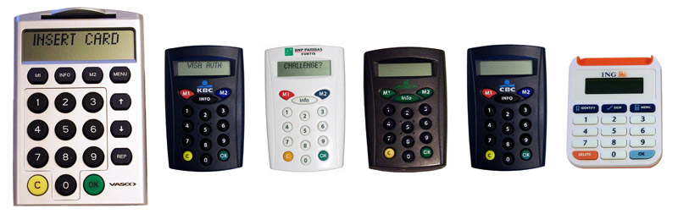
EMV-CAP

Slide 58
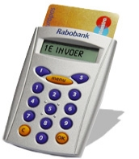
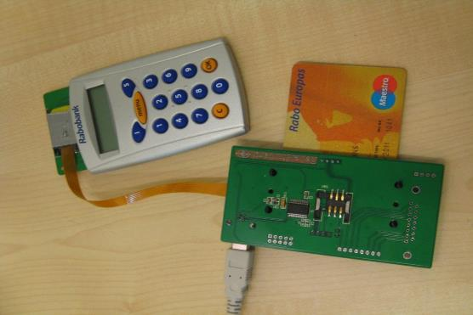
EMV CAP protocol
EMV chip used for internet banking or e-commerce
  challenge-response mechanism using the bank card
EMV CAP is defined on top of EMV:
an EMV-CAP session is an aborted EMV session, where one of the cryptograms is used to construct the 8 digit response
internet banking
  Mastercard : CAP (Card Authentication Program)
  Visa : DPA (Dynamic Passcode Authentication)
e-commerce
  Mastercard: SecureCode
  Visa: Verified by Visa
EMV CAP specs are secret but have been largely reverse-engineered

Slide 59
Limitations of EMV-CAP
EMV-CAP does not protect against e.g.
Man-in-the-Browser attacks,
  ie. malware inside the browser or on the user’s PC
Phishing attacks tricking customers to go to fake bank websites
Social engineering attacks by telephone on customers

Slide 60
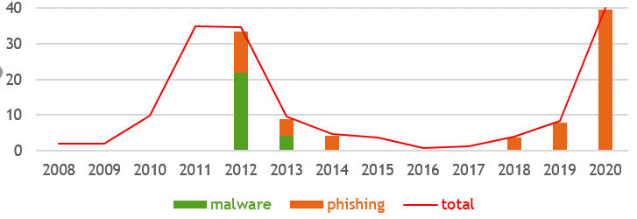
Internet banking fraud in Netherlands (millions euro)
After 2012, up to 2019, fraud under control thanks to
better monitoring - for suspicious transactions & money mules
  finding money mules, to extract money from the system without being caught, is the bottleneck for attackers
awareness campaigns
criminal switching to ransomware as better business model?
[Source: Betaalvereniging]
Notes:
almost all of the current fraud is phishing

Slide 61
Example attack on internet banking (1)
Your online bank statement shows you received 3000 euro from some company you never heard of
You get a phone call from the bank, saying that this is a mistake and asking you to transfer the money back
You never received 3000 euro, but malware in your browser inserts the fake transaction
  i.e. Man-in-the-Browser attack
When you transfer the money back, that is not a fake transaction…

Slide 62

Example attack on internet banking (2)
victim
criminal web shop
bitcoin
web shop
how much for an iPhone ?
200 €
200 € worth of bitcoin, please
cool, I want one
bank
website
redirect to bank
redirect to bank
bitcoins
Problem: Money trail no longer leads to criminal webshop, but to the innocent bitcoin shop
Root cause: messages to user not very informative, so user does not spot the attack
Solution: better monitoring, and banks impose extra rules on bitcoin shops & online casinos for allowing internet payments

Slide 63
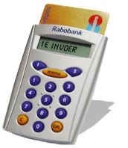
Protocol flaw in EMV-CAP Mode 2
  user → reader : challenge
  reader → card : 0x000000
  card → reader : K ,
  where K = HMAC_{Key}(0x000000 ++ counter)
  reader displays some digits from {challenge}_K
So challenge C never goes to the card!
The message in step 2 is predictable so an attacker with temporary access to a card could harvest responses K to do internet banking later
  [P. Szikora and P. Teuwen, Banques en ligne: à la découverte d’EMV-CAP, MISC (Multi-System & Internet Security Cookbook) , 2011]

Slide 64
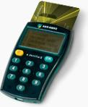
Example attack on internet banking (3)
Security flaw in Gemalto e.dentifier2 for ABN/AMRO
  only when device is used with USB cable
Found during Master thesis project of Arjan Blom
    [A. Blom et al., Designed to Fail: A USB-Connected Reader for Online Banking NordSec 2012]
Bug now fixed, but old vulnerable devices not recalled

Slide 65

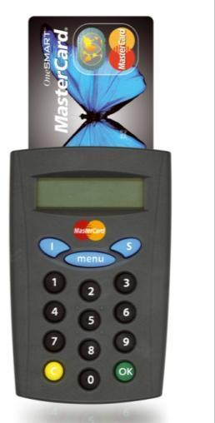

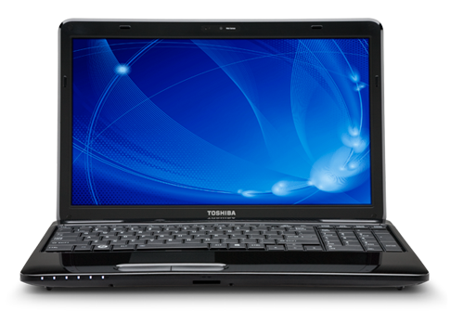
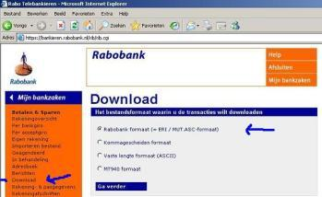


Motivation for USB cable
This reader can be trusted.
But can the user understand
the semantics of numbers?
Computer display of
cannot be trusted
(despite )
→ 23459876
← 123654

Slide 66

Motivation for USB cable
This display can be
trusted & understood
“What You Sign is
What You See”
(WYSIWYS)
USB

Slide 67
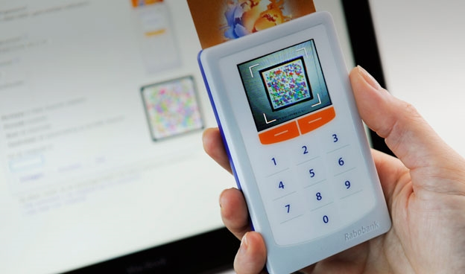
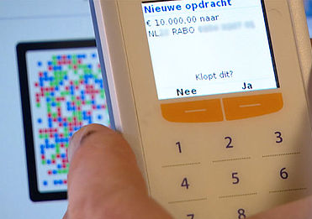
Rabo Scanner
Alternative solution to allow communication to hand-held reader (with coloured QR code)
No communication back to the PC, unlike with USB cable

Slide 68

Analysis of e.dentifier: first observation
Text for display goes in plain-text over USB line
So malware on the laptop can make the token show any message

Slide 69

Reverse-Engineered Protocol
PC
reader
card
ASK-PIN
display:‘enter pin’
user enters PIN
PIN
OK
PIN-OK
SIGN (number, text )
display:‘text’
user presses OK
USER-OK
COMPLETE
GENERATE AC f(number, text)
cryptogram
g(cryptogram)

Slide 70
Reverse-Engineered Protocol
PC
reader
card
ASK-PIN
display:‘enter pin’
user enters PIN
PIN
OK
PIN-OK
SIGN (number, text )
display:‘text’
user presses OK
USER-OK
COMPLETE
GENERATE AC f(number, text)
cryptogram
g(cryptogram)

Slide 71
Attack!
PC
reader
card
ASK-PIN
display:‘enter pin’
user enters PIN
PIN
OK
PIN-OK
SIGN (number, text )
COMPLETE
display:‘text’
user presses OK
USER-OK
GENERATE AC f(number, text)
cryptogram
g(cryptogram)

Slide 72

Problem with Todos/Gemalto e.dentifier2
It’s possible to press OK via
USB cable...
Malware on an infected PC could change all the transaction details and press OK
Purely academic, no criminal ever abuses thus
[Arjan Blom et al.,
Designed to Fail: A USB-Connected Reader for Online Banking, NordSec 2012]

Slide 73
Conclusions

Slide 74
Conclusions about EMV & banking world
EMV protocol suite is way too complicated too many options, written down in confusing way, without useful abstractions, without explaining security, ...
Banks - or their suppliers - routinely screw up security. Eg we saw
  DDA: why not let the card sign transactions if it can do RSA?
  backwards compatibility problems
  lousy random number generators in ATMs
  misconfiguration of contactless cards
  contactless terminal crashing on extended length APDUs
  protocol flaws in EMV-CAP mode 2 and e.dentifier2
  …
Technical flaws harmless if there is no good attacker business model. But always a public relations risk.
Bottleneck in security here: AUTHENTICATION

Slide 75
Conclusions about the banking world
Not so clear who is taking responsibility for checking security
    The banks?
    Scheme holders such as MasterCard and Visa? EMVco?
    Their suppliers? (eg Gemalto, ST Microelectronics,...)
    The parties doing certification tests for scheme holders? (eg UL)
    The Dutch or European Central Bank?
Banks appear to assume - and trust - that others check the security!
Or maybe their employees are happy with Cover-Your-Ass security?

Slide 76
Moral of the story
Keep it simple!
Protocols should only have one version/variant, namely the secure one!
Never assume that somebody else (eg. a vendor, Mastercard, Visa, ...) has checked that things are secure!

