Slide 1


Software Security problems
Erik Poll
Digital Security group
Radboud University Nijmegen

Slide 2

Problems with
Insecure input handling is the most common security problem
aka lack of input validation, but that terminology is misleading (as we’ll see later)
All input is dangerous & evil
All input should be treated as highly poisonous & contagious
Beware of the terms untrusted input or untrusted user input : by default, any input & all users should be untrusted

Slide 3
The I/O attacker model (‘hacking’)
Aka end point attacker, as opposed to MitM attacker
Attacker goals?
  DoS, information leakage, remote code execution (RCE), or anything in between
  ie. compromising integrity & availability of the application’s behaviour in any way
Input flaws we already saw?
  buffer overflows, integer overflows & format string attacks.
  TOCTOU is also an input problem, but an odd one out.
malicious
input
application
I/O

Slide 4
Dangers of
Faced with an I/O attacker
Garbage In, Garbage Out
becomes
Malicious Garbage In, Security Incident Out
or
Malicious Garbage In, Evil Out
Input is dangerous:
Any line of code that handles user input is at risk
Any resources (CPU cycles, memory, …) used in processing are a risk
So ideally, these are kept to a minimum

Slide 5
Abusing bugs or features?
Two types of input security flaws:
Some input attacks exploit bugs
  Bugs in code can provide weird behaviour that is accidentally introduced in the code by programmer; Attackers try to trigger & exploit such weird behaviour
  Classic example: buffer overflows
Other input attacks abuse features
  Some flaws accidently expose functionality that was deliberately introduced in the code, but which was not meant to be accessible by attackers.
  Classic example: command or SQL injection
The line between 1 & 2 can be blurry, and a matter of opinion

Slide 6
Root causes of input problems
The input formats and languages involved play a central role:
Complexity of input formats & languages
  making bugs in input processing likely
Sloppily & unclear specifications of input formats
  making bugs even more likely
Expressivity of input languages
  giving lots of power to the attackers (for flaws exploiting features)
  worst thing to do: including a programming language in your input format
(Too?) many input formats & languages
  often combined, stacked or nested, aggrevating all the problems above

Slide 7
Exploiting bugs
(caused by complexity)

Slide 8
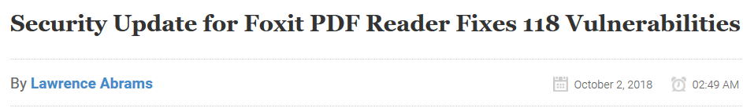
Security update of the week
https://www.foxitsoftware.com/support/security-bulletins.php
Mainly memory corruption bugs, many allowing Remote Code Execution (RCE), so high impact, and easy to exploit with email attachments.
Why are there so many vulnerabilities in a PDF reader?
PDF is a very complex data format, and Foxìt is a “feature-rich” PDF viewer, and also support JavaScript in PDF.
Other PDF viewers also suffer from this
https://cve.mitre.org/cgi-bin/cvekey.cgi?keyword=PDF

Slide 9
Root cause of many exploitable memory errors: parsing
Input need to be parsed before it can be processed
  as IP packet, PDF document, HTML, JPG, mp3 …
Complex languages make for many parser bugs
https://cve.mitre.org/cgi-bin/cvekey.cgi?keyword=parsing
  Notorious example: Flash, the union of all audio/graphics/video formats you ever heard of & more JPG+GIF+PNG+H.264/MPEG4+VP6+MP3+AAC+Speex+PCM+ADPCM +Nellymoser+G7.11+..
  https://cve.mitre.org/cgi-bin/cvekey.cgi?keyword=Flash
If these parsers are memory-unsafe C(++) code, then such bugs cause security vulnerabilities with high impact, incl. RCE
Bugs in input parsers are easy to trigger by attacker, with malicious input in an email attachment, on a webpage, ..

Slide 10
Example problem with complex format
Microsoft Security Bulletin MS04-028
Buffer Overrun in JPEG Processing (GDI+) Could Allow Code Execution
Impact of Vulnerability: Remote Code Execution
Maximum Severity Rating: Critical
Problem occurs with a zero length comment field, without content.
Buffer overflow in image processing is an ideal attack vector!
The victim only has to view an image (in email or on webpage) to get infected, and impact is high (namely remote code execution)

Slide 11
Even in ‘safe’ programming languages
OpenJDK: JPEG decoder input stream handling [CVE-2014-2421]
“A vulnerability in Oracle Java allows an unauthenticated, remote attacker to execute arbitrary code on a targeted system.
The vulnerability is due to improper bounds checks when the affected software parses certain JPEG images. An attacker could exploit this vulnerability by persuading a user to open a malicious web page or crafted malicious file that contains a crafted JPEG image. An exploit could allow the attacker to conduct a buffer overflow attack and execute arbitrary code on the system.
The following Oracle products are vulnerable: Java SE 8, SE 7u51, SE 6u71, SE 5.0u61, Java JavaFX 2.2.51, Java SE Embedded 7u51”
How is this possible in a library of a safe programming language like Java?
Native code in graphics library
Why do people use native code here?
Efficiency…

Slide 12
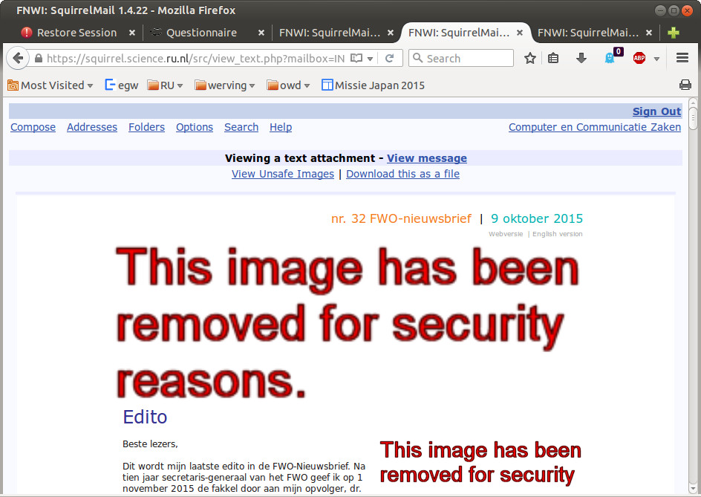
Countermeasure

Slide 13
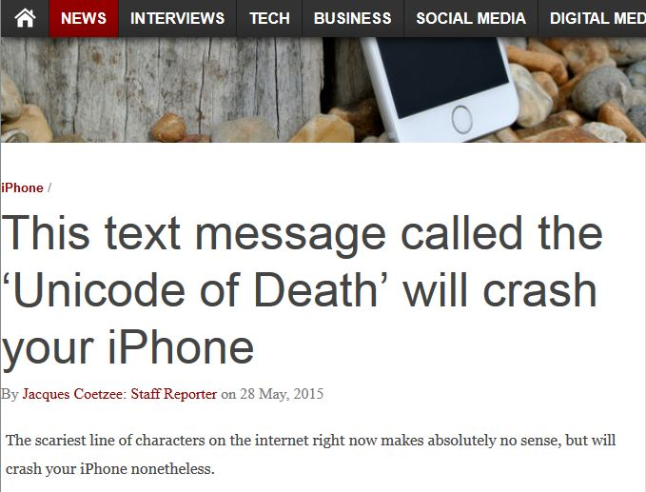
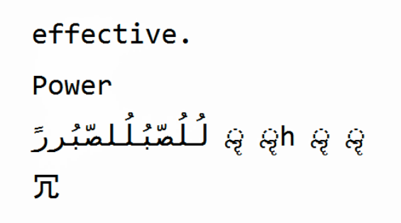
Complex input formats
Example dangerous
SMS text message
Different characters sets or characters encoding,
are a constant source of problems.
Many input formats rely on underlying notion of characters.

Slide 14
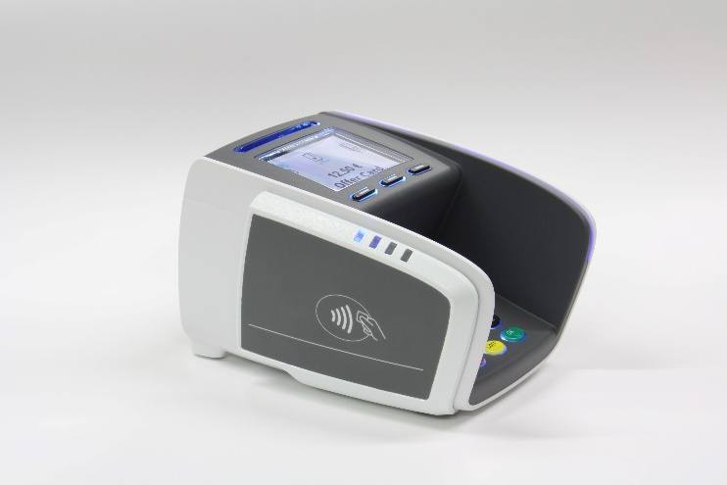
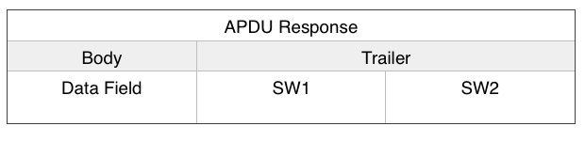
Even processing simple input languages can go wrong
Sending an extended length APDU can crash a contactless payment terminal.
  [Jordi van den Breekel, A security evaluation and proof-of-concept relay attack on Dutch EMV contactless transactions, MSc thesis, 2014]

Slide 15
Exploiting features
(caused by expressivity)

Slide 16
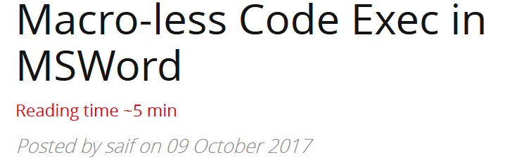
Word & Excel & …
Favourite attack vector for attackers:
Powershell macros in Word & Excel document!
Why? No need to craft complex shell code to exploit bugs, simply write a macro to exploit features!
Also without macros using Windows DDE (Dynamic Data Exchange)
Also possible using emails in Outlook Rich Text Format (RTF)
  https://sensepost.com/blog/2017/macro-less-code-exec-in-msword/

Slide 17
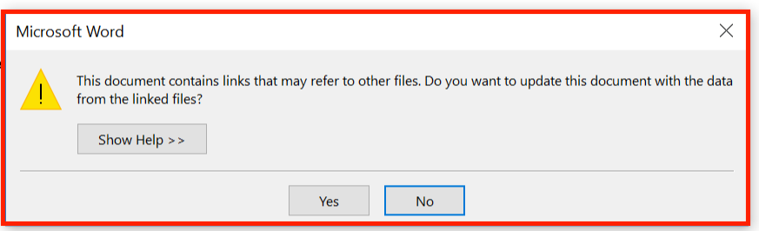
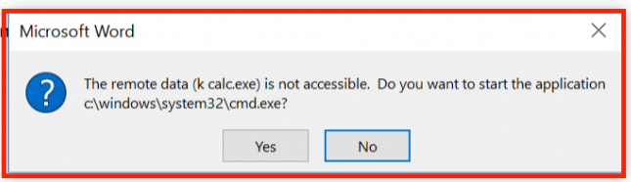
DDE warnings
Microsoft considers DDE a feature, and not a bug, but did file a security advisory data autumn 2017

Slide 18
XML & zip bombs
Some input formats enable Denial-of-Service attacks
a zip bomb (aka zip-of-death) is a small zip file of 40 KB that explodes to 4 GB when unzipped
an XML bomb is a small XML file of 1 KB that explodes to 3 GB when XML parser expands recursive definitions (as part of canonicalisation)
  aka billions laughs attack, as the original attack used the string LOL
Moral: any CPU cycles spent or any memory used in processing input (before the input has been validated) pose a security risk!

Slide 19
Injection attacks
Exploiting functionality of some back-end services
OS command injection
Path traversal
SQL injection
HTML injection (incl. XSS)
Format string attacks
LDAP injection
Xpath injection
…
Tell-tale signs
special characters or keywords that have a special meaning for the input language for this back-end service
  This is a sign that data will be parsed & processed

Slide 20
Injection attacks
These attacks abuse expressive power of some input language, eg the language of
OS commands erik@ru.nl; rm –fr /
Path expressions ../../../etc/passwd
SQL statements 'OR '1'='1'; ;DROP TABLES
HTML <script>…document.cookie…</script>
  HTML5 includes JavaScript, DOM, CSS
Format strings %x%x%x%x%n
XML (//student[username/text..
LDAP admin)(&)
….

Slide 21
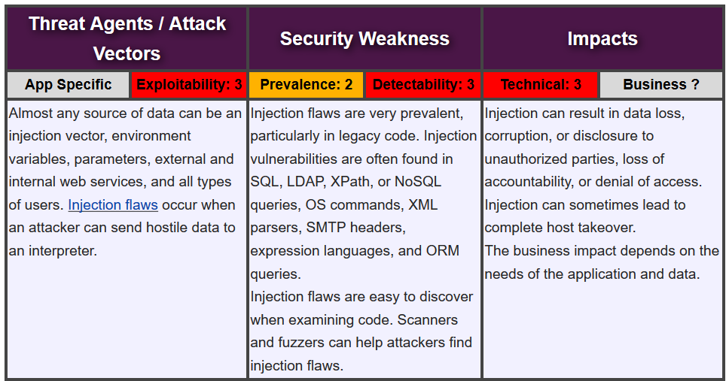
Injection Attacks : no. 1 in Top Ten https://www.owasp.org/index.php/Top_10-2017_A1-Injection

Slide 22
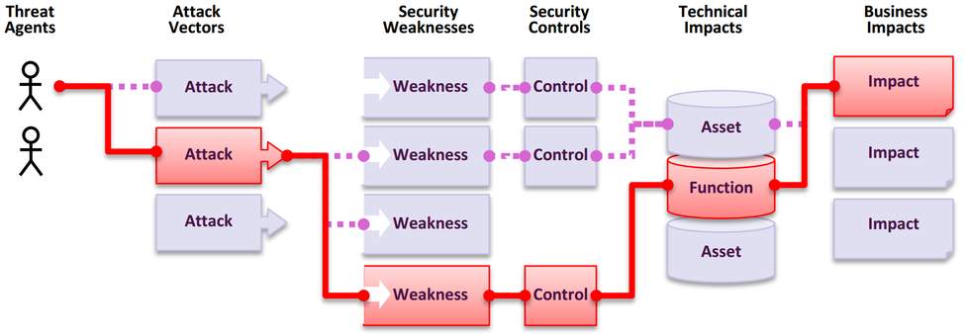
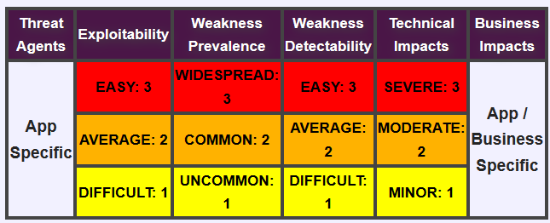
OWASP Top 10 - Risk Rating

Slide 23

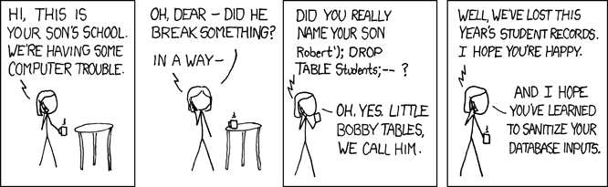
SQL injection
Exploiting the language of SQL queries
Or the language of SQL commands
    There are more interesting commands than DROP TABLE
    for example exec master.dbo.xp_cmdshell

Slide 24
Processing vs injection/forwarding attacks
Processing Flaws
a bug !
malicious
input
application
eg buffer overflow in PDF viewer
Injection aka Forwarding Flaws
(abuse of) a feature !
malicious
input
application
back-end service
eg SQL
query

Slide 25
2nd order SQL injection
Suppose I want to access peter's account
I register an account myself with the name peter' --
I log in as peter' -- and change my password
If the password change is done with the SQL statement
    UPDATE users
    SET password='abcd1234'
    WHERE username='peter' --' and password='abc'
  then I have reset peter's password
  Here abcd1234 is user input, but the dangerous input to the statement comes from the server's own database, where it was injected earlier
Moral of the story: be very careful what you trust.
Even data coming from sources you think can trust -- here a username from our own system – may be malicious

Slide 26
LDAP injection
An LDAP query sent to the LDAP server to authenticate a user
(&(USER=jan)(PASSWD=abcd1234))
can be corrupted by giving as username
admin)(&)
which results in
(&(USER=name)(&))(PASSWD=pwd)
where only first part is used, and (&) is LDAP notation for TRUE
There are also blind LDAP injection attacks.

Slide 27
XPath injection in XML
XML data, eg
<student_database>
<student><username>jan</username><passwd>abcd1234</passwd>
</student>
<student><username>kees</nameuser><passwd>geheim</passwd>
<student>
</student_database>
can be accessed by XPath queries, eg
(//student[username/text()='jan' and
passwd/text()='abcd123']/account/text()) _database>
which can be corrupted by malicious input such as
' or '1'='1'

Slide 28
Path traversal aka directory traversal
File names constructed from user input – by string concatenation – can cause problems.
Eg suppose a program uses the paths
"/usr/local/client-info/" ++ username
"/usr/local/profilepictures/" ++ username ++ ".jpg“
Malicious usernames for attacker to inject:
../../../etc/passwd
../../../etc/passwd%00
null terminator %00 means suffix .jpg will be ignored

Slide 29
Impact of path traversal
Information leakage
  ../../../etc/passwd
Denial-of-Service (DoS)
../../dev/random (is very long to read)
../../var/spool/lpr (is impossible to read)
Abitrary code execution?
  If attacker can trick systems in executing the wrong file, ideally a file that the attacker can upload
  Eg put javascript code in your Brightspace profile picture, and try to link to it somewhere in Brightspace

Slide 30
Beyond simple path traversal
Windows supports many notations for path names
  classic MS-DOS notation C:\MyData\file.txt
  file URLs file:///C|/MyData/file.txt
  UNC (Uniform Naming Convention) \\192.1.1.1\MyData\file.txt
  which can be combined in fun ways, eg file://///192.1.1.1/MyData/file.txt
Some notations trigger unexpected behaviour , eg
UNC paths to remote servers handled by SMB protocol aka Samba
  SMB sends password hash to authenticate aka pass the hash
  This can be exploited by SMB relay attacks on applications handling file names
    CVE-2000-0834 in Windows telnet,
    CVE-2008-4037 in Windows XP/Server/Vista, …
    CVE-2016-5166 in Chromium
    CVE-2017-3085 & CVE-2016-4271 in Adobe Flash,
    ZDI-16-395 in Foxit PDF viewer
    [Example thanks to Björn Ruytenberg, https://blog.bjornweb.nl]

Slide 31
More injection problems: OWASP list
Blind SQL Injection
Blind XPath Injection
Code Injection
Command Injection
Comment Injection Attack
Content Spoofing
CORS RequestPreflightScrutiny
Cross-site Scripting (XSS)
Custom Special Character Injection
Direct Dynamic Code Evaluation ('Eval Injection')
Format string attack
Full Path Disclosure
[https://www.owasp.org/index.php/Category:Injection]
Function Injection
LDAP injection
Parameter Delimiter
PHP Object Injection
Regular expression Denial of Service - ReDoS
Resource Injection
Server-Side Includes (SSI) Injection
Special Element Injection
SQL Injection
SQL Injection Bypassing WAF
Web Parameter Tampering
XPATH Injection

Slide 32
More obscure example: SSI Injection
Server-Side Includes (SSI) are instructions for a web server written inside HTML. Eg to include some file
<!--#include file="header.html" -->
If attacker can inject HTML into a webpage, then he can try to inject a SSI directive that will be executed on the server
Of course, there is a directive to execute programs & scripts
<!--#exec cmd="rm –fr /" -->
NB: with SSI injected code is executed server-side, with XSS injected code ( javascript) is executed client-side in browser

Slide 33
Deserialisation attacks
Serialisation aka marshalling aka flattening aka pickling
The process of turning some data structure into a binary representation
Why?
To transfer it over network
or store it on disk (ie for persistence)
Inverse operation of deserialisation, unmarshalling, … used later to reconstruct the object from the raw data
Deserialisation of malicious input can trigger strange behaviour…
affects Java, PHP, python, Ruby, …

Slide 34
Deserialisation attacks [for Java]
Sample code to read in Student objects from a file
  FileInputStream fileIn = new FileInputStream("/tmp/students.ser");
  ObjectInputStream objectIn = new ObjectInputStream(fileIn);
  s = (Student) objectIn.readObject(); // deserialise and cast
If file contains serialised Student objects, readObject will execute the deserialization code from Student.java
If file contains other objects, readObject will execute the deserialisation code for that class
  So: attacker can execute deserialisation code for any class on the CLASSPATH
  Subtle issue: the cast is only performed after the deserialization
If this object is later discarded as garbage, eg because the cast fails, the garbage collector will invoke its finalize methods
  So: attacker can execute finalize method for any class on CLASSPATH
Countermeasure: Look-Ahead Java Deserialisation to white-list which classes are allowed to be deserialised

Slide 35
How to exploit deserialisation ?
DoS
  Attacker serialises a recursive object structure, and deserialization unwinds the recursion and never terminates
  Attacker edits a serialised object to set an array length to MAX_INT

Slide 36
How to exploit deserialisation ?
Arbitrary code execution
  Possible by abusing rich functionality offered by commonly used libraries (eg. WebLogic, IBM WebSphere, JBoss, Jenkins, OpenNMS,Adobe Coldfusion…)
  May even be possible from scratch, eg in python
  DEFAULT_COMMAND = "netcat -c '/bin/bash -i' -l -p 4444"
  COMMAND = sys.argv[1] if len(sys.argv) > 1 else DEFAULT_COMMAND
  class PickleRCE(object):
  def __reduce__(self):
  import os
  return (os.system,(COMMAND,))

Slide 37
More input problems: CWE classification
Some clusters in the CWE classification, esp.
CWE-990 Tainted Input
collect dozens of variants of input attacks
See http://cwe.mitre.org/data/definitions/896.html

Slide 38
CWE/SANS Top 25 (out of 732!)‏ [Version 3.0]
Improper Neutralization of Special Elements used in an SQL Command
... ('OS Command Injection')
Buffer Overflow
.. ('Cross-site Scripting')
Missing Authentication for Critical Function
Missing Authorization
Use of Hard-coded Credentials
Missing Encryption of Sensitive Data
Unrestricted Upload of File with Dangerous Type
Reliance on Untrusted Inputs in a Security Decision
Execution with Unnecessary Privileges
Cross-Site Request Forgery (CSRF)
…('Path Traversal')
Download of Code Without Integrity Check
Incorrect Authorization
Inclusion of Functionality from Untrusted Control Sphere
Incorrect Permission Assignment
Use of Potentially Dangerous Function
Use of a Broken or Risky Cryptographic Algorithm
Incorrect Calculation of Buffer Size
Improper Restriction of Excessive Authentication Attempts
URL Redirection to Untrusted Site ('Open Redirect')
Uncontrolled Format String
Integer Overflow or Wraparound
Use of a One-Way Hash without a Salt

Slide 39
Still to come
Countermeasures, incl.
  input validation
  output encoding
  sandboxing
  but also LangSec approach to address these root causes
(Optional) lecture on SQL injection, XSS?

